Slide 1
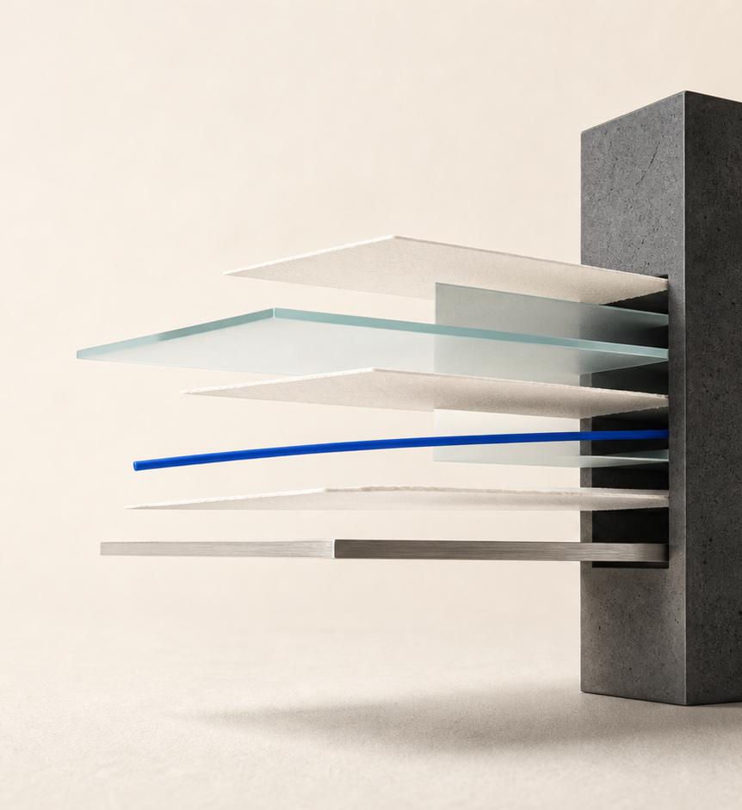
SECURE BANK / SECURITY DEMONSTRATION
Secure Bank
Turning the CW1 security architecture
into working evidence.
ALGORITHM / PROTOCOL / SYSTEM
Coursework prototype · synthetic data only
Notes:
For CW1, we designed a layered security architecture for an online bank. For this prototype, we wanted to go beyond just showing the diagram. We built the main controls, tested what happens when someone tries to bypass them, and made the results visible.

Slide 2
CONTEXT
02
One transaction. Three security layers.
The architecture becomes useful when each layer leaves evidence we can inspect.
3
01
Protect the data
AES-256-GCM, ECDSA P-384 and SHA-256 create confidentiality, authenticity and tamper evidence.
02
Protect every connection
TLS 1.3, OIDC with PKCE, mTLS, database TLS, STARTTLS and SFTP each have a rejection test.
layers, one proof path
03
Protect the system
WAF, segmentation, signed audit, SIEM and verified backups reduce impact and preserve evidence.
The demo follows the same path: transaction → transport → detection → recovery.
Notes:
Rather than explaining every box separately, we are going to follow one test transaction through the system. First, we will look at how the data is encrypted and signed. Then we will check the connections between services. Finally, we will show the monitoring and recovery side.

Slide 3

01 / ALGORITHM
03
The algorithm layer protects the message and the proof.
A single transfer creates encrypted data, a signed receipt and a linked audit record.
01
AES-256-GCM
Encrypts customer fields, transfer references, statements and backup data with authenticated associated data.
02
ECDSA P-384
Signs receipts, audit entries and backup manifests while the private key stays inside the key service.
03
SHA-256
Links audit entries and digests backup ciphertext so later modification is detectable.
docker compose run --rm test-runner
Live: customer transfer + tamper tests
Notes:
At the algorithm level, we use three main controls. AES-256-GCM protects sensitive data and also detects tampering. ECDSA P-384 signs receipts and other evidence. SHA-256 links the audit records together so a missing or changed record can be detected.
We will now leave the slides and show these controls through a real transfer and the automated negative tests.
//SWITCH//

Slide 4
02 / PROTOCOL
04
Protocol checks are designed to fail.
A secure connection is only convincing when weaker and anonymous alternatives are rejected.
BROWSER
IDENTITY
SERVICES
DATABASE
MAIL
FILES
TLS 1.3
OIDC + PKCE
mTLS
DB TLS
STARTTLS
SFTP
→
→
→
→
→
TLS 1.2 rejected
Forged token → 401
Anonymous denied
verify-full
Certificate checked
Password denied
Denied by design
docker compose run --rm toolbox protocol-check
The negative result is part of the evidence.
Notes:
This slide shows the main connections we are about to test. The browser reaches the public edge through TLS 1.3. Inside the system, the services use mutual TLS, the database verifies its encrypted connection, mail upgrades with STARTTLS, and file transfers use SFTP with keys rather than passwords.
The important part is that we also test the connections that should fail, including an older TLS version, anonymous access to the key service, and password-based SFTP.
//SWITCH//

Slide 5
02 / ATTACK EVIDENCE
05
Same attack. Different outcome.
The comparison passes only when the secure target blocks and the isolated lab is exploitable.
SECURE TARGET
ISOLATED LAB
BLOCKED
same
payload
EXPLOITED
WAF · validation · RBAC · signed tokens · idempotency
Synthetic data · separate network · opt-in profile
01
02
03
04
05
06
SQL injection
Stored XSS
IDOR
Token tampering
CSRF / replay
Brute force
docker compose --profile lab run --rm attack-runner
Notes:
For the next part, we run the same test attacks against two targets. One is our protected application. The other is a deliberately vulnerable application made only for this comparison.
On the secure side, every attack should be blocked. On the vulnerable side, the same input should succeed. We will now switch back to the laptop and run that comparison.
//SWITCH//

Slide 6

03 / SYSTEM
06
System controls work as a sequence, not a checklist.
Contain the request, make the event visible, then preserve a recovery path.
01
Prevent
OWASP CRS, segmented networks, RBAC and two health-checked API replicas reduce exposure.
02
Detect
Threshold-based SIEM rules and signed append-only audit make attacks and integrity failures visible.
03
Recover
Encrypted primary and DR copies, no-overwrite storage and restore validation keep a usable path back.
Admin proof: alerts · audit integrity · controls · backups — without customer transfer access
Notes:
At the system level, our controls are grouped into three jobs. First, prevent unnecessary access through role-based permissions and network separation. Second, detect suspicious activity through the WAF, application events, and IDS or SIEM rules. Third, recover using encrypted backups that are copied to restricted stores.
We will now move to the administrator dashboard to show the access restrictions and the evidence produced by the monitoring controls.
//SWITCH//

Slide 7
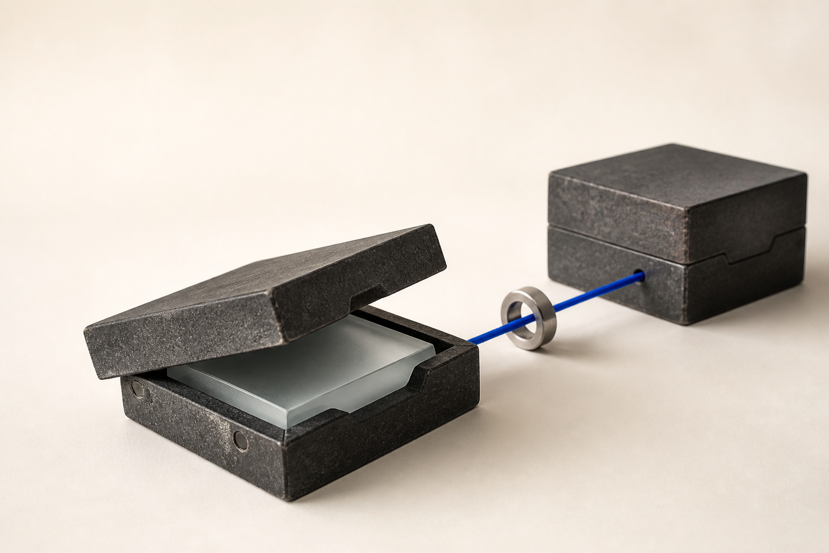
03 / RECOVERY
07
Recovery is verified before it is trusted.
The restore check proves authenticity, integrity, confidentiality and usability in one run.
01
Encrypt
A unique AES-256-GCM data key and nonce protect each database dump.
02
Sign and hash
The manifest is signed; SHA-256 covers the ciphertext; the data key is wrapped.
03
Replicate
Ed25519 SFTP writes the same immutable artefacts to primary and DR stores.
04
Restore
Verification happens before decryption and a disposable database is queried at the end.
docker compose --profile restore run --rm restore-check
Notes:
This slide shows the recovery chain before we run it. The database backup is encrypted with a fresh data key. That key is wrapped by the key-management service, and a signed manifest records the backup digest and metadata. The encrypted copy is then sent to primary and DR stores.
The last step is the most important one: we restore the backup into a temporary database and run a query against it. We will switch to the terminal and verify that whole chain now.
//SWITCH//

Slide 8
CONCLUSION
CONTROL
+
REJECTION
+
EVIDENCE
What this prototype proves.
A control is only credible here when we can also show its rejection path and its evidence.
Implemented
Prototype-only boundaries
Encryption and signatures
Secure transport and identity
WAF, SIEM, audit and restore
Software key service, not certified HSM
Docker segmentation, not physical NGFW
One-host DR; browser OTP is not production MFA
Secure Bank · synthetic data only
Questions
Notes:
To finish, we want to be clear about the scope. This is a coursework prototype, not a production bank. Docker networks demonstrate segmentation, but they are not a physical next-generation firewall. Our key service models the boundary of an HSM, but it is not hardware-backed. The monitoring works from security events rather than mirrored network traffic, and both backup locations are still on one host.
Even with those limitations, the main CW1 ideas are working. At each layer, we can show the control, show what happens when someone tries to break it, and show the evidence the system produces. That is what we wanted this prototype to prove.

