Slide 1


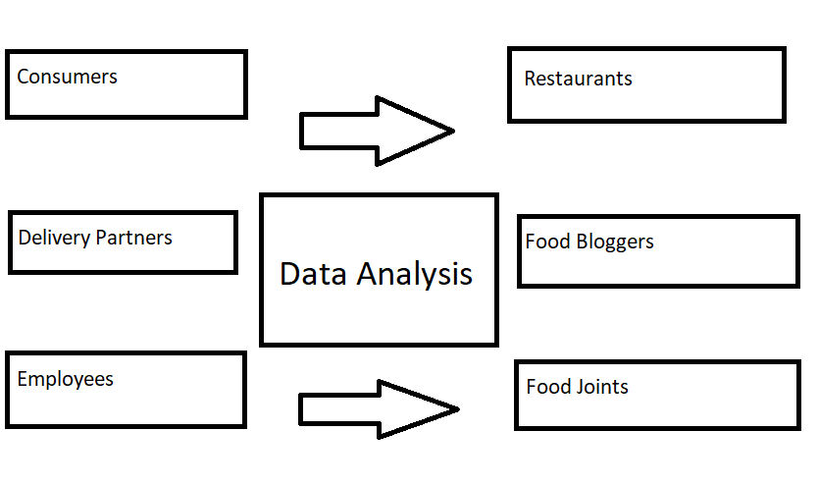





Track Name – Analytics using Python (Track B)
Team Name - Amigos
Analyzing Restaurants in Bengaluru using Zomato data
Himanshi Singhal | -PGDM RBA
Arik Biswas | -PGDM RBA
Prashant Pujari | -PGDM RBA
Tanmoy Biswas | -PGDM EBIZ
Sarvesh Ghadge | -PGDM CORE
Anjali More | -PGDM RBA
Problem Statement
Secondary Research
Visualizing the online order facility.
Analyzing the online order vs no online order facility in terms of rating.
Analyzing the table booking facility vs no table booking facility in terms of rating.
Analyzing the online order facility (location-wise)
Analyzing number of votes (location-wise)
Research and analysis of existing Zomato data to study the restaurants, their offerings and the food culture preferred in Bengaluru.
Insights
Stakeholders
Most of the people prefer online ordering facility instead of physically dining-in the restaurants.
The top rated restaurants have variety of Cuisines available.
Most of the restaurants offer online ordering facility.
Most of the ratings to a particular restaurant come from locations like BTM and HSR.
Solution
We have analyzed the data and provided the statistics for the same which will help the restaurant owners to improve their business by changing their business strategies.
The restaurants can take an insight whether their customers prefer online food ordering or offline and then increase their focus on improving in that particular area.
By referring to the data the restaurants can analyze where most of the reviews for their restaurants are coming from and target those locations for increasing profitability.
Way Ahead ?
The data gives an in-depth analysis of the food culture of the people in a particular locality. The taste of a locality can be found out by their ordering pattern and the type of restaurant it houses.
The data can be used to find out the popular food, type of people, residency area etc to help new restaurants take better data driven decisions.
After going through the data restaurants can understand the behavioural and eating patterns of their target customers and take the necessary steps to grow in that direction accordingly.
Restaurants can modify their menus according to the liking of the people in that particular locality and make profits.

