Slide 1
REAL TIME TEXT SEARCH USING MOBILE PHONES

Slide 2
Team
Mentor
Dr. S.K. Singh
Dept. of Computer Science
Himanshu Gupta
Dept. of Electrical Engineering
Shantanu Agrawal
Dept. of Electrical Engineering
Shikhar Trivedi
Dept. of Electrical Engineering

Slide 3

Need Of Real Time Text Search
We always feel the need to search a word or phrase in a document, book, novel etc and always wish that there should be a Ctrl+F(In Windows) function to just type the word and search for it.

Slide 4
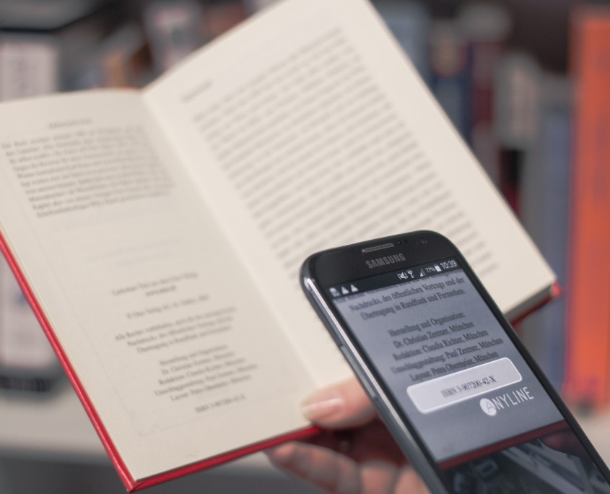
Plans Of The Project
We are planning to build the same model by incorporating text detection, text recognition and Machine Learning into a dynamic prototype (e.g. Camera). It will have the feature of searching the text you wish to search by typing it in the search bar. A square box will hover around the text we are searching for. It is just like the face recognition which is seen in the mobile camera.
Currently we are working on dense text like novel, newspaper, magazines etc. We are not focusing on natural scenes.

Slide 5
Applications
Suppose we are reading a novel. Suddenly we feel to search relevance of a particular word in previous few pages. We simply hover the mobile phone over the text to search for the same word instead of reading whole lines finding that word.
Assessment of a particular document on the basis of particular keywords.
Searching of a particular library book amongst others in book stack.
Searching a particular licence plate of a car in traffic.
Help in categorising paper works in offices based on certain keywords.

Slide 6
Work Done
Our application requires three step of Image processing. These are:
Image Pre-processing -Required to remove noise and make the image more suitable for further processing.
Text Detection – Required to detect regions in image containing Text. This is done to separate out text regions and non-text regions.
Text Recognition – Required to recognize the text in image and convert it into machine readable form (String).

Slide 7
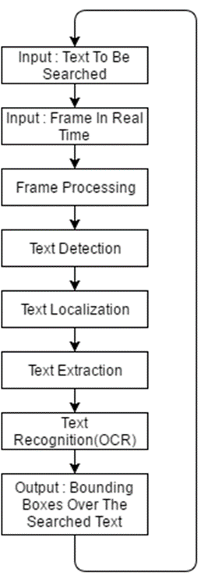
WORK FLOW

Slide 8
Image Pre-Processing
To do Image Pre-processing we used the following methods:
Colour image to Grey Scale image.
Histogram Equalization- This is done to increase the contrast of image which has pixel intensity distributed over small range.
Blurring- It is useful for removing noises. It actually removes high frequency content (e.g.: noise, edges) from the image. So edges are blurred a little bit in this operation.

Slide 9
Text Detection
Following methods are used in detecting text regions in image:
Canny Edge Detector: The Canny edge detector is an edge detection operator that uses a multi-stage algorithm to detect a wide range of edges in images. This is basically done to highlight the regions in in images that contains text.
Morphological Closing: This is done to close small holes inside the foreground objects, or small black points on the object. It is also done to fill the edges of text region.
MSER(Maximally Stable Extremal Regions): This is used to select the regions which are the candidate region for text recognition.

Slide 10
MSER
MSERs are connected regions, that are defined by an extremal property of the intensity function in the region and on its outer boundary. MSERs have properties that form their superior performance as stable local detector. The set of MSERs is closed under continuous geometric transformations and is invariant to affine intensity changes. Furthermore MSERs are detected at different scales.
The MSER detector from Matas etal.[1] has proven to be one of the best interest point detectors in computer vision. Evaluations by Mikolajczyk and Schmid [2] and Fraundorfer revealed that the MSER detector performs best on a wide range of test sequences.

Slide 11
Text Recognition
The candidate text regions obtained from mser after text detection is than passed to OCR(Optical Character Recognition) for recognizing the text and converting it to Machine Readable Format such as string.
In our implementation we used Pytesseract module of Python for Text Recognition.
If the Queried word is found in the image a bounding box is created around it.

Slide 12
Tesseract-OCR
OCR, Optical Character Recognition, is developed to translate scanned images of handwritten, typewritten or printed text into machine-encoded text. A lot of OCR software have been developed to accomplish this mission. Tesseract, originally developed as proprietary software at Hwelet-Packard between 1985 and 1995, now sponsored by Google, is considered to be one of the most accurate open source OCR engine currently available. It is capable of recognizing text in variety of languages in a binary image format.

Slide 13
RESULTS

Slide 14
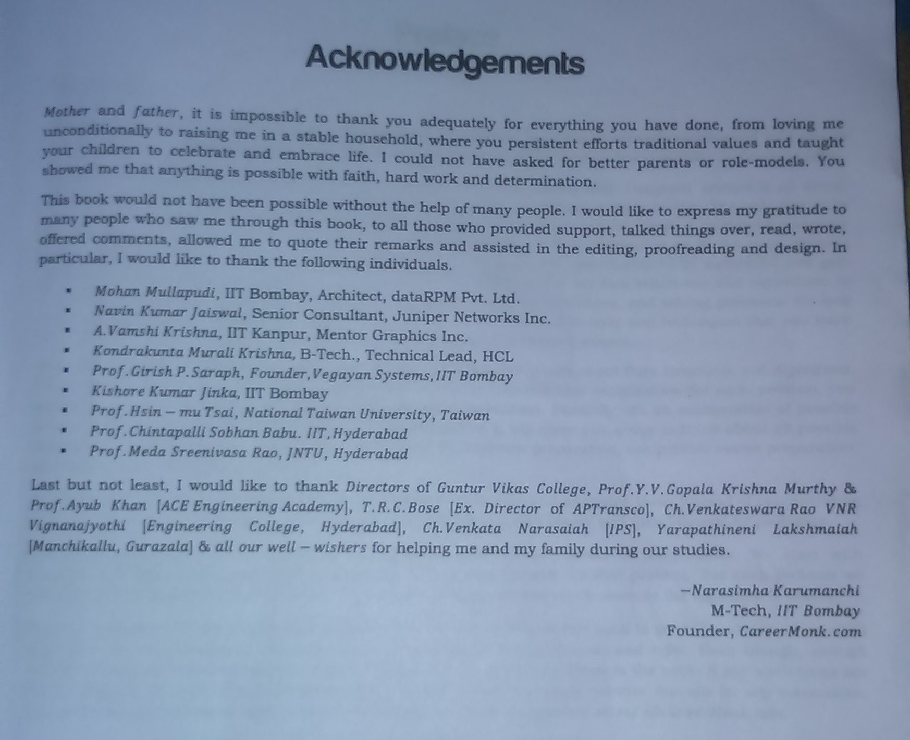
Original Image

Slide 15
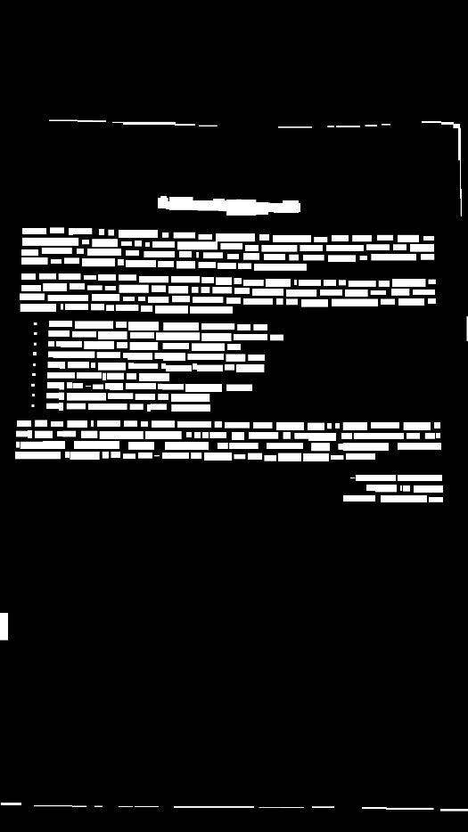

Slide 16
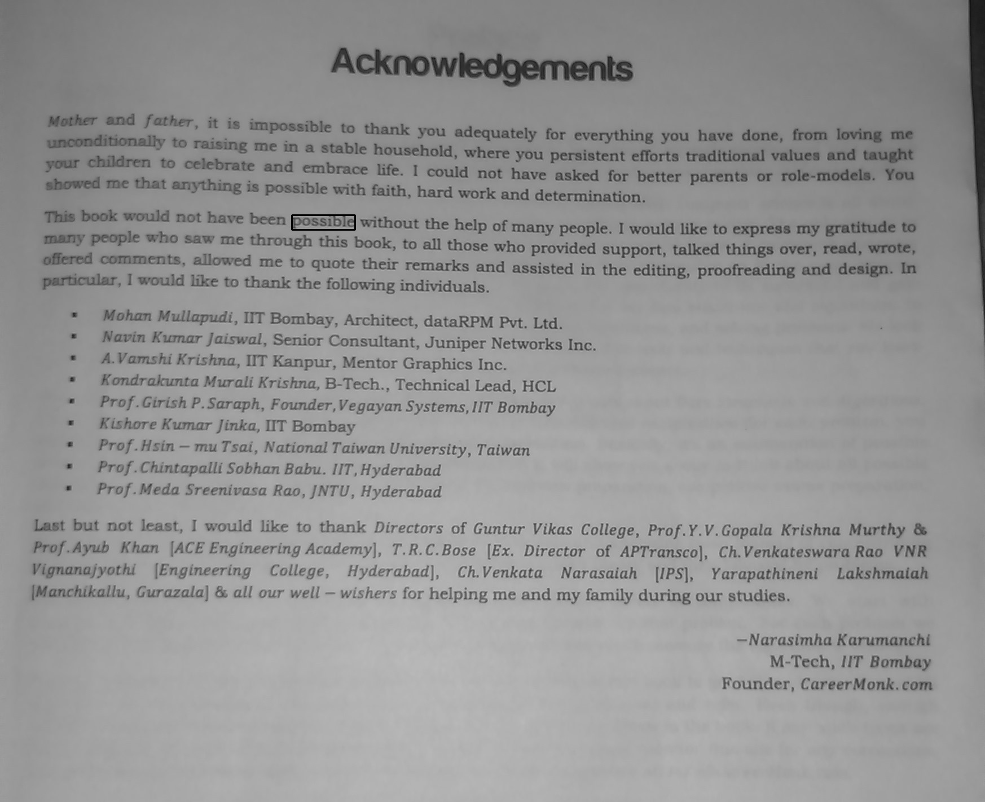
Resulting Image with bounding box around the word possible.
possible

Slide 17
Implementation On Android Platform
The application was implemented on android platform to be used on mobile devices.
The application requires an additional application ‘OpenCV manager’ for its working.
It takes frames from camera source and undergoes the same process as mentioned in the previous slides.
Process implemented :
Image Preprocessing-
Text Detection
Text Recognition- For Text recognition, we had to add tesseract folder to android.

Slide 18
Results on Android Phones

Slide 19
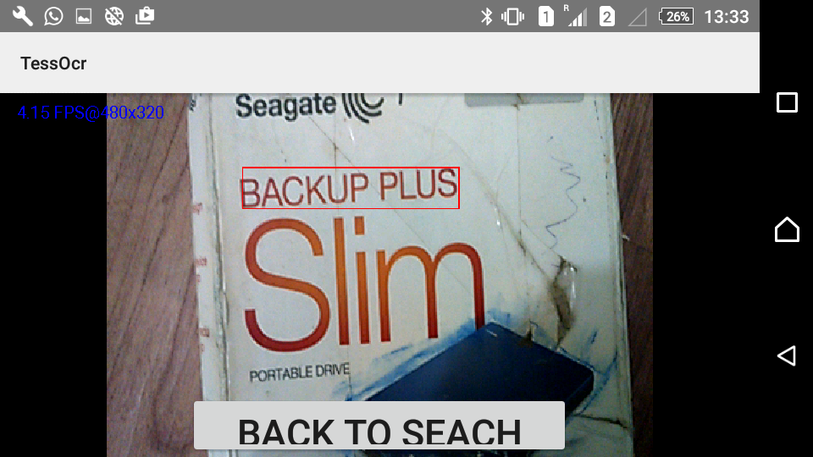
Medium Sized text on White Background

Slide 20
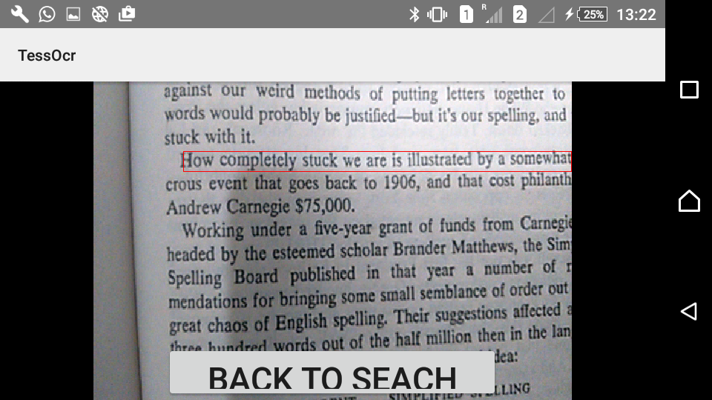
Small Sized Text

Slide 21
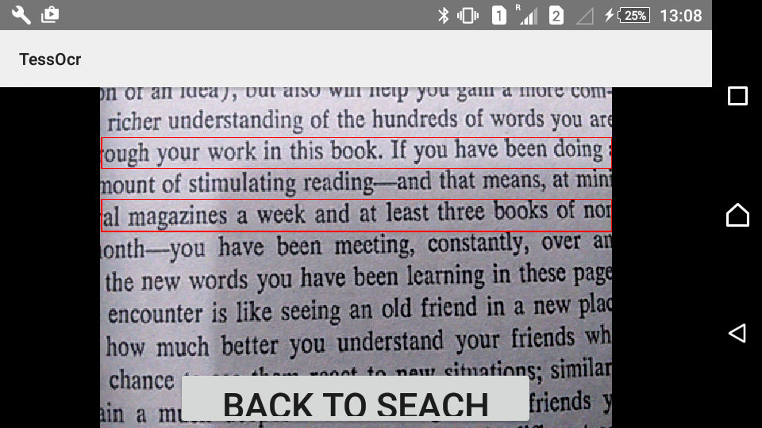
Small Text Detection (Multiple Matches) Searched Text: book

Slide 22
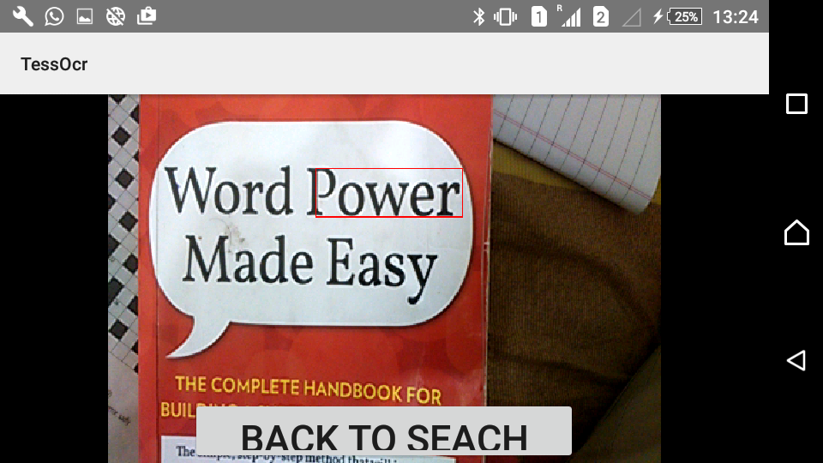
Large Text on White Background

Slide 23
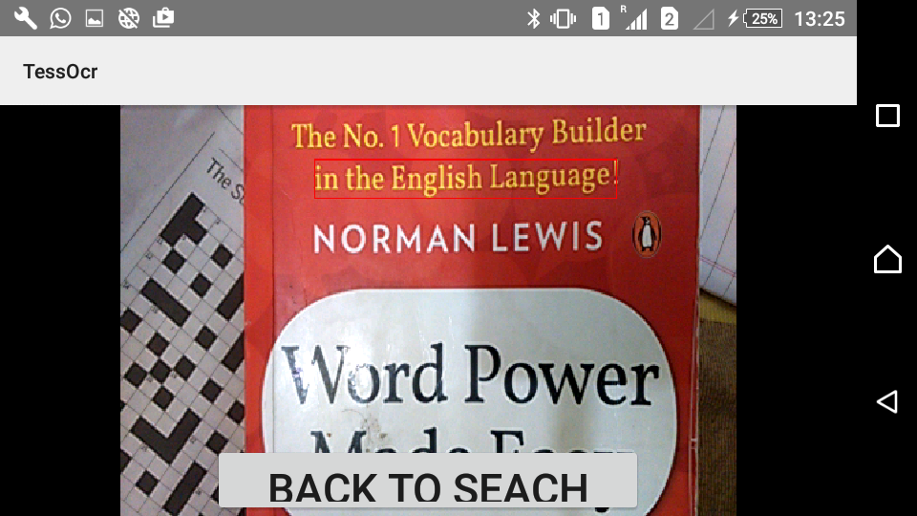
Text on coloured Background

Slide 24
Experiments And Results
The Accuracy of the Tesseract OCR is as follow:
Type Of Text | %Error | %Accuracy
Very Small Text | 4.93 | 95.07
Small text | 4.27 | 95.73
Big Text | 4.64 | 95.36
Medium Text | 2.62 | 97.38

Slide 25
Conclusions
We have achieved an android based application on real time text detection and recognition. From the performance evaluation of our system, we concluded that our application is quite robust for large text. Following work needs to be done in order to drive our application into commercial product:
Adapt fast text extraction algorithm to smaller and denser text.
Detect and recognize text in Natural scenes.
Further enhance the speed and improve accuracy.

Slide 26
Future Goals
Higher Efficiency
The efficiency of the program depends on the quality of the image send to the OCR and the efficiency of the OCR itself.
We plan to implement further processing methods to improve the quality of the image
Time efficiency
The application should take reasonable amount of time to work.
Our goal is to reduce the processing time as much as possible to make it more user friendly.

Slide 27
References
J. Matas, 0. Chum, M. Urban, and T. Pajdla, "Robust wide baseline stereo from maximally stable extremal regions,“ in Proc. of British Machine Vision Conference, 2002, pp. 384-393.
HuiK. Mikolajczyk and C. Schmid, "Comparison of affine invariant local detectors and descriptors," in Proc. Of the 12th European Signal Processing Conference, Austria, 2004, pp. 257-263.
ping Li, David Doermann and Omid Kia, Automatic Text Detection and Tracking in Digital Video. IEEE Transaction on Image Processing Vol. 9 No. 1, Jan 2000.
Carlos Merino, Majid Mirmehdi, A Framework Towards Realtime Detection and Tracking of Text.
Derek Ma, Qiuhau Lin, Tong Zhang, Mobile Camera Based Text Detection and Translation.

Slide 28
THANK YOU

