Slide 1
Aggregation Framework
MongoDB World
Rick Houlihan
Senior Solutions Architect, MongoDB

Slide 2
Notes to the presenter
Note that the Expressions section is hidden by default in this deck, as the presentation is quite long. Please include only if time permits!
Themes for this presentation:
Map Reduce is good and capable, but a hammer (everything looks like a nail)
Agg framework is a more elegant solution to address majority of needs
Realtime vs batch

Slide 3
Agenda
What is the Aggregation Framework?
The Aggregation Pipeline
Usage and Limitations
Aggregation and Sharding
Summary

Slide 4
What is the Aggregation Framework?

Slide 5


Aggregation Framework

Slide 6



Aggregation in Nutshell
We're storing our data in MongoDB
Our applications need ad-hoc queries
We must have a way to reshape data easily
You can use Aggregation Framework for this!

Slide 7

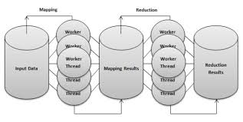
MapReduce is great, but…
Extremely versatile, powerful
Overkill for simple aggregation tasks
Averages
Summation
Grouping
Reshaping
High level of complexity
Difficult to program and debug

Slide 8


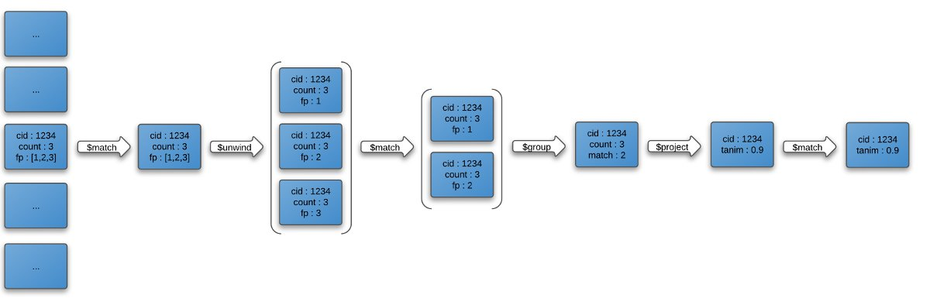
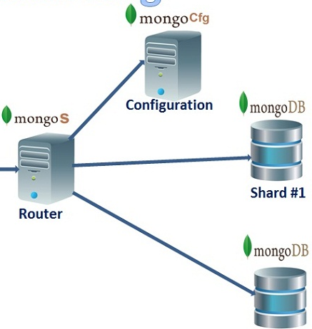
Aggregation Framework
Executes in native code
Written in C++
JSON parameters
Flexible, functional, and simple
Operation pipeline
Computational expressions
Plays nice with sharding

Slide 9
Aggregation Pipeline

Slide 10
What is an Aggregation Pipeline?
A Series of Document Transformations
Executed in stages
Original input is a collection
Output as a document, cursor or a collection
Rich Library of Functions
Filter, compute, group, and summarize data
Output of one stage sent to input of next
Operations executed in sequential order
$match
$project
$group
$sort

Slide 11
Pipeline Operators
$match
Filter documents
$project
Reshape documents
$group
Summarize documents
$unwind
Expand documents
$sort
Order documents
$limit / $skip
Paginate documents
$redact
Restrict documents
$geoNear
Proximity sort documents
$let, $map
Subexpression variables

Slide 12
Our Example Data
{
_id: 375,
title: "The Great Gatsby",
ISBN: "9781857150193",
available: true,
pages: 218,
chapters: 9,
subjects: [
"Long Island",
"New York",
"1920s"
],
language: "English"
}

Slide 13


$match
Filter documents
Uses existing query syntax
Can facilitate shard exclusion
No $where (server side Javascript)

Slide 14
Matching Field Values
{
title: "The Great Gatsby",
pages: 218,
language: "English"
}
{ $match: {
language: "Russian"
}}
{
title: "War and Peace",
pages: 1440,
language: "Russian"
}
{
title: "War and Peace",
pages: 1440,
language: "Russian"
}
{
title: "Atlas Shrugged",
pages: 1088,
language: "English"
}

Slide 15
Matching with Query Operators
{
title: "The Great Gatsby",
pages: 218,
language: "English"
}
{ $match: {
pages: {$gt:100}
}}
{
title: "War and Peace",
pages: 1440,
language: "Russian"
}
{
title: "War and Peace",
pages: 1440,
language: "Russian"
}
{
title: "Atlas Shrugged",
pages: 1088,
language: "English"
}
{
title: ”Atlas Shrugged",
pages: 1088,
language: “English"
}

Slide 16

$project
Reshape Documents
Include, exclude or rename fields
Inject computed fields
Create sub-document fields

Slide 17
Including and Excluding Fields
{
_id: 375,
title: "Great Gatsby",
ISBN: "9781857150193",
available: true,
pages: 218,
subjects: [
"Long Island",
"New York",
"1920s"
],
language: "English"
}
{ $project: {
_id: 0,
title: 1,
language: 1
}}
{
title: "Great Gatsby",
language: "English"
}

Slide 18
Renaming and Computing Fields
{
_id: 375,
title: "Great Gatsby",
ISBN: "9781857150193",
available: true,
pages: 218,
chapters: 9,
subjects: [
"Long Island",
"New York",
"1920s"
],
language: "English"
}
{ $project: {
avgChapterLength: {
$divide: ["$pages",
"$chapters"]
},
lang: "$language"
}}
{
_id: 375,
avgChapterLength: 24.2222,
lang: "English"
}

Slide 19
Creating Sub-Document Fields
{
_id: 375,
title: "Great Gatsby",
ISBN: "9781857150193",
available: true,
pages: 218,
chapters: 9,
subjects: [
"Long Island",
"New York",
"1920s"
],
language: "English"
}
{ $project: {
title: 1,
stats: {
pages: "$pages",
language: "$language",
}
}}
{
_id: 375,
title: "Great Gatsby",
stats: {
pages: 218,
language: "English"
}
}

Slide 20

$group
Group documents by value
Field reference, object, constant
Other output fields are computed
$max, $min, $avg, $sum
$addToSet, $push
$first, $last
Processes all data in memory by default

Slide 21
Calculating An Average
{
title: "The Great Gatsby",
pages: 218,
language: "English"
}
{ $group: {
_id: "$language",
avgPages: { $avg:
"$pages" }
}}
{
title: "War and Peace",
pages: 1440,
language: "Russian"
}
{
_id: "Russian",
avgPages: 1440
}
{
title: "Atlas Shrugged",
pages: 1088,
language: "English"
}
{
_id: "English",
avgPages: 653
}

Slide 22
Summing Fields and Counting
{
title: "The Great Gatsby",
pages: 218,
language: "English"
}
{ $group: {
_id: "$language",
pages: { $sum: "$pages" },
books: { $sum: 1 }
}}
{
title: "War and Peace",
pages: 1440,
language: "Russian"
}
{
_id: "Russian",
pages: 1440,
books: 1
}
{
title: "Atlas Shrugged",
pages: 1088,
language: "English"
}
{
_id: "English",
pages: 1316,
books: 2
}

Slide 23
Collecting Distinct Values
{
title: "The Great Gatsby",
pages: 218,
language: "English"
}
{ $group: {
_id: "$language",
titles: { $addToSet: "$title" }
}}
{
title: "War and Peace",
pages: 1440,
language: "Russian"
}
{
_id: "Russian",
titles: [“War and Peace”]
}
{
_id: "English",
titles: [
"Atlas Shrugged",
"The Great Gatsby” ]
}
{
title: "Atlas Shrugged",
pages: 1088,
language: "English"
}

Slide 24

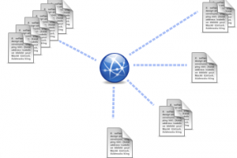
$unwind
Operate on an array field
Create documents from array elements
Array replaced by element value
Missing/empty fields → no output
Non-array fields → error
Pipe to $group to aggregate

Slide 25
Collecting Distinct Values
{
title: "The Great Gatsby",
ISBN: "9781857150193",
subjects: [
"Long Island",
"New York",
"1920s"
]
}
{ $unwind: "$subjects" }
{ title: "The Great Gatsby",
ISBN: "9781857150193",
subjects: "Long Island” }
{ title: "The Great Gatsby",
ISBN: "9781857150193",
subjects: "New York” }
{ title: "The Great Gatsby",
ISBN: "9781857150193",
subjects: "1920s” }

Slide 26

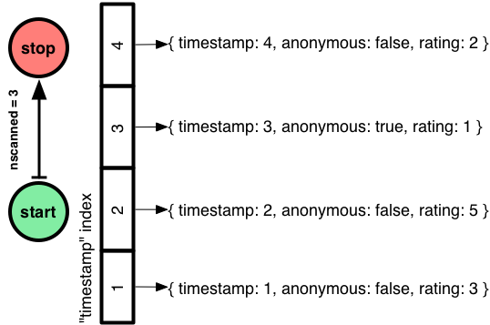
$sort, $limit, $skip
Sort documents by one or more fields
Same order syntax as cursors
Waits for earlier pipeline operator to return
In-memory unless early and indexed
Limit and skip follow cursor behavior

Slide 27
Sort All the Documents in the Pipeline
{ title: “Great Gatsby, The” }
{ $sort: {title: 1} }
{ title: “Brave New World” }
{ title: “Animal Farm” }
{ title: “Grapes of Wrath” }
{ title: “Brave New World” }
{ title: “Animal Farm” }
{ title: “Great Gatsby” }
{ title: “Lord of the Flies” }
{ title: “Grapes of Wrath, The” }
{ title: “Lord of the Flies” }

Slide 28
Limit Documents Through the Pipeline
{ title: “Great Gatsby, The” }
{ $limit: 5 }
{ title: “Brave New World” }
{ title: “Great Gatsby, The” }
{ title: “Grapes of Wrath” }
{ title: “Brave New World” }
{ title: “Animal Farm” }
{ title: “Grapes of Wrath” }
{ title: “Lord of the Flies” }
{ title: “Animal Farm” }
{ title: “Fathers and Sons” }
{ title: “Lord of the Flies” }
{ title: “Invisible Man” }

Slide 29
Skip Documents in the Pipeline
{ title: “Great Gatsby, The” }
{ $skip: 3 }
{ title: “Brave New World” }
{ title: “Animal Farm” }
{ title: “Grapes of Wrath” }
{ title: “Lord of the Flies” }
{ title: “Animal Farm” }
{ title: “Fathers and Sons” }
{ title: “Lord of the Flies” }
{ title: “Invisible Man” }
{ title: “Fathers and Sons” }
{ title: “Invisible Man” }

Slide 30

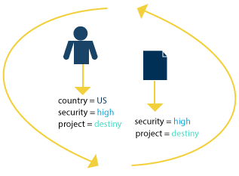
$redact
Restrict access to Documents
Use document fields to define privileges
Apply conditional queries to validate users
Field Level Access Control
$$DESCEND, $$PRUNE, $$KEEP
Applies to root and subdocument fields

Slide 31
$redact Example Data
{
_id: 375,
item: "Sony XBR55X900A 55Inch 4K Ultra High Definition TV",
Manufacturer: "Sony",
security: 0,
quantity: 12,
list: 4999,
pricing: {
security: 1,
sale: 2698,
wholesale: {
security: 2,
amount: 2300 }
}
}

Slide 32
Query by Security Level
db.catalog.aggregate([
{
$match: {item: /^.*XBR55X900A*/}
},
{
$redact: {
$cond: {
if: { $lte: [ "$security", ?? ] },
then: "$$DESCEND",
else: "$$PRUNE"
}
}
}])
{
"_id" : 375,
"item" : "Sony XBR55X900A 55Inch 4K Ultra High Definition TV",
"Manufacturer" : "Sony”,
"security" : 0,
"quantity" : 12,
"list" : 4999
}
security = 0
{
"_id" : 375,
"item" : "Sony XBR55X900A 55Inch 4K Ultra High Definition TV",
"Manufacturer" : "Sony",
"security" : 0,
"quantity" : 12,
"list" : 4999,
"pricing" : {
"security" : 1,
"sale" : 2698,
"wholesale" : {
"security" : 2,
"amount" : 2300
}
}
}
security = 2

Slide 33

$geoNear
Order/Filter Documents by Location
Requires a geospatial index
Output includes physical distance
Must be first aggregation stage

Slide 34
$geonear Example Data
{
"_id" : 10021,
"city" : “NEW YORK”,
"loc" : [
-73.958805,
40.768476
],
"pop" : 106564,
"state" : ”NY”
}

Slide 35
Query by Proximity
{
"_id" : "35089",
"city" : "KELLYTON",
"loc" : [ -86.048397, 32.979068 ],
"pop" : 1584,
"state" : "AL",
"dist" : 0.0007971432165364155
},
{
"_id" : "35010",
"city" : "NEW SITE",
"loc" : [ -85.951086, 32.941445 ],
"pop" : 19942,
"state" : "AL",
"dist" : 0.0012479615347306806
},
{
"_id" : "35072",
"city" : "GOODWATER",
"loc" : [ -86.078149, 33.074642 ],
"pop" : 3813,
"state" : "AL",
"dist" : 0.0017333719627032555
}
db.catalog.aggregate([
{
$geoNear : {
near: [ -86.000, 33.000 ],
distanceField: "dist",
maxDistance: .050,
spherical: true,
num: 3
}
}])

Slide 36
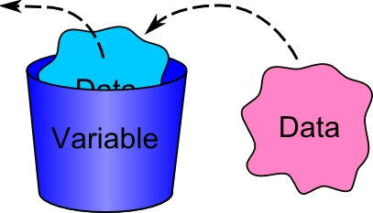
$let / $map
Bind variables to subexpressions
Apply conditional logic
Define complex calculations
Operate on array field values

Slide 37
$let Example Data
{
"_id" : 1,
”price" : 10,
”tax" : 0.50,
”discount" : true
}

Slide 38
Subexpression Calculations
db.sales.aggregate( [
{
$project: {
finalPrice: {
$let: {
vars: {
total: { $cond: {
if: '$applyDiscount',
then: { $multiply: [0.9, '$price’] },
else: '$price'
}
}
},
in: { $add: [ "$$total", '$tax'] }
}}}}])
{ "_id" : 1, "finalPrice" : 9.5 }
{ "_id" : 2, "finalPrice" : 10.25 }

Slide 39
$map Example Data
{
"_id" : 1,
”price" : 10,
”tax" : 0.50,
”discount" : true,
”units" : [ 1, 0, 3, 4, 0, 0, 10, 12, 6, 5 ]
}

Slide 40
Subexpressions on Arrays
db.sales.aggregate( [ {
$project: {
finalPrice: {
$map: {
input: "$units",
as: "unit",
in: {
$multiply: [ “$$unit”, {
$cond: {
if: '$applyDiscount', then: {
$add : [
{ $multiply: [ 0.9, '$price'] }, '$tax’ ] },
else: { $add: [ '$price', '$tax’ ] }
} } ] } } } } } ] )
{
"_id" : 1,
"finalPrice" :
[ 9.5, 0, 28.5, 38, 0, 0, 95, 114, 57, 47.5 ]
}
{
"_id" : 2,
"finalPrice" :
[ 51.25, 30.75, 20.5, 51.25, 0, 0, 0, 30.75, 41, 71.75 ]
}

Slide 41
Aggregation and Sharding

Slide 42
Sharding
Workload split between shards
Shards execute pipeline up to a point
Primary shard merges cursors and continues processing*
Use explain to analyze pipeline split
Early $match may excuse shards
Potential CPU and memory implications for primary shard host
* Prior to v2.6 second stage pipeline processing was done by mongos
Result
mongos
Shard 1 (Primary) $match, $project, $group
Shard 2 $match, $project, $group
Shard 3 excluded
Shard 4 $match, $project, $group

Slide 43
Usage and Limitations

Slide 44
Usage
collection.aggregate([…], {<options>})
Returns a cursor
Takes an optional document to specify aggregation options
allowDiskUse, explain
Use $out to send results to a Collection
db.runCommand({aggregate:<collection>, pipeline:[…]})
Returns a document, limited to 16 MB

Slide 45
Collection
db.books.aggregate([
{ $project: { language: 1 }},
{ $group: { _id: "$language", numTitles: { $sum: 1 }}}
])
{ _id: "Russian", numTitles: 1 },
{ _id: "English", numTitles: 2 }

Slide 46
Database Command
db.runCommand({
aggregate: "books",
pipeline: [
{ $project: { language: 1 }},
{ $group: { _id: "$language", numTitles: { $sum: 1 }}}
]
})
{
result : [
{ _id: "Russian", numTitles: 1 },
{ _id: "English", numTitles: 2 }
],
“ok” : 1
}

Slide 47
Limitations
Pipeline operator memory limits
Stages limited to 100 MB
“allowDiskUse” for larger data sets
Some BSON types unsupported
Symbol, MinKey, MaxKey, DBRef, Code, and CodeWScope

Slide 48
Expressions

Slide 49
Expressions
Return computed values
Used with $project and $group
Reference fields using $ (e.g. "$x")
Expressions may be nested

Slide 50
Boolean Operations
Input array of one or more values
$and, $or
Short-circuit logic
Invert values with $not
Evaluation of non-boolean types
null, undefined, zero ► false
Non-zero, strings, dates, objects ► true
{ $and: [true, false] } ► false
{ $or: ["foo", 0] } ► true
{ $not: null } ► true

Slide 51
Comparison Operators
Compare numbers, strings, and dates
Input array with two operands
$cmp, $eq, $ne
$gt, $gte, $lt, $lte
{ $cmp: [3, 4] } ► -1
{ $eq: ["foo", "bar"] } ► false
{ $ne: ["foo", "bar"] } ► true
{ $gt: [9, 7] } ► true

Slide 52
Arithmetic Operators
Input array of one or more numbers
$add, $multiply
Input array of two operands
$subtract, $divide, $mod
{ $add: [1, 2, 3] } ► 6
{ $multiply: [2, 2, 2] } ► 8
{ $subtract: [10, 7] } ► 3
{ $divide: [10, 2] } ► 5
{ $mod: [8, 3] } ► 2

Slide 53
String Operators
$strcasecmp case-insensitive comparison
$cmp is case-sensitive
$toLower and $toUpper case change
$substr for sub-string extraction
Not encoding aware (assumes ASCII alphabet)
{ $strcasecmp: ["foo", "bar"] } ► 1
{ $substr: ["foo", 1, 2] } ► "oo"
{ $toUpper: "foo" } ► "FOO"
{ $toLower: "BAR" } ► "bar"

Slide 54
Date Operators
Extract values from date objects
$dayOfYear, $dayOfMonth, $dayOfWeek
$year, $month, $week
$hour, $minute, $second
{ $year: ISODate("2012-10-24T00:00:00.000Z") } ► 2012
{ $month: ISODate("2012-10-24T00:00:00.000Z") } ► 10
{ $dayOfMonth: ISODate("2012-10-24T00:00:00.000Z") } ► 24
{ $dayOfWeek: ISODate("2012-10-24T00:00:00.000Z") } ► 4
{ $dayOfYear: ISODate("2012-10-24T00:00:00.000Z") } ► 299
{ $week: ISODate("2012-10-24T00:00:00.000Z") } ► 43

Slide 55
Conditional Operators
$cond ternary operator
$ifNull
{ $cond: [{ $eq: [1, 2] }, "same", "different"] } ► "different”
{ $ifNull: ["foo", "bar"] } ► "foo"
{ $ifNull: [null, "bar"] } ► "bar"

Slide 56
Summary

Slide 57

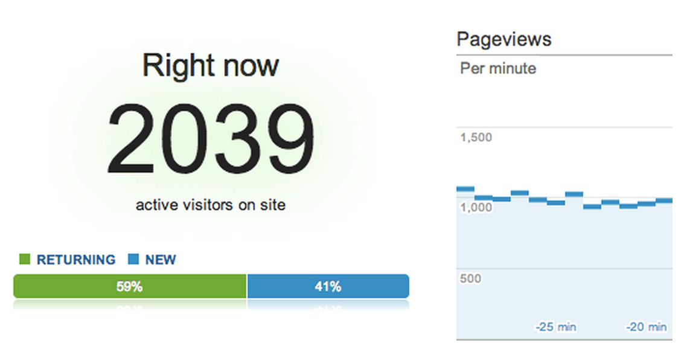

Aggregation Use Cases
Ad-hoc reporting
Real-time Analytics
Transforming Data

Slide 58

Enabling Developers and DBA’s
Do more with MongoDB and do it faster
Eliminate MapReduce
Replace pages of JavaScript
More efficient data processing
Not just a nice feature
Enabler for real time big data analytics

Slide 59
Thank You

