Slide 1
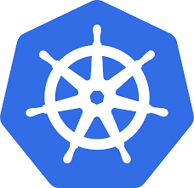
KUBERNETES (K8s)
Getting Started

Slide 2
Problems with containers
Managing containers
Scalability challenges
With docker, we used to say, run this container on this node. With K8 we say, run this container anywhere.

Slide 3
What is Kubernetes
an open-source system for
automating deployment,
scaling, and
management of containerized applications.
originally designed by Google, and is now maintained by the Cloud Native Computing Foundation.
Open source
Written in Go
Stands on linux
Geek word means : The person who steers a ship

Slide 4
Features
Service discovery and load balancing
Horizontal & vertical Auto scaling
Secret and configuration management
Storage orchestration
Automated rollouts and rollbacks(blue/green deployment)
Batch execution
Self-healing
Supports canary deployments using istio plugin

Slide 5
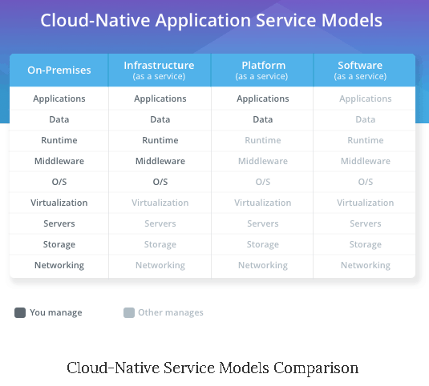
Kube vs cf
PCF is “Application” PaaS
K8s is “Container” PaaS

Slide 6
contd
PCF is ideal for
new applications,
cloud-native apps and apps that run fine out of a buildpack.
For teams working with short lifecycles and frequent releases, PCF offers an excellent product.
K8s
a lower-level abstraction in the PaaS world meaning greater flexibility to implement customizations and build your containers to run how you want them to run. Unfortunately, this also means more work for your engineering teams and decreased productivity.

Slide 7
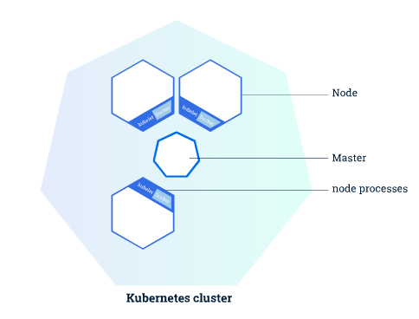
Kubernetes cluster
The Master coordinates the cluster
Nodes are the workers that run
applications

Slide 8
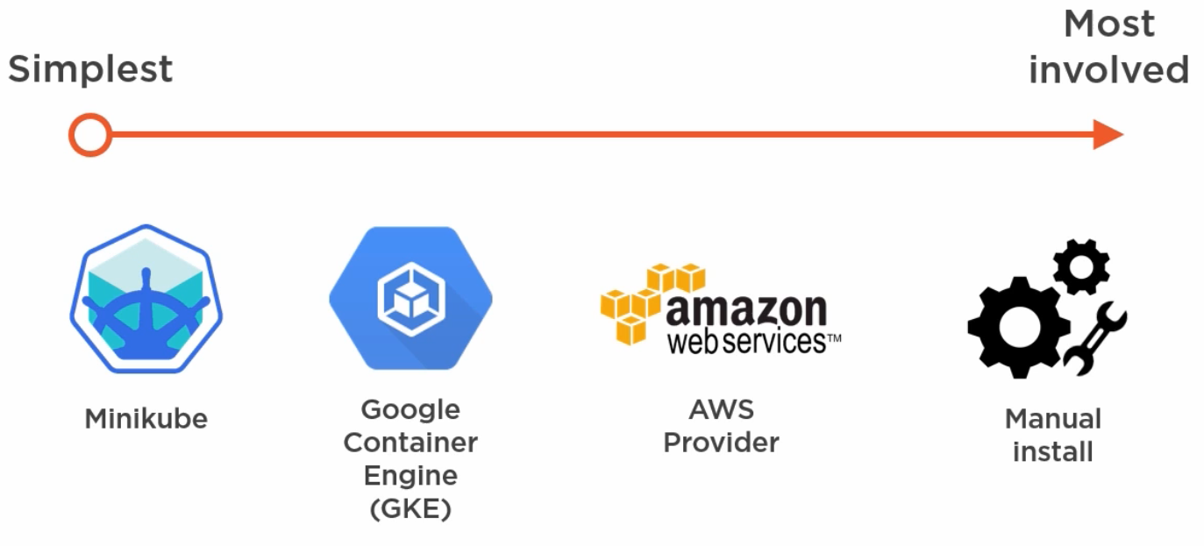
Tools to setup k8 cluster

Slide 9
Hands on : Installation
Set up kubernetes
Install kubectl
Validate : kubectl version : server info will not be provided
Install minikube
Setup Kubernetes cluster
minikube start : downloads and sets up cluster(single node). This also creates a virtualbox named minikube
Setup k8 dashboard
minikube dashboard
minikube ip : to get ip of the node
Validate and get info
Kubectl version : server info also provided
kubectl get nodes : To view the nodes in the cluster

Slide 10
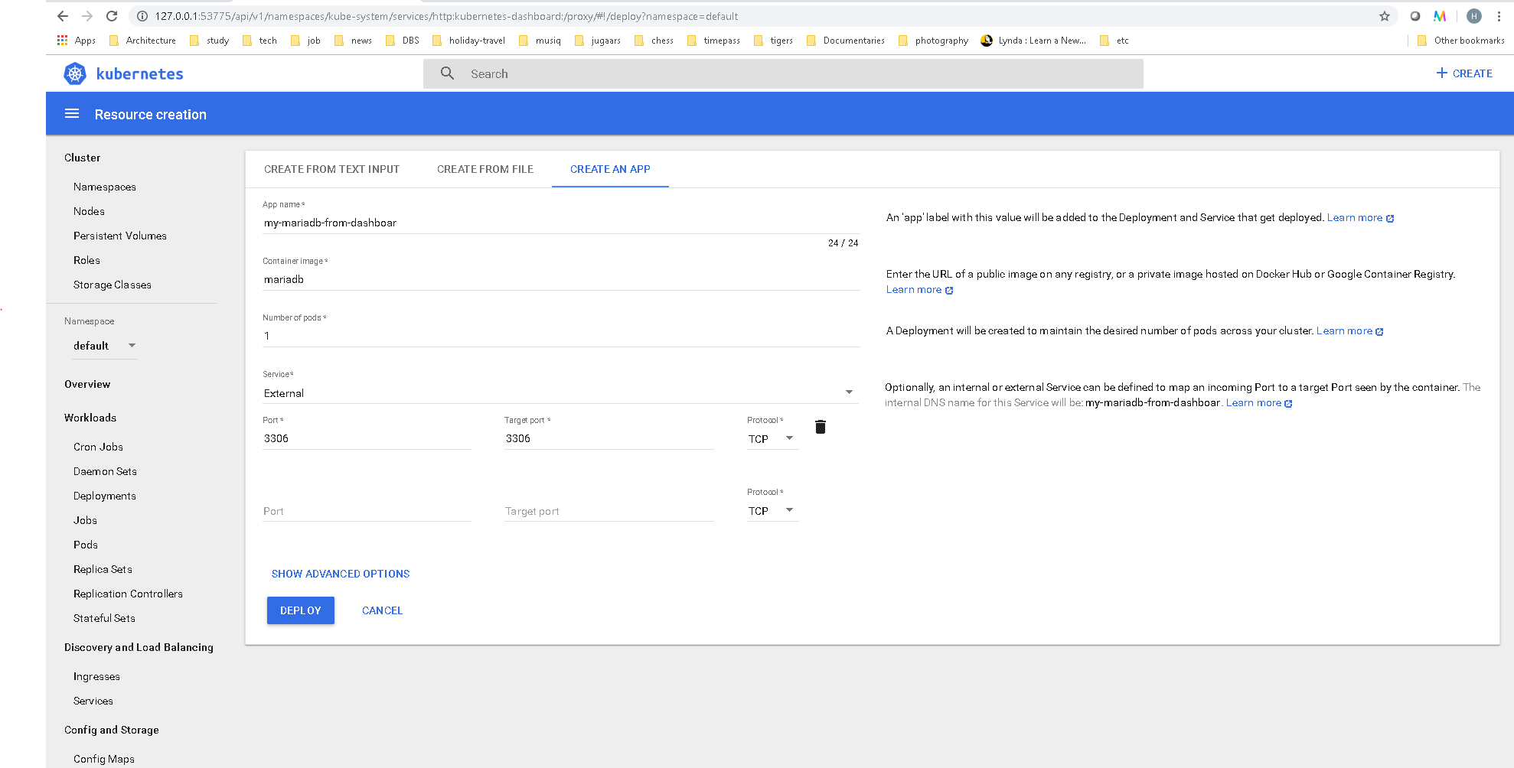
Dashboard

Slide 11
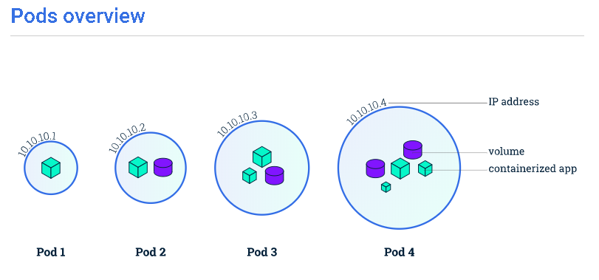
Pods
A Pod is a Kubernetes abstraction that represents a group of one or more application containers (such as Docker or rkt), and some shared resources for those containers.
Container always runs inside a pod
A pod contains 1 network stack, kernel namespace, storage. If multiple containers running inside a pod all share the same network, storage.
Unit of scaling in Kubernetes is also pod
Every time a pod goes down it comes up with new ip
So to communicate we cant use pod’s ip, this is where
we use service
A pod gets 1 ip

Slide 12
Hands on
Deploy pod
kubectl run mykube-mariadb --image=mariadb --port=3306: pulls mariadb from docker hub and deploys
Kubectl get deployments : To see the deployments
Kubectl get pods : to get the deployed pods
kubectl describe pods/hello-pod : to get details of specific pod
Kubectl delete pods <podname>
To access the deployed container
Kubectl proxy : sets up a stream with the container

Slide 13
Deploy pod using manifest file
Pod.yaml file :
kubectl create -f pod.yaml
apiVersion: v1
kind: Pod
metadata:
name: hello-pod
spec:
containers:
- name: hello-ctl
image: nigelpoulton/pluralsight-docker-ci:latest
ports:
- containerPort: 8080

Slide 14
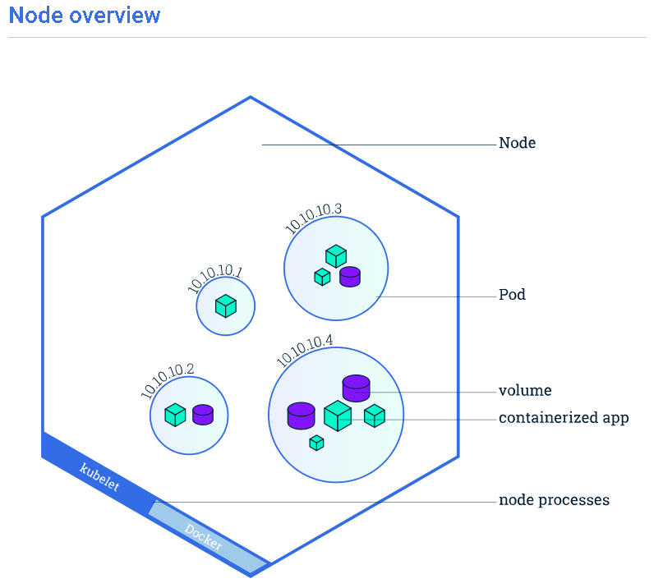
Node
A Pod always runs on a Node.
A Node is a worker machine in Kubernetes and may be either a virtual or a physical machine, depending on the cluster.
A Node can have multiple pods, and the Kubernetes master automatically handles scheduling the pods across the Nodes in the cluster.

Slide 15
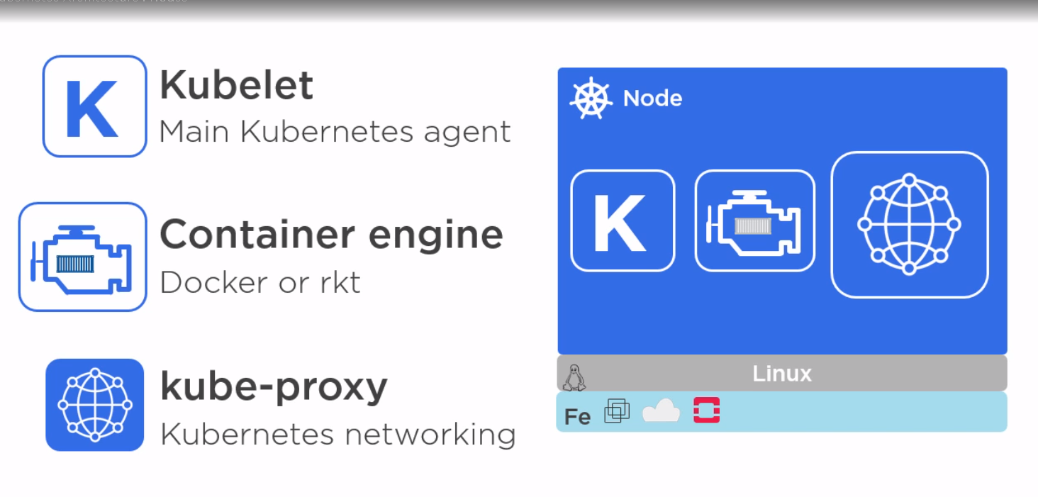
Node

Slide 16
Hands on
Kubectl get pods : lists the pods
Kubectl describe pods : lists the info of containers inside every pod, can see container state as terminated
Kubectl logs <pod_name>
kubectl run mykube-mariadb --image=mariadb --env="MYSQL_ROOT_PASSWORD=root“ –port=3306
Kubectl describe pods : 2 pods the new one has container state as running
kubectl exec <pod name> bash : execute command in that container

Slide 17
Pods limitation
Kubernetes Pods are mortal. Pods in fact have a lifecycle. When a worker node dies, the Pods running on the Node are also lost. A ReplicaSet might then dynamically drive the cluster back to desired state via creation of new Pods to keep your application running.
When a pod dies and a new pod comes up it will not be having the same ip as old one.

Slide 18
Replication controller
Scale pods
Have pods with desired state

Slide 19
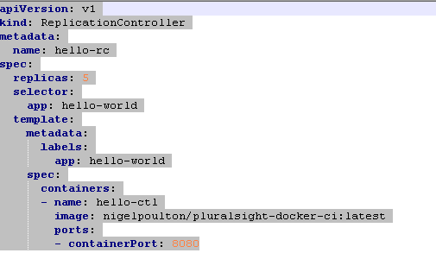
Hands On
kubectl create -f .\rc.yaml
If we want to change, just change the yaml file and execute :
kubectl apply -f .\rc.yaml

Slide 20
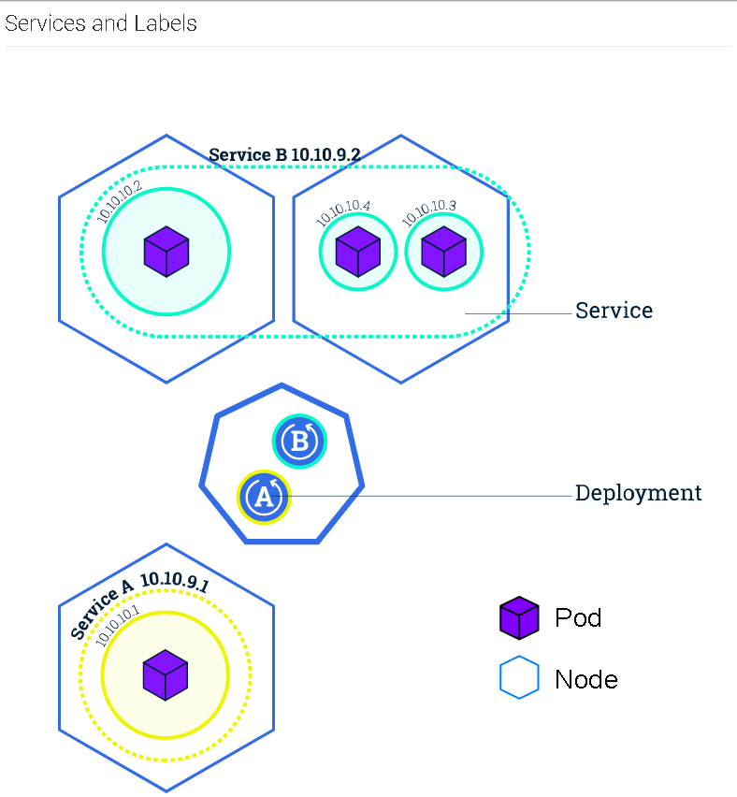
Service
its an abstraction layer which defines a logical set of Pods
enables external traffic exposure
load balancing
service discovery for those Pods.
Only sends traffic to healthy pods
Lets us access pods from outside container

Slide 21
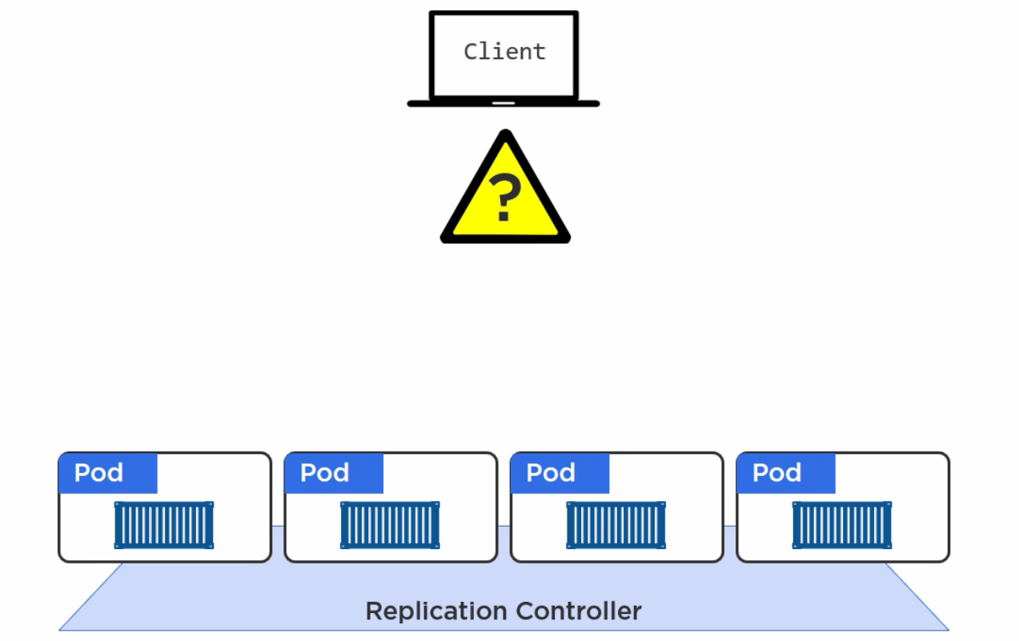
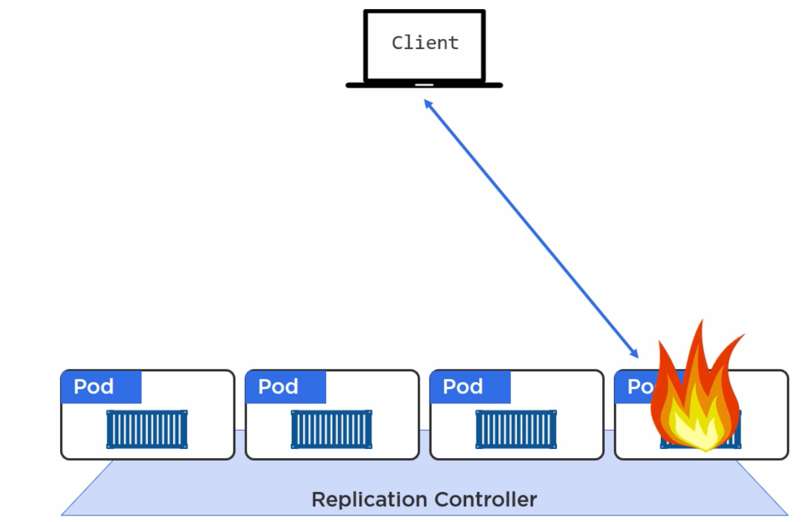
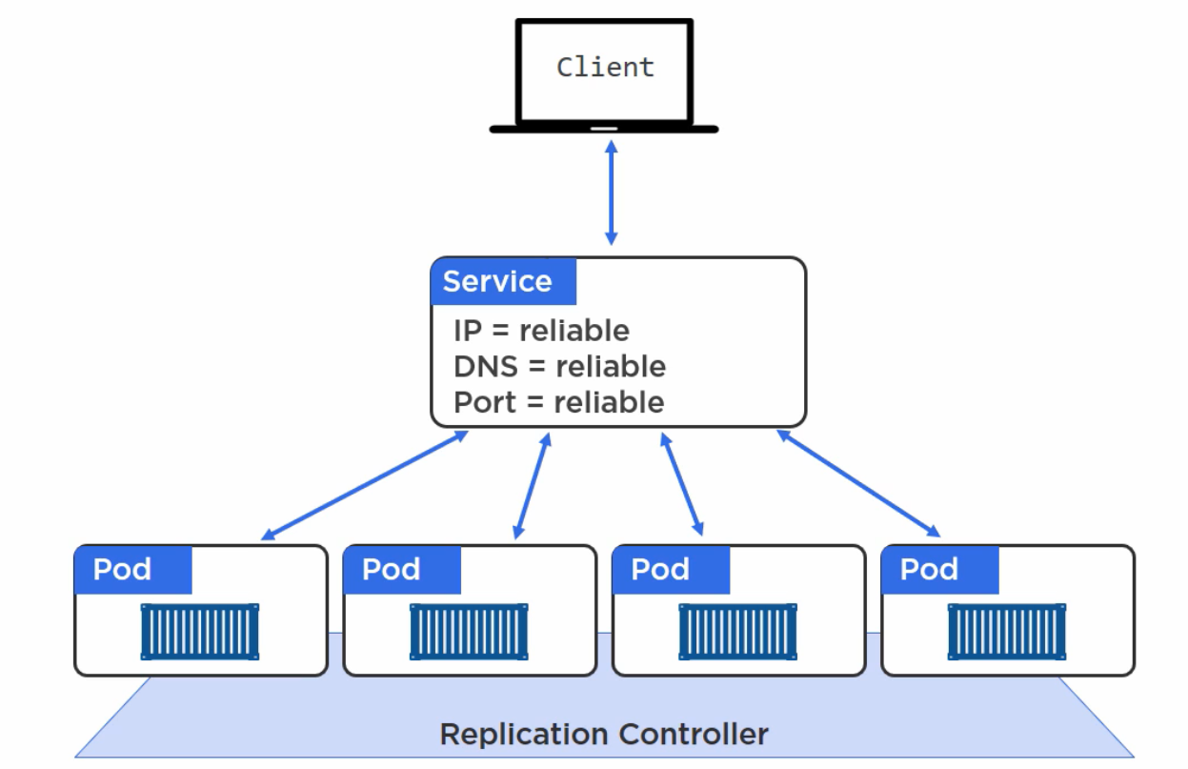
Service

Slide 22
Hands on : Service
Kubectl get services
kubectl expose deployment/mykube-mariadb1 --type="NodePort" --port=8080 : create service using pod
kubectl expose rc hello-rc --name=hello-svc --target-port=8080 --type=NodePort : create service using replication controller
Kubectl describe deployment : describe the deployment label
kubectl delete service -l run=mykube-mariadb1
kubectl describe svc hello-svc : describe service

Slide 23
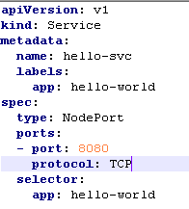
Yaml file : set up a service
Kubectl create –f <yaml file>

Slide 24
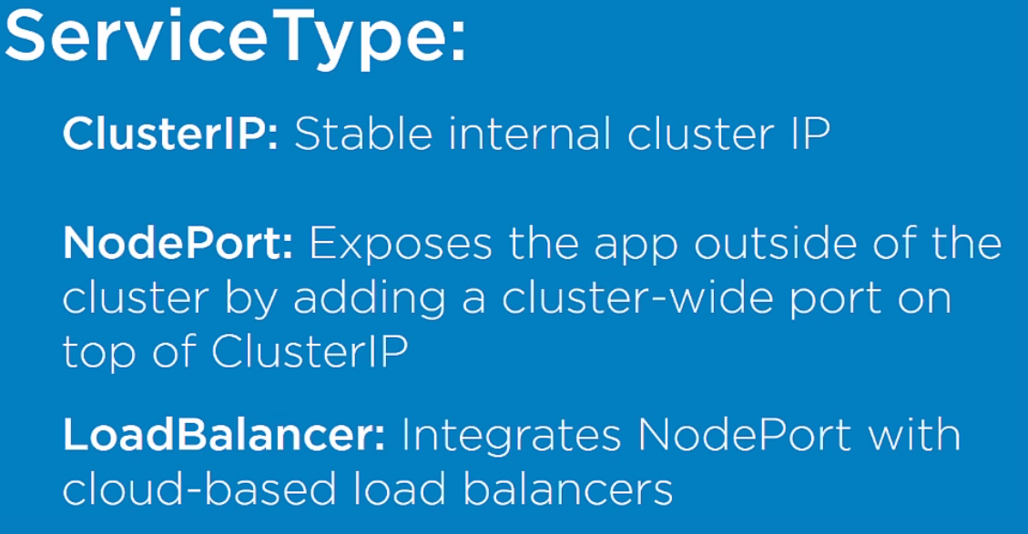
Service types

Slide 25
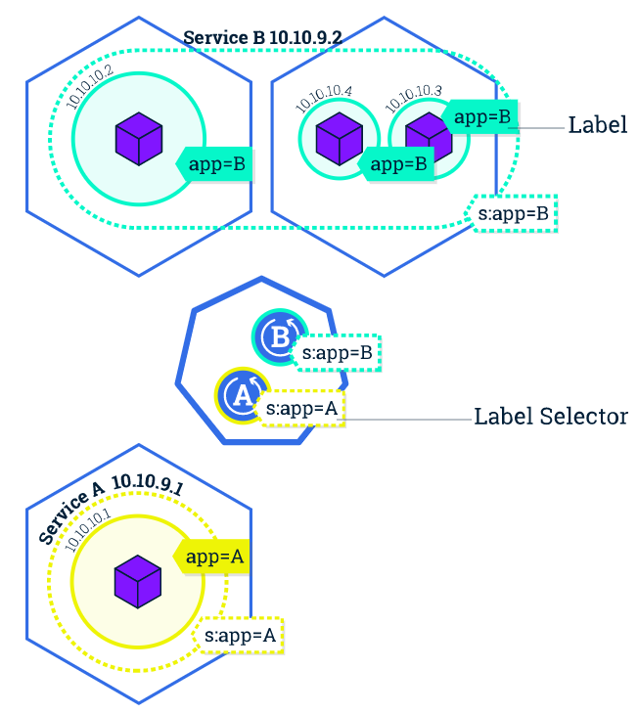
Label
Services match a set of Pods using labels and selectors, a grouping primitive that allows logical operation on objects in Kubernetes.
Label is used to bind pods with service
With labels help we can do canary release

Slide 26
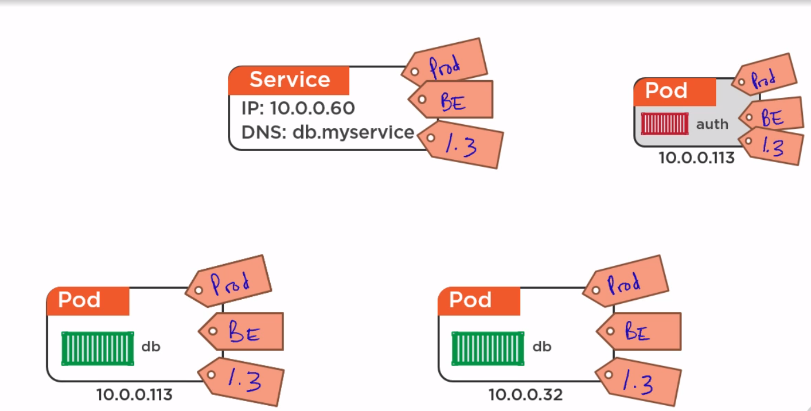
Label

Slide 27
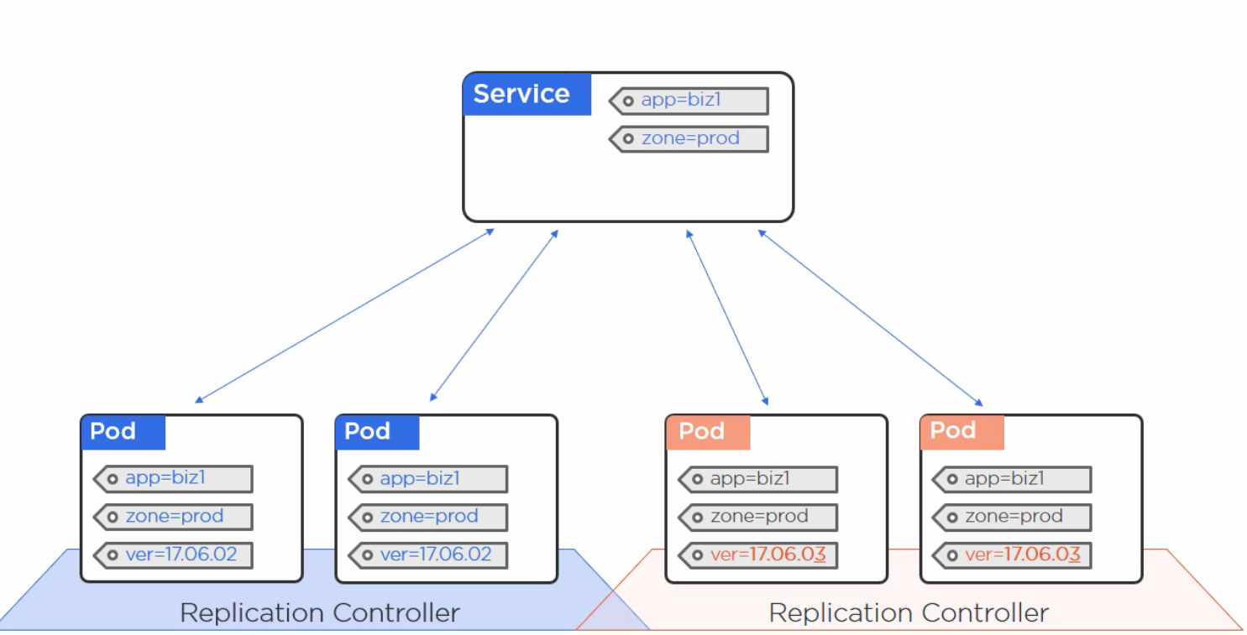
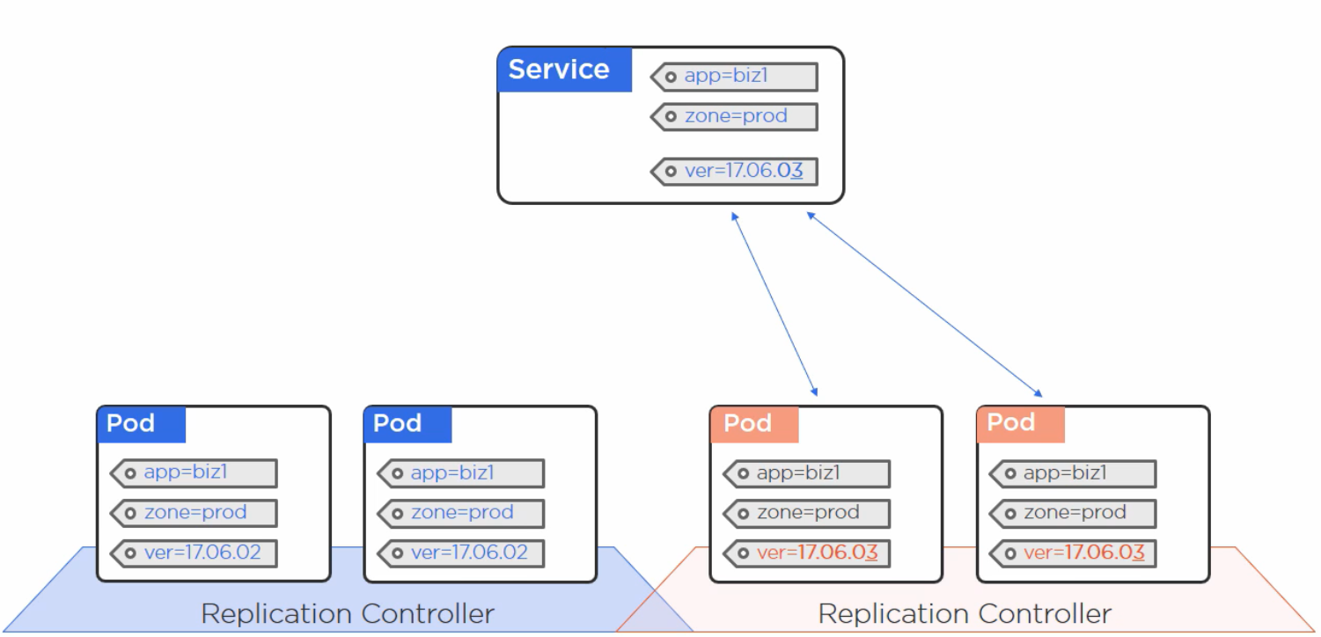
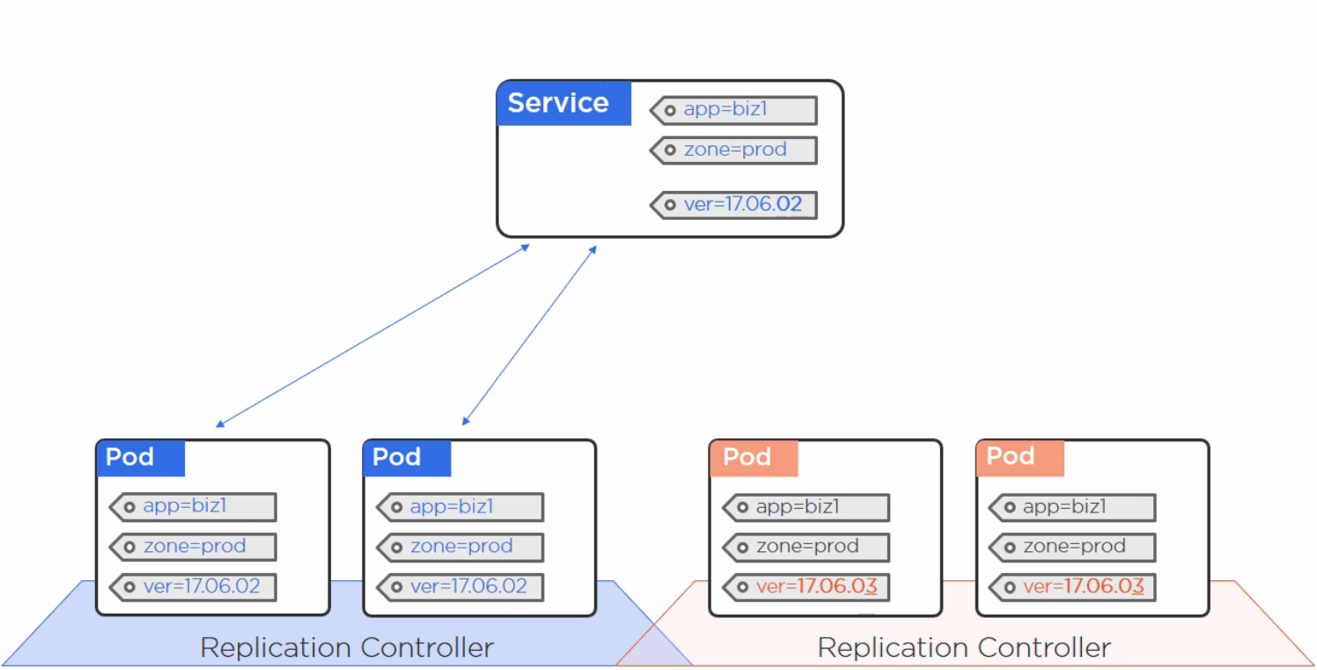
Release update

Slide 28
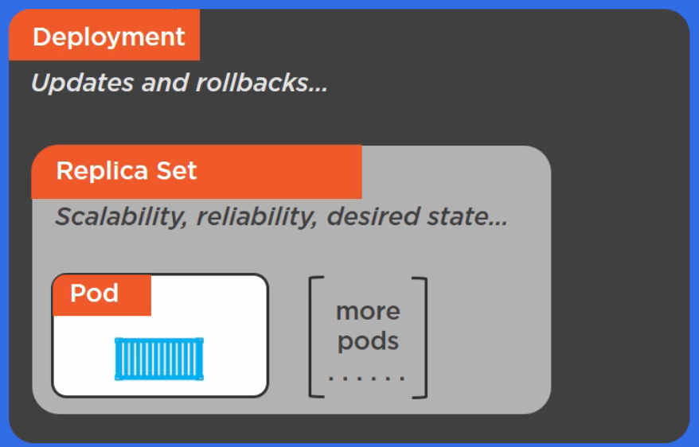
Deployment
Provides simple rolling updates and rollbacks
Supports blue-green deployments
Canary releases
Handles replication controllers

Slide 29
Hands on
kubectl create -f .\deploy.yaml

Slide 30
How to release update
Update the image in deploy yaml
kubectl apply -f .\deploy_update.yaml --record
kubectl rollout status deployment hello-deploy
kubectl get deploy hello-deploy
kubectl rollout history deployment hello-deploy

Slide 31
How to rollback
Kubectl rollout undo deployment hello-deploy --to-revision=1

Slide 32
Autoscaling
horizontal
kubectl autoscale deployment <Application Name> --cpu-percent = 50 --min = 1 --max = 10

Slide 33
Config Management
ConfigMap
is just a set of key-value pairs
three ways to consume a ConfigMap in a pod:
Command line arguments
Environment variables
Files in a volume

Slide 34
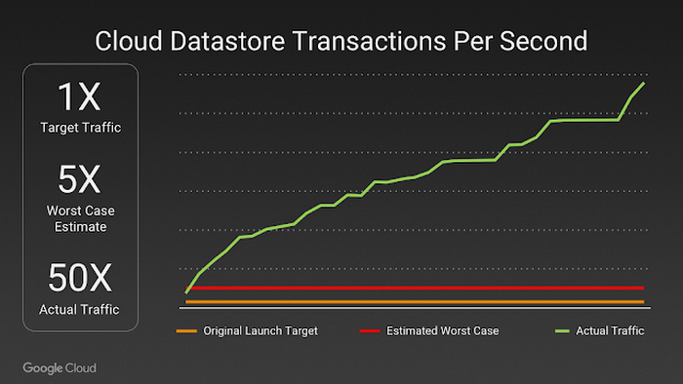
Usage PokemonGo

Slide 35
Setup dashboard using kubectl
Deploying the Dashboard UI:
kubectl apply -f https://raw.githubusercontent.com/kubernetes/dashboard/v2.0.0-beta1/aio/deploy/recommended.yaml
Copy provided snippets to some dashboard-adminuser.yaml file and use kubectl apply -f dashboard-adminuser.yaml to create them.
Create Service Account
We are creating Service Account with name admin-user in namespace kube-system first.
apiVersion: v1
kind: ServiceAccount
metadata:
name: admin-user
namespace: kube-system
Bearer token :
kubectl -n kube-system describe secret $(kubectl -n kube-system get secret | grep admin-user | awk '{print $1}’)
kubectl proxy : to open the proxy
Kubectl will make Dashboard available at http://localhost:8001/api/v1/namespaces/kubernetes-dashboard/services/https:kubernetes-dashboard:/proxy/.
Copy the token named : admin-user-token

Slide 36
References
https://kubernetes.io/docs/tutorials/
Kubectl dl :https://kubernetes.io/docs/tasks/tools/install-kubectl/

