Slide 1

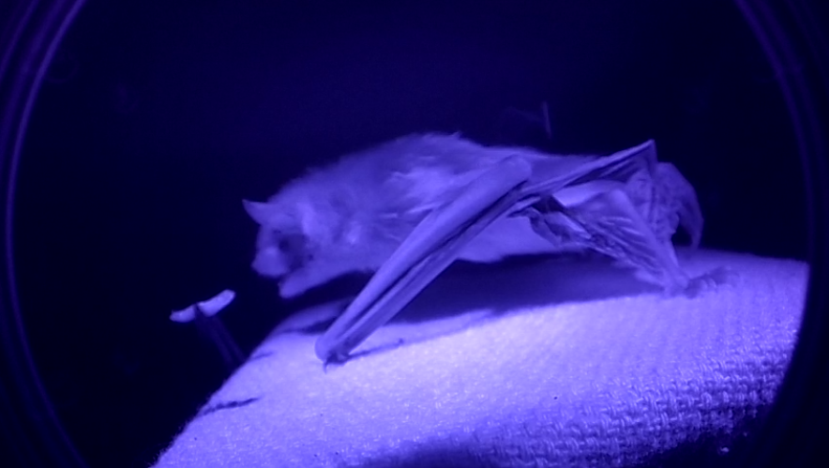
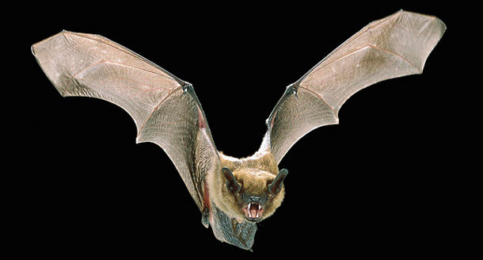
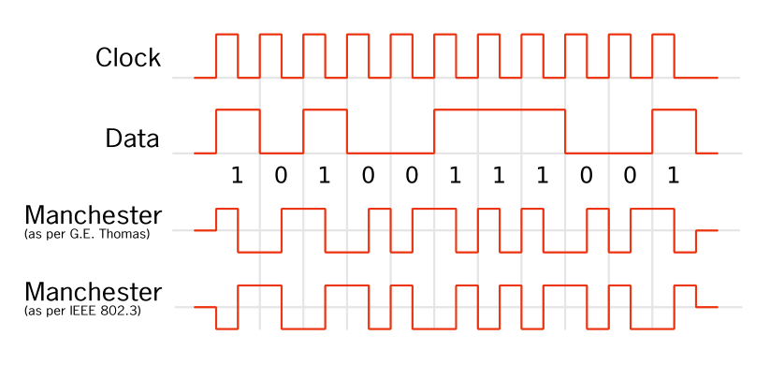
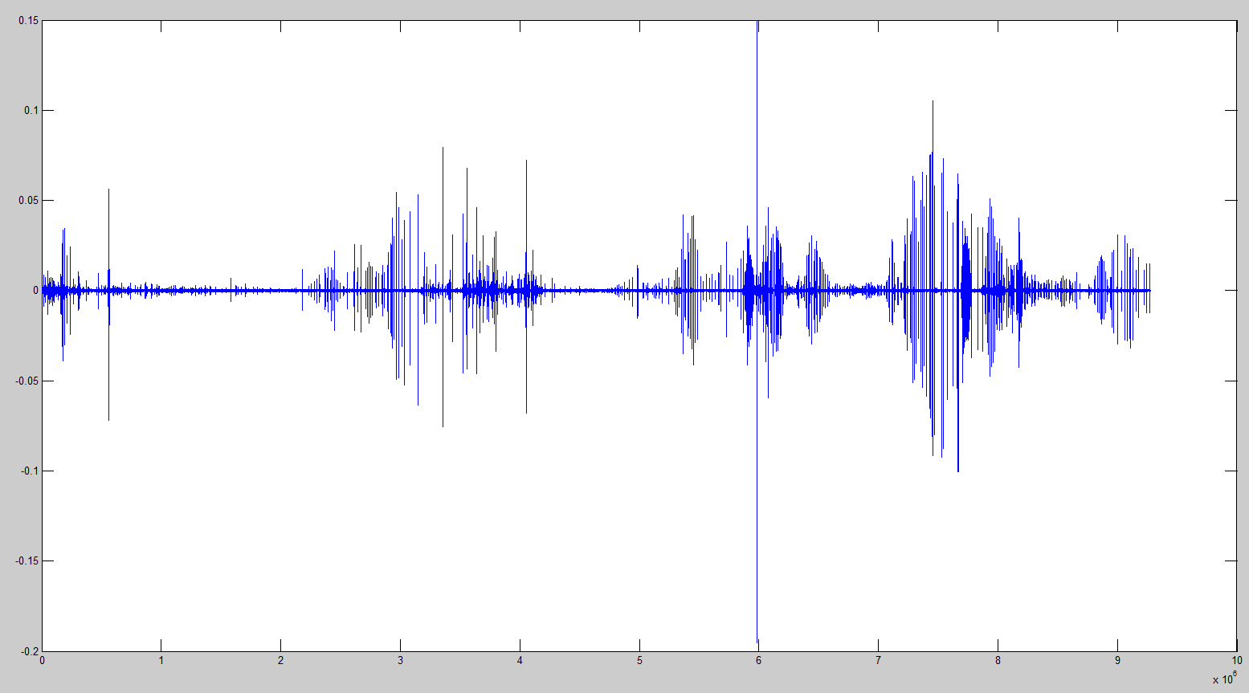
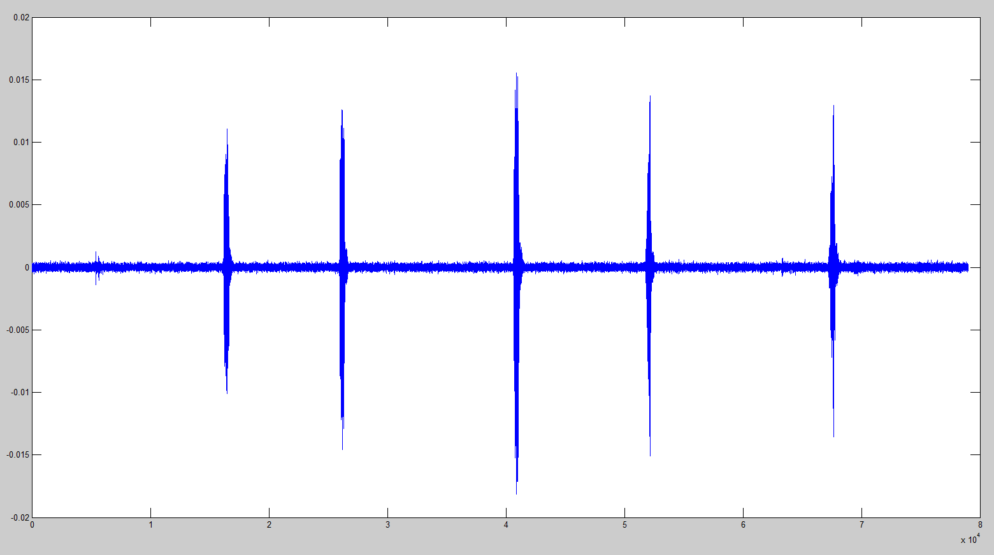
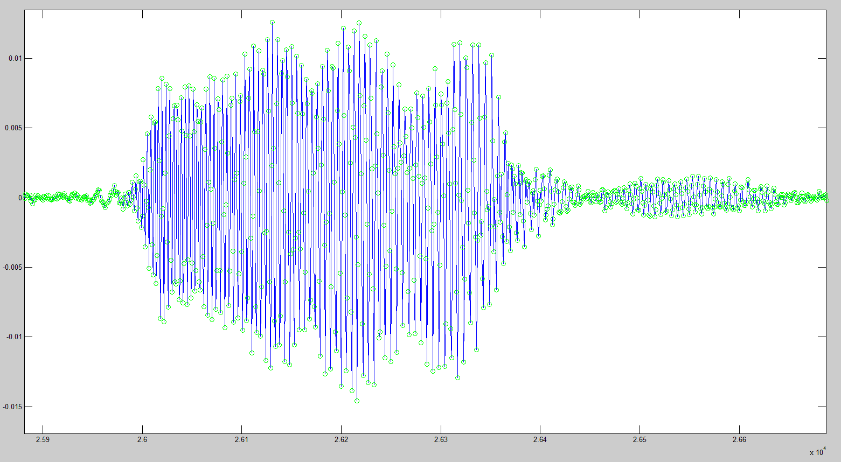
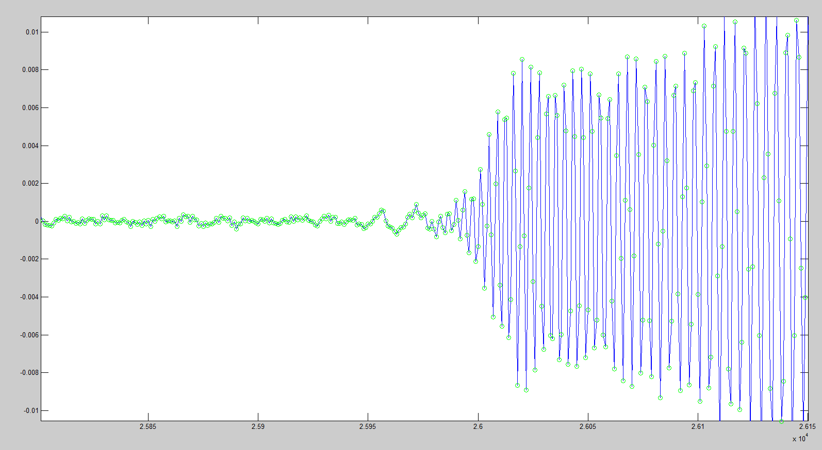

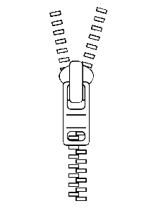


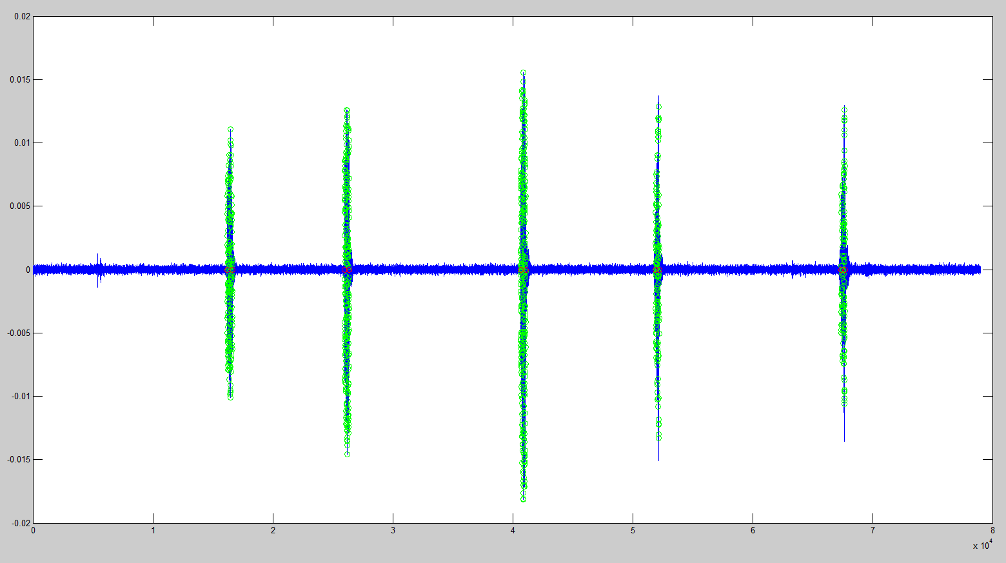
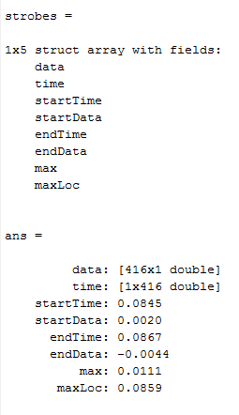

Computational Methods to Analyze Echolocation in Eptesicus fuscus
Ryan Himmelwright¹, Laura Kloepper², Jason Gaudette², and James Simmons²
¹ Lafayette Neuroscience Program, Easton PA and ²Simmons Bat Lab, Brown University, Providence RI
Poster #8
The Big Brown Bat
Decoding the Manchester Signal
- In order to synchronize all the different audio recording tools, an encoded Manchester audio signal is played and recorded by the devices. The signal gives several pairs of 64-bit sequences that represent increasing identification numbers and timestamps.
- A Manchester signal encodes temporal data in the switches between between the bits. So for the G.E. Thomas Convention, going from a 1 to 0 bit represents a 1 and going from a 0 to 1 represents a 0 in the Manchester signal.
- In order to convert the audio signal into useful integer values, a script in MATLAB was created to read the audio data and convert the Manchester values to binary, and then integer values.
- First the script found the 64-bit Manchester chunks by looking at the difference values of the data points and applying a time filter (the chunks all lasted 4 ms). Once the chunks are extracted, the switches were are by again looking at the large jumps in the data. The switches were used to directly read the Manchester code, that was then converedto binary, and finally integer values.
A bat in the lab (Dori), goes to eat a meal worm
during training. Filmed with an infrared lens on
the GoPro camera.
The Big Brown Bat uses echolocation
To navigate during nocturnal hunting.
- The Big Brown Bat (Eptesicus fuscus), is a fairly common species in North America. Considered “large” for an American bat, Eptesicus fuscus has an average weight between 14 and 21 grams, with a 12-16 inch wingspan.
A Description of Manchester encoding. The binary data bits are represented with two bits in the Manchester code. The switch between a 0 to 1 or 1 to 0 determines the data value. Every bit has both a 0 and a 1. It is the ordering that determines whether this sequence represents a 1 or 0 in the data.
- Being a nocturnal hunter, the Big Brown Bat uses echolocation to navigate flight and to capture prey, which consists of insects.
- During echolocation, the bat emits many sound pulses. Based on the strength and timing of the returning echos, the bat constructs a map of its surroundings.
Extracting the Pulses
Research Background
- Recent research has shown that Bats produce calls in what are known
as 'strobe groups', or groups of a few pulses emitted close together.
-This helps show that bat calls are dynamic signals, rather than a single sound pulse that is sent and returned.
- Current research is trying to show if, how, and why these strobe groups vary from bat to bat.
-Additionally, Simmons lab wants to look at the 3 dimensional sound profiles of the bat sound beam across different frequency bands and correlate these sound profiles to the physical characteristics of the bat's mouth and ears.
-To do this, the lab has constructed a 228 microphone array (arrayzilla) for spatial audio recording of the sound beam, and uses a GoPro camera with an infrared filter for high speed video capture of the bat as it calls.
An example of the plotted bat call audio data.
Zoomed in section of several bat calls
-Previously, when analyzing the audio data, the bat calls had to be extracted manually. This made it very time consuming to obtain a large number of call samples to use for research.
-A MATLAB script was made to help find and extract the bat pulses.
-The bat pulses have a specific profile that was exploited when locating them from the rest of the noise.
-The pulses have a rather consistent duration. This time window was used to determine if a sound was likely to be a bat call.
Arrayzilla
1.0 Meter
Bat on Stand
GoPro Camera
Audio Extraction Scripts
Remote Linux Machine
A zoomed in section of a single pulse. The green dots are the locations of the actual data points.
A zoomed in section of the front of a pulse. The green dots are the locations of the actual data points.
Bat_1_video
Bat_1_vid
Bat_1_vid_aud
-Due to the audio being recorded at a constant sampling rate, when a call occurs, the difference between the data points during the calls is much larger than the difference between data the points for the background noise.
-By looking for this increase in the difference between data points, the sounds above background noise were located. Specific windows were then applied to further specify if the noise was a pulse from a bat call.
Run Script
Bat_2_vid
Bat_2_vid_aud
Bat_2_video
...
...
Bat_n_vid
Bat_n_vid_aud
Bat_n_video
Compressed Tar Package
-In order to compare the audio data from both the GoPro video and a high quality microphone, the audio had to first be efficiently and correctly extracted from the GoPro video file.
-ffmpeg and sox were installed to a remote Linux machine that the lab used and a custom shell script was written to strip the audio from the GoPro Video.
Pull Package
To Laptop
-The shell script automated the process by asking the user to select the file type to convert. When the user confirmed the files, the script pulled the audio from the GoPro video files and saved it to a .wav file.
The estimated locations of the bat pulses. The green indicates where the script thinks there is a pulse.
The information of each pulse was gathered in a MATLAB structure for easy use in further analysis.
-The user was then prompted if they would like to package the sound files for easier transfer, and if they wanted to include the original video files in the package as well.
-After the pulses were found, they were added to a MATLAB structure, where each element represented a different pulse.
-The structure contained an array of corresponding data values, an array of corresponding time values, the pulse start time, the pulse end time, the data start time, the data end time, the max amplitude of the pulse, and the location of the max amplitude for each pulse in the structure.
-After the package was created, the user could easily transfer it to another computer for analysis.

