Slide 1
Deep Learning

Slide 2
Deep Learning:-
Deep Learning is a upgraded concept of Machine Learning It can easily handle huge amount of data (structured and unstructured data). As compare to Machine Learning it can be use to solve complex operations problems. Also it is a fastest technique to solve real life problems.
Deep Learning does the (Feature Extraction + Classification) part itself automatically. We don’t need to do it manually as we were doing in Machine Learning.

Slide 3
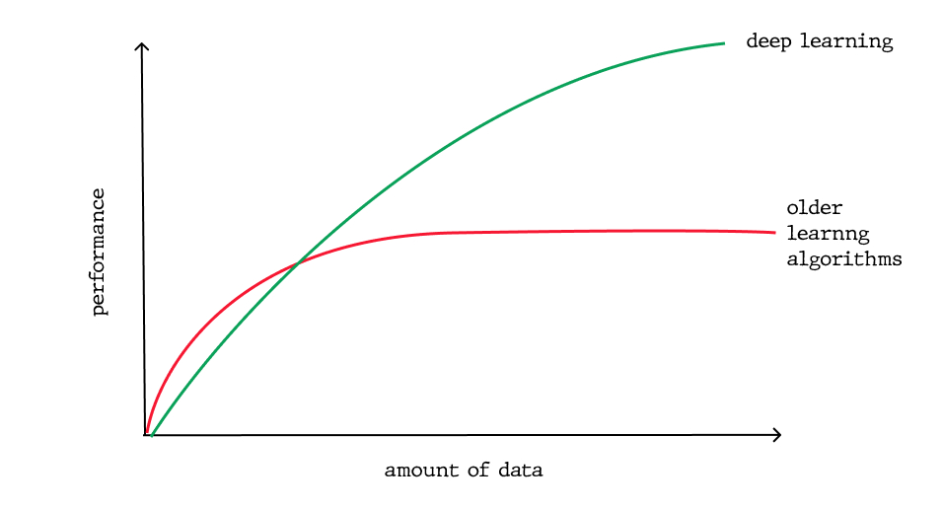
Performance rate Deep Learning vs Machine Learning:-

Slide 4
Use Sector of Deep Learning:-
Deep Learning is using now a days different sector for solving real world problems.
Medical Field.
Robotics.
Self Driving Cars.
Translation.
Speech Recognition.

