Slide 1
Neural Network -
Topologies
in Deep Learning:-

Slide 2
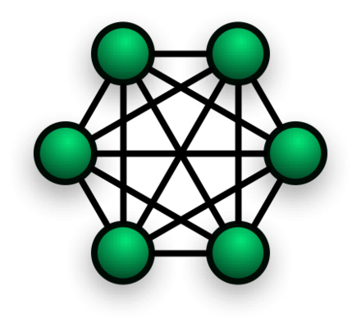
Topologies - Completely Connected
This completely connected topology is the topology that completely connected with each other. It’s a Network topology in which there’s direct link between all pair of nodes.

Slide 3
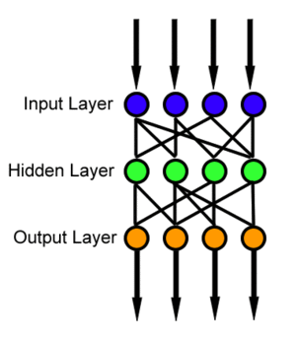
Feedforward (Directed) - Topology
It Connect with Next layer. In this Feedforward Network that refers to first Input Layer, then pass to Hidden Layer and then goes to Output Layer.
As we can simply say forwarding to the Next Layer.

Slide 4
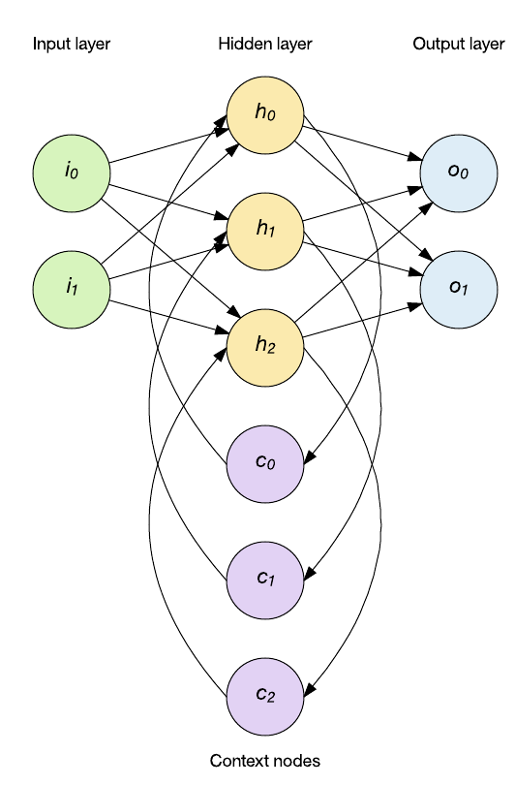
Recurrent Network Topology:-
Recurrent Network Topology is a Network where neurons are inter connected with same layer. Also where output from previous step are fed as input to the current step.

Slide 5
Neural Networks - Types
Feedforward vs Recurrent Networks:- Feedforward means there’s no loop. It provides information to the input then hidden layer after-that goes to output. Recurrent means repeating the process with same layer again and again.
Continuous vs Spiking:- In continuous neurons firing rate on continuously to the all Neuron. In Spiking Neuron firing rate whether goes up and down.
Supervised vs Unsupervised Learning:- Supervised need a teacher and in that output provided by the user. Else unsupervised find hidden patterns in input data by clustering, classification etc.

