Slide 1
Neural Networks - Perceptron
in Deep Learning:-

Slide 2
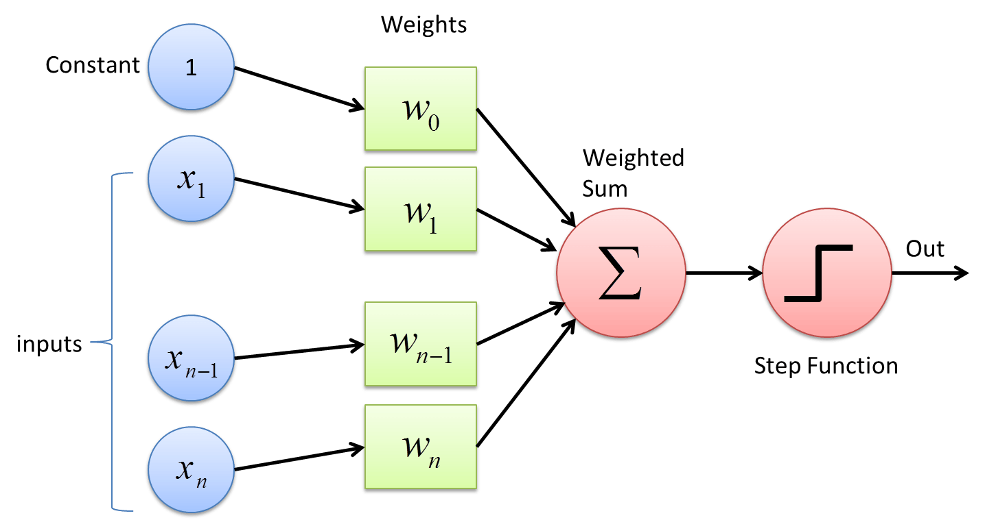
Perceptron:-
Perceptron is first Artificial Neural Network. In Perceptron we provide weights (features) and Bias (extra feature or information). It can take linear boundary with Single-Layer Perceptron and Non-Linear Perceptron with Multi-Layer Perceptron. Multi-Layer is faster. In Multi-Layer Perceptron we start creating Decision boundary for Non-Linear.

Slide 3
How Submission calculated Weight:-
(1 * w0) + (x1 * w1) + (xn-1 * wn-1) + (xn * wn)
→ Submission ( Weighted Sum )

