Slide 1
Padding
in Deep Learning:-

Slide 2
Padding in CNN:-
Padding is the process of adding layers of Zero to our input image so it can prevent shrinkage and border effect problems and losing information on the corners of the image.
There’s two types of padding available:-
Same Padding.
Valid padding.

Slide 3
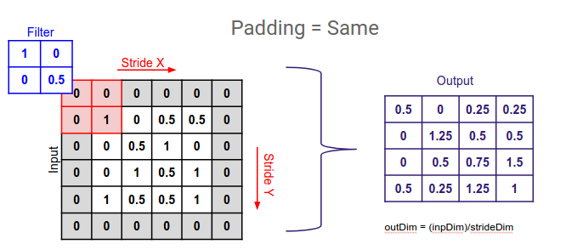
Types of Padding:-
Same Padding. 2. Valid Padding.
It’s an additional layer which we can add to the border of an image. As you can see in this picture there’s one more layer added on the 4*4 image and now it’s converted in to 5*5 image.

