Slide 1
Neuron
in Deep Learning:-

Slide 2
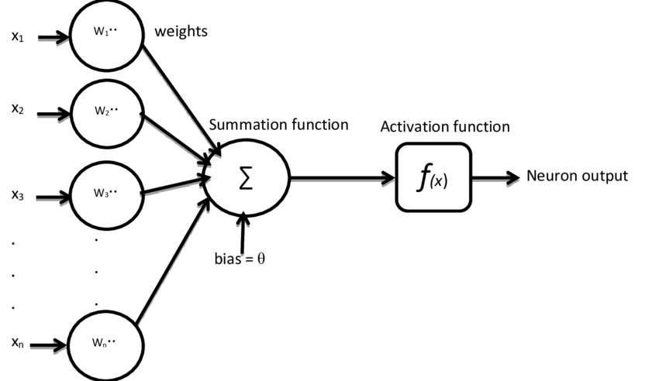
Neuron:-
Neuron is a Mathematical function. It takes inspiration from biological Neuron. It does multiplication on weighted area of Input, then it does the submission then pass it to the non-linear activation function.

Slide 3
Intuition:- (How Neural Network Work)
Neuron takes input then process data and gives output. It provides important output and it also provides Non important output to the different Neuron which needs that.
In Neuron dendrites become input values, the computation (Nucleus) becomes submission, axon becomes activation, spike becomes output. This is artificial Neuron.
Axon check whether the information is important or not.
Nucleus does the calculation work.
Spike through out the output.

