Slide 1
Overfitting and Underfitting Problems

Slide 2
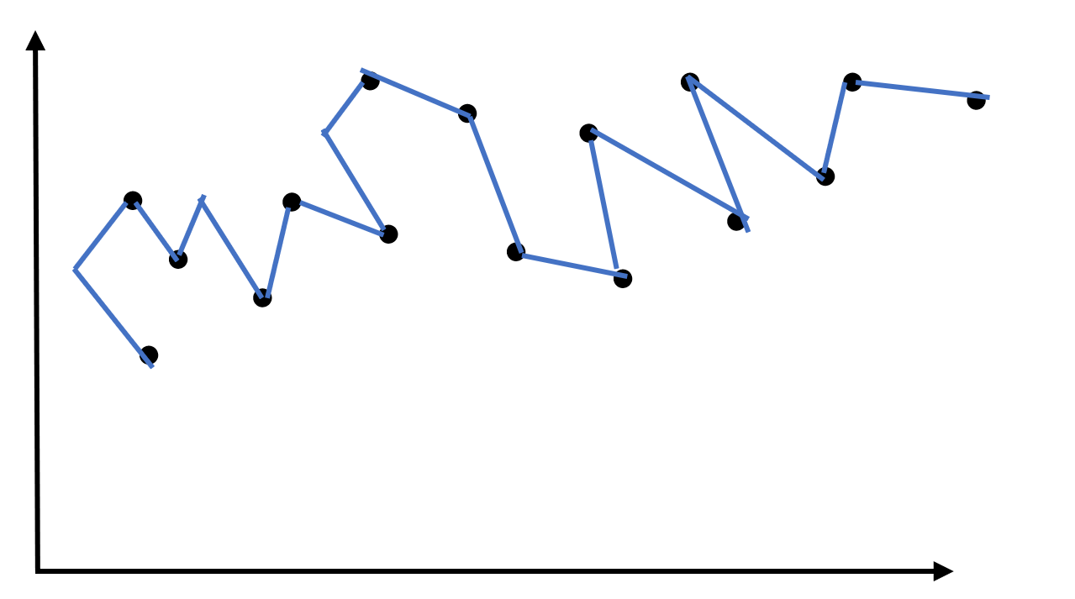
Overfitting :-
Overfitting occurs when a statistical Model or Algorithm capture (focus) the noise (errors) of data.
An Overfitting Model has Low bias and High Variance.
Example of Overfitting in chart -

Slide 3
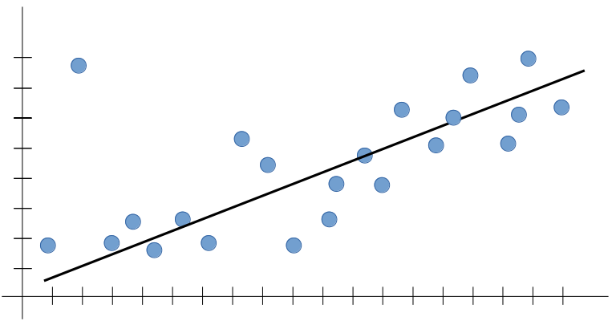
Underfitting:-
Underfitting occurs when a statistical Model or Algorithm cannot capture the underlying trend of data.
An Underfit Model has low Variance and high Bias.
Example of Underfitting in chart -

