Slide 1
Deep Learning - Training

Slide 2
Sample Labeled Data
(batch)
Forward it through the Network, and get predictions
Back Propagate the errors.
Update the Network Weights.
In Deep Learning Training Model it first of all takes input data then pass it through the Network. Once get prediction then check for loss function (error). Once we get error there then send it back to backpropagate the errors. After that we update the weights to the Network.

Slide 3
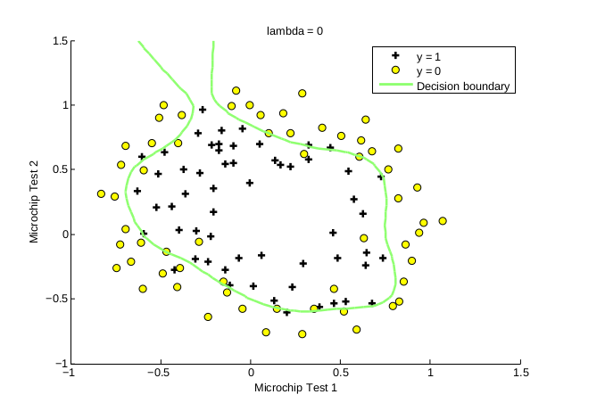
Decision Boundary:-
Decision Boundary is the process where it adjust the weight and classify the separate class. With the help of Decision Boundary we can adjust the weight in our actual value. So we can reduce the errors.

Slide 4
Feature Detectors:-
It pass Strong signal to the important weight or information and pass low signal to non important information.
In general if weight is important it pass strong signal there else it avoid and pass low signal or negative signal to that.
In feature detector it may be single or multi hidden layer. It may contain maximum 5 multiple hidden layer.

