Slide 1
Activation Function
in Neural Networks:-

Slide 2
Activation Function:-
It takes submission or collected information and then (check whether it’s important or not. Also check what to be fires) then it fires to next Neuron and it’ll add non-linearity mostly by creating decision boundary.
Activate Function plays important role in Neural networks.
Next you can see different types of Activation Function:-

Slide 3
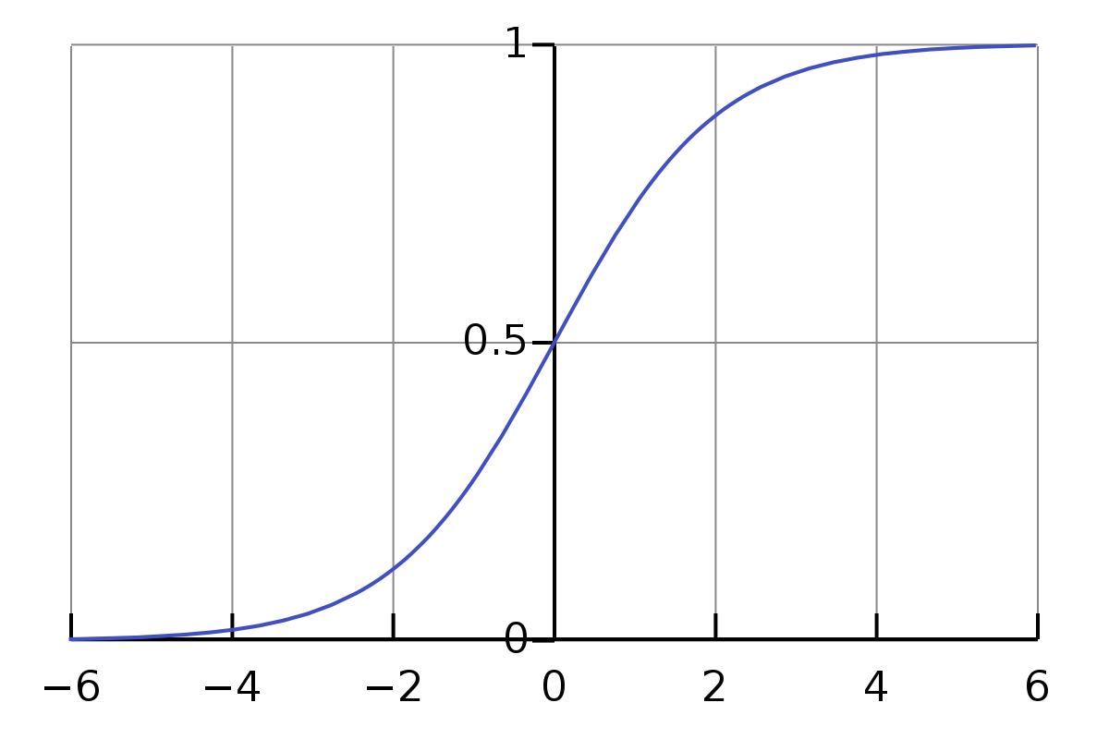
Sigmoid Function:-
In Sigmoid it start from 0 till 1 and then centered point is 0.5 it makes information important if firing rate is high else it’ll keep it as not information. It’s Non-Zero Centered point.

Slide 4
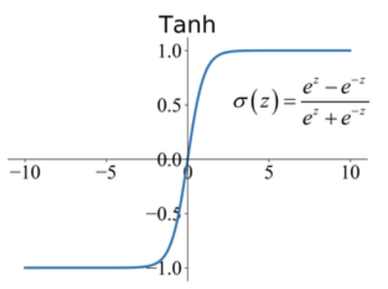
Tanh (Hyperbolic Tangent) Function:-
It’s Zero-Centered point. It taken negative value as well. It does more segregation than Sigmoid because it’s start from Negative. It does more firing rate and it start from -1 instead in Sigmoid start from 0.

Slide 5
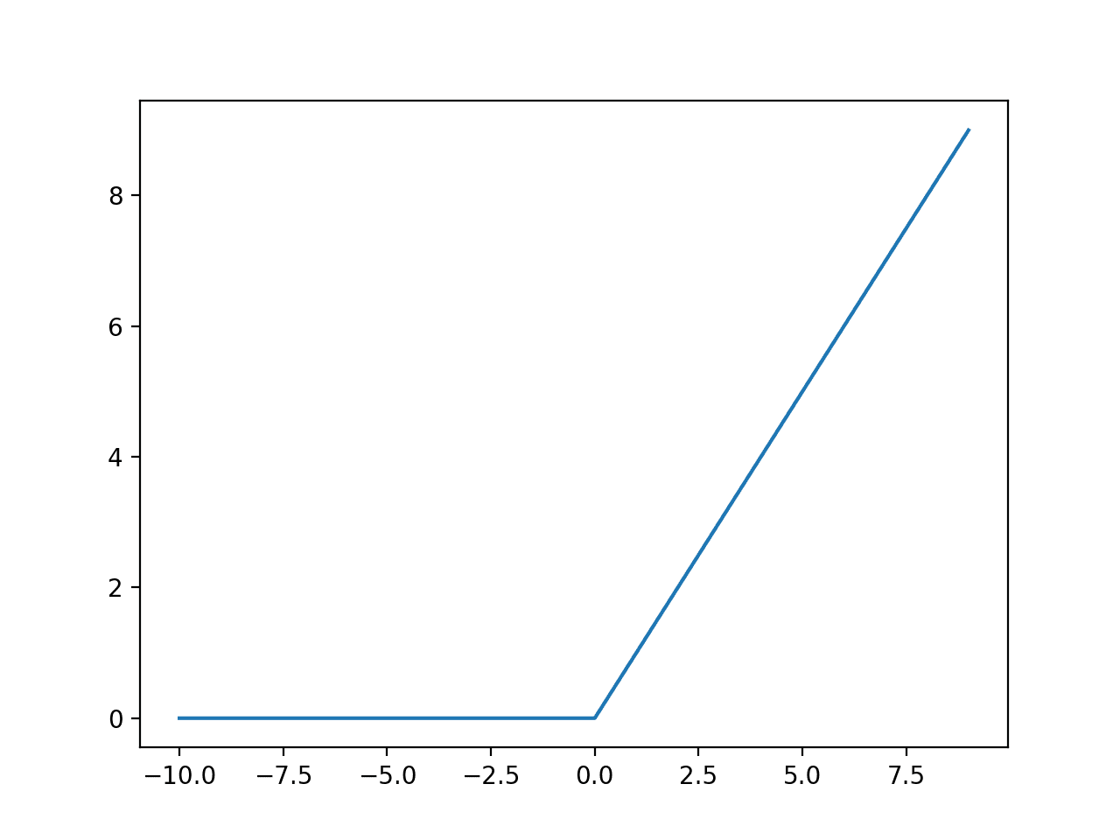
Relu (Re-actified Linear Unit):-
Relu Activation Function is mostly using because it trains faster than other. Also it’s most using activation function now a days. It’s also Zero-Centered and it prevents the gradient vanishing problem.

Slide 6
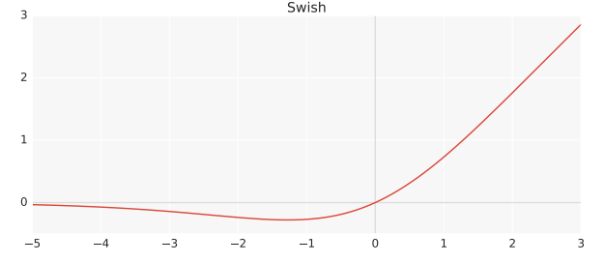
Swish Function:-
This Swish Function is Proposed by Google Brain’s Team. They have flip the line instead of going in negative they moved it towards x.

Slide 7
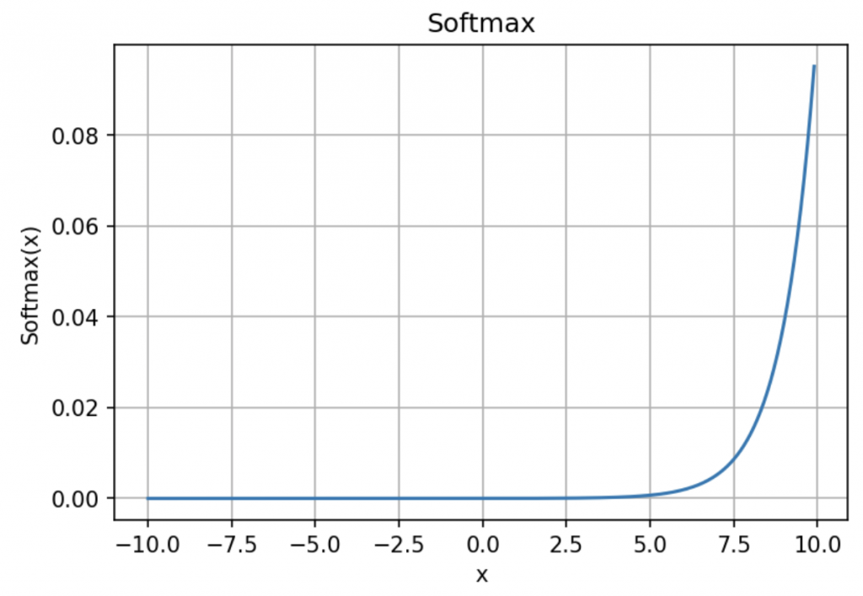
Softmax Function:-
This Softmax function is used as a activation function on Output layer in Neural Networks. Also it use in classification Problems.

