Slide 1
Training (Computation) process in ANN:-
a concept of Deep Learning (Neural Network):-

Slide 2
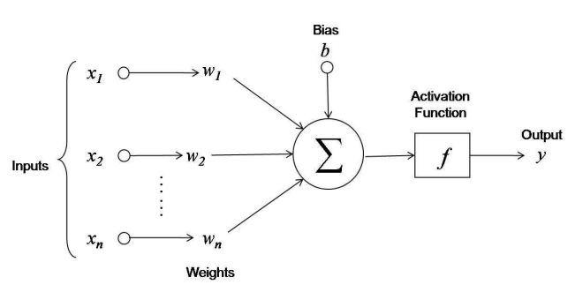
Training (Computation) Process:-
In this training Model first we provide input to the Network then Input section pass it to the Hidden layer then it does Computation part and then provide output. So there we want to predict a value from Model that’s Predicted Value is 0. but Computation provides us a value (0.8) that’s actual.
Once we do (Prediction - Actual) we get error or loss function then we get error that’s (0.8) then Network does the ‘Adjustment of the Weight’ to reduce the error.
Predicted value
(0)
Actual value
‘provide by output’
(0.8)
Error is (0.8)

Slide 3
Activation Function Solves Problems:-
Vanishing Gradient Problem:- It sends Gradient to the level so it can Segregate and then the error can be reach to Local Minimum.
Zero-Centered Problem:- Activation function allows gradient to the less than 0 or we can say in ( - values).
Computational Expense:- with the help of Activation function Computational Expense decrease or it takes less time in order to compute or process.
Differentiable:- with the help of Activation function it can Separate important or unwanted data.

