Slide 1
Lasso and Ridge Regression
in Machine Learning-

Slide 2
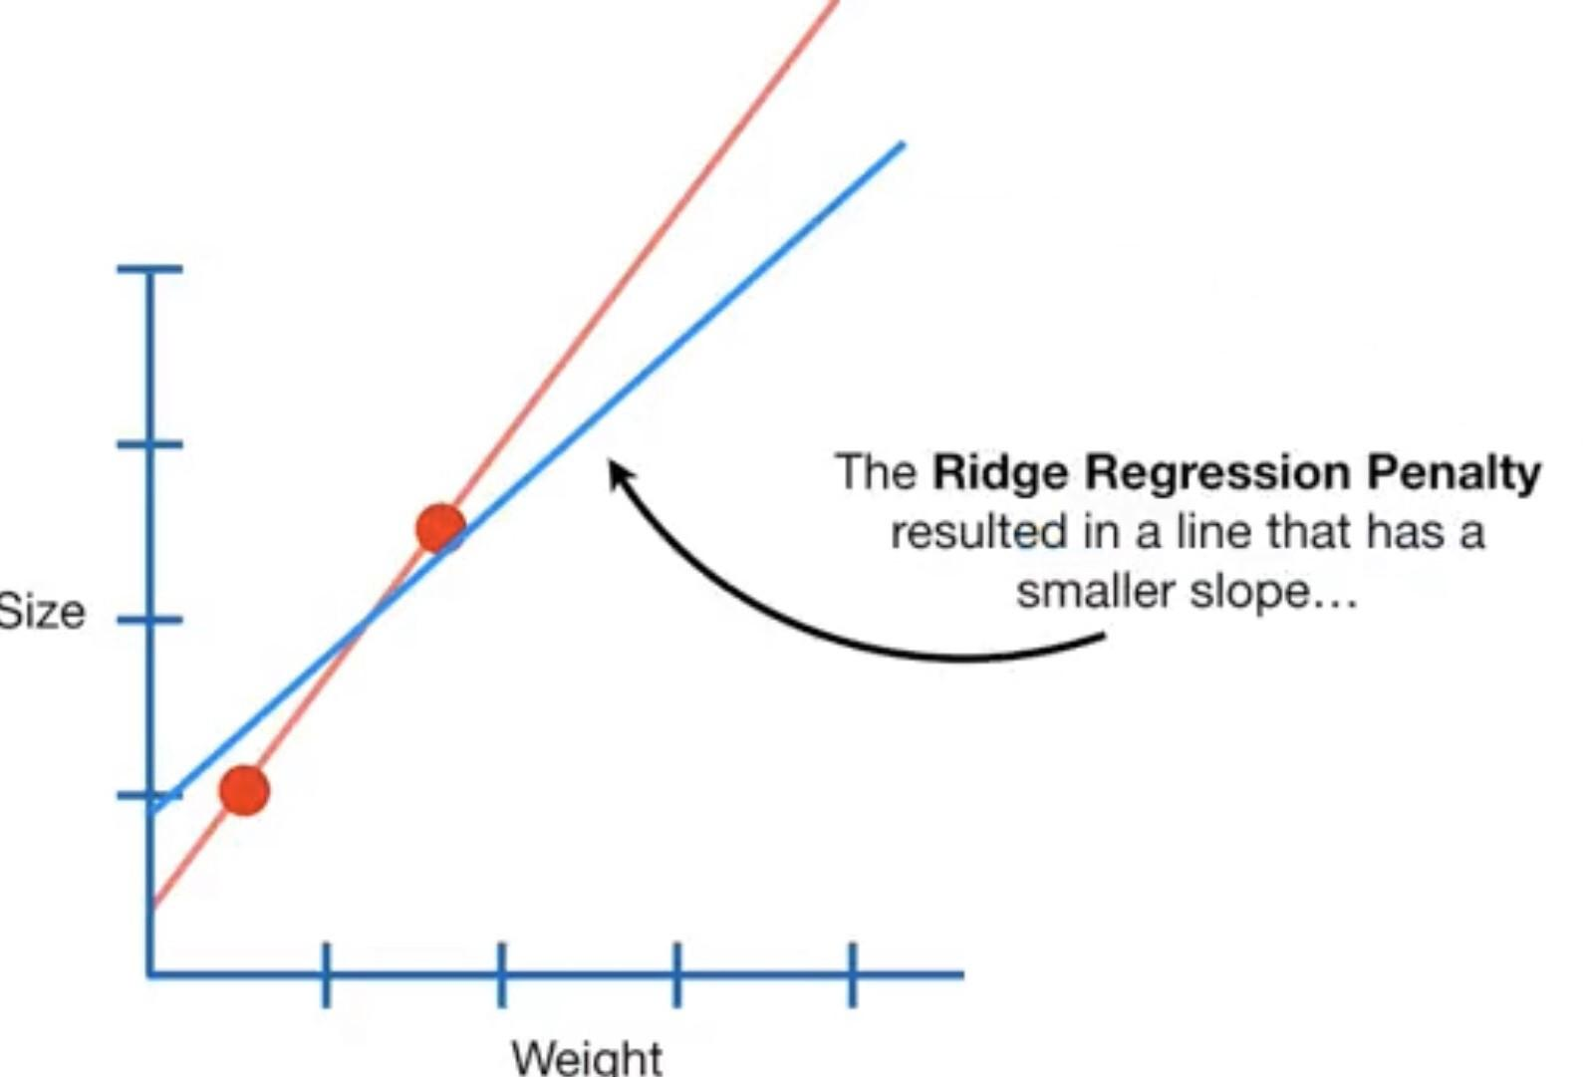
Ridge Regression:-
Ridge Regression is a extension of linear regression where the loss function is modified to minimize the complexity of the Model. This Modification is done by adding a penalty parameter that is equivalent to the square of magnitude of coefficients.

Slide 3
Lasso Regression:-
Lasso Regression or least shrinkage and selection operator, is also a modification of linear regression. In Lasso, the loss function is modified to the minimize the complexity of model by limiting the sum of absolutes value of model coefficients.

