Slide 1
Logistic Regression

Slide 2
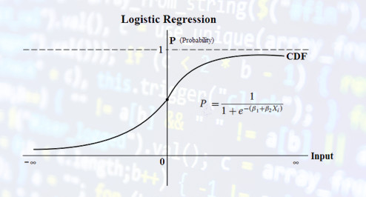
Logistic Regression:-
Logistic Regression is a algorithm which classify the dataset according to available class.
It calculates probability of belonging to particular class.
If p < 50 = 1
If p > 50 = 0

Slide 3
Logistic Regression takes features and labels in training data. Then fit a linear model. and then instead of giving result it gives Logistic of result.
It always predict the value either in 0 and 1 on the basis of sigmoid.
The difference between linear and logistic regression is that linear regression helps to solve regression problems where logistic regression is used to handle classification problems.

