Slide 1
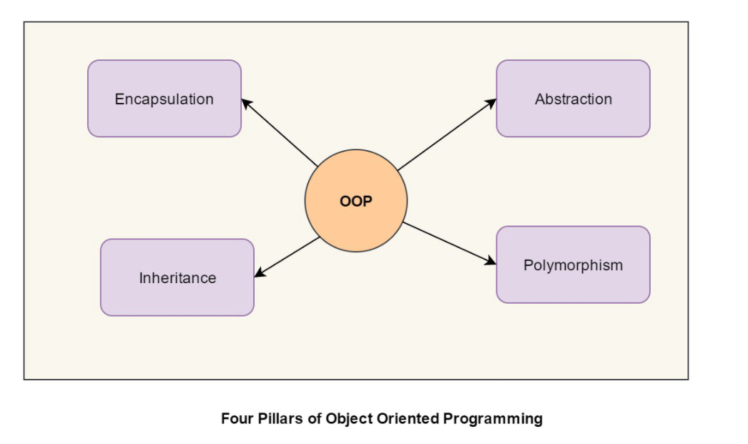

Slide 2
Namespace: him/mvc/
Encapsulation
Xblock
protected
Library
public
Namespace
navnekollisjoner
bibliotek av klasser
Classes, methods, traits,
Visibility (method,variable,property)
public
protected
Private
GradeXblock
protected
InternalXBlock
private
Namespace: ntnu/mvc/
XBlock
Library

Slide 3
Inheritance
AbstractXBlock
render()
arv
Kun en foreldre
protected variabler eller metoder er synlig for barnet
TextXBlock
render()
ProblemXBlock
$problem
AbstractGradedProblemXBlock
grade()
MathGradedXBlock
render()
grade()

Slide 4
Abstraction
AbstractXBlock
render()
abstract class
interface (høyere nivå enn abstract class)
TextXBlock
render()
ProblemXBlock
$problem
AbstractGradedProblemXBlock
grade()
MathGradedXBlock
render()
grade()

Slide 5
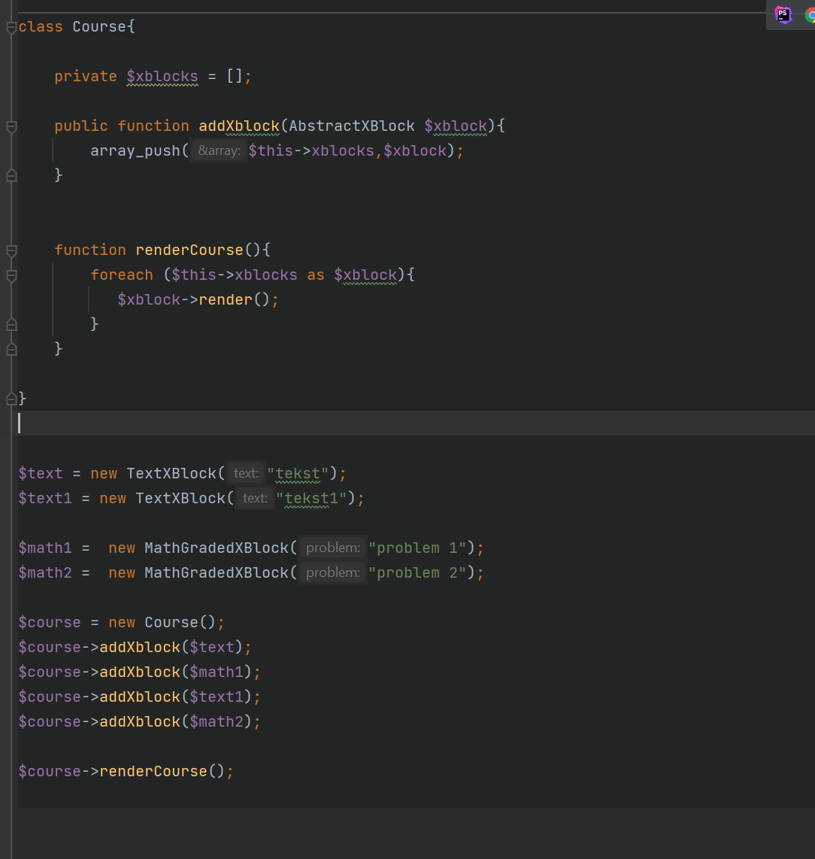
Polymorphism
«many shapes» – mange former
php kan jobbe på abstrakte klasser, men endrer form ved runtime

Slide 6
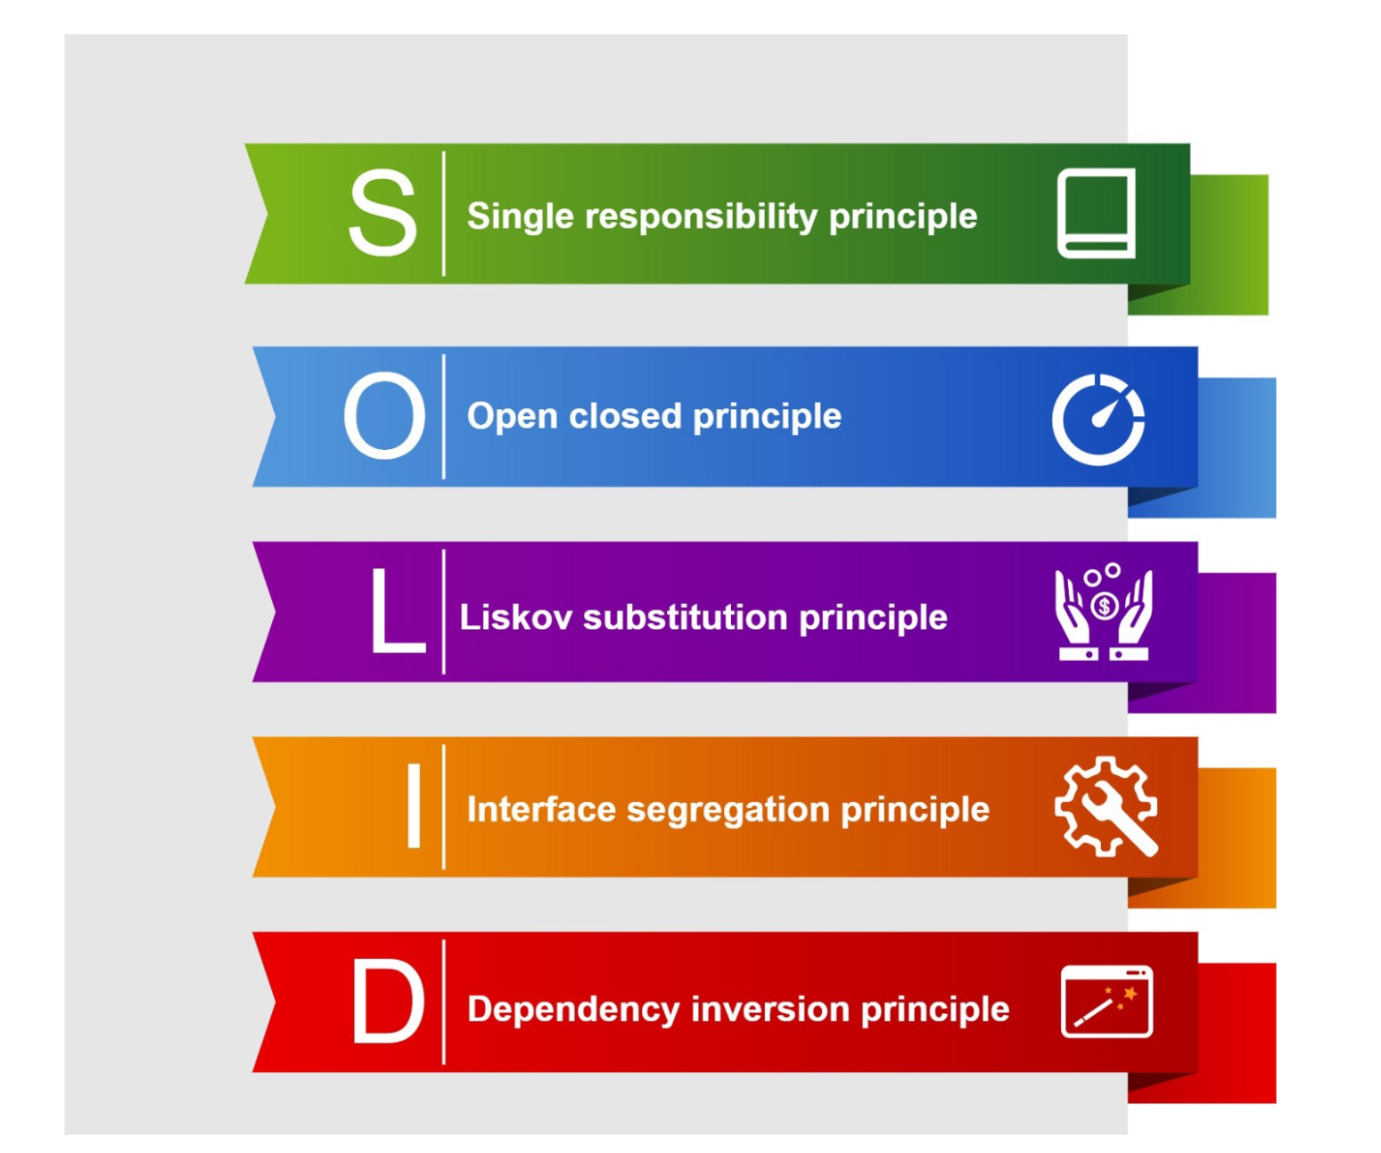
SOLID
OOP forteller oss HVA vi kan programmere
SOLID forteller oss HVORDAN vi skal programmere

Slide 7
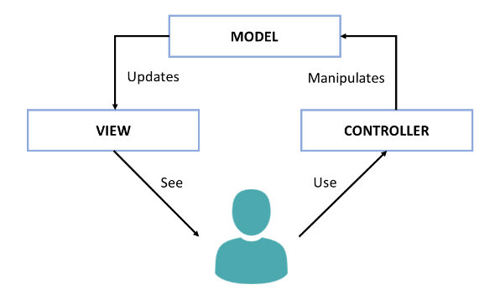
MVC framework

Slide 8
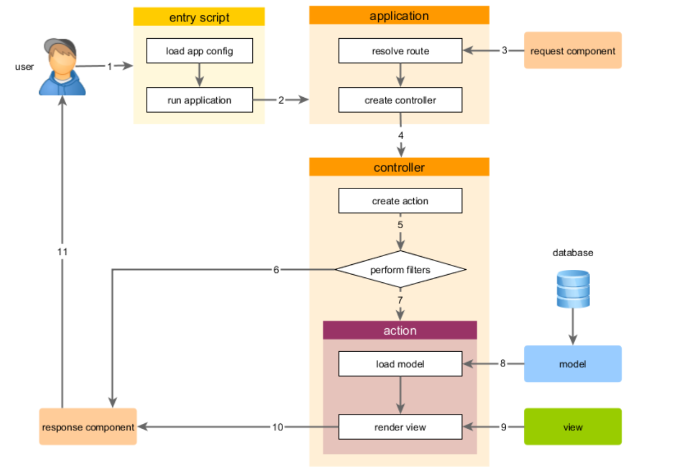
MVC framework
En bruker sender en HTTP-request til web serveren, som ruter requesten til index.php.

