Slide 1
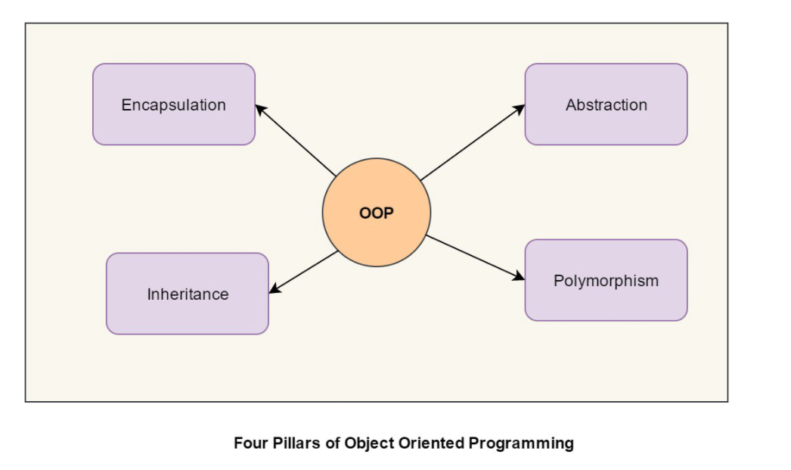

Slide 2
Encapsulation

Slide 3
Abstraction

Slide 4
Inheritance

Slide 5
Polymorphism

Slide 6
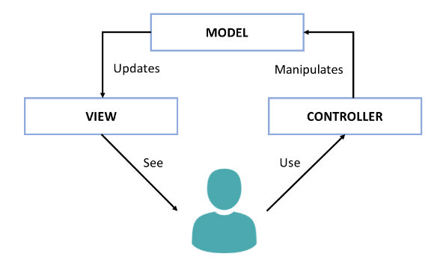
MVC framework

