Slide 1
WebXR current position and beyond to the Recommendation
Atsushi Shimono (html5j)
SFC, Keio University

Slide 2
In this talk...
WebXR overview
Recent updates on WebXR ecosystem and expectation
Emerging points
  WebGPU integration
  Spatial context, mixed reality (physical integration), and related area
  <model> - 3D assets as native Web element
Note: this talk does not touch with client libraries such as Three.js or Unity.

Slide 3

What is WebXR?
WebXR enables accessing XR behavior via JS API.
Originally was WebVR from Mozilla, extended to AR/VR (XR).
WebXR does:
Handle XR view, both HMD and flat screen (like smartphone)
  Along with basic 3D transformation routines
Connect input sources
  gamepad, hand input, depth sensing
Additional modules handles XR related methods
  Physical representation incl. environment, objects, real world position
WebXR does not:
Render 3D contents – use WebGL or WebGPU
Handle cross site operation, like metaverse engine does

Slide 4
WebXR as Standard
WebXR specifications are developed in the IWWG
(Immersive Web Working Group) of W3C, with proposal based incubation at IWCG (IW Community Group).
WebXR Device API (Core) as extendable core functionality
  Handles XR device and session (w/ 3D space coordinates)
  Provide base interfaces to be extended by modules
WebXR modules – to extend Core per single functionality
  AR module provides AR session (historical reason,,,)
  Around 20 modules... https://www.w3.org/immersive-web/list_spec.html
  Over wide variety of XR features, e.g. input, lighting, object detection

Slide 5
Recent updates in WebXR (I)
Core feature in XR has been mostly stable
Some update from WebIDL limitation or underlay system (OpenXR etc.)
Getting new features from generic XR (not Web), like dynamic foveation
Some goes to extension modules, with slight change into Core
No completed implementation yet, no two independent implementation
Chromium partly implemented WebXR Device API spec
Gecko, Webkit behind flag
Will continue living standard based mutuality level in Candidate Recommendation
Some of extension modules are quite stable and implemented
Like modules of AR, Gamepads, layers
Aiming Recommendation by two independent implementations
based on Chromium for headset device implementations

Slide 6
Recent updates in WebXR (II)
New modules under incubation (back in next part)
And some incubations got slowed... (as usual?)
WebGPU
  Addition to XRWebGLLayer, WebGPU integration is under development
Physical integration, Real world geometry
  The same as XR space, so-called metaverse is getting emerging topic
  Plane Detection module graduated from incubation
  MSF/OMBI announced metaverse browser engine in this area
    https://metaverse-standards.org/news/press-releases/metaverse-standards-forum-introduces-sneeze-the-worlds-first-open-metaverse-browser-engine/
3D assets as first citizen in the Web
  <model> element and CSS spatial module proposals
  Web Spatial to extend surface (2D plane) to real materials
  HTML-in-Canvas as DOM Layers

Slide 7
Emerging points within WebXR
After while from XR (and mixed reality) introduced to the World and the Web, bunch of evolution happened over hardware and services, and new emerging requirements have been introduced.
In WebXR area, many modules have been proposed and incubated following them, as listed in recent updates. Jumping into them with picking up following three points.
WebGPU in addition to WebGL backend for 3D rendering
Spatial context handling
<model> element proposal to HTML

Slide 8
WebGPU - XRGPUBinding
WebGL was used for 3D rendering from the initial.
WebGPU started ~2019, to enable Web directly interface to GPU, and WebXR desired to have. After incubation and investigation over potential options, following scheme is now taken:
Add new XRGPUBinding interface
  in parallel to XRWebGLBinding, but not exchangeable (nor switchable)
SubImage and Layers have additional interface for WebGPU
  still under some investigation, and not yet fixed
  createProjectionLayer returns normal XRProjectionLayer, but within WebGPU

Slide 9
Spatial context handling
Several modules have been incubated and implemented to dealt with real world using WebXR. In addition to basic function like distance to physical objects in AR or ray casting, anchoring objects in 3D or relation to geolocation are in target, and still evolves.
WebXR Anchors: anchors tracked by underlying system
  6DoF anchor point tracked by UUID
  Persistent anchors between sessions are postponed to module Lv2
WebXR Plane Detection: flat surfaces detected by XR system
  Tracking planes and room capture, from native XR system
  For advance, mesh detection is under incubation
Marker tracking: detect and handle markers in real world (e.g. QR)
Geo Alignment: 6DoF geospatial orientation

Slide 10
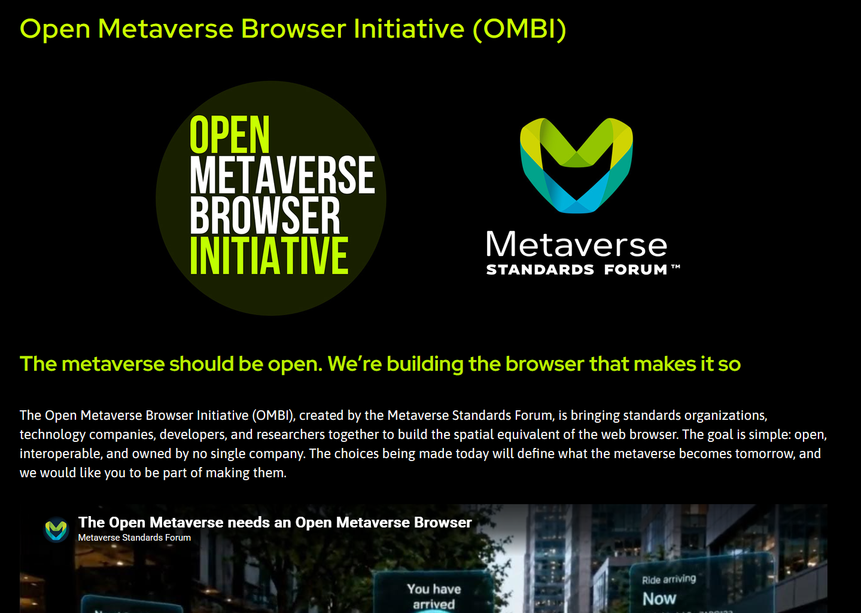
In relation to,,

Slide 11
<model> element proposal
3D asset files are handled in JS of website using WebXR, request to handle these natively in the Web emerged, even without WebXR session.
Conversation held since 2019 to bring 3D assets as native media file in the Web, a new HTML element <model> has been proposed and incubated (partly implemented like in Apple Vision Pro).
Initial idea is to add in parallel to <img> or <video>, with a11y consideration incl. fallback to 2D image, but extended to:
CSS integration with fullscreen capable
Interaction using JS or attribute
Additional features, like autoplay/playback, environment maps

Slide 12
In addition for Web ecosystem...
In parallel to <model> element, penetrating into the Core Web for immersive related presentations.
The Web handled 2D assets, but WebXR and <model> tries to introduce 3D real world into there. Some incubations to extend 2D Web are undergo, such as
CSS Spatial Layout https://webkit.github.io/explainers/css-spatial/explainer.html
  Introduces 3D position into CSS with adding z-axis, instead of z-index
  For full portals into 3D worlds, all expressed in declarative CSS
WebSpatial https://webspatial.dev/
  Spatial context over HTML elements
  https://www.youtube.com/@WebSpatial

Slide 13
CSS Spatial Layout module

Slide 14

Questions?
Contact information are available via QR code
Talk will be available on my YouTube as archive

