Slide 1
MMC Hackathon 2019
December 2019
Hemanshu Waghulde
Deepak Khot
Pankaj Grover
Due Diligence using Artificial Intelligence
Mumbai

Slide 2
Due Diligence using AI
Summary of Idea
Problem Statement
Legacy JLT's Financial Crime Unit and MMC currently under the regulatory obligation need to perform name screening checks and rely on the licensed third party service providers i.e, Refinitiv , Lexus Nexus etc . The name screening identifies the potential risk related to Financial Crimes like ML , ABC , Sanctions etc while on-boarding any client or on existing clients. The current limitation is the Information received about our Clients on third party database is not real time which may lead to FC risk by not identifying the risk well on time and can result in the breach of regulatory obligation or affect the franchise Goodwill.
Solution
An intelligent prediction system built using AI would help as a parallel tool to provide reliable results in real-time. This will make organisation to make firmed decisions and reduce risk in the future.
Business Benefits
Adverse media from regulatory point of view will be more effective i.e. two different system checks are always better than one.
More accurate outcome resulting in less Financial Crime Risk events.
Automation of checks will reduce time taken to complete the scrutiny.
Notes:
Important to understand the differences between SRs and RFCs
Both share the Change Order form in CASD
Service Requests
Category starts Service Request
No formal rules on the workflow
Dates usually not significant
Outside the change policy and procedures
Not managed / owned by Change Management
NOT AUDITED
RFCs
Category does not start Service Request
Comply with change policy 7 procedures
Managed by Change Management
AUDITED

Slide 3
Due Diligence using AI
Our Approach – Classification problem
Manual Approach
Program
Human intervention
Fetch news articles from Google
Dump it to a File
Check if news is valid
Draw a conclusion
AI Approach
Program
Fetch REAL-TIME news articles from TRUSTED/VERIFIED source
Classify the entity based on whether involved in crime
Draw a conclusion
Human Review

Slide 4
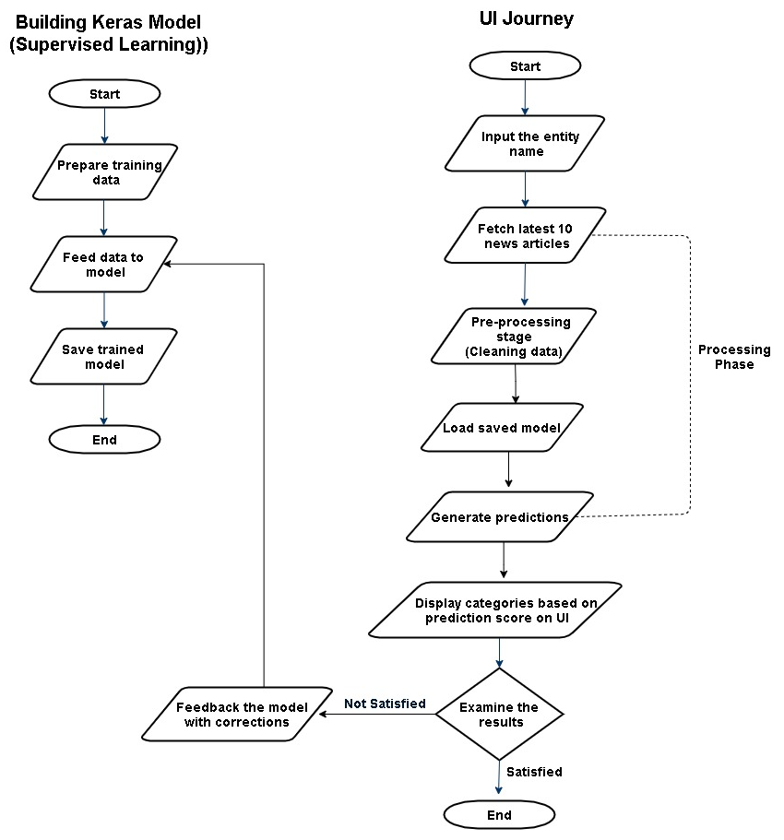
Due Diligence using AI
Flow of the application

Slide 5
Due Diligence using AI
Technologies & Softwares used
Python 3.5 and libraries like NLTK, Scikit learn, NumPy, Pandas, etc.
Django UI Framework (Based on Python)
Deep learning – Keras API
Event Registry(News API)
PyCharm IDE
SQLite3 database
Git repository for version control

Slide 6
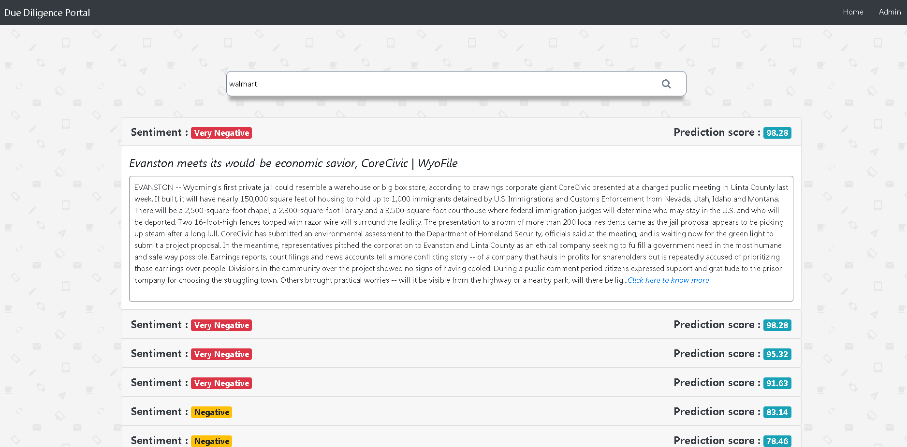
Due Diligence using AI
UI screen with prediction results

Slide 7
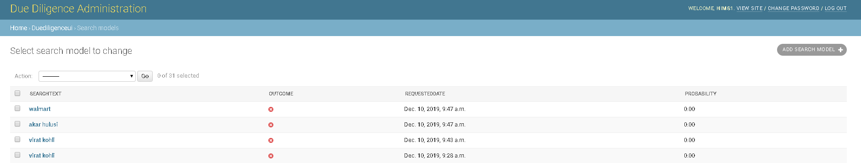
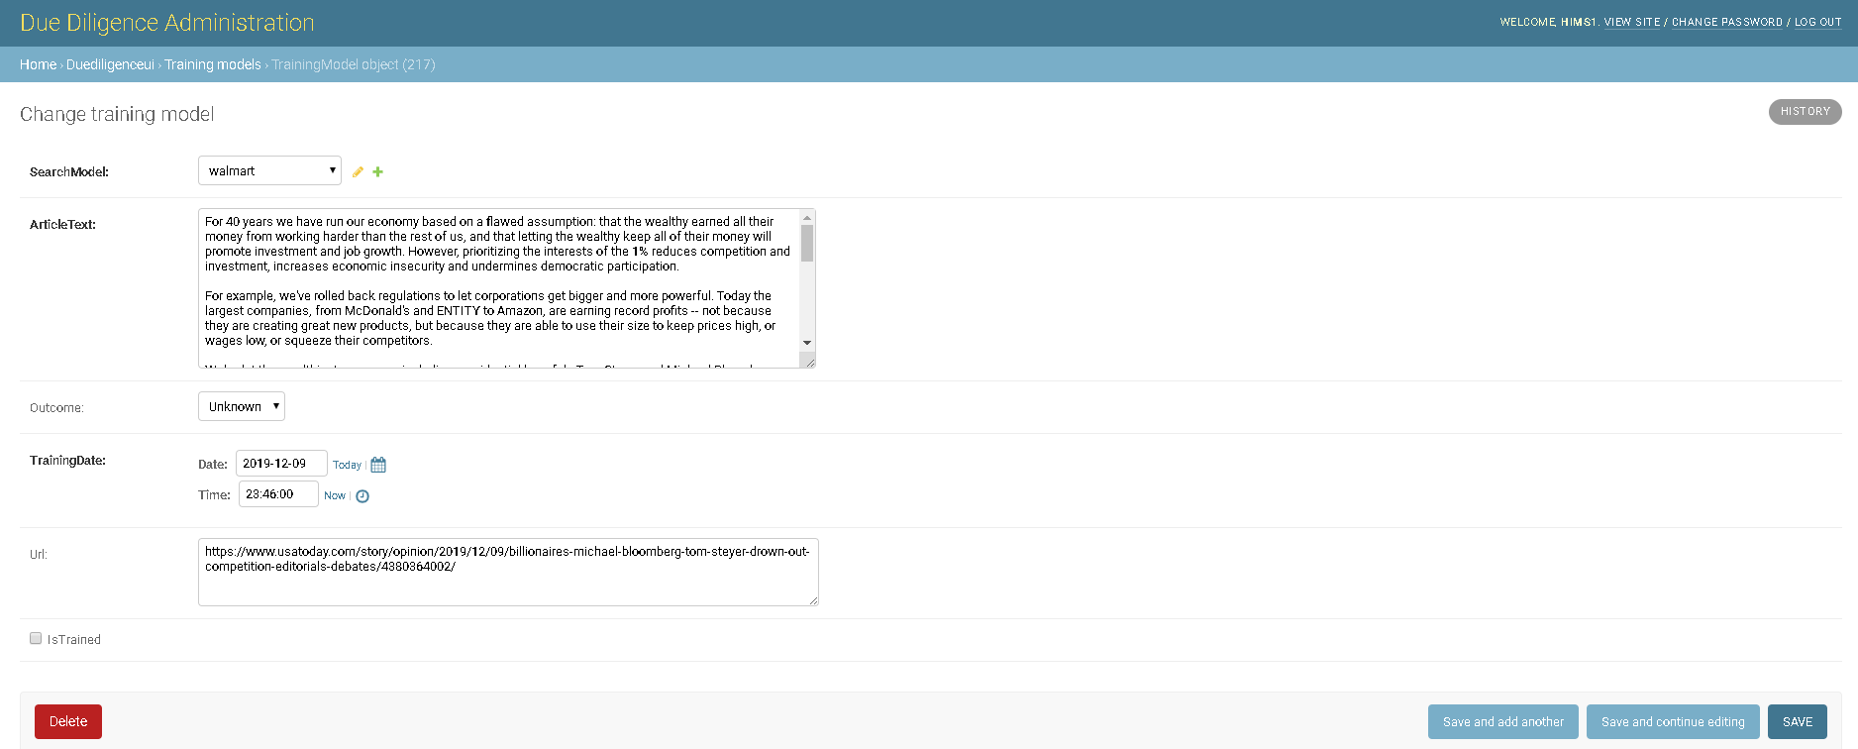
Due Diligence using AI
Admin UI screens

Slide 8

Any Questions?

