Slide 1
Pesticide Residue Analysis
Keen Koalas – Nautical Narwhals
INFM600 – Section 0101

Slide 2
Data
The Pesticides Data Program (PDP) is a national pesticide residue monitoring program implemented by United States Department of Agriculture and it produces the most comprehensive pesticide residue database in the U.S.
Over ten thousand samples of agricultural goods sold in the U.S are tested every year.
The PDP provides sampling and residue testing results data for the years 1992-2014.
Include details such as where and when the samples were collected, the types of processing the products had undergone, the types and amounts of residue, and whether the products had organic or pesticide-free claims.

Slide 3
Target Audience
Health conscious mothers with (young) children in middle-class families with enough money to consider more expensive produce options if they are better for their family. But, who still have budget constraints so they need to make educated and selective decisions.
Perhaps residing in suburban areas with access to health food stores.

Slide 4
Questions
The overall "big" question:
How to make the healthiest but economical choices when purchasing produce for your family and kids, especially if you have younger children who would be more at risk of potential side effects of pesticides? And if more expensive options (organic, premium, etc.) are worth the extra cost in terms of pesticide residue?
We answer the above by looking at the following with pesticide residue testing data from the USDA, focusing on Apples:
What are the most common pesticides found in apples (and the corresponding average concentrations), and have those changed from what they were a decade ago? What about organic apples?
Are there any differences in pesticide types and amounts in apples by variety, where they were from, or when they are labeled as being of a higher grade (Premium, Extra Fancy, etc.)?

Slide 5
Relevance
In 2015, apples were the 2nd most consumed fruit in the US, after bananas (PBH Foundation, 2015).
Apples are frequently ranked #1 on the Dirty Dozen list for pesticide residue.
Pesticides’ effects are greater on children.
Infants and children are more sensitive to the toxic effects of pesticides than adults (NPIC, 2015).
Children often eat and drink more relative to their body weight than adults, which can lead to a higher dose of pesticide residue per pound of body weight (NPIC, 2015).
Affects metabolism and weight.
Endocrine disruptors - Chemical pesticides in food and water have been linked to increased BMI in children and insulin resistance in rodents (Holtcamp, 2012).
Mixtures of different Pesticides may carry additional health risks.
A UCLA study on mixtures of 3 frequently used agricultural fumigants found that the combined effect may be greater resulting in increased cell damage and increased risk of cancer (Wyer, 2016).
Organics are generally much more expensive.
Study in 2015 found organic foods to be 47% more expensive on average (Consumers Report, 2015).

Slide 6
Pesticide Effects
Some possible effects of exposure to pesticides:
Pesticide | Health Effect
Boscalid | Possible carcinogen
Carbendazim | Possible carcinogen
Carbaryl | Carcinogen
Diazenon (organophosphate) | Linked to ADHD
Endosulfan | Endocrine disruptor, neurotoxin
Thiabendazole | Carcinogenic in high doses
Note. Various potential health effects of pesticides from the U.S. Environmental Protection Agency (2015), Colborn et al. (2014), Bouchard et al. (2010).

Slide 7
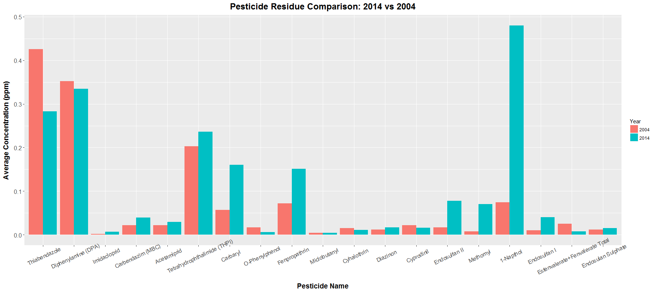
Analysis – 2014 vs 2004

Slide 8
Interpretation – 2014 vs 2004
Only 6 out of 19 pesticides declined in average concentration from 2004 to 2014.
Cyhalothrin, Cyphrodinil, Diphenylamine, Esfenvalerate+Fenvalerate Total, O-Phenylphenol, Thiabendazole
However, all other pesticides have average concentrations that increased from 2004 to 2014.

Slide 9
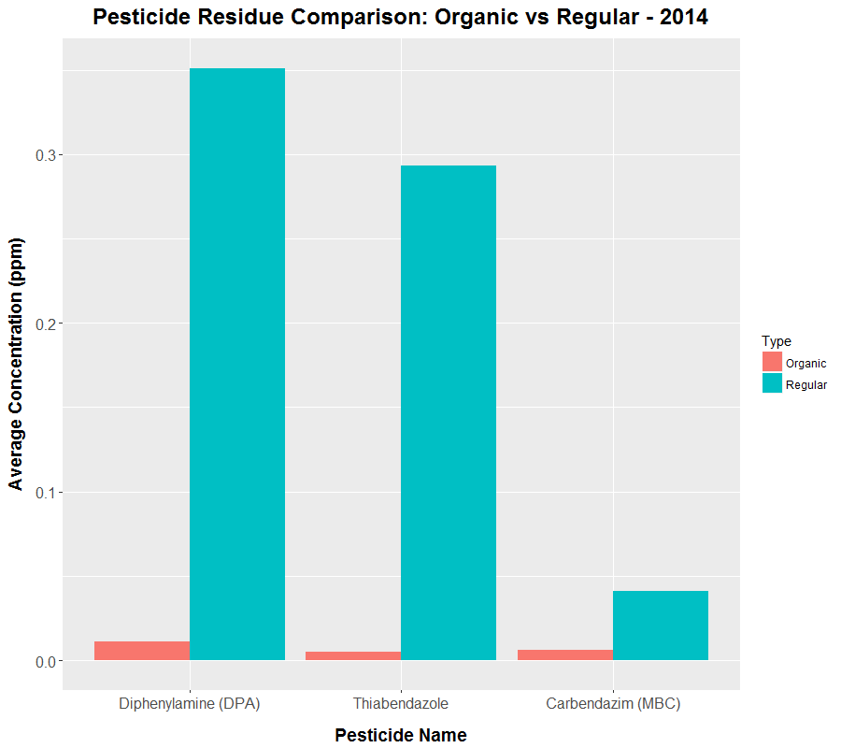
Analysis – Organic vs Conventional
Only 4 kinds of pesticides are detected on organic apples.
3 of which are also found on conventional apples.
43 types of pesticides detected on conventional apples.
Regular apples in 2014 had significantly higher average pesticide concentrations than their organic counterparts.

Slide 10
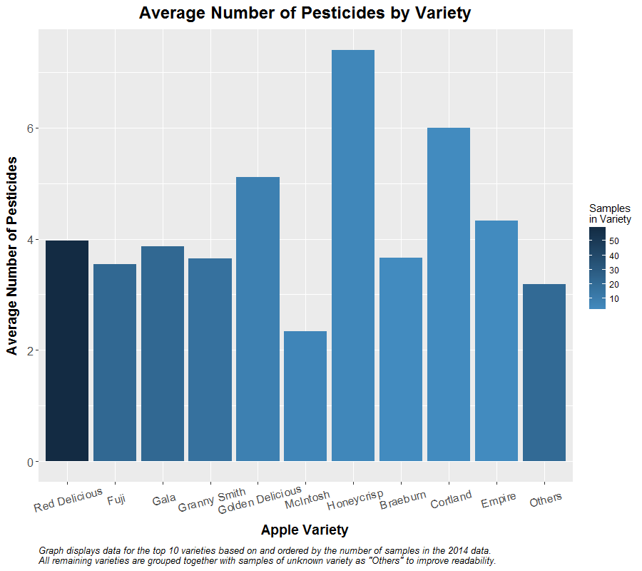
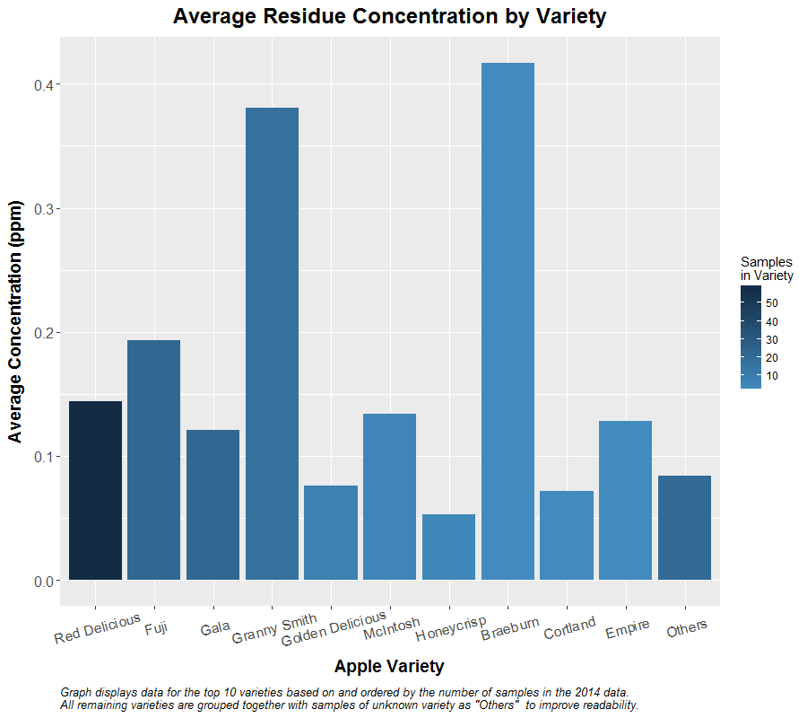
Analysis Results - Varieties

Slide 11
Interpretation - Varieties
Most common apple varieties have an average of around 4 types of pesticide per sample, while Honeycrisp appears to have more per sample (7.4) compared to the other varieties.
Granny smith and Braeburn had the highest average concentrations of the top 10 varieties in 2014 at around 0.4 ppm.
Residue concentration average for Honeycrisp appears to be low at 0.053 ppm.
More types of pesticide but of low concentrations in the batches tested in 2014.
McIntosh apples are potentially a preferable choice for conventional.
Lowest number of pesticides without an exceedingly high average concentration.

Slide 12
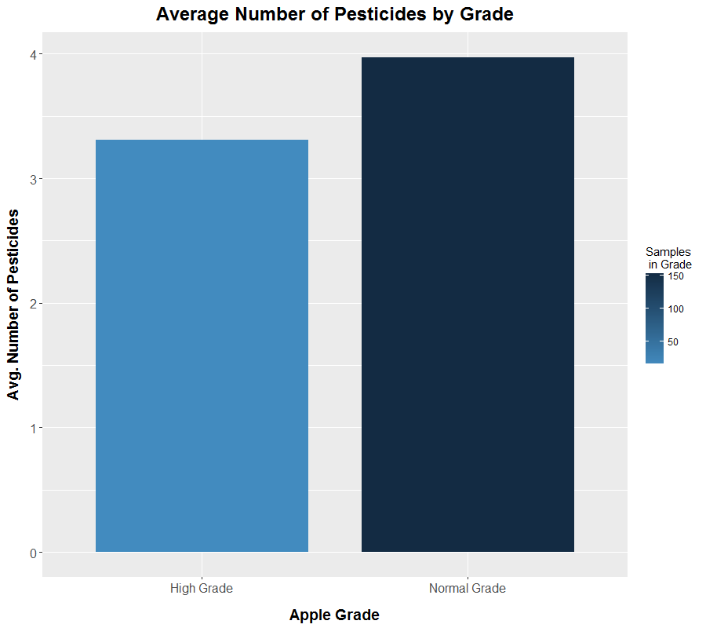
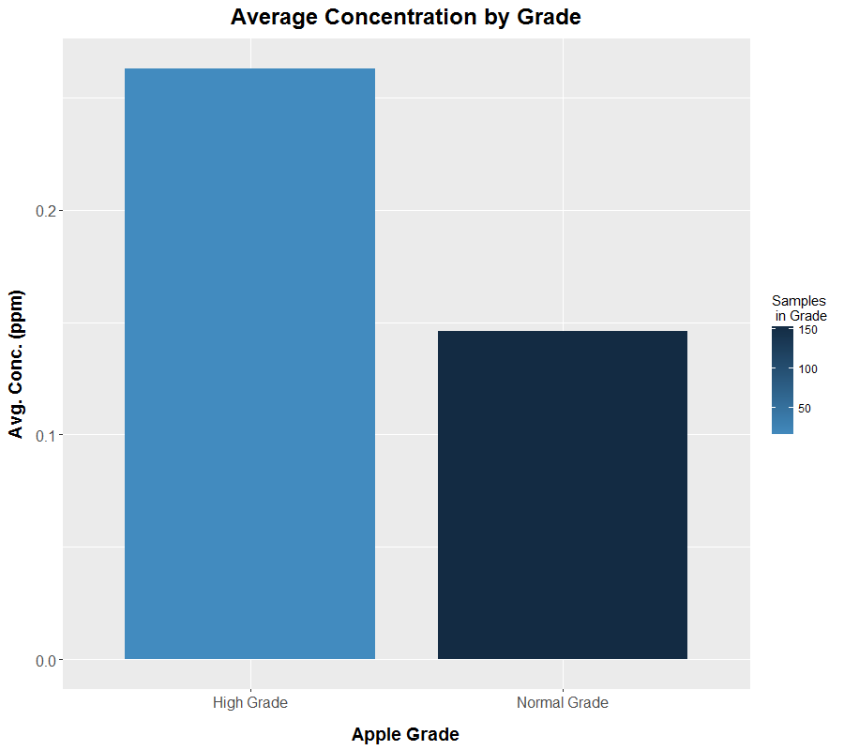
Analysis Results – Premium Grade

Slide 13
Interpretation - Grade
Pesticide concentration levels range between 0.103 and 0.263 parts per million.
Normal grade apples have on average 0.66 more pesticides than high grade apples, but with a significantly lower average concentration (0.146 compared to 0.263 for high grade apples).

Slide 14
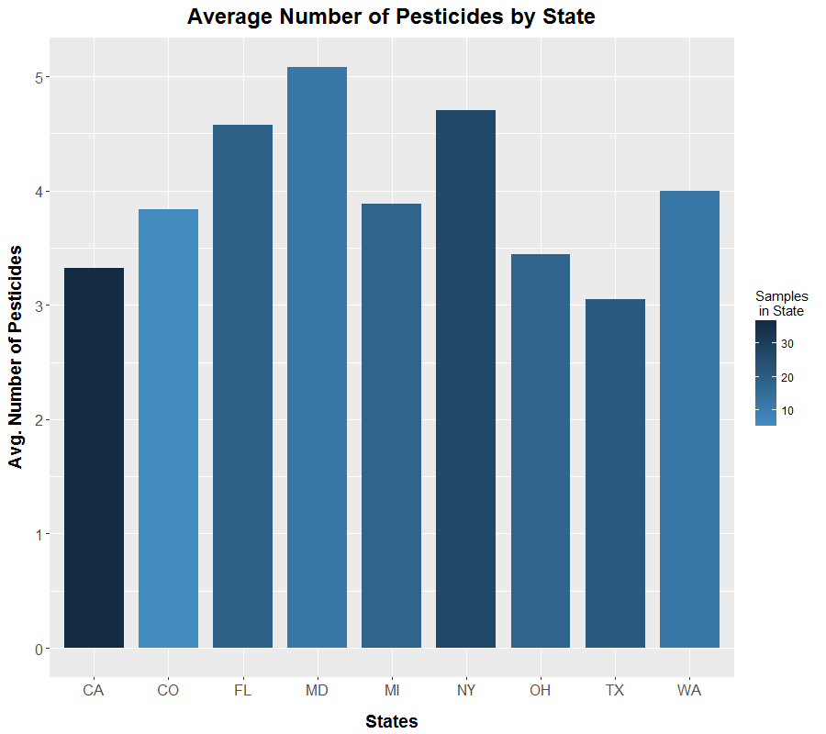
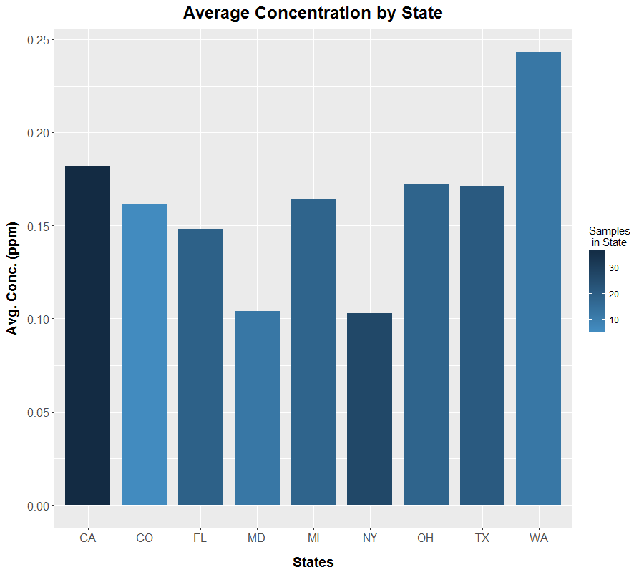
Analysis Results – States

Slide 15
Interpretation - State
Average Pesticide concentration:
Lowest: New York (0.103 ppm)
Highest: Washington (0.243 ppm)
Number of pesticides
Least: Texas (3.048 pesticides)
Most: Maryland (5.083 pesticides)
A weak inverse correlation between the number of pesticides found and the average concentration, with states with more pesticides per sample having a lower average concentration of pesticides. This is not true for all states, however.

Slide 16
Conclusion
While not 100% pesticide-free, organic apples had significantly fewer numbers and average concentrations of pesticides found compared to conventional.
Increase in the average residue concentration from 2004 to 2014 for the majority of pesticides found on samples from both years, indicating possible increased pesticide usage.
Inverse correlation where samples with more pesticide types detected actually had lower average residue concentration.
Apples with high grade labels had a slighter lower average number of pesticides but at almost double the concentration.

Slide 17
Recommendations
Highly recommend purchasing organic produce if the health effects of pesticides is a concern, especially for children consumption.
Avoid premium grade apples due to the much higher average residue concentration.
Common premium grade labels: Fancy, Extra Fancy, Premium
McIntosh apples may be a good variety choice for conventional apples.
Avoid varieties with higher than average numbers of pesticides to avoid potential risks of chemical mixtures.
Honeycrisp & Cortland
Consider avoiding varieties with extremely high average pesticide concentrations.
Granny Smith & Braeburn

Slide 18
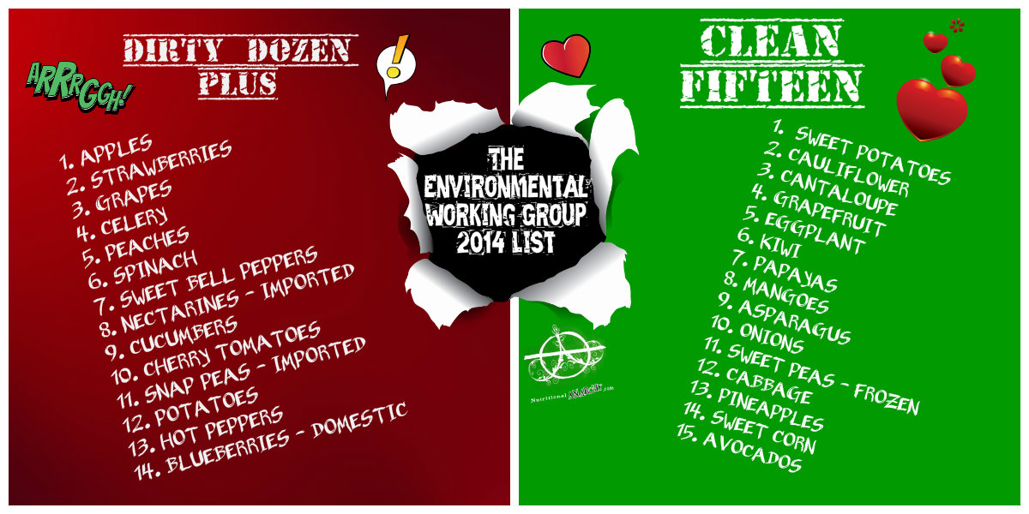
Recommendations – Dirty Dozen+ & Clean 15
Figure 1. Dirty Dozen Collage (Luther, 2014)

Slide 19
References
Bouchard, M. F., Bellinger, D. C., Wright, R. O., & Weisskopf, M. G. (2010). Attention-Deficit/Hyperactivity Disorder and Urinary Metabolites of Organophosphate Pesticides. Pediatrics. Retrieved December 14, 2016, from http://pediatrics.aappublications.org/content/early/2010/05/17/peds.2009-3058
Colborn T., Dumanoski D., Myers J. P. (1997). Our Stolen Future: Are We Threatening Our Fertility, Intelligence and Survival? --A Scientific Detective Story. New York, NY: Plume.
Consumers Report. (2015). The cost of organic food. Retrieved December 13, 2016, from: http://www.consumerreports.org/cro/news/2015/03/cost-of-organic-food/index.htm
Holtcamp, W. (2012). Obesogens: An Environmental Link to Obesity. Environmental Health Perspectives, 120(2): a62–a68. doi: 10.1289/ehp.120-a62
Luther, D. (2014). The Good, the Bad, and the Deadly: EWG Releases 2014 Dirty Dozen and Clean Fifteen Lists. Retrieved December 13, 2016, from: http://www.nutritionalanarchy.com/2014/04/30/the-good-the-bad-and-the-deadly-ewg-releases-2014-dirty-dozen-and-clean-fifteen-lists/
National Pesticide Information Center (NPIC). (2015). Pesticides and Children. Retrieved December 13, 2016, from: http://npic.orst.edu/health/child.html
Produce for Better Health Foundation. (2015). State of the Plate, 2015 Study on America’s Consumption of Fruit and Vegetables. [PDF document]. Retrieved December 13, 2016, from: http://www.pbhfoundation.org/pdfs/about/res/pbh_res/State_of_the_Plate_2015_WEB_Bookmarked.pdf
United States Department of Agriculture, Agricultural Marketing Service. (2016). PDP Databases, 1992-2014. [ZIP archives with data files]. Retrieved September 9, 2016, from: https://www.ams.usda.gov/datasets/pdp/pdpdata
U.S. Environmental Protection Agency. (2015). Annual Cancer Report 2015. [PDF document]. Retrieved December 14, 2016, from http://npic.orst.edu/chemicals_evaluated.pdf
Wyer, K. (2016). Pesticide mixtures may increase health risks but are still unregulated by California. Retrieved December 11, 2016, from: https://www.sciencedaily.com/releases/2016/02/160217145936.htm

