Slide 1
GCP Hackathon
GOOGLE CLOUD VISION-API
(Reunion 2.0)
Himanshu Sharma,
Sumit jangir

Slide 2
Vision-API
Google Cloud Vision API enables developers to understand the content of an image by encapsulating powerful machine learning models in an easy to use REST API. It quickly classifies images into thousands of categories (e.g., "sailboat", "lion", "Eiffel Tower"), detects individual objects and faces within images, and finds and reads printed words contained within images. You can build metadata on your image catalog, moderate offensive content, or enable new marketing scenarios through image sentiment analysis. Analyze images uploaded in the request or integrate with your image storage on Google Cloud Storage
Insight From Your Images-
Easily detect broad sets of objects in your images, from flowers, animals, or transportation to thousands of other object categories commonly found within images. Vision API improves over time as new concepts are introduced and accuracy is improved.

Slide 3
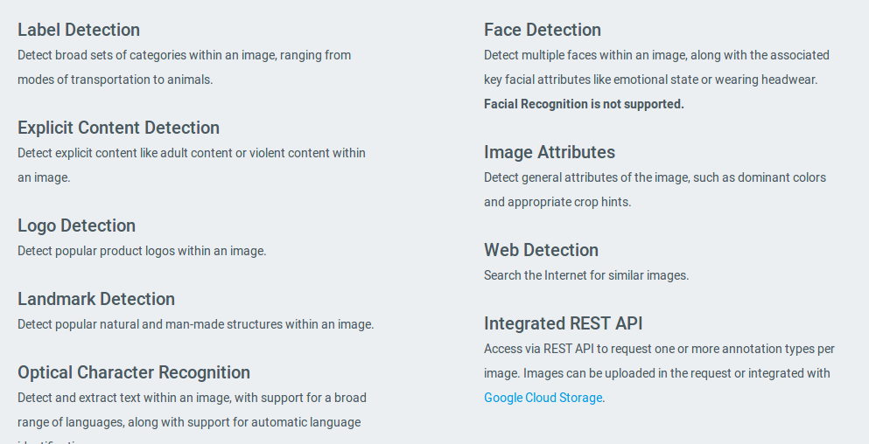
Detect Inappropriate Content-
Powered by Google SafeSearch, easily moderate content from your crowd sourced images. Vision API enables you to detect different types of inappropriate content from adult to violent content.
Those things were succesfully integrated in the given cloud vision api.Due
To this API image recognization,text filtering ,font logo detections are solved.GoogleCloud Vision-Api provides functionality to achieve these stuffs.

Slide 4
During the creation of Cloud Vison-api,first we have to make a account an account of Google Cloud Platform,after the signing in we have to enable the cloud vision API ,after that using Python scripting language we can create
A script to call the Vision API.
First we have to make a oauthetication ,using the credentials of serivce key
Which will be used to grant a permission during the callback url.As the oauthentication done ,the script will load the cloud vision api and send the given image as object to call the vision api,and it will load the json file
And we can easily get the parameters required to print the information regarding the image we passed as object to the given file
So basically we require the knowlegde about the api calling in Python3.0
And JSON to get the image annalysis
Technology/GCP Stack

Slide 5

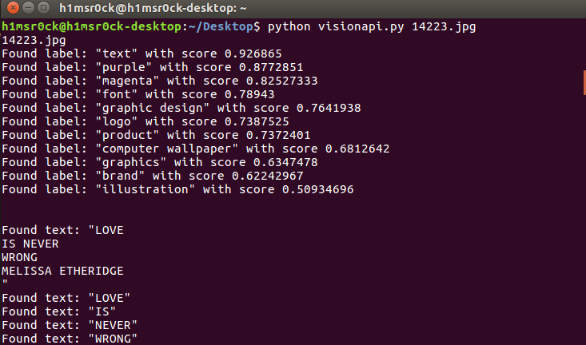

Slide 6
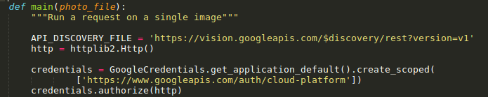
Challenges faced-
During the creation of the vision-api,we faced the problem regarding the scripting error and some libarary error of oauth2client and issues regarding the
Credentials of the service key,we have to generate the JSON file of service key
So as to get the proper login credentials of Cloud vision-api.When we get the credentials we have to create the object in order to check the credentials.
Proper function to check the credentials-

Slide 7
As we have a created the scripted file of python to call the vision-api we can
Easily transfered these file into the .exe and then connect it to the any front end we have
Using .net or android studio then we can easily connect that front end to backend to get the required application to call the vision-api of google cloud.
As these is all about the knowledge of python and json we can also create this script using other languages like JS,GO,PHP etc. ,so as to call the required API in diffrenet form.
We can also create the .CSV file using python so as to store the output of the given API in these file.keen knowlegde of the python library will help you to create such things.So basically my whole idea is Implemented in python.
Calling the vision api in order to get the annalysis of the image.
Possible Improvement -

Slide 8



