Slide 1

Panchaayat
India's public record for consumer resolutions —
and case management SMEs can trust
Investor & Partnership Pitch • 2026

Slide 2
The Problem
Fragmented complaints. No accountability. No closed loop.
🧩
🚫
📥
🔍
Fragmented
No Proof
Lost Queries
No Track Record
Reviews, complaints & grievances scattered across silos
Brands self-mark issues 'resolved' with no verification
SMEs bury customer queries in shared email inboxes
Consumers can't see a brand's real resolution history
"I complained. They said 'resolved'. Nothing changed."
Existing options (Google Reviews, NCH, MouthShut) never close the loop with the actual affected consumer.
Panchaayat — Confidential • 2026

Slide 3
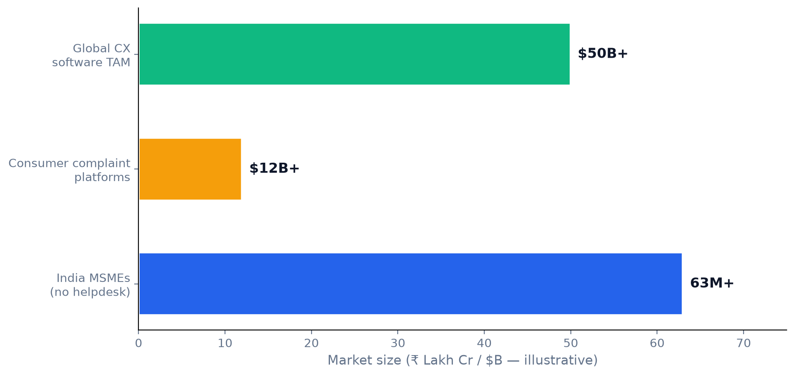
Market Opportunity
India-first: huge consumer economy + underserved SME support
Wedge: rank on '[Brand] complaints' SEO + affordable SME SaaS vs. Zendesk / Freshdesk
Panchaayat — Confidential • 2026

Slide 4
The Solution
One platform — public reputation + private case management
Public
Complaints
Brand
Profiles
Panchaayat
Hub
SME Case
Management
AI + API
Layer
Make it visible. Get it resolved. Verified by you.
Panchaayat — Confidential • 2026

Slide 5
How It Works
Consumer-confirmed resolution — our core differentiator
1
2
3
4
5
Share
post + evidence
Discuss
community + Me Too
Respond
brand replies
Propose
refund / fix
Confirm
only YOU close it
Brands cannot unilaterally close a complaint.
The full, immutable resolution history stays public forever — that is the trust moat.
Panchaayat — Confidential • 2026

Slide 6
Product — MVP is Live
Full-stack platform, deployed and demo-ready
✍
🔎
📊
🔁
Complaint Wizard
Smart Search
Brand Dashboard
Resolution Loop
AI draft + quality check
NL queries + synonyms
KPIs + complaint inbox
propose → confirm
📰
🎯
🏷
🤖
Public Feed
Contextual Ads
B2B Pages
AI Layer
trending + resolved
AI targeting, no bias
pricing + API docs
Azure GPT + fallbacks
Live Demo
github.com/himsinghvi/panchayat • login admin / demo123 • 8 personas · 6 brands · seeded cases
Panchaayat — Confidential • 2026

Slide 7
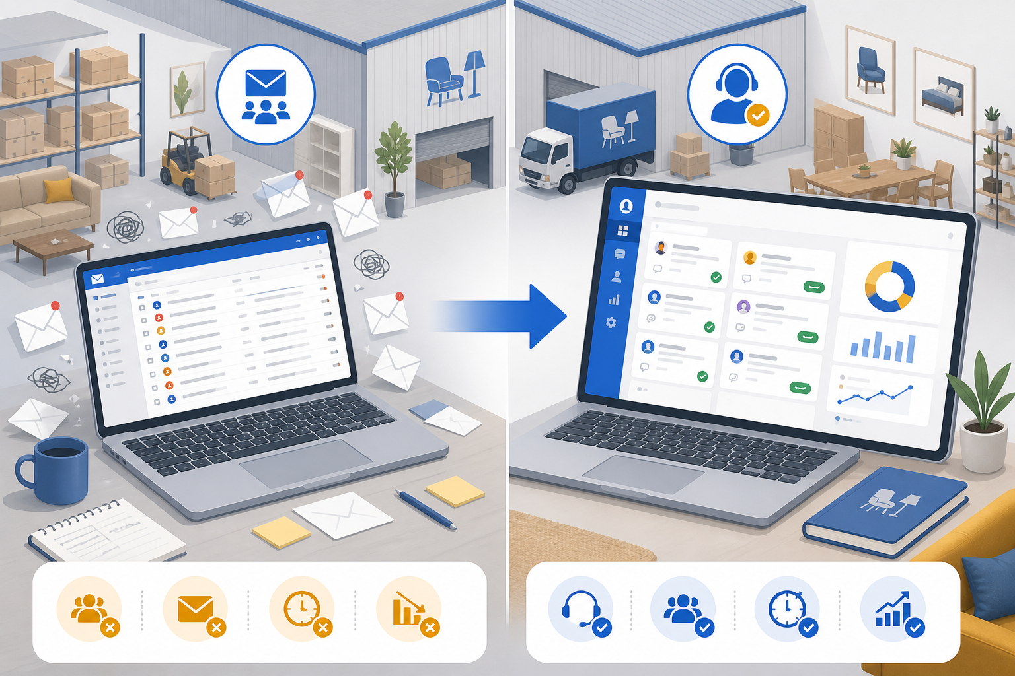
For Business
Turn a chaotic inbox into a case-management system
🌐
Branded page panchaayat.in/yourbrand
✉
2-way email → case sync
🆔
Case ID, status & owner on every query
🔒
Private by default; public escalation if ignored
📈
CSAT / NPS + SLA dashboards
🎁
14-day free trial, cancel anytime
Panchaayat — Confidential • 2026

Slide 8
SaaS Pricing
Simple, affordable plans for SMEs & MSMEs
MOST POPULAR
Startup
Scale-up
Enterprise
₹1,999/mo
₹3,999/mo
₹5,999/mo
✓ 150 cases / mo
✓ 1 seat
✓ Branded page
✓ Email + SMS
✓ Unlimited cases
✓ 10 seats
✓ Email → case sync
✓ CSAT + social
✓ Full REST API
✓ White-label
✓ AI triage
✓ Unlimited seats
All plans: no setup fee • 30-day money-back • GST invoice
Panchaayat — Confidential • 2026

Slide 9
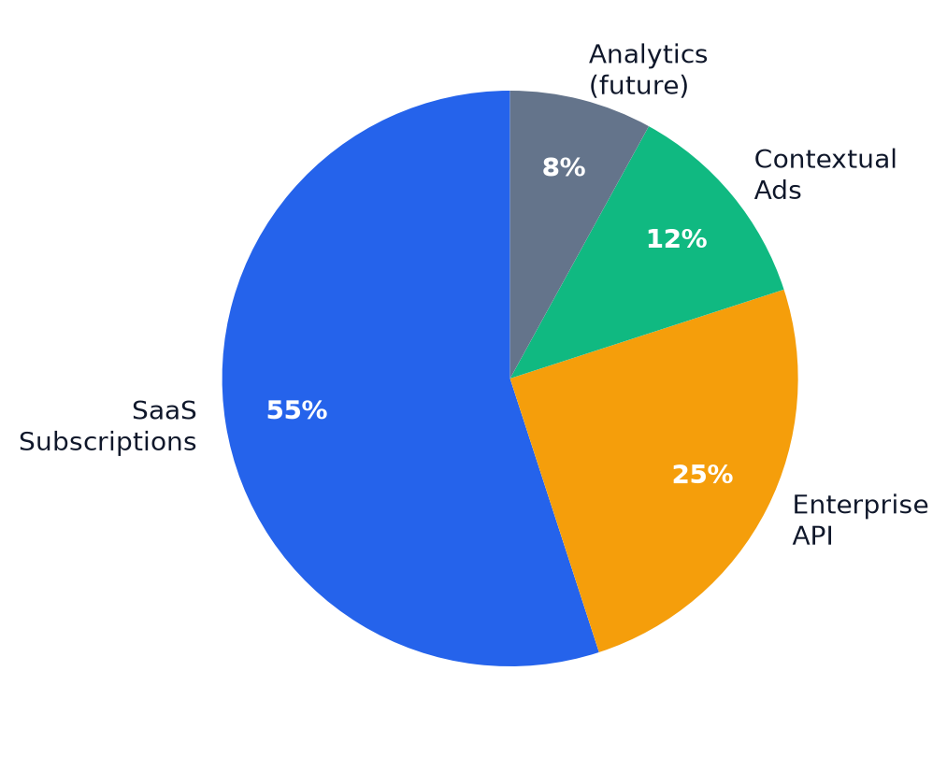
Business Model
Trust-first monetization
SaaS subscriptions
primary revenue — Startup → Enterprise
Enterprise API & white-label
banks, insurers, telcos
Contextual ads
legal aid, warranty, refund tools — never bias complaints
Verified analytics (future)
trends, benchmarks, researcher API
✗ We never let brands pay to remove complaints
Panchaayat — Confidential • 2026

Slide 10
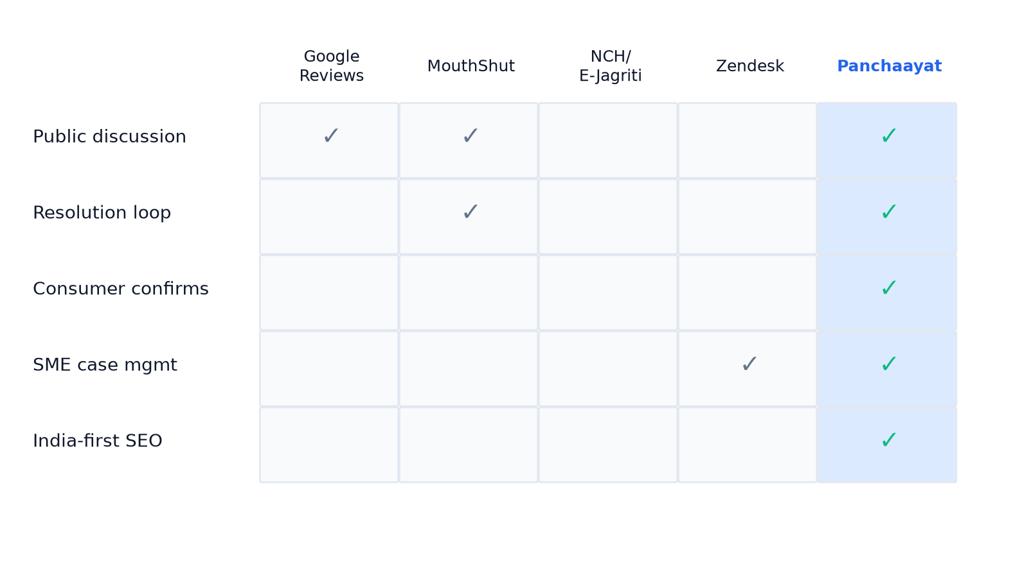
Competitive Landscape
No incumbent owns the full resolution loop
Panchaayat — Confidential • 2026

Slide 11
Go-to-Market
Hyper-local density → national scale
Phase 1
Seed Pune / Hyderabad
with demo brands
Phase 2
SEO: '[Brand] complaints'
organic traffic
Phase 3
SME outbound —
D2C & appliances
Phase 4
Enterprise API —
banks & insurers
🔥
Viral growth via Me Too, trending & recently-resolved feeds
🎁
14-day free trial converts SMEs; email-sync lock-in reduces churn
🏛
Roadmap: partner with NCH / E-Jagriti for escalations
Panchaayat — Confidential • 2026

Slide 12
Traction & KPIs
Where we are today — and what we measure
MVP
8
6
3
Live & deployed
Demo personas
Seeded brands
SaaS tiers
North-star metrics we will report to investors
⏱
Brand response < 7 days
✅
Consumer-confirmed resolution %
📉
Median time-to-resolution
💳
SME trial → paid conversion
Panchaayat — Confidential • 2026

Slide 13
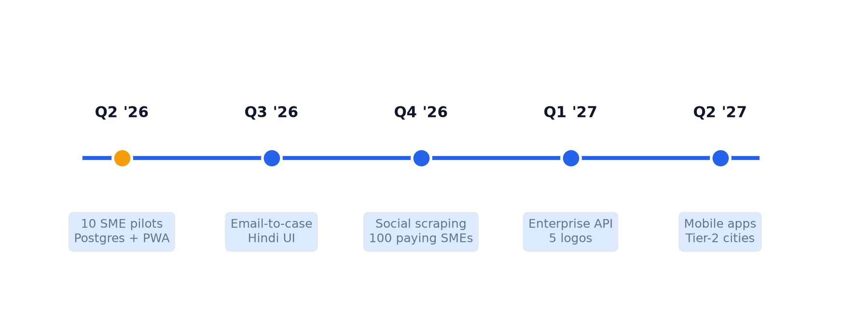
Roadmap
12–18 month product & GTM plan
Panchaayat — Confidential • 2026

Slide 14
Risks & Mitigations
Honest assessment for investors
Defamation
ToS, evidence requirement, takedown & appeal process
Fake reviews
Verified-purchase signal + moderation queue
Cold start
Hyper-local seeding + SEO complaint pages
Brand apathy
Public pages rank on Google for '[brand] complaints'
SME churn
Email-sync lock-in + 30-day money-back guarantee
Panchaayat — Confidential • 2026

Slide 15
The Ask
₹[X] Cr Seed Round
Customize this figure before presenting
Use of funds
40% GTM & Sales • 30% Engineering • 20% Ops & Legal • 10% Buffer
12-month milestones
100 paying SMEs • 10K MAU • 1 enterprise pilot
Customize funding amount & milestones before investor meetings

Slide 16
Thank You
Make it visible. Get it resolved.
Demo: [your-vercel-url].vercel.app
GitHub: github.com/himsinghvi/panchayat
Email: [founder@email.com]
Questions?

