Slide 1

Panchaayat
India's public record for consumer resolutions — and case management SMEs can trust
Investor & Partnership Pitch

Slide 2
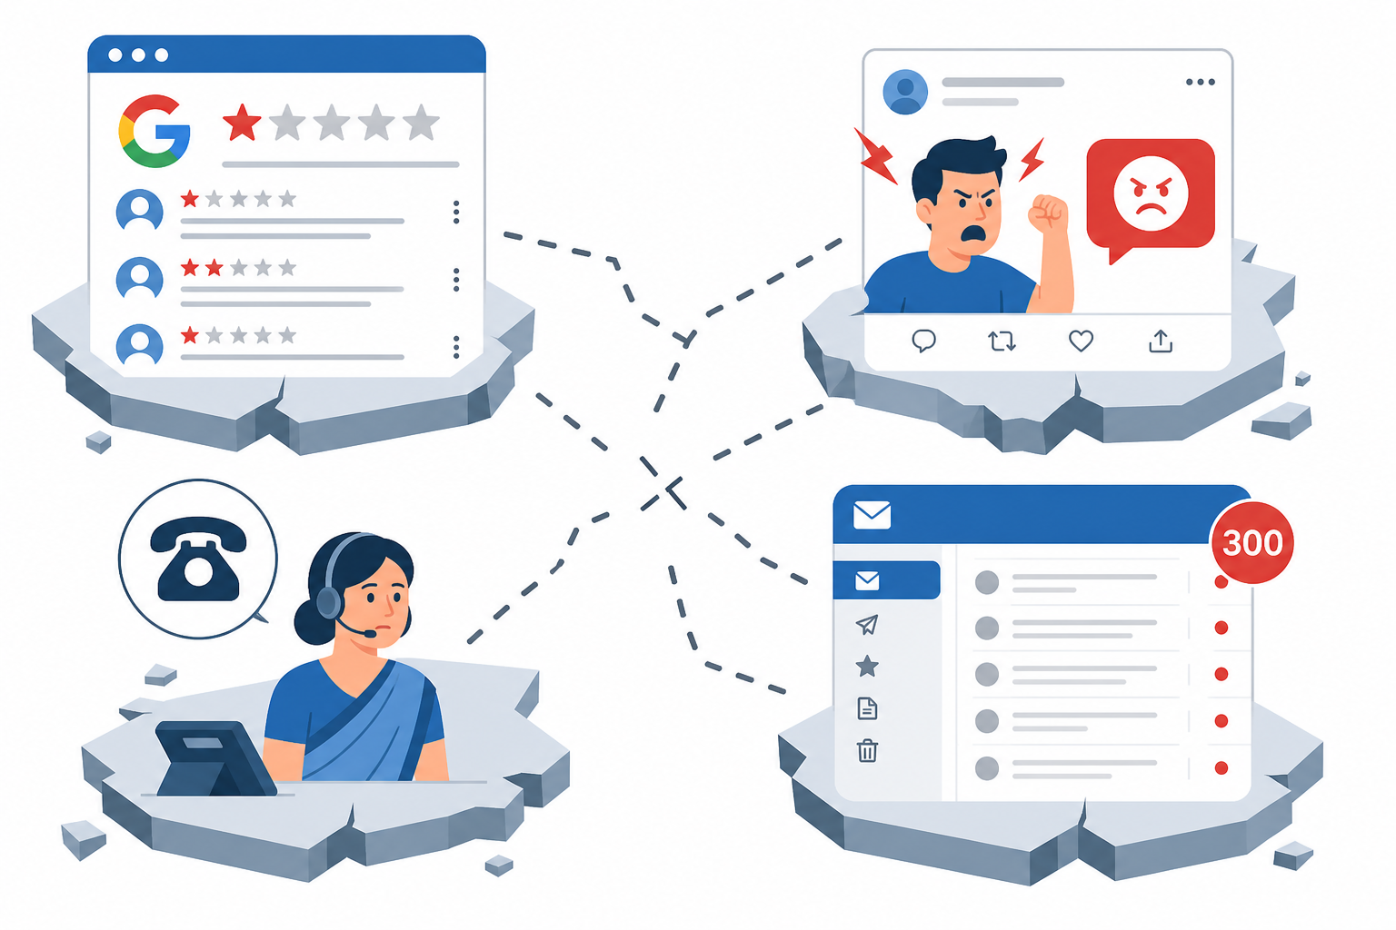
The Problem
Fragmented complaints. No accountability. No closed loop.
• Reviews, complaints & grievances live in silos
• Brands self-mark issues 'resolved' without proof
• SMEs lose queries in shared email inboxes
• Consumers can't see real resolution track records
Panchaayat — Confidential | 2026

Slide 3
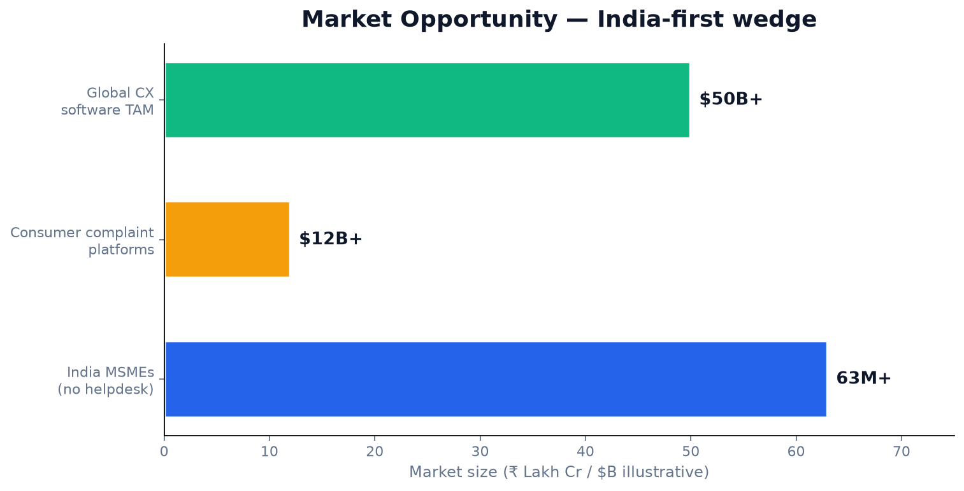
Market Opportunity
India-first — massive consumer economy + underserved SME support
Wedge: SEO on '[Brand] complaints' + affordable SME SaaS vs. Zendesk/Freshdesk
Panchaayat — Confidential | 2026

Slide 4
The Solution
One platform — public reputation + private case management
Public Complaints
Brand Profiles
Panchaayat Hub
SME Case Management
AI + API Layer
Make it visible. Get it resolved. Verified by you.
Panchaayat — Confidential | 2026

Slide 5
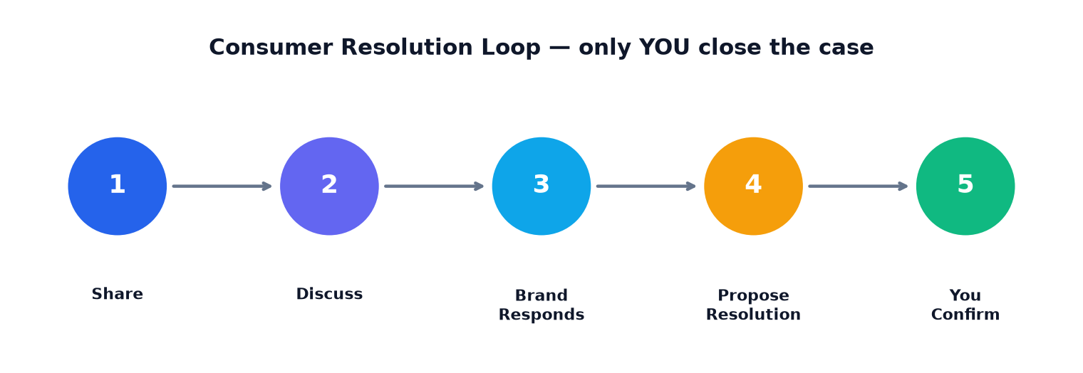
How It Works
Consumer-confirmed resolution — our core differentiator
• Guest or registered users post with evidence
• Community discusses; Me Too builds pressure
• Brands respond officially on the public record
• Only the original consumer can close the case
Panchaayat — Confidential | 2026

Slide 6
Product — MVP Live
Full-stack platform deployed and demo-ready
Complaint Wizard
AI draft & quality check
Smart Search
NL queries + synonyms
Brand Dashboard
KPIs + inbox
Resolution Loop
Propose → confirm
Public Feed
Trending + resolved
Admin + Ads
AI targeting
B2B Pages
Pricing + API docs
Themes
Dark / light mode
Live Demo
github.com/himsinghvi/panchayat • Login: admin / demo123 • 8 personas, 6 brands, seeded complaints
Panchaayat — Confidential | 2026

Slide 7
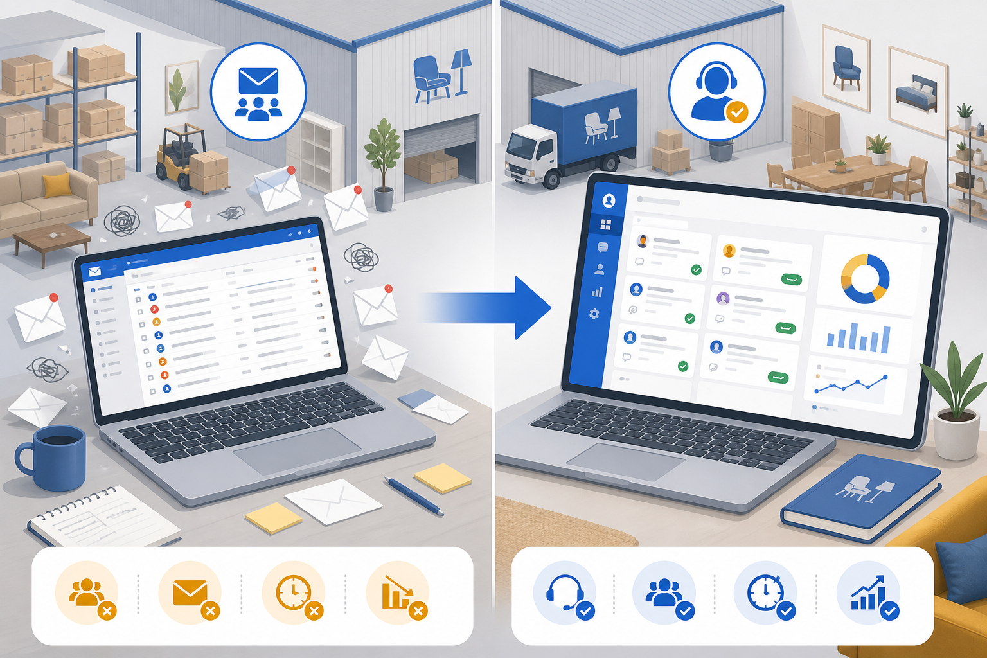
B2B — For Business
Turn your inbox into a case management system
• Branded page: panchaayat.in/yourbrand
• 2-way email-to-case sync
• Case ID, status, owner for every query
• Private by default; public escalation if unresolved
• CSAT/NPS + SLA dashboards
• 14-day free trial
Panchaayat — Confidential | 2026

Slide 8
SaaS Pricing
Simple plans for SMEs and MSMEs
MOST POPULAR
Startup
₹1,999/mo
✓ 150 cases/mo
✓ 1 seat
✓ Branded page
✓ Email + SMS
Scale-up
₹3,999/mo
✓ Unlimited cases
✓ 10 seats
✓ Email sync
✓ CSAT + social
Enterprise
₹5,999/mo
✓ Full API
✓ White-label
✓ AI triage
✓ Unlimited seats
Panchaayat — Confidential | 2026

Slide 9
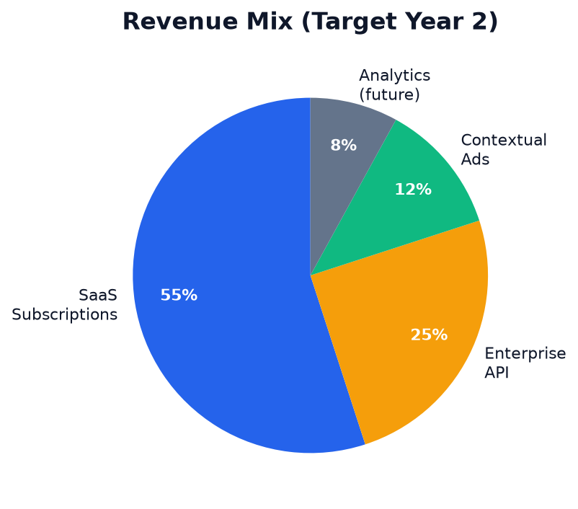
Business Model
Trust-first monetization
• SaaS subscriptions — primary revenue (Startup → Enterprise)
• Enterprise API & white-label — banks, insurers, telcos
• Contextual ads — legal aid, warranty, refund tools (never bias complaints)
• Future: verified analytics, researcher API
• Explicitly avoided: pay-to-remove complaints
Panchaayat — Confidential | 2026

Slide 10
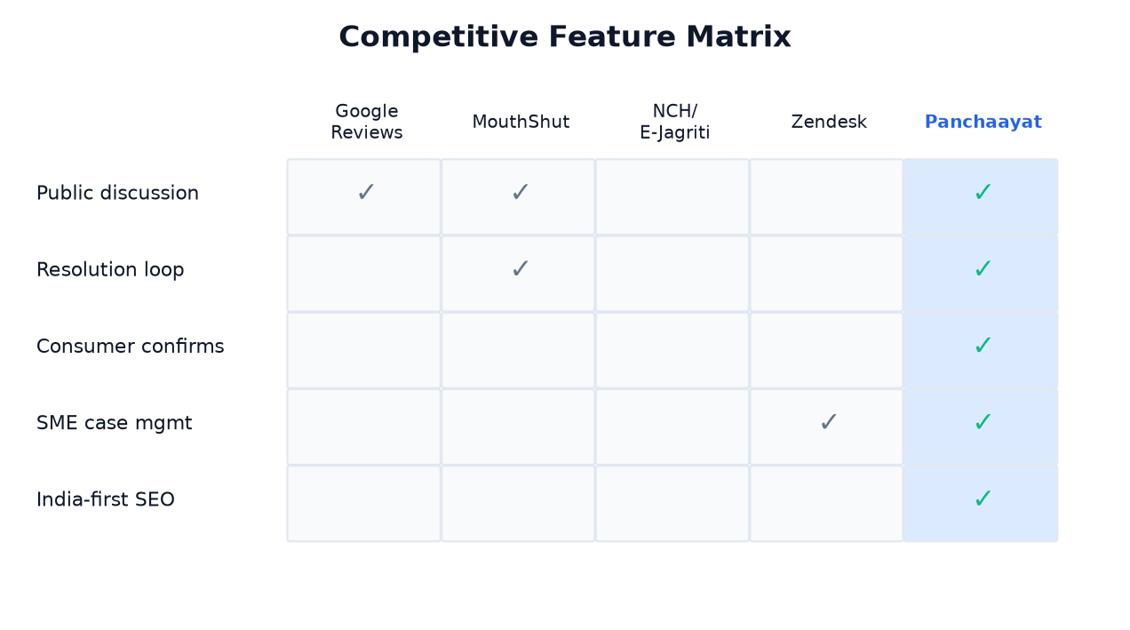
Competitive Landscape
No incumbent owns the full resolution loop
Panchaayat — Confidential | 2026

Slide 11
Go-to-Market
Hyper-local density → national scale
Phase 1
Seed Pune/Hyderabad with demo brands
Phase 2
SEO: [Brand] complaints organic traffic
Phase 3
SME outbound D2C & appliances
Phase 4
Enterprise API banks & insurers
• Community growth via Me Too, trending feed, recently resolved
• 14-day free trial for business accounts
• Partnerships with consumer bodies (NCH, E-Jagriti) in roadmap
Panchaayat — Confidential | 2026

Slide 12
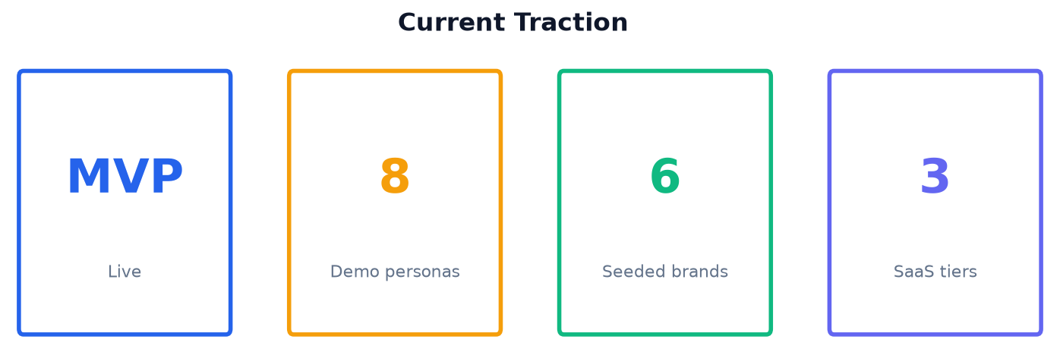
Traction & KPIs
Where we are today — what we measure
Brand response < 7 days
North-star
Consumer-confirmed resolution %
North-star
Median time-to- resolution
North-star
SME trial → paid conversion
GTM
Panchaayat — Confidential | 2026

Slide 13
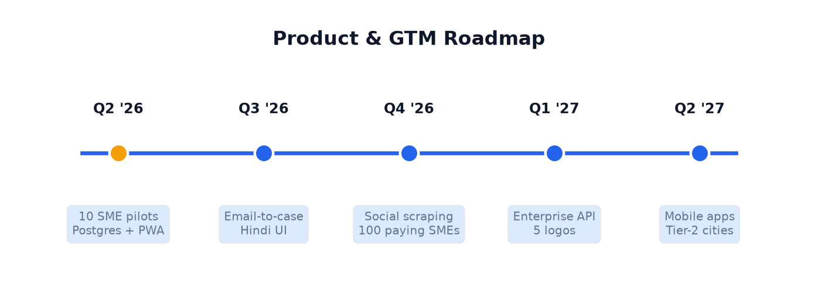
Roadmap
12–18 month product & GTM plan
Panchaayat — Confidential | 2026

Slide 14
Risks & Mitigations
Honest assessment for investors
Defamation
→ ToS, evidence reqs, takedown process
Fake reviews
→ Verified purchase, moderation queue
Cold start
→ Hyper-local seeding, SEO pages
Brand incentive
→ Public pages rank on Google
SME churn
→ Email sync lock-in, 30-day guarantee
Panchaayat — Confidential | 2026

Slide 15
The Ask
₹[X] Cr Seed Round
Customize before presenting
40% GTM & Sales
30% Engineering | 20% Ops & Legal | 10% Buffer
12-mo Milestones
100 paying SMEs • 10K MAU • Enterprise pilot
Customize funding amount before investor meetings

Slide 16
Thank You
Make it visible. Get it resolved.
Demo: [your-vercel-url].vercel.app
GitHub: github.com/himsinghvi/panchayat
Email: [founder@email.com]
Questions?

