Slide 1
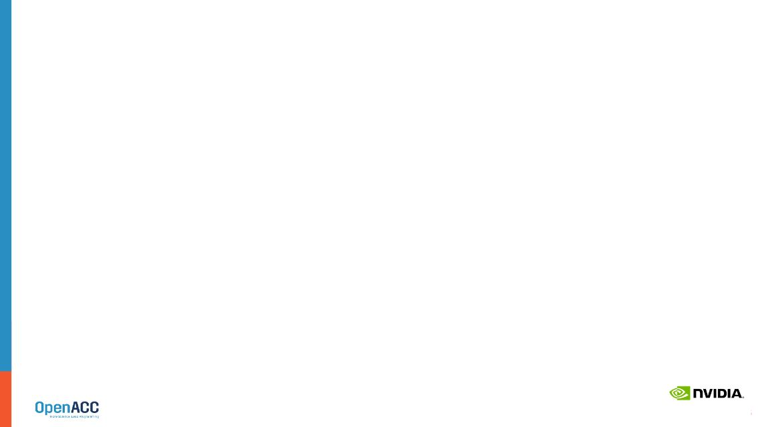



India Agentic AI Open Hackathon
TEAM NAME: Team VirtualTwin
CHOSEN TRACK: Track A: Agentic Workflows

Slide 2
Contents:
Team Introduction & Skillset
AI Use Case: NemoClaw Virtual Twin Companion
Tech Stack & Implementation Strategy
Roadmap & Overcoming Limitations

Slide 3
TEAM INTRODUCTION
SKILLSET / EXPERIENCE

Slide 4
Skillset / Experience
Organization Details: Enterprise PLM Professionals (Independent Participation).
Agentic AI & Tools Skillset:
Extensive domain expertise in CATIA, 3DEXPERIENCE, and complex engineering product lifecycles.
Strong background in software quality engineering, Java microservices architecture, and API integration.
Experience architecting AI review frameworks, Model Context Protocol (MCP) servers, and managing strict YAML-based infrastructure configurations for agentic tools.
Current AI Deployment Setup: Utilizing Claude/GPT models via API for codebase analysis, context engineering (Parent-Child models), and RAG pipeline development.
NVIDIA SDK Experience: Currently familiarizing with the NeMo Agent Toolkit and NemoClaw runtime for secure, sandboxed agent execution.
Past Hackathon Experience: [Insert any past hackathon wins or participations here, or remove if none].

Slide 5
AI Use Case
Expand on your project

Slide 6
AI Use Case: NemoClaw Virtual Twin Companion (VTC)
Parametric Drone Optimizer
TRACK | A
Project Description: A multi-agent engineering assistant that ingests natural language specifications (e.g., thrust load, max weight). An Orchestrator routes tasks to a Design Agent (modifies a parametric CadQuery Python script for an X-Frame drone) and a Validator Agent (evaluates outputs against a RAG compliance database). The system iterates autonomously to meet safety margins, outputting a manufacturing-ready .STEP file.
Project Motivation: Industrial design is bottlenecked by manual geometry updates and decoupled compliance checks. Drawing from our PLM background, we aim to demonstrate a deterministic "Virtual Companion" that bridges text-based AI reasoning with exact, executable 3D math, preventing the spatial hallucinations common in standard LLMs.
Dataset for Training & Inferencing:
Existing/Planned: A synthetic JSONL dataset mapping natural language engineering prompts to specific Python parametric variable configurations (our "Master Drone Template").
Scale: ~1,000 high-quality instruction-code pairs for fine-tuning; lightweight RAG corpus of aerospace manufacturing standards (PDFs).
License: Open-source (MIT/Apache 2.0) for CadQuery code, and open data licenses for standard engineering reference manuals.
Results Achieved: Core multi-agent architecture and YAML-based agent execution configurations mapped out. Local proof-of-concept for the Python CadQuery geometry generation established.
Notes:
Teams are recommended to be as much descriptive as possible and highlight the methodology clearly. Teams are recommended to expand on this topic and use as many slides as you prefer.

Slide 7
Tech Stack
Strategy for building/improving your project

Slide 8
Tech Stack & Implementation Strategy
Track: Track A (Agentic Workflows)
Prior Experience: RAG pipeline development, automated QA optimization, and context-aware LLM tool routing.
Tools Planned: LangGraph/AutoGen (Orchestration), CadQuery (Headless CAD execution), Streamlit/PyVista (UI/3D Viewer), Java (Backend microservices).
NVIDIA SDKs & Tools:
NemoClaw: Core secure runtime for sandboxed execution of Python CAD scripts.
NeMo Agent Toolkit: Orchestration, state management, and Guardrails.
NVIDIA NIM: Fast inference for Nemotron models.
Nemotron Embed: For the RAG compliance database.
Model Training: Yes (Parameter-Efficient Fine-Tuning / LoRA on DGX hardware).
Differentiation: We avoid asking an LLM to generate 3D meshes directly. Our agents generate deterministic Python code that compiles into exact BREP geometry. We enforce compliance through a strict, QA-inspired "Validator Agent" loop.
Potential Bottlenecks: Agent routing loops (infinite iteration if constraints are too tight), execution latency during repetitive geometry compilations, and prompt-drifting.

Slide 9
Road Map
Ideas for further improvement of the solution.

Slide 10
Roadmap & Strategic Plan
Areas for Mentor Support:
Executing a highly efficient PEFT/LoRA fine-tuning job on Nemotron using the provided DGX hardware during the Bangalore finals.
Optimizing NemoClaw sandbox security policies for safe Python script execution.
Long Term Goals: Expand the Master Template concept to full parametric assemblies. Integrate the pipeline with enterprise tools (like 3DEXPERIENCE) and physical AI validation environments (NVIDIA Omniverse).
Key Limitations: Base LLMs possess zero true spatial reasoning. They cannot invent novel mechanical topology from scratch reliably.
Ideas to Overcome: We constrain the AI's domain. By limiting the LLM to modifying predefined variables within a robust "Master Parametric Template," we leverage its strength in text/logic parsing while offloading the spatial math to an open-source CAD kernel. We will use the final hackathon days to fine-tune the model to understand our specific engineering constraints better, reducing iteration loops.
Notes:
Teams are recommended to be as much descriptive as possible. Teams are recommended to expand on this topic and use as many slides as you prefer.

Slide 11
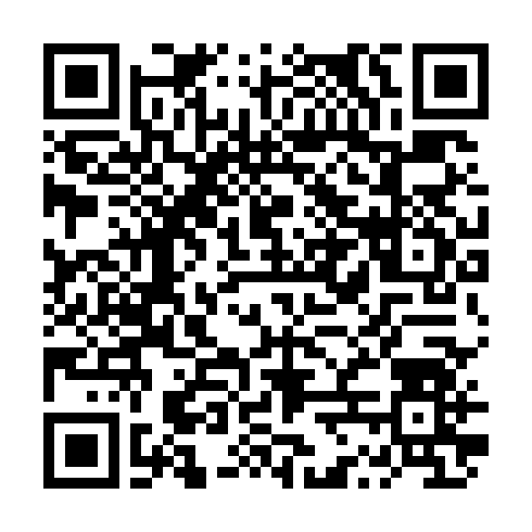
Need Help? Contact Us!!
Join the Slack Workspace here

