Slide 1
Lending Club Case Study
Himanshu Pandey
Megha Murthy

Slide 2
Agenda
Introduction
Primary goals
Represents different aspects of data
Suggestion
Summary

Slide 3
Introduction
You work for a consumer finance company which specialises in lending various types of loans to urban customers. When the company receives a loan application, the company has to make a decision for loan approval based on the applicant’s profile. Two types of risks are associated with the bank’s decision:
If the applicant is likely to repay the loan, then not approving the loan results in a loss of business to the company
If the applicant is not likely to repay the loan, i.e. he/she is likely to default, then approving the loan may lead to a financial loss for the company

Slide 4
Primary goals
Annual revenue growth
When a person applies for a loan, there are two types of decisions that could be taken by the company:
Loan accepted: If the company approves the loan, there are 3 possible scenarios described below:
Fully paid: Applicant has fully paid the loan (the principal and the interest rate)
Current: Applicant is in the process of paying the instalments, i.e. the tenure of the loan is not yet completed. These candidates are not labelled as 'defaulted'.
Charged-off: Applicant has not paid the instalments in due time for a long period of time, i.e. he/she has defaulted on the loan
Loan rejected: The company had rejected the loan (because the candidate does not meet their requirements etc.). Since the loan was rejected, there is no transactional history of those applicants with the company and so this data is not available with the company (and thus in this dataset)

Slide 5
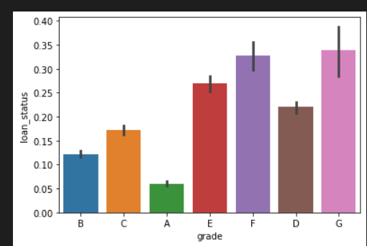
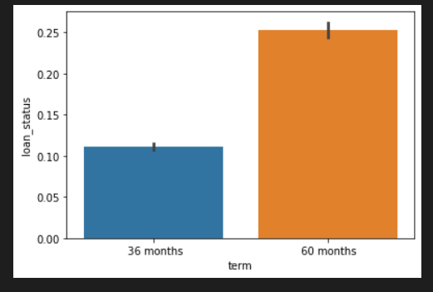
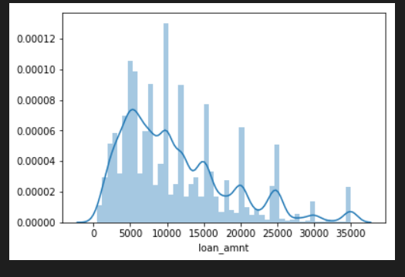
Represents different aspects of data
Univariate Analysis

Slide 6
Summary
Applicants taking loan for 'home improvement' and have income of 60k -70k
Applicants whose home ownership is 'MORTGAGE and have income of 60-70k
Applicants who receive interest at the rate of 21-24% and have an income of 70k-80k
Applicants who have taken a loan in the range 30k - 35k and are charged interest rate of 15-17.5 %
Applicants who have taken a loan for small business and the loan amount is greater than 14k
Applicants whose home ownership is 'MORTGAGE and have loan of 14-16k
When grade is F and loan amount is between 15k-20k
When employment length is 10yrs and loan amount is 12k-14k
When the loan is verified and loan amount is above 16k
For grade G and interest rate above 20%

Slide 7
Success is not one day process.
“
”
Himanshu Pandey and Megha Murthy

Slide 8


Meet our team
Himanshu Pandey
Megha Murthy
IIITB Student
IIITB student

Slide 9








The full team
Takuma Hayashi
Mirjam Nilsson
Flora Berggren
Rajesh Santoshi
President
Chief Executive Officer
Chief Operations Manager
VP Marketing
Graham Barnes
Rowan Murphy
Elizabeth Moore
Robin Kline
VP Product
SEO Strategist
Product Designer
Content Developer

Slide 10
Plan for product launch
Deploy strategic networks with compelling e-business needs
Planning
Synergize scalable e-commerce
Marketing
Disseminate standardized metrics
Design
Coordinate
Foster holistically superior methodologies
Launch
Strategy
e-business applications
1
2
3
4
5

Slide 11
Timeline
Deploy strategic networks with compelling e-business needs
Sep 20XX
Synergize scalable e-commerce
Nov 20XX
Disseminate standardized metrics
Jan 20XX
Coordinate e-business applications
March 20XX
Foster holistically superior methodologies
May 20XX

Slide 12
Areas of focus
B2B market scenarios
Cloud-based opportunities
Develop winning strategies to keep ahead of the competition
Capitalize on low-hanging fruit to identify a ballpark value
Visualize customer directed convergence
Iterative approaches to corporate strategy
Establish a management framework from the inside

Slide 13
How we get there
ROI
Niche Markets
Supply chains
Envision multimedia-based expertise and cross-media growth strategies
Visualize quality intellectual capital
Engage worldwide methodologies with web-enabled technologies
Pursue scalable customer service through sustainable strategies
Engage top-line web services with cutting-edge deliverables
Cultivate one-to-one customer service with robust ideas
Maximize timely deliverables for real-time schemas

Slide 14
Summary
At Contoso, we believe in giving 110%. By using our next-generation data architecture, we help organizations virtually manage agile workflows. We thrive because of our market knowledge and great team behind our product. As our CEO says, "Efficiencies will come from proactively transforming how we do business."

Slide 15
Thank you
Mirjam Nilsson​
mirjam@contoso.com
www.contoso.com

