Slide 1
Lending Club Case Study
Himanshu Pandey

Slide 2
Agenda
Introduction
Primary goals
Represents different aspects of data
Suggestion
Summary

Slide 3
Introduction
You work for a consumer finance company which specialises in lending various types of loans to urban customers. When the company receives a loan application, the company has to make a decision for loan approval based on the applicant’s profile. Two types of risks are associated with the bank’s decision:
If the applicant is likely to repay the loan, then not approving the loan results in a loss of business to the company
If the applicant is not likely to repay the loan, i.e. he/she is likely to default, then approving the loan may lead to a financial loss for the company

Slide 4
Primary goals
Annual revenue growth
When a person applies for a loan, there are two types of decisions that could be taken by the company:
Loan accepted: If the company approves the loan, there are 3 possible scenarios described below:
Fully paid: Applicant has fully paid the loan (the principal and the interest rate)
Current: Applicant is in the process of paying the instalments, i.e. the tenure of the loan is not yet completed. These candidates are not labelled as 'defaulted'.
Charged-off: Applicant has not paid the instalments in due time for a long period of time, i.e. he/she has defaulted on the loan
Loan rejected: The company had rejected the loan (because the candidate does not meet their requirements etc.). Since the loan was rejected, there is no transactional history of those applicants with the company and so this data is not available with the company (and thus in this dataset)

Slide 5
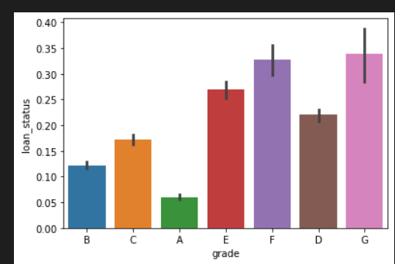
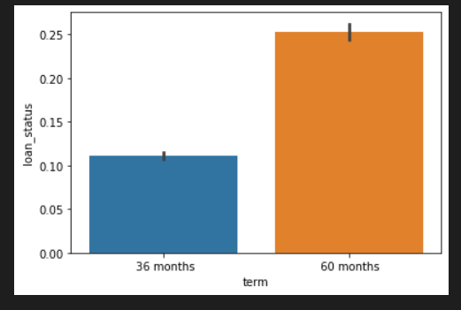
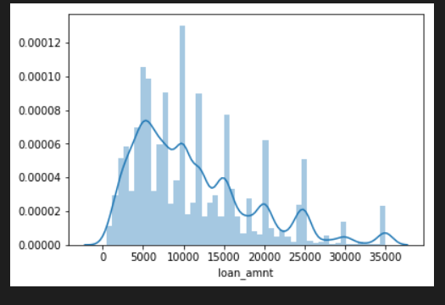
Represents different aspects of data
Univariate Analysis

Slide 6
Summary
Applicants taking loan for 'home improvement' and have income of 60k -70k
Applicants whose home ownership is 'MORTGAGE and have income of 60-70k
Applicants who receive interest at the rate of 21-24% and have an income of 70k-80k
Applicants who have taken a loan in the range 30k - 35k and are charged interest rate of 15-17.5 %
Applicants who have taken a loan for small business and the loan amount is greater than 14k
Applicants whose home ownership is 'MORTGAGE and have loan of 14-16k
When grade is F and loan amount is between 15k-20k
When employment length is 10yrs and loan amount is 12k-14k
When the loan is verified and loan amount is above 16k
For grade G and interest rate above 20%

Slide 7
Success is not one day process.
“
”
Himanshu Pandey

Slide 8

Meet our team
Himanshu Pandey
IIITB Student

