Slide 1

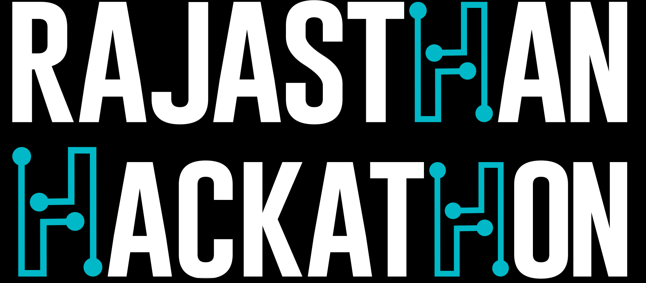
ई-LITE
BY: CODE_JAMMER

Slide 2
About the ई-LITE App
The ई-LITE is Progressive Cross-Platform Web App. This app is basically a light version App which can be loaded at a very low connectivity with much less yet very important services. This App provides basic end-user government services specifically emitra services through mobile and web platform . There will be no updates required from the client side as all the changes are from the server side and will be directly implemented at the time of next loading from client side.
Necessity of the ई-LITE
ई-LITE can become a very useful as well as successful among the people who are not able to reach to the E-Mitra or have an emergency regarding to the services of E-Mitra. And keeping this in mind the app is build in such a way that It contain all basic services given by E-Mitra like bonafied ,certificates, postpaid bill payments etc.

Slide 3
Progression Done in Hackathon
Starting from the scratch we made the app using HTML5 for the front-end, php for server calling and SQL for the database handling. According to our plan of building a lite app we restricted the app size in 15mb which can be further reduced to 2.5 mb– 4 mb.
As we planed to build a cross platform app we used INTEL xdk Cordova for the conversion of code to make it compatible for various platforms like Chromecast, android, web app & iOS.

Slide 4
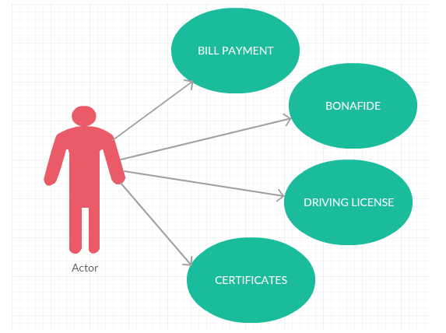
The services we were able to implement in the app are:
1- Bonafied (Domicile)
2- Certificate (Birth Certificate, Marriage Certificate, Caste Certificate, Lease Certificate)
3- Payment (Postpaid Mobile Bill Payment using SSOID, PHED water bill)
4- RTI(for any query eligible for RTI)
5- Status(To check the status of the application by applicant)
6-Review(Review by authority for errors)
Use case diagram
RTI

Slide 5
Bonafide-In this section we have currently made the form to be filled online and will be directly submitted to e-Mitra office in the prescribed format to be printed in offline form.
Certificate- in this section we have provided 4 types of certificates which will have all the fields required to be filled in the offline and will be stored In database and will be printed in prescribed form. Till now we have managed to complete General caste certificate with complete back end in this section.
Payment: This section relates to the various online transections. Here we have included Mobile post paid bills, PHED water bills(according to API given). User can choose between various category and it requires SSOID to proceed for payment gateway.
RTI: This section is not a part of the current e-Mitra services but as we think that RTI can play an important role in connection of government with people. So in this section we have added a from which contains field of name mobile number and query. The data will be collected in the database of the app server and it will also be stored and show in the RTI office for the team to analyse the query and respond accordingly.
Status: This section allows the applicant to track the status of the application i.e. Date of delivery or errors in the form etc. . It includes section of mobile number, category of application, application no. and the status will me received by the applicant through a notification or a SMS.

Slide 6
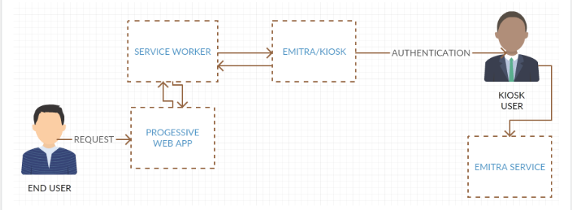
Architecture
Block Diagram 1

Slide 7
Technology Stack
Software Used
IDE: Dreamweaver CC, Sublime Text 3
Tools: Intel XDK
Frame work: Cordova
Languages Used
HTML5, php, SQL
Supported platform
Android 5+, iOS 9+, Windows 8+, Chromecast

Slide 8
How we imagine the future of the of the app???
If this app got a chance to develop further then we will connect almost the services keeping the concept of lite web app so that it will be easily assessable in all kinds of area even in weak internet and networks zone.
Thinking this app as a plan we will also add services which include biometric as a formality. We will give the option to request the free home services to take the samples of required biometric for further process. Also giving the data directly in E-Mitra database will reduce the working middle man up to a great extent. It will help the even the most common person to connect with the basic services without delays and giving extra money to middle man.
Thank You…..

