Slide 1
Decentralized Uptime Platform Using DePIN
Revolutionizing Infrastructure Reliability with Decentralized Networks.
Himanshu Sharma
RA2211050010032

Slide 2
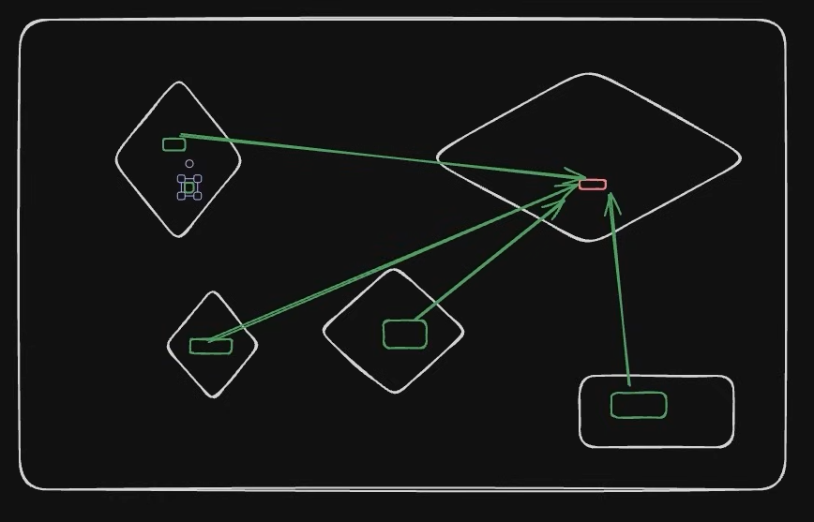
Problem Statement
Centralized uptime monitoring systems have inherent limitations, including single points of failure and lack of transparency. A decentralized uptime platform, powered by DePIN, addresses these issues by distributing the monitoring process across a network of nodes. Decentralization enhances reliability, reduces dependency on single entities, and fosters a more transparent, trustworthy system.
Limitations of Centralized Systems
Single Points of Failure
Lack of Transparency
High Operational Costs

Slide 3
Proposed Solution
A decentralized uptime platform ensures the availability of online services through a distributed network, monitoring services in a decentralized manner. Unlike traditional uptime monitoring tools, it eliminates single points of failure and increases transparency using blockchain technology. This approach not only enhances reliability but also fosters trust and reduces operational costs, marking a significant advancement in system monitoring.
Key Components
Validator Network: Distributed nodes that check website status from diverse global locations
Blockchain-Based Verification: Cryptographic proof of monitoring through the Solana blockchain
Tokenized Incentive Structure: Rewards for validators who provide accurate monitoring data
Dashboard: Simple interface for website owners to monitor their sites' performance

Slide 4
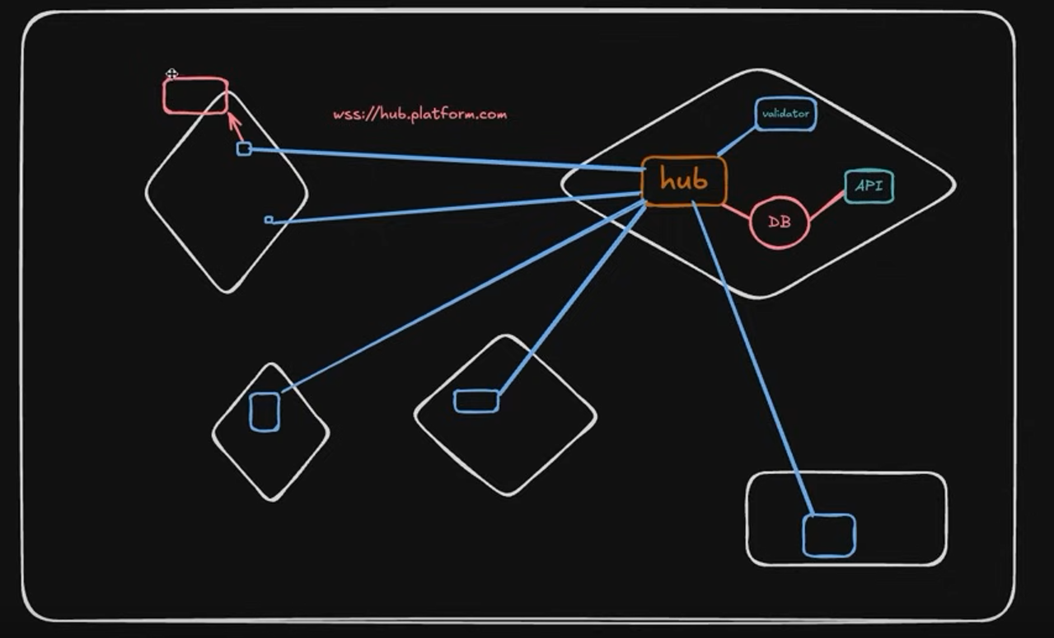
Underlying Architecture
Four Main Components
API: Handles user requests, website registration, and data queries
Hub: Coordinates validation requests and manages the validator network
Validators: Distributed nodes that perform actual website checks
Frontend: User interface for website owners

Slide 5
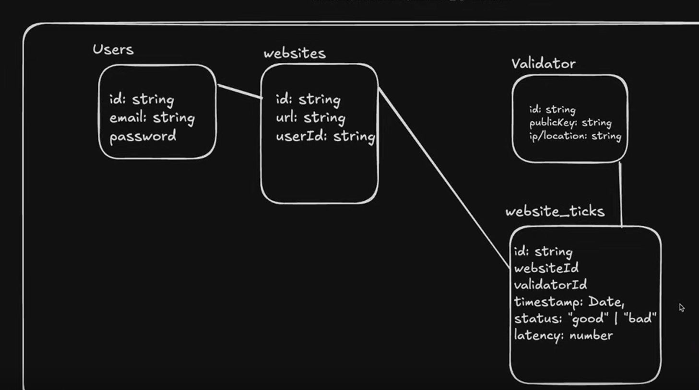
Data Base Schema

Slide 6
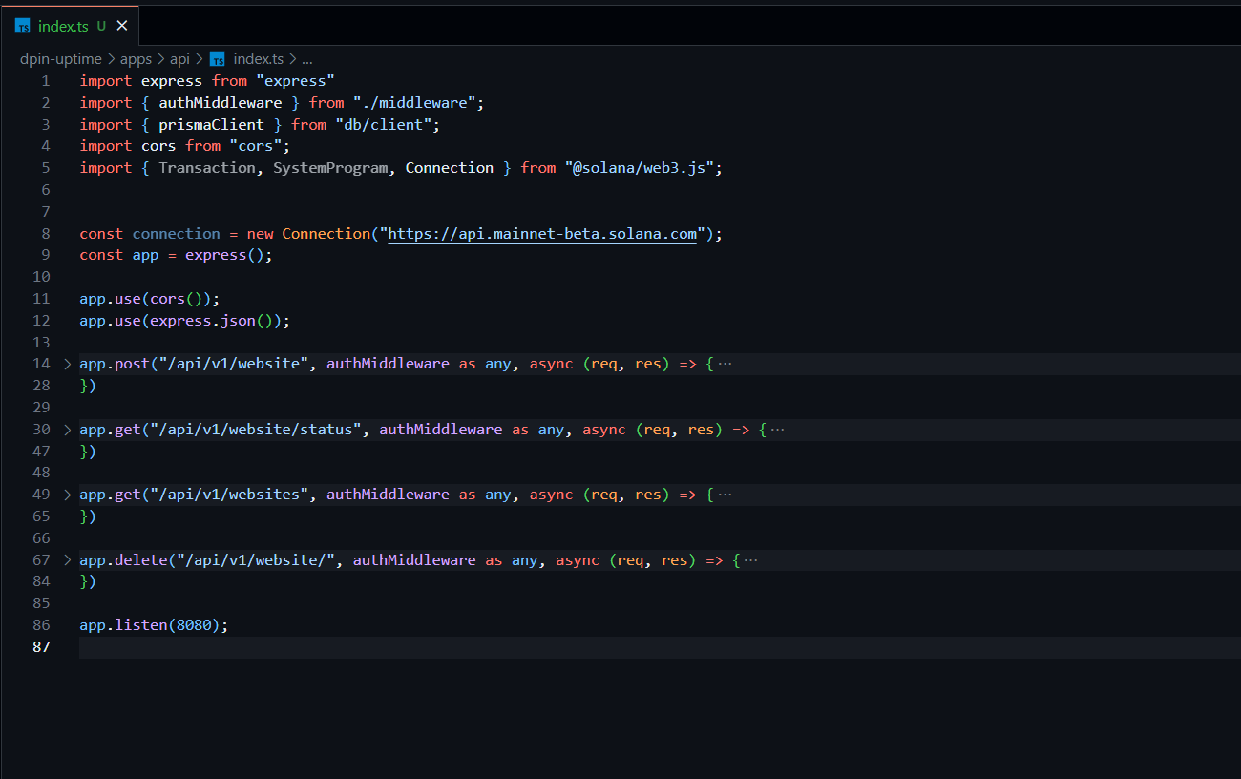
API Component
Four Main Controllers
Add Websites: Lets the user add website to monitor
Get Status: Returns the status of the website
Get all Websites: Fetches all the websites added in database
Delete : Soft Delete the website from database

Slide 7
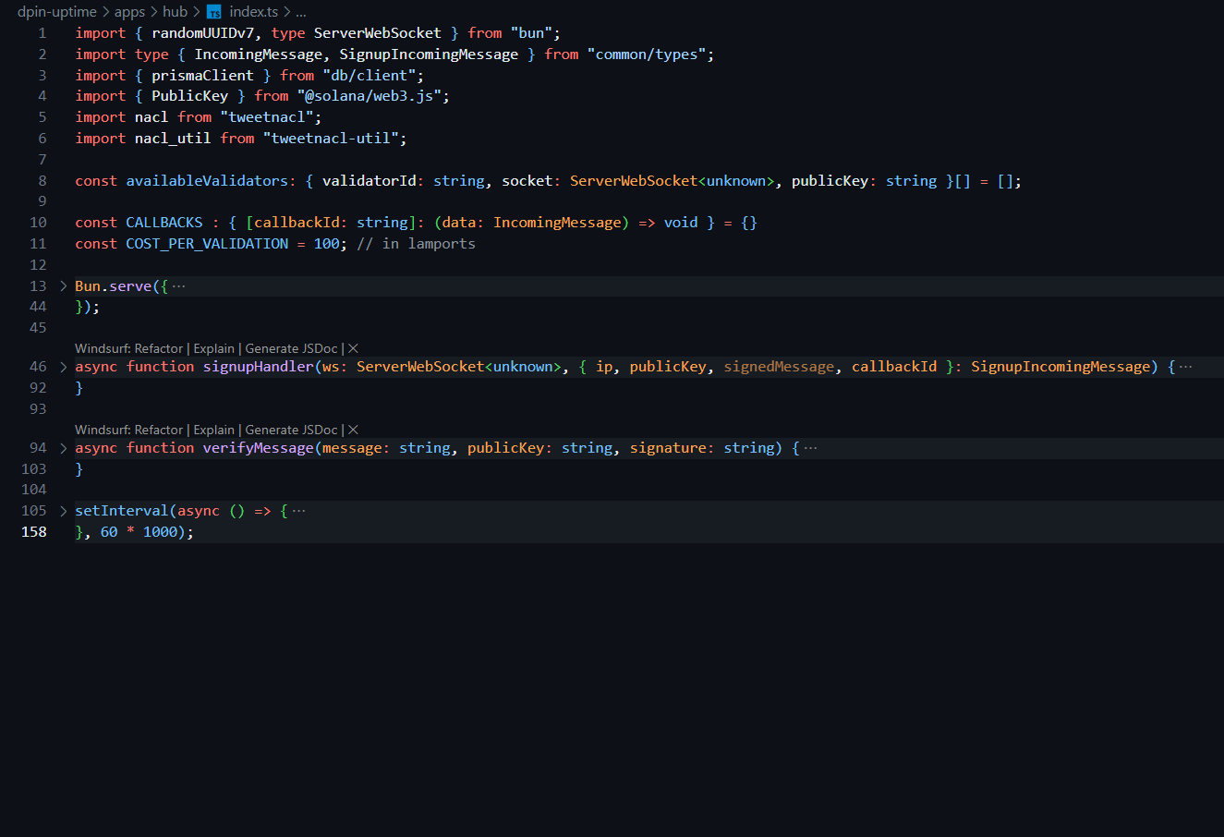
HUB Component
Two Main Controllers
Sign up Handler: Creates the user based on their public key , IP and callback id.
Verify Message: Verify the message using Signature and Public key

Slide 8
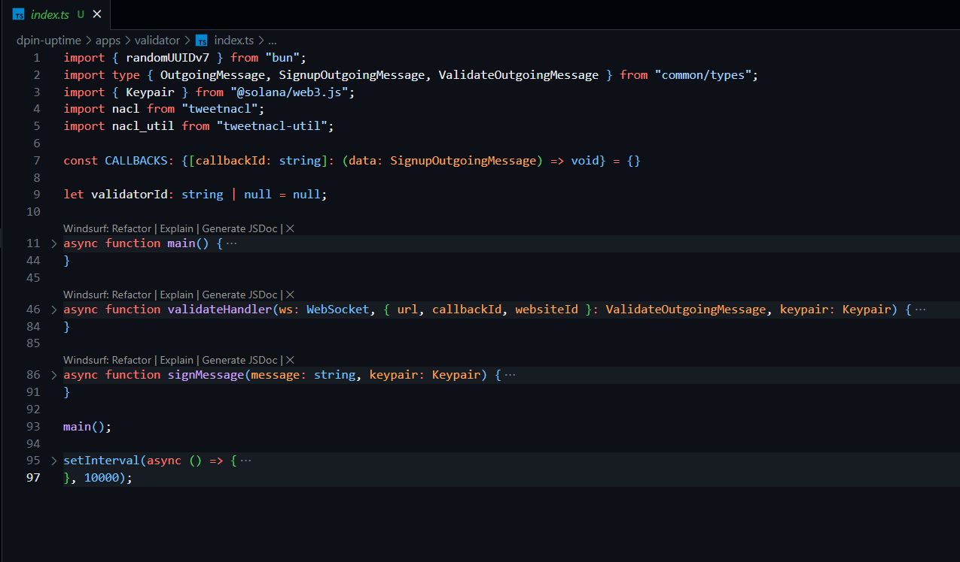
Validator Component
Two Main Controllers
Validate Handler: Validate the URL based on the response time , latency and status.
Sign Message: returns a signature using keypair

Slide 9
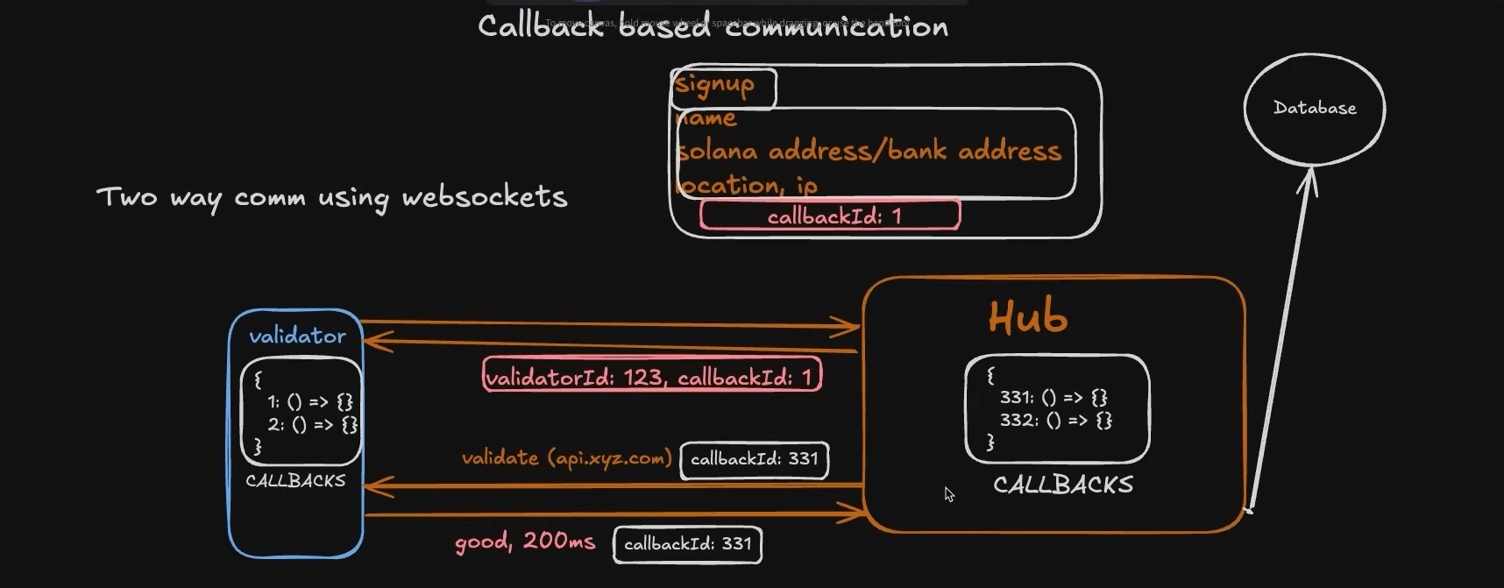
Two-way communication using Sockets

Slide 10
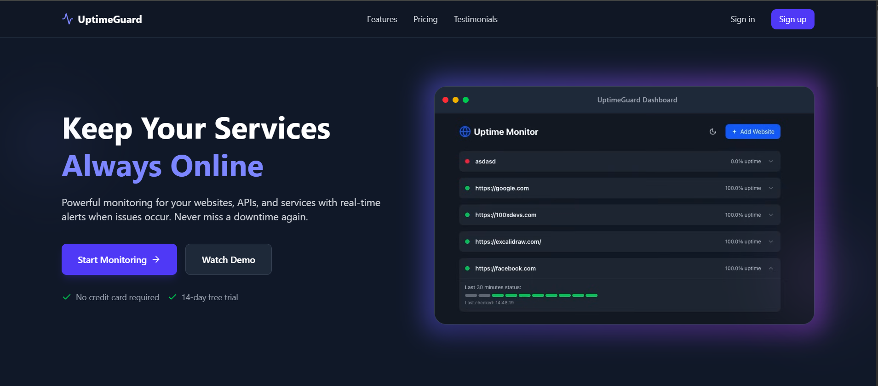
Frontend Landing Page

Slide 11
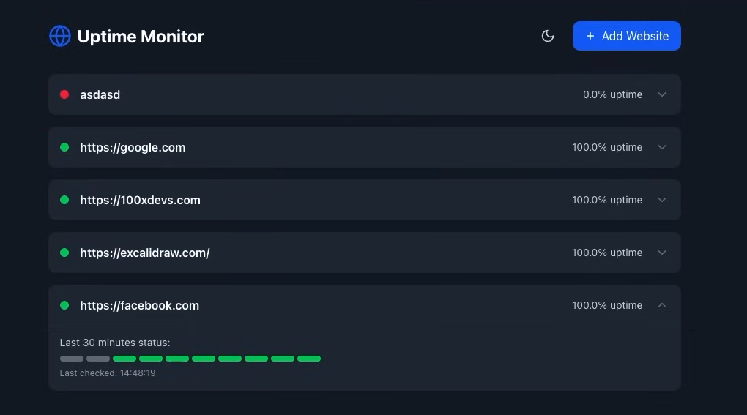
Frontend Dashboard Page

Slide 12
Under Development and Future Scopes
Notification System: A complete real-time notification system consisting of SMS , emails and in-app notifications.
Meta Mask Integration: Integrating Meta-mask for authentication along with clerk .
Payout System: A Payment system for the validators in crypto
Deployment: Containerization and deployment of all services.

