Slide 1


INFLUENCER ENGAGEMENT TRACKER
Team 2

Slide 2
OVERVIEW
INTRODUCTION
FRONTEND DASHBOARD
WEEK 1
CONCLUSION
WEEK 2
FUTURE SCOPE
WEEK 3

Slide 3
INTRODUCTION
The aim is to ensure that the solution aligns with current market needs, provides actionable insights, and solves critical pain points faced by marketing teams. By analyzing credible sources and industry trends, this research ensures that the problem statement reflects a genuine need for innovation in influencer analytics.
Marketing teams face significant challenges in tracking and analyzing influencer performance across multiple social media platforms. The fragmented nature of influencer data on platforms like Instagram, YouTube and Twitter makes it difficult to gain unified insights into engagement metrics, audience demographics, and ROI. This lack of comprehensive tools hinders their ability to optimize campaigns, measure success accurately, and demonstrate business impact effectively.

Slide 4
WEEK 1
M1.2:Key User & Business Requirement Identification
M1.1: Problem Statement Validation Research
This activity aims to identify the primary users and outline business requirements for developing an automated Influencer Engagement Tracker. The system leverages social media APIs to analyze influencer performance metrics The solution provides automated insights and visual dashboards that help stakeholders make data-driven marketing decisions.
This activity involves conducting structured research to validate whether the proposed Influencer Engagement Tracker addresses a real and pressing challenge in influencer marketing.

Slide 5
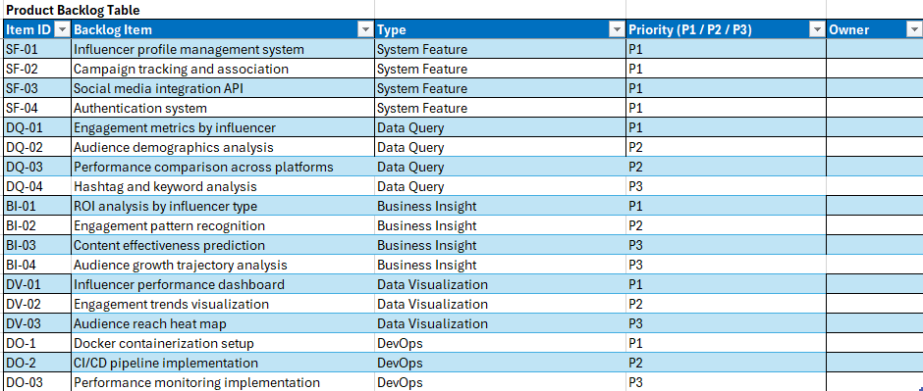
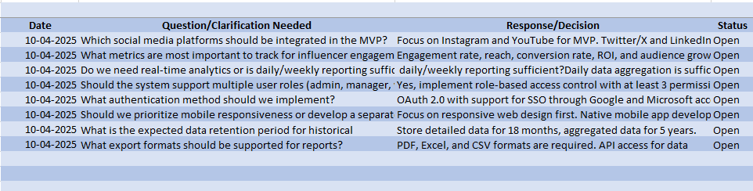
WEEK 1
M1.3: Product Backlog
M1.5:Clarification Log

Slide 6
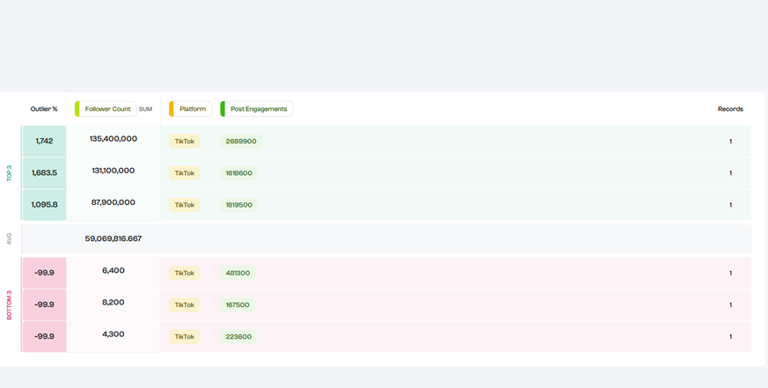
M1.4: WIREFRAME DESIGN DOCUMENT

Slide 7
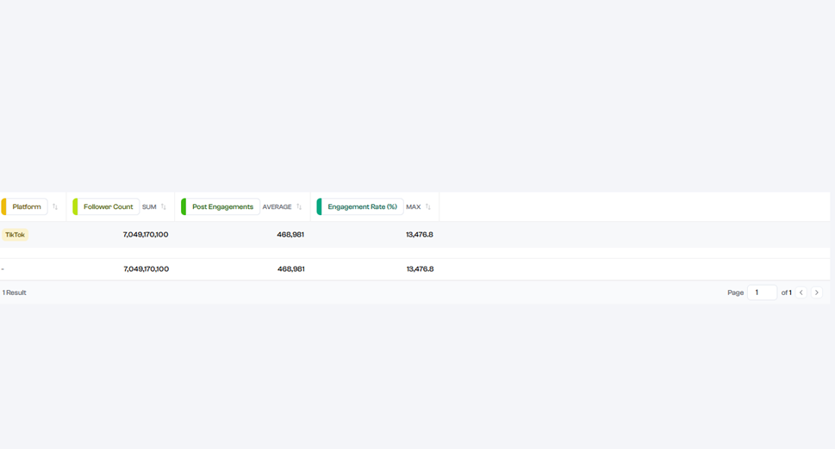
M1.4: WIREFRAME DESIGN DOCUMENT

Slide 8
WEEK 2
M2.1: List of Data Sources
M2.2: Data Repository
We have gathered the following Datasets:
Instagram Graph API
Twitter API V2
Youtube Data API V3
Twitter Sentiment 140
Influencer Net Dataset
We have gathered the following Datasets:
Social Blade API
Hyper Auditor API
Youtube Trending Dataset
Youtube Comments Sentiment
Youtube Data API v3

Slide 9
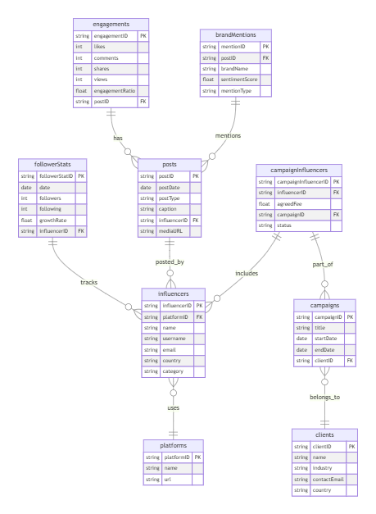
M2.3 ER DIAGRAM

Slide 10
WEEK 2
M2.4: Data Dictionary
M2.5: Database Design
The data dictionary document describes about the schema of the databases and the tables used in the project including Influencers, Platforms, Posts, Engagements, Follower Stats, Clients and Brand Mentions.
This document describes the table structure of the database with the mentioning of the different columns used in the tables with the constraints associated with it. This also shows an overview of the database and the relations with the tables inside.

Slide 11
WEEK 3
We built a full end-to-end pipeline to analyze and model influencer engagement data across Instagram, YouTube datasets.
We started by:
a: Checking for missing values and data types
b: Understanding the distribution of engagement rate
c: Visualizing top countries and correlations between numeric features
Why it matters: Helps identify patterns like which countries dominate, or which metrics (like followers or post count) influence engagement.
2. Data Preprocessing
a: Dropped irrelevant text columns (like profile links, IDs)
b: Encoded categorical features like Country and Post Category
c: Created a new target column: Engagement_Level (Low, Medium, High)
d: Scaled features to prepare for machine learning
Why it matters: Preprocessing makes the data ML-friendly. Binning engagement into categories helps marketers act on insights more easily than interpreting floating-point rates.

Slide 12
WEEK 3
3. Machine Learning Models
a: Random Forest Classifier
b: Logistic Regression
On the classification task: predicting whether an influencer’s engagement is Low, Medium, or High.
Why it matters: This helps marketing teams:
a: Score influencers automatically
b: Select high-engagement influencers for partnerships
c: Compare platforms (e.g., is YouTube or Instagram better for your brand?)
4. Evaluation
a: Accuracy
b: Classification Report (Precision, Recall, F1)
c: Confusion Matrix heatmap
Why it matters: Ensures the model is reliable in differentiating between engagement levels, especially avoiding false “High” predictions which could cost brands money.

Slide 13
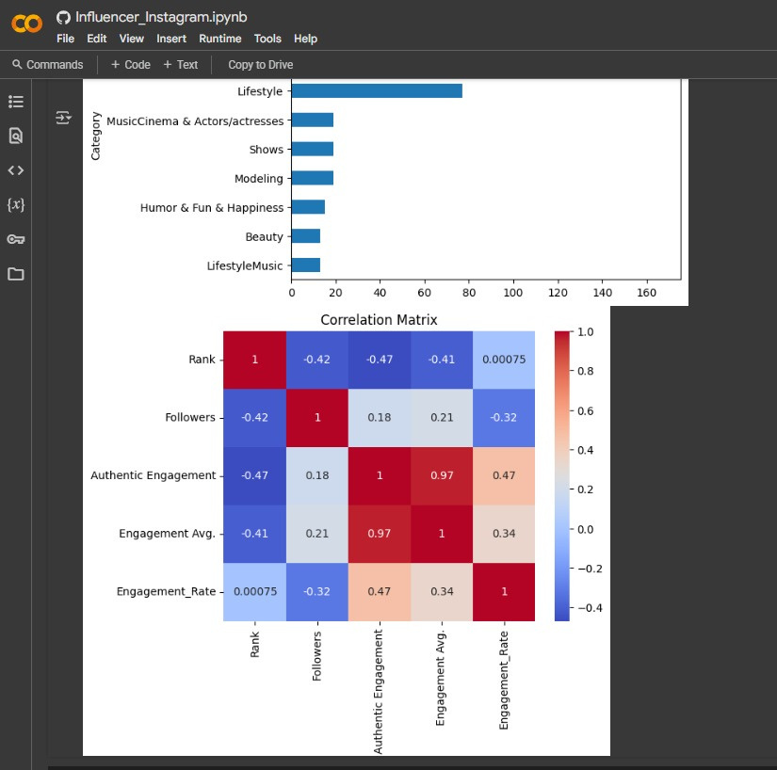
CORR. MATRIX

Slide 14
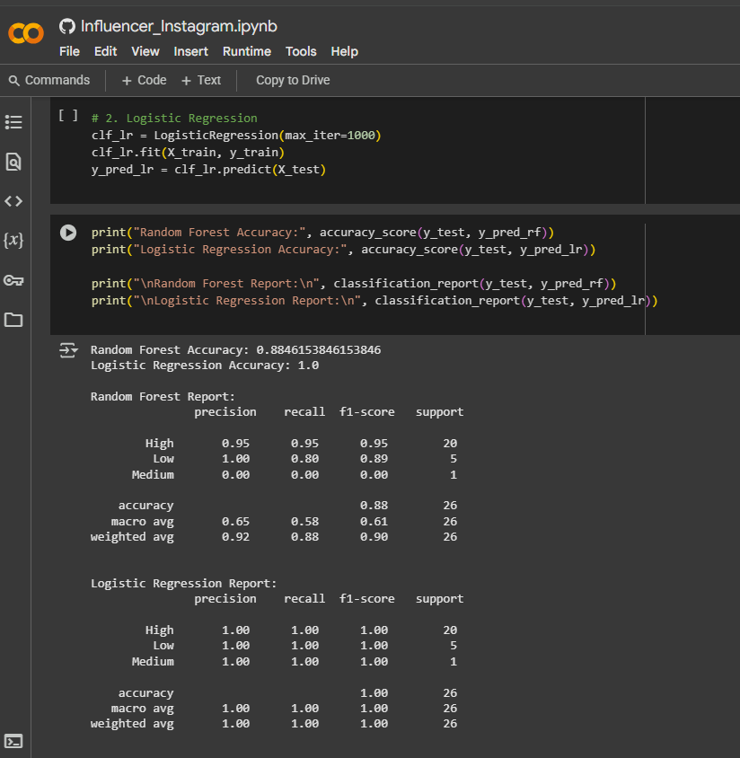
ACCURACY METRICS

Slide 15
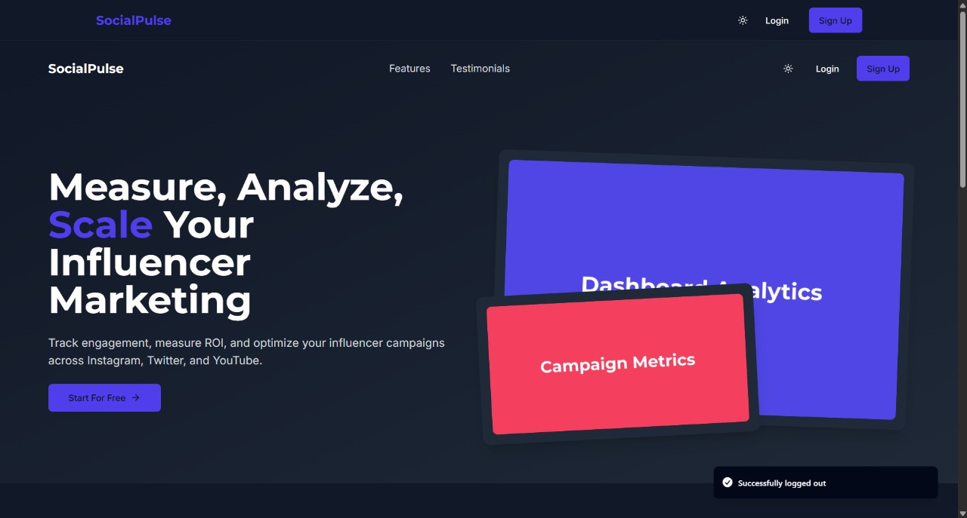
FRONTEND DASHBOARD
LANDING PAGE

Slide 16
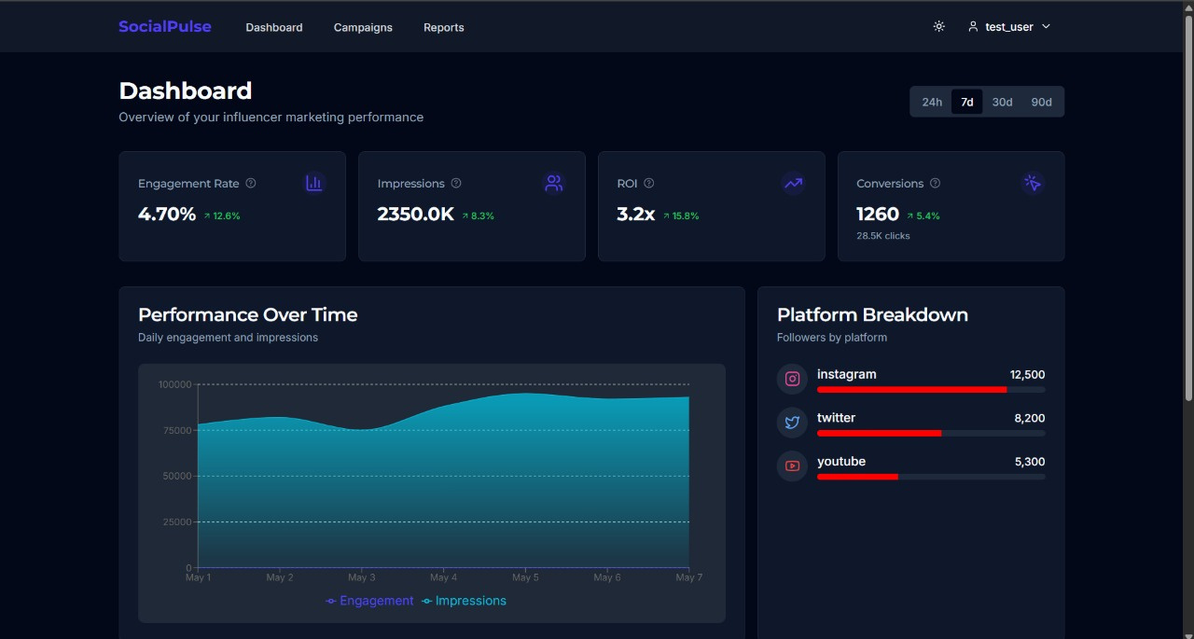
FRONTEND DASHBOARD
DASHBOARD PAGE

Slide 17
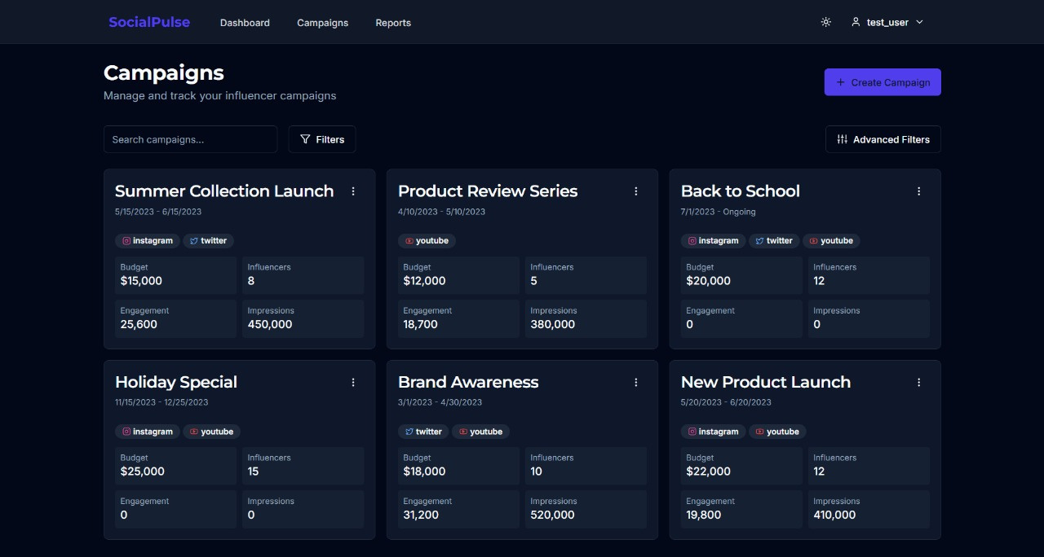
FRONTEND DASHBOARD
CAMPAIGNS PAGE

Slide 18
CONCLUSION
The research highlights several critical gaps in current influencer analytics tools:
Most existing solutions fail to provide unified cross-platform analytics.
Real-time tracking capabilities are limited in many tools, leaving marketers unable to respond dynamically during campaigns.
Fraud detection features (e.g., identifying fake followers or bots) are increasingly important but underrepresented in mainstream solutions.
There is growing demand for predictive analytics powered by AI to forecast campaign outcomes based on historical data.
Additionally, incorporating automated reporting capabilities with shareable dashboards would enhance usability for stakeholders.

Slide 19
FUTURE SCOPE
Dynamic responsiveness
Subscription based models
Real time data fetching and updating the dashboard
Deploying in Cloud architecture
Integrating CI/CD pipelines

Slide 20
Thank You

