Slide 1
Research Paper Simplification
Deep Neural NLP
Project Presentation
Presented by:
Jainisha Choksi (202211019)
Hinal Desai (202211035)
Man Desai (202211040)
Rutvik Prajapati (202211053)

Slide 2
01
introduction

Slide 3
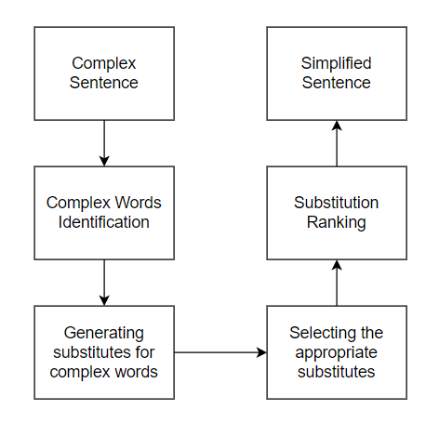
simplification
Simplification means modifying the content and structure of the text so as to make it easier to understand and read, but keeping the main idea and original meaning intact.
It involves rephrasing the complex sentences into simpler sentences while retaining the original meaning.

Slide 4
02
Problem formulation

Slide 5
Problem formulation
Given a research paper as an input, we aim to produce a simplified version of that research paper with a simpler vocabulary while preserving the main ideas in the original sentence.
Our focus is on lexical simplification.
Lexical simplification refers to replacing the complex words with simpler synonyms without changing the grammatical meaning of the text.
Input: Research paper in natural language text format.
Output: Simplified version of input text, with complex sentences rephrased.

Slide 6
03
Methodology

Slide 7
methodology
01
Identifying the words in the sentence that need to be simplified.
Complex Word Identification
02
Getting the possible substitutes for the identified complex words.
Substitute Generation
03
Selecting the best substitutes based on zipf values.
Selecting the best candidates

Slide 8
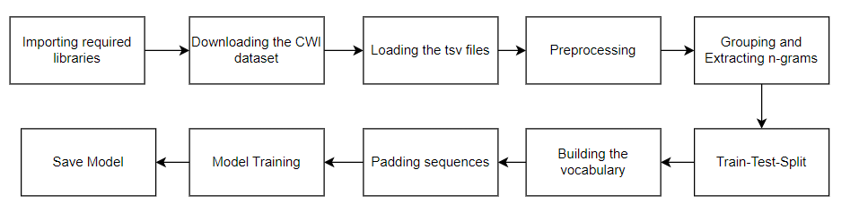
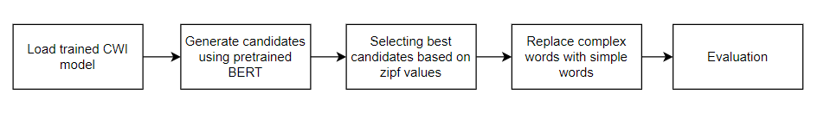
methodology
Fig: Complex Word Identification model
Fig: Substitute generation & Selecting best candidates

Slide 9
04
Model architecture

Slide 10
Cwi model
Complex word identification is a subtask of lexical simplification. It identifies the difficult words or phrases in a text.
The dataset used for complex word identification is the Complex Word Identification (CWI) Shared Task 2018 dataset. It contains information about complex phrases annotated with some statistics.
Dataset consists of:
id: unique identifier
sentence: actual sentence where there exists complex phrase annotation.
start, end: start and end offsets of complex phrase annotation
target: actual complex phrase annotation.
nat, non_nat, nat_marked: number of native annotators, non-native annotators and total number of annotators who marked this complex phrase.
Notes:
(add information about the architecture, hyperparameters, loss function, dataset, optimizer etc.)

Slide 11
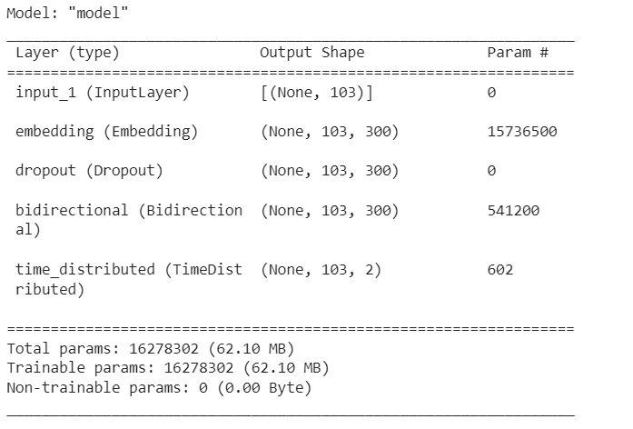
Cwi model architecture
Loss = categorical_crossentropy
Optimizer = adam
Metric = accuracy

Slide 12
Rationale behind architecture
Input layer: used to feed the data into the neural network. Input is a sequence of words.
Embedding layer: used to convert words or tokens into dense vectors of fixed size. This step helps model capture semantic relationships between words and enables it to understand contextual meaning.
Dropout layer: used for regularization to prevent overfitting.
Bidirectional layer: processes the input sequence in both forward and backward directions, allowing the model to capture both past and future context.
Time distributed layer: often used in sequence labelling tasks. It allows the model to apply the same set of parameters to every time step in the sequence independently. It helps the model make predictions for each word in the sequence.

Slide 13
Simplification model
Using BERT masked language model to get the possible candidates
Computing the zipf frequency values of each candidates to rank and select the simplest one.
Zipf’s Law: It is an empirical law that describes the statistical distribution of word frequencies in natural language. It suggests that the frequency of a word is inversely proportional to its rank.
We used the zipf_frequency function from wordfreq library to calculate the zipf_frequency.

Slide 14
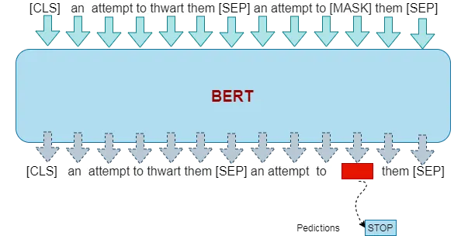
Simplification model
Image source: https://medium.com/@armandj.olivares/how-to-use-bert-for-lexical-simplification-6edbf5a4d15e

Slide 15
05
results

Slide 16
Evaluation
Original text: “Event-Triggered Adaptive Output Feedback Control for Stochastic Nonlinear Systems With Time-Varying Full-State Constraints” Simplified text: “Event-Triggered Adaptive Output Feedback system for Stochastic complex Systems With Time-Varying Full-State problems” sentence_bleu score: 0.42502
Original text: “The developed algorithm allows the finding of solutions for a wide range of robots by using a geometric approach, representing points in a polar coordinate system” Simplified text: “The developed system allowed the finding of solutions for a wide family of problems by using a linear approach, representing points in a polar coordinate system ” sentence_bleu score: 0.58288

Slide 17
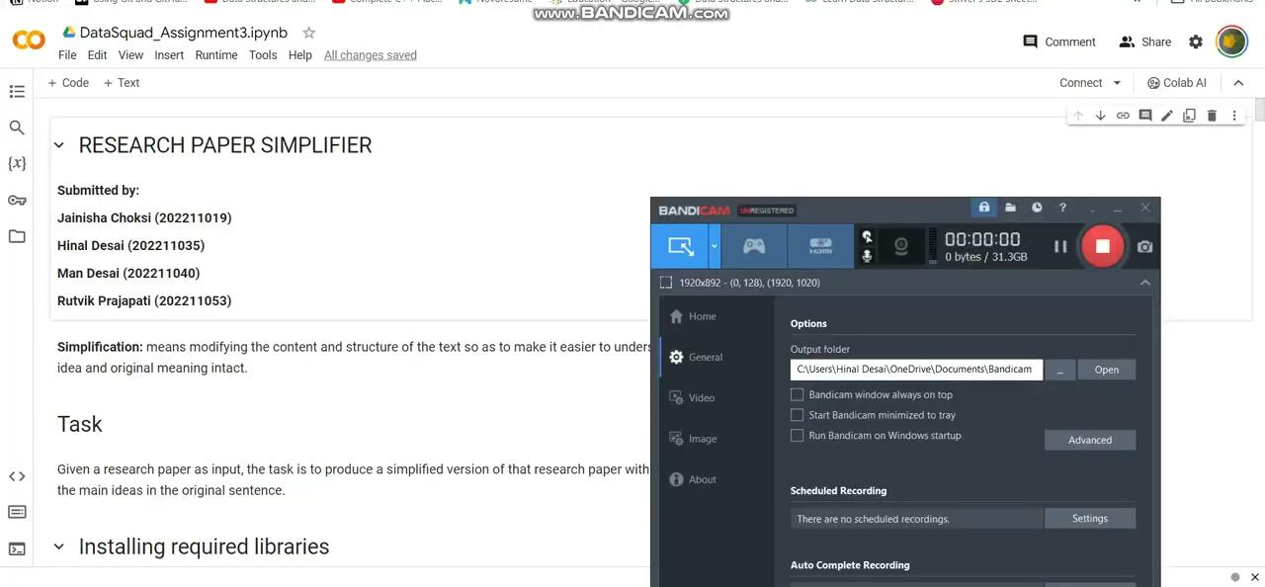
Demo

Slide 18
references
[1] Qiang, J., Li, Y., Zhu, Y., Yuan, Y. and Wu, X., 2020. LSBert: a simple framework for lexical simplification. arXiv preprint arXiv:2006.14939.
[2] Kriz, R., Miltsakaki, E., Apidianaki, M. and Callison-Burch, C., 2018, June. Simplification using paraphrases and context-based lexical substitution. In Proceedings of the 2018 Conference of the North American Chapter of the Association for Computational Linguistics: Human Language Technologies, Volume 1 (Long Papers) (pp. 207-217).
[3] Yimam, S.M., Biemann, C., Malmasi, S., Paetzold, G.H., Specia, L., Štajner, S., Tack, A. and Zampieri, M., 2018. A report on the complex word identification shared task 2018. arXiv preprint arXiv:1804.09132.

Slide 19
thanks!

