Slide 1
Technical Skills
Hina Murdhani
Variables 33

Slide 2
Technologies
C
C++
JAVA
PHP
Android
HTML
CSS

Slide 3
Projects
Vaccination Indicator
GTU Project Portal

Slide 4
Vaccination Indicator
Why we choose this domain?
In India many children's are suffer from disease due to they do not get vaccine of children on time.
Vaccination has its own time, period and schedule.
There are many problem related to vaccine like parents don’t know the time or date of vaccine.
In some rural area illiterate persons don’t have any information about any vaccine so they can’t protect their children from the diseases related to vaccine.

Slide 5
Cont....
The main functionality of this website is that it will generate vaccine chart based on birth date of child.

Slide 6
Work Flow
Registration
Login
Generation of vaccine chart based on child DOB.

Slide 7
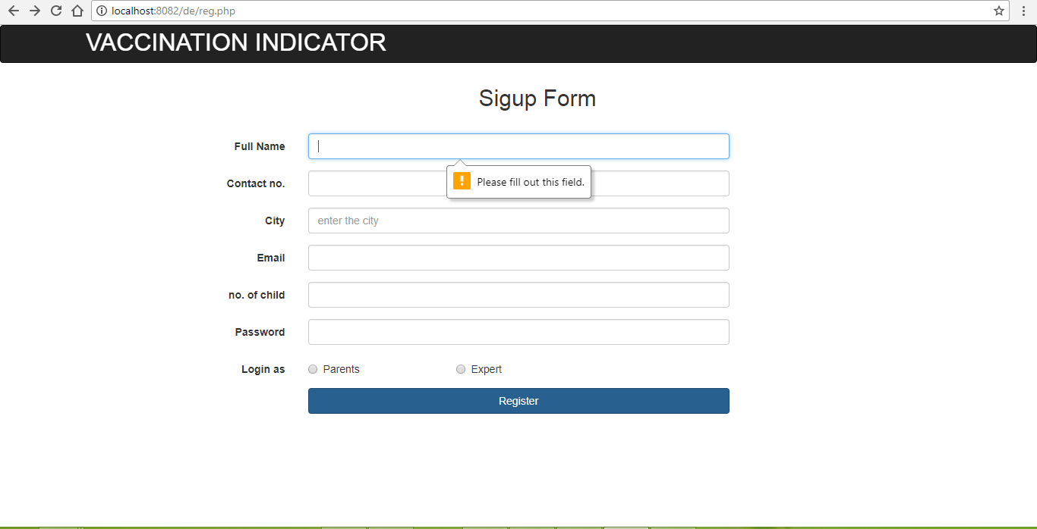
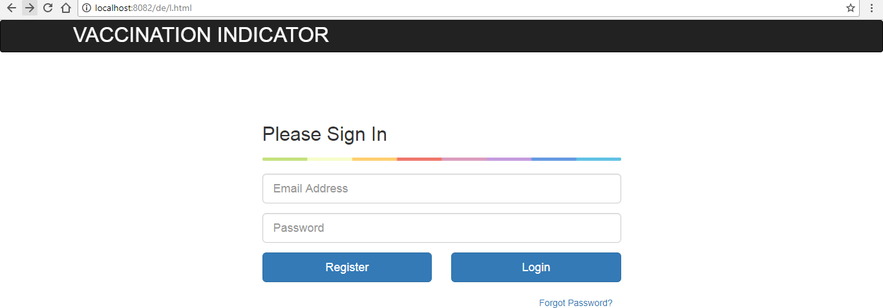

Slide 8
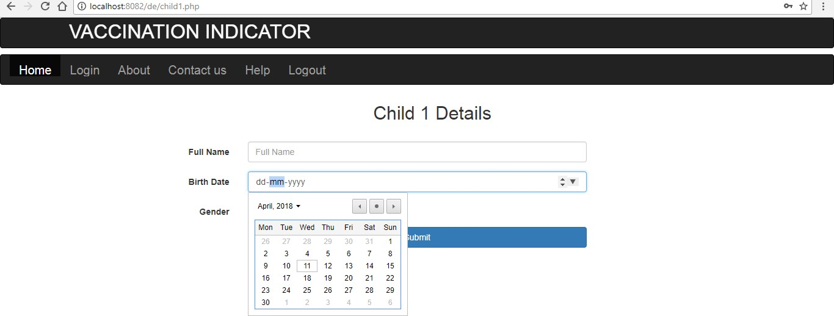

Slide 9
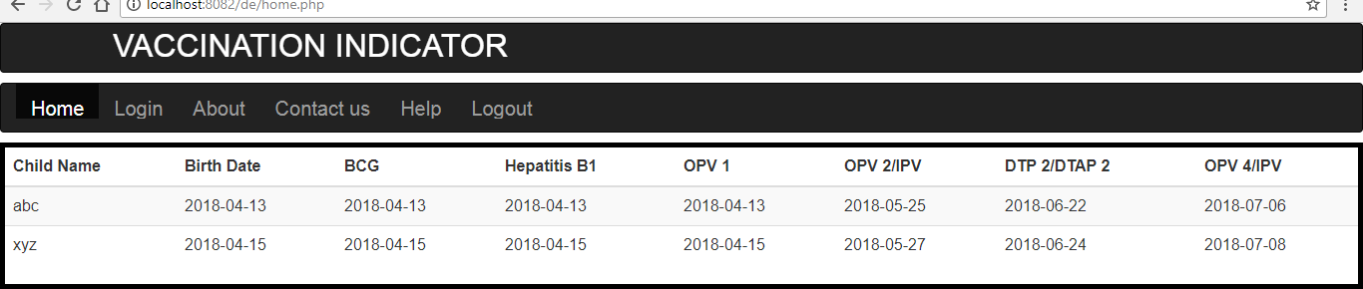

Slide 10
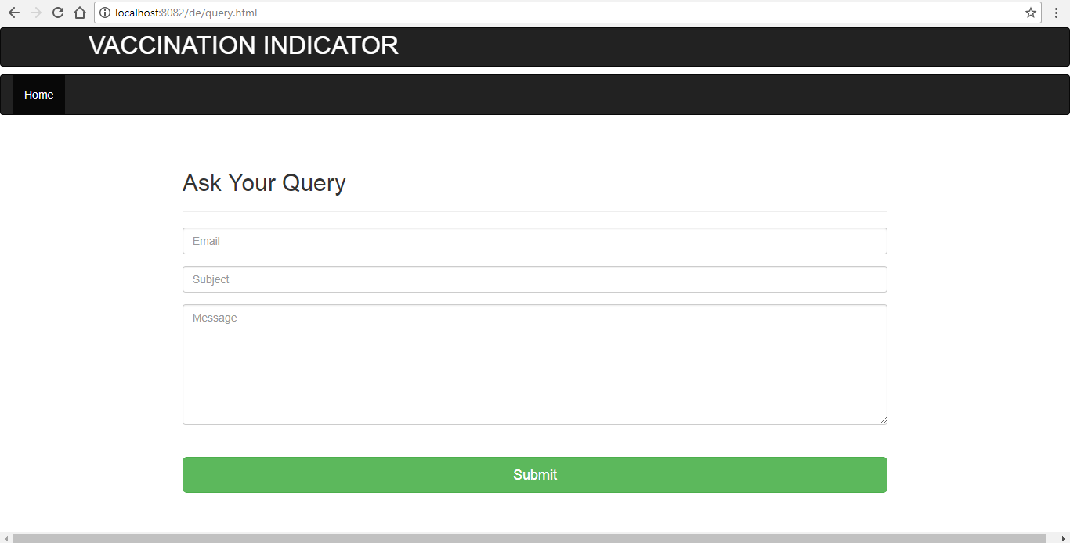

Slide 11
GTU Project Portal
GTU PROJECT PORTAL" we can say that it is extended version of GTU DESIGN PORTAL. It is based on design thinking methodologies which is developed and used by engineers and designers all over the glob.
Main purpose of this is to convert the design thinking into reality.
The other objective behind that is to simulate thought process and creativity among the students.
To learn the problem solving techniques and increase the progression of practical learning and skill development.
It will provide the platform due to which students can convert their ideas into reality and can develop his/her self practically

Slide 12
User Characteristics
Admin:-
Manage Data
Update Data
modified system if any requirement changes is there
All the privileges are given to the admin

Slide 13
Users
Faculty
Registration
Login
can see all the activities uploaded by students.
can comment if any mistake is done by students
can approve all the activities of the students
Feedbacks

Slide 14
Student
Registration
Login
can upload all the activities of their project.
Feedbacks

Slide 15

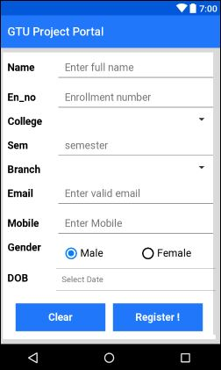
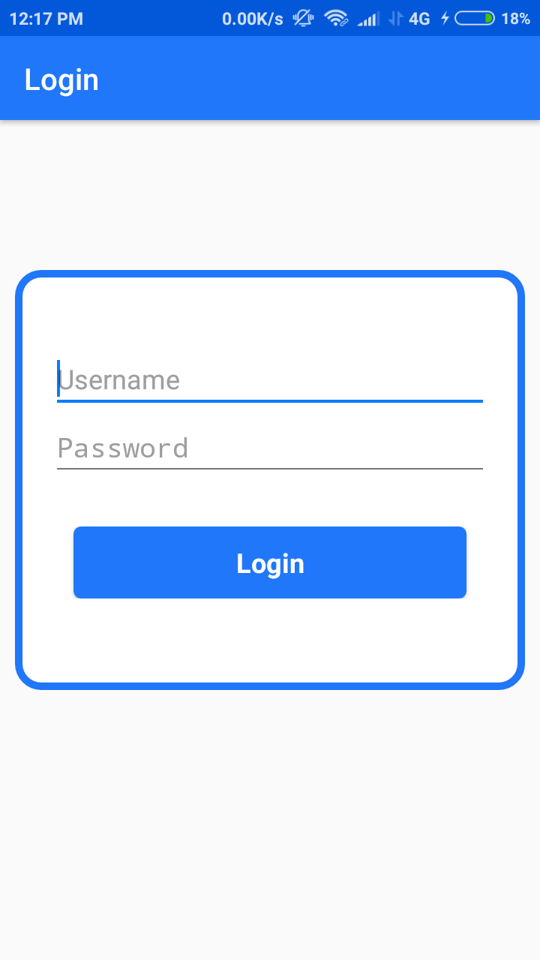

Slide 16
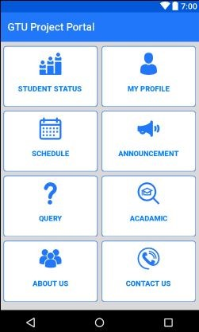
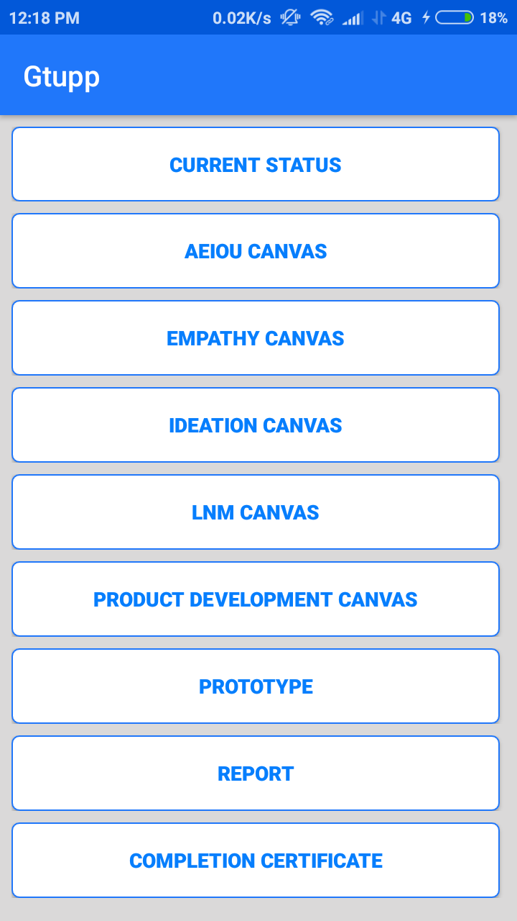
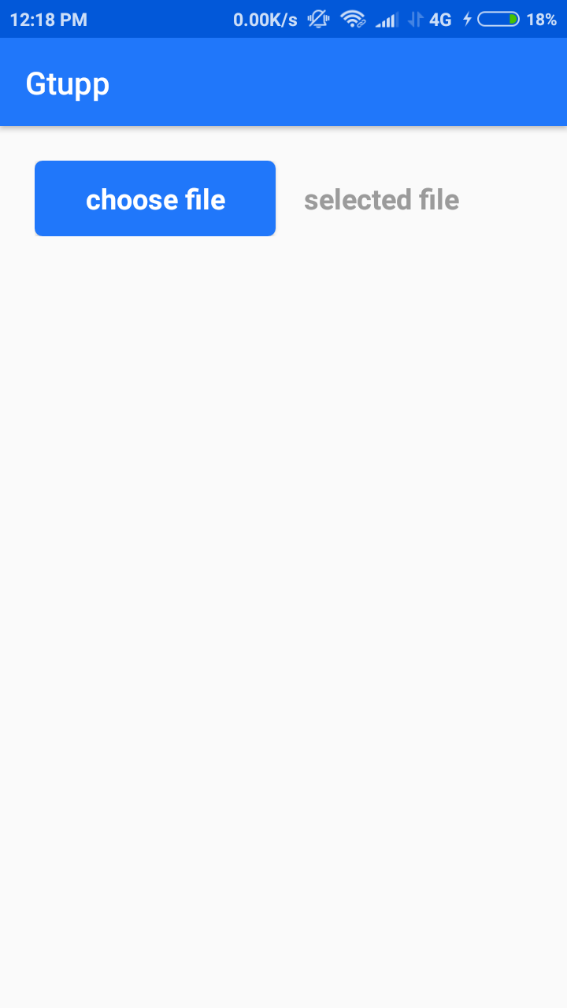

Slide 17
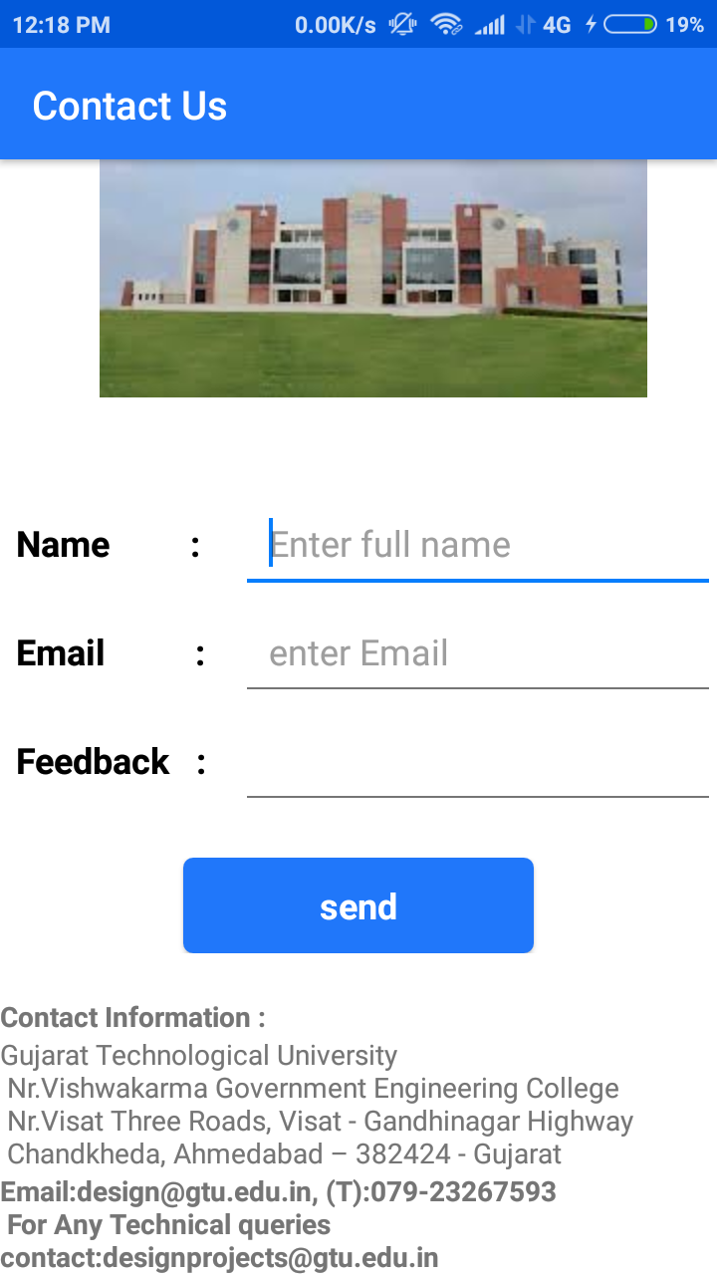

Slide 18
THANK YOU

