Slide 1
Solar Telescope Proposal
June 2024
Hina Suzuki

Slide 2
Project goals
1. Implementation of Solar finder
No solar finder is implemented to the solar telescope located outside of the visitor center.
When visitors align the solar telescope to the Sun, it require visitor to look up the Sun directly and point telescope to it.
Solar finder is needed to point the Sun more accurately without damaging users eyes.
2. Improvement on Indicator
3V voltmeter was implemented as a indicator, however it does not clearly show difference on radio emission from the Sun and from ground/cold sky.
We aim to improve indicator (e.g. speaker) to make this more apparent and attractive.

Slide 3
Timeline (Solar Finder)
1. Implementation of Solar finder
Finalize design ( -12 June )
Choose the design of solar finder (design idea on next slide). The common and user-oriented design is demanded.
3D modeling dimensions ( - 19 June )
Design handy size finder with attachment based on measurement of existing telescope.
3D modeling & print prototype ( - 28 June )
Develop 3D modeling and materials may differ depending on finder design.
Installation & Test ( - 3 July )
Install to the solar telescope and test finder.
Demo ( 5 July )

Slide 4

Solar Finder Design Ideas
#1 : Closed Tube
#2 : Open design
Long lifetime
Safe design for children
Development complexity due to multiple materials
Sun light ray may reach to the users eyes
Easy to develop
Possible injury due to design
May easy to be broken
User never need to look up the sky
Semi- transparent
For both design, we need to consider main material carefully so that solar finder will not melt in high temperature in summer season.
As the goal of solar finder was to prevent visitors from possible injury by aiming the telescope to the sun, we would user #2 Open Design.

Slide 5
Timeline (Indicator)
2. Improvement on Indicator
Explore why indicator is not sufficient to attract people ( - 12 June )
Test equipment behavior
Refer instruction for visitors
Look back the telescope design ( - 21 June )
Re-write diagram of connection from receiver to voltmeter
Calculate estimated output on voltmeter
Suggest method(s) for indicator improvement ( - 5 July )
Relatively small improvement if possible
Some rough ideas on next slides
Design & develop new system ( - 2 August )
Test & Demo ( - 14 August )
Install new system at the site and test its behavior

Slide 6







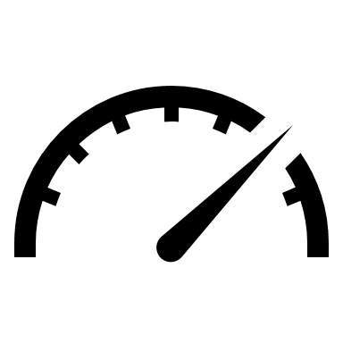
Sun
Ground
Satellite
The higher value on voltmeter, the more LED light turns on.
Colorful LEDs
Require many LED for more precise indication
Could be hard to maintain/ need to have regular maintenance
No need to change instruction for visitor
Install 3 LEDs lighten up when Sun, Ground, Satellite is pointed
No need to change instruction
Need cover
Values differ on each day (Atmospheric conditions, solar activities)
Need to have cover to make LED lights visible in the sun

Slide 7
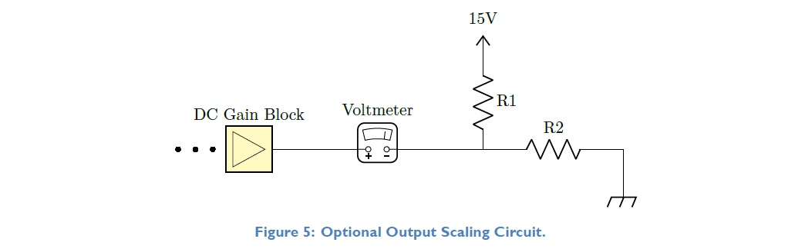
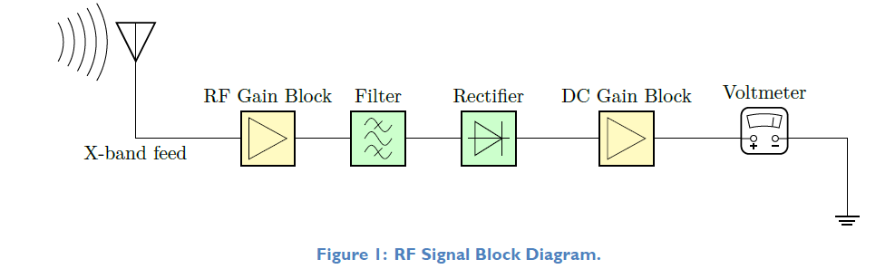
Change offset value of voltmeter
Cold sky ≈ 0 V
Change Gain factor
Use 0 – 5 V
It may problem when telescope catch the satellite signals
Need to re-calculate gain factor, offset value depending on solar activity cycle (increase 2 more years and decrease after)
Credit : Redesign of the Visitor Center Solar Telescope, Nguyen. R

