Slide 1
EduBridge
A project on
Placement Management System
By
Hinal Shah
B.E
Batch code:5758
Center: Thane Sprayas
Guidance By
Chittaranjan Ghosh
Technical Trainer
Edubridge

Slide 2
Introduction:
Our project explain about the Placement Management System.
This project mainly explains the various actions related to apply for job. Our project Include
Modules:
Student module
Recruiter module
Admin module
I have developed this application in Spring Boot, Hibernate , Mysql. It’s a web-based project so I have used HTML, CSS , Bootstrap and Thymeleaf .

Slide 3
The main feature of the project is to search job easier. You can access this website from anywhere and everywhere.
In Student module, student can access the website and apply for jobs. New student can register and login. Student can edit profile , upload picture n resume on portal.

Slide 4
In recruiter module, recruiter also can access the website for upload the job details. And new recruiter can also register and login. Recruiter can show student details
In Admin module, admin can delete the student. He can also view the total number of student and recruiter at present in website. Admin can only see admin page.

Slide 5
Software Requirements:
Frontend: HTML, CSS, Bootstrap, Thymeleaf
Backend & Middlewire: Spring Boot, Hibernate,Mysql
Application server: Embedded Tomcat Apache
IDE: Spring Tool Suite(STS)
Browser : Best result on Google chrome
Operating System: Windows 10

Slide 6
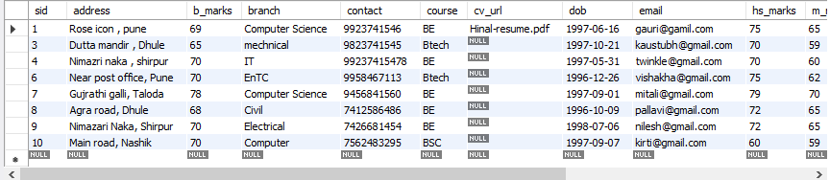
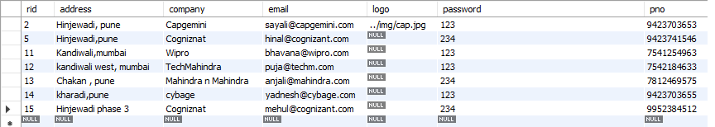
Data Dictionary :
Student :
Recruiter

Slide 7
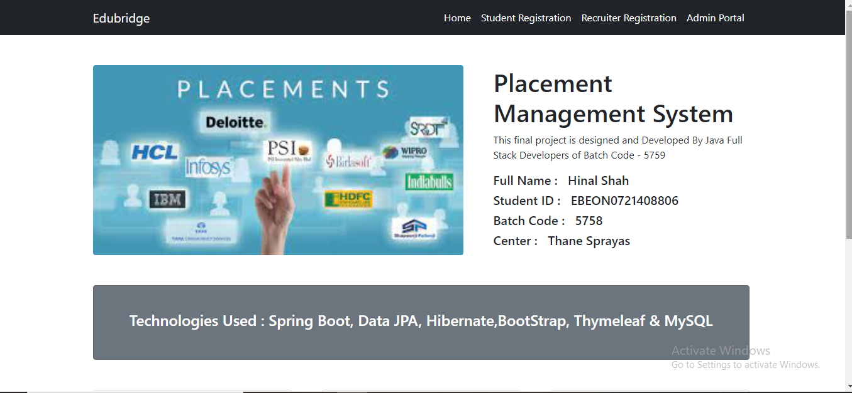
ScreenShots:
Home Page-

Slide 8
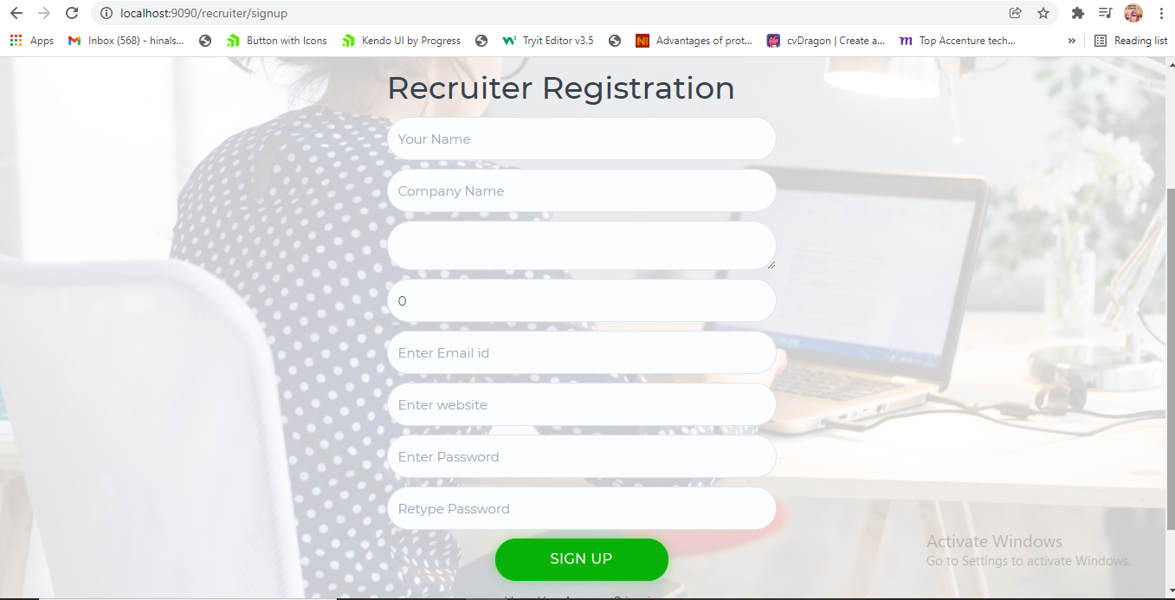
Recruiter Signup page-

Slide 9
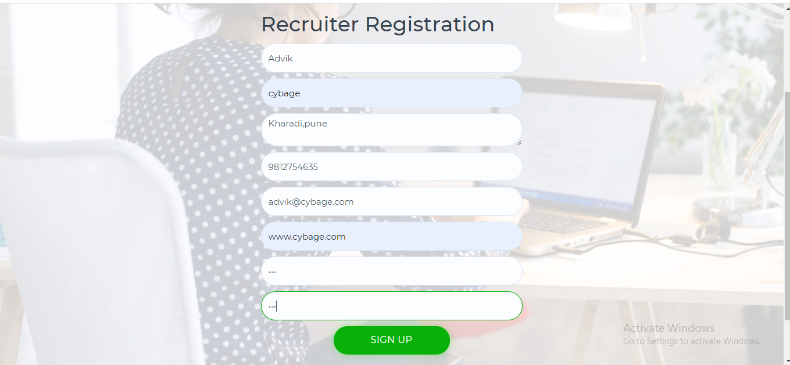
Register page with data

Slide 10


Registration done successfully
Signin Page

Slide 11
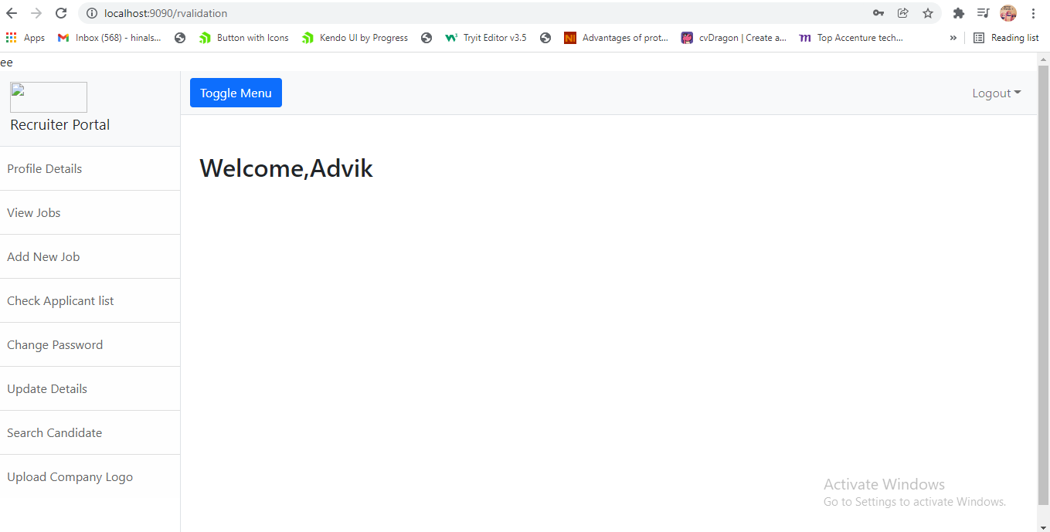
Recruiter portal

Slide 12
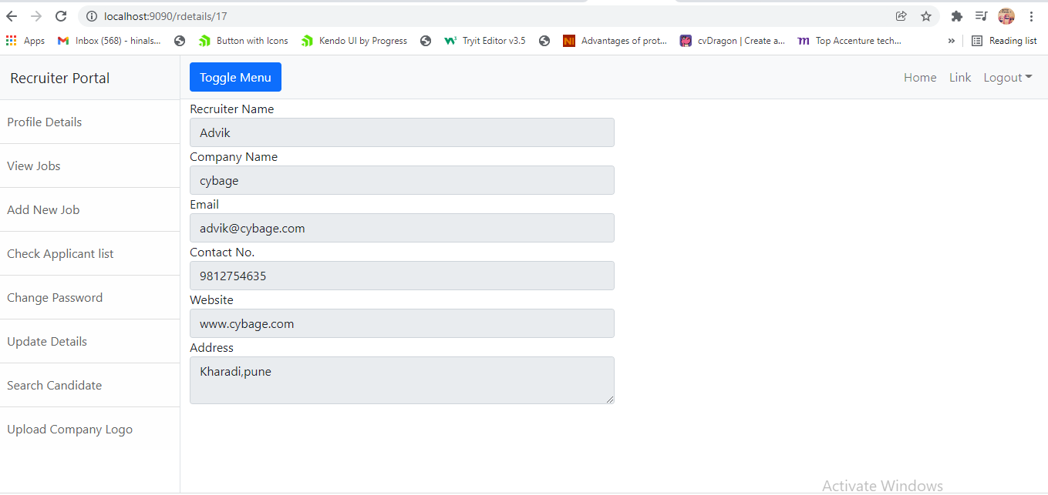
Recruiter profile Details -

Slide 13
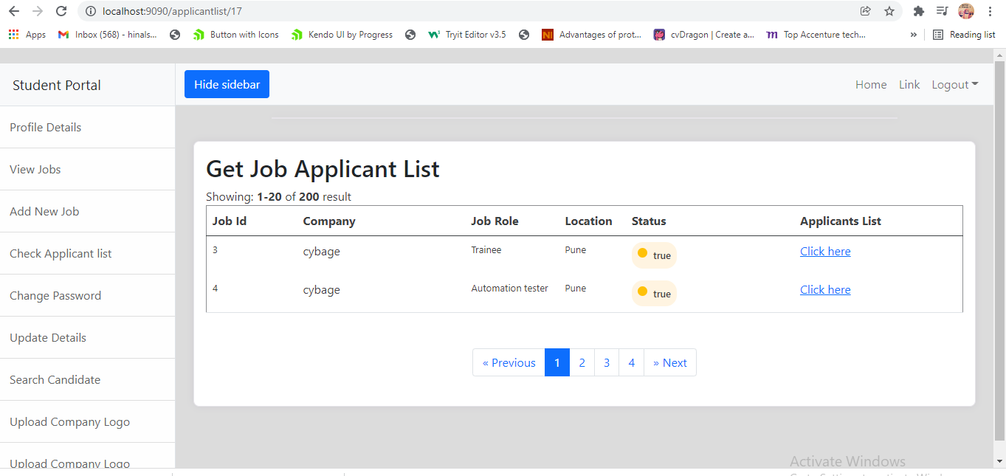
Job applicants

Slide 14
Thank You

