Slide 1
Hold That Line
Presented By: Group 2
Anusha Ayyagari
Hinal Bhavesh Desai
Saraswathi Sravani Pulluri
Devam Sheth
Saumya Singh

Slide 2

Story so far:
SUREFIRE
SUbordinate REadiness by Frequent Interval Role Exchange
Comprises 2 units: the line and the corporate staff.
Ben: responsible for line management.
Ted: HR personnel representing the corporate staff.
STRIKE: Line workers are planning for a strike.
A program to build superior/subordinate empathy relations on the job.
The Email from the VP of HR.
Scenario | Ted | Ben
Surefire and no strike | Max Benefit | Little Benefit
Surefire and strike | Not much of a loss | Little Benefit
No Surefire and no strike | Not much of a loss | Max Benefit
No Surefire and strike | Benefit | Max Loss

Slide 3
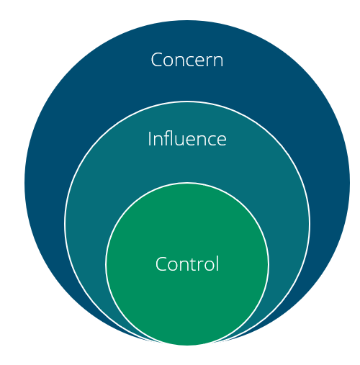
Lessons:
Circle of Influence/Concern
Situational Managerial Decisions
Accountability and Responsibility
Circle of Influence/Concern
Risks v/s Rewards
Organizational over personal

Slide 4

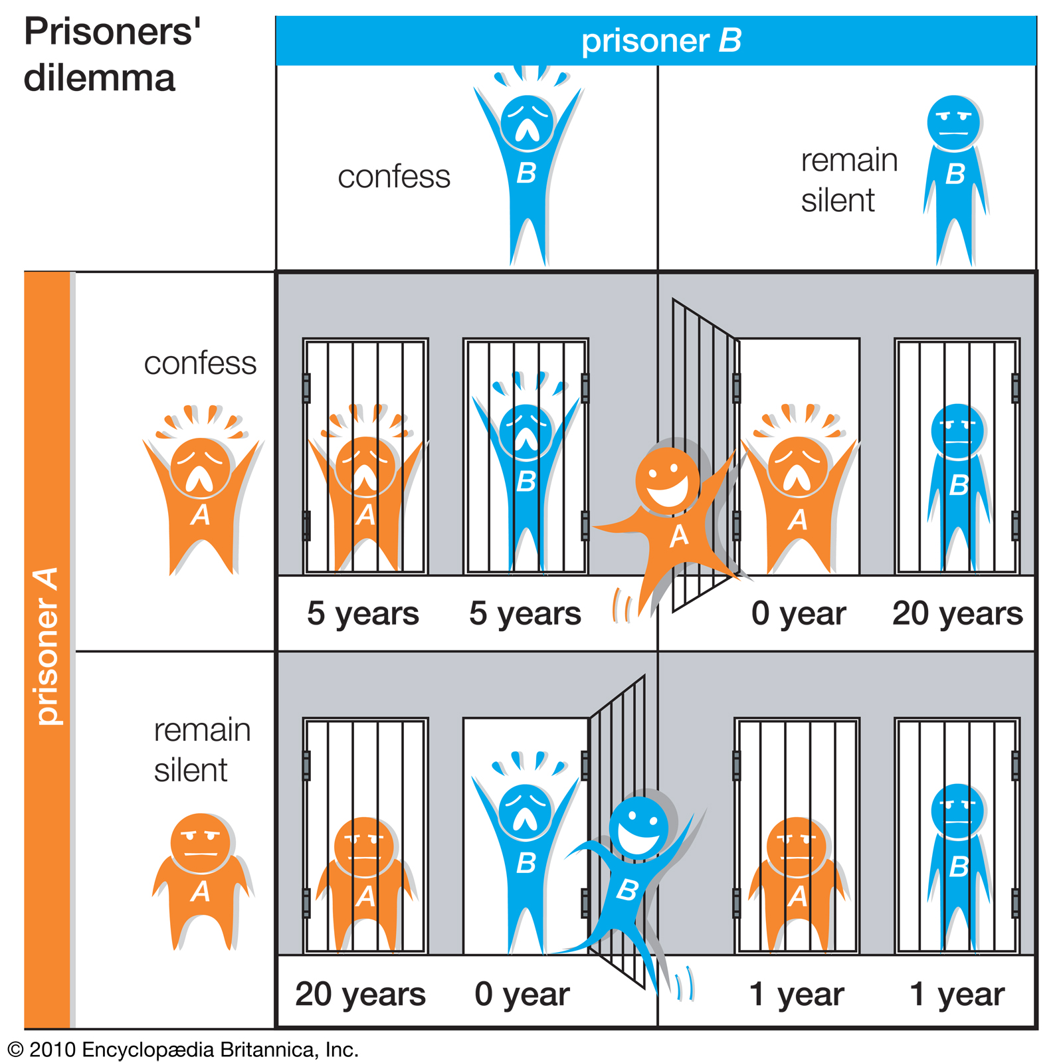
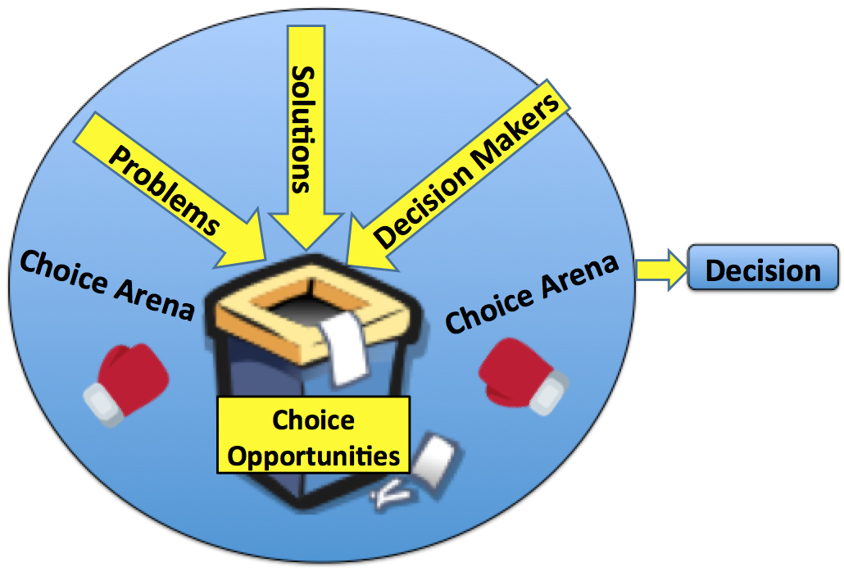
Research:
Game Theory
Game Theory:
Develop a range of outcomes based on decisions by reasonable actors and to present the advantages and disadvantages of each option.
Prisoner’s Dilemma:
Logically deriving predictions of behavior that are rational for all players and seem likely to occur.
Garbage Can Model of Decision Making:
Decisions often operate in an irrational environment with a lot of uncertainty.
Decision makers don’t always go for the perfect solution.
Interest-Based Relational Approach (IBR):
(IBR) approach to conflict resolution makes it possible to resolve a conflict while also maintaining a positive personal relationship.
Prisoner’s Dilemma
Garbage Can Model

Slide 5
QUESTIONS?
References:
1.https://www.mckinsey.com/business-functions/strategy-and-corporate-finance/our-insights/making-game-theory-work-for-managers
2.https://www.britannica.com/science/game-theory/The-prisoners-dilemma
3.https://thinkingbat.substack.com/p/game-theory?s=r
4.https://bizfluent.com/list-7428304-disadvantages-participative-leadership-theories.html
5. http://rpmconsultancy.com/ibr-conflict-management-strategy/

