Slide 1
Stitch In Time
Presented By: Group 2
Anusha Ayyagari
Hinal Bhavesh Desai
Saraswathi Sravani Pulluri
Devam Sheth
Saumya Singh

Slide 2
Story so far:
THE CRYING WAITRESS
A very busy restaurant in a big city.
It is not known for its cuisine, but people prefer it because of the quick service.
Difficult to manage the customers for the waiters and waitresses.
Nancy can’t handle the pressure and always goofs up.
Magda manages the situation well.
The key to Magda’s success is that she keeps the customers from having to think too much and makes the decisions for them.
Suggest what’s available and fast rather than what’s best or what the customer really likes.
THE COMPANY
Kerry Drake was a Construction Superintendent.
Stanley was Kerry’s Assistant.
They were lagging behind in time for the construction of their new plant.
Marshall Mason, the corporate staff watchdog enquires about the status of the construction.
Kerry lies to him stating that they are on time.
Stanley was awestruck.
Kerry explains Stanley about the benefits of manipulating the truth.

Slide 3
Lessons:
Decide with speed over precision- The best leaders quickly process available information, rapidly determine what matters most, and make decisions with conviction.
Problem resolution
If you let others set agenda for you, then you can’t control the consequences.
You should manage the situation rather than worrying about who is going to manage.

Slide 4
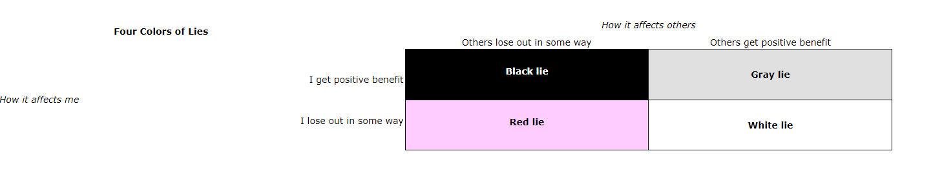
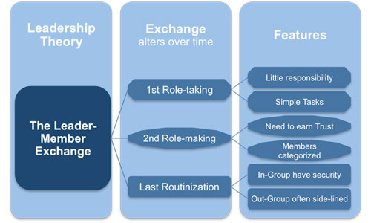
Research:
Four Color of Lies Theory
Four Color of Lies Theory
Leader–member exchange (LMX) theory
New paradigm due to Pandemic
Green Initiatives, diversity, inclusivity, etc.
Brand Humanity
How it affects me
LMX Theory

Slide 5
QUESTIONS?
REFERENCES:
https://www.sciencedirect.com/topics/social-sciences/leader-member-exchange-theory
Fig 2 Source: http://www.free-management-ebooks.com/faqld/leadmodels-06.htm
Fig 1 Source: http://changingminds.org/explanations/behaviors/lying/four_lies.htm
https://www.forbes.com/sites/forbesbusinesscouncil/2021/03/16/the-new-paradigm-shift-why-business-as-usual-wont-cut-it-anymore-for-consumers-and-employees/?sh=62172c684524
https://www.theguardian.com/sustainable-business/values-led-business1

