Slide 1


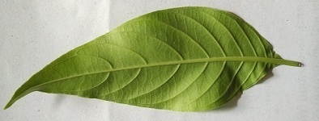
Sardar Vallabhbhai Patel Institute of Technology
Electronics & Communication Department(Embedded System)
A
DISSERTATION PHASE – II
ON
“DESIGNING OF LEAVES CLASSIFIER FOR AYURVEDIC PLANTS USING HYBRID FEATURE EXTRACTION”
Presented By:
HINAL PATEL(170410754002)
ME-EMBEDDED SYSTEM(4TH SEM.)
Guided By:
Dr.Nehal G. Chitaliya
Asso. Prof., E & C Dept.,
SVIT, Vasad.

Slide 2

OUTLINE
Motivation
Introduction
Objective of system
Problem Definition
Literature Review
Comparative analysis
Proposed System
Implementation & Result
Parameters
Applications
Conclusion
References

Slide 3
MOTIVATION

Slide 4
Ayurvedic Medicinal plants are most widely used in the medicinal industry to make medicines.
Today, the ayurvedic leaves are collected by a human from the forest area; those are not professionally trained to identify the correct ayurvedic plant species and those are very few in number[1].
With a good digital camera and a recognition program, one could get some useful information [2].
Plants assume a vital part in our surroundings. Without plants there will be no presence of the world's nature. Be that as it may, as of late, many sorts of plants are at the danger of termination [3].

Slide 5
INTRODUCTION

Slide 6

Today, identification and classification of unknown plant species are performed manually by expert personnel who are very few in number. The important aspect is to develop a system which classifies the plants. This approach presents a new recognition approach based on Leaf Features Fusion and ML Classification algorithms for classifying the different types of plants [1].
The proposed approach consists of Four phases that are pre-processing, Segmentation, feature extraction, and classification phases.
Figure 1: Simple Plant Identification and Classification of system

Slide 7
OBJECTIVE
OF
SYSTEM

Slide 8
Objective of System
To confirm the importance of leaf length, width, area and perimeter.
To improve learning of plant species using multi classification.
To improve effective use of medicine properties of plant with its identification.
To increase accuracy of Plant Identification based on Hybrid Feature Fusion.
To be suitably depicted with the assistance of different classification Approach.

Slide 9
PROBLEM
DEFINITION

Slide 10
Problem Definition
Plant Species knowledge is essential for protecting biodiversity. The identification of leaf by conventional keys is complex, time consuming, and due to the use of type of plant botanical terms frustrating for non-experts. This creates a hard to overcome hurdle for novices interested in acquiring Plant classification.
In Existing systems there is many feature extraction methods which is Contain feature combination of Shape-Color, Shape-texture or Color-Texture but there is not use any Vein feature with this Combination. So in our Proposed System trying to combine shape, color, texture, vein to over come all problems.

Slide 11
LITERATURE REVIEW

Slide 12
Paper | Identification of Ayurvedic Medicinal Plants by Image Processing of Leaf Samples | Leaves Classification Using Neural Network Based on Ensemble Features
Publication Year | 2017 Third International Conference on Research in Computational Intelligence and Communication Networks (ICRCICN) | 2018 5th International Conference on Electrical and Electronic Engineering (ICEEE)
Authors | Manojkumar P., Surya C. M., Varun P. Gopi | Sigit Adinugroho, Yuita Arum Sari
Used Methods | Pre-Processing -gray scaling, Resize Segmentation -morphological operation Feature Extraction -Color(HSV mean & std.) Texture (contrast, correlation, Zernike movement) -Geometry feature (diameter, solidity, eccentricity, extent, aspect ratio, compactness) Classification -ANN | Pre-Processing Segmentation -morphological operation Feature Extraction -Shape (perimetri, roundness, compactness, aspect ratio) -Color (standard deviation, skewness, kurtosis) -Texture(GLCM) Classification -Neural network
Advantages | -combination of morphological, color and texture features gives maximum identification rate of green leaves -it’s give accuracy 94.9% using MLP classification | -14 hidden nodes gives 95.54% accuracy using neural network
Limitation | -venation feature is not considered -not suitable for tiny leaves | -Training time is more -variant features are not used

Slide 13
Paper | Feature Selection for Texture-Based Plant Leaves Classification | Leaf Classification Using Completed Local Binary Pattern Of Textures
Publication Year | 2017 Intl Conf on Advanced Control Circuits Systems (ACCS) Systems & 2017 Intl Conf on New Paradigms in Electronics & Information Technology (PEIT) | 2017 IEEE 7th International Advance Computing Conference (IACC)
Authors | Heba A. Elnemr | Anilkumar.Muthevi, Dr.Ravi babu. uppu
Used Methods | Pre-Processing -gray scaling, unsharp filter -ROI separation Segmentation -Otsu’s method Feature Extraction -curvelet descriptor, LBP, GLCM Classification -KNN | Pre-Processing -gray scaling -cropping -Noise remover Segmentation Feature Extraction -LDSMT, CLBP histogram Classification -Binary classifier
Advantages | -Use of texture feature gives better performance | -combine feature extraction and classification methods use signification performance
Limitation | -color & shape features are not included - Classification can be improved using deep learning | -low dataset should increase -not applicable for Real Time application

Slide 14
Paper | An Improved Technique of Plant Leaf Classification Using Hybrid Feature Modelling | Leaf Classification and Identification using Canny Edge Detector and SVM Classifier
Publication Year | International Conference on Innovative Mechanisms for Industry Applications (ICIMIA 2017) | International Conference on Inventive Systems and Control (ICISC-2017)
Authors | Anusha Rao, Dr. S.B. Kulkarni | Adil Salman, Ashish Semwal, Upendra Bhatt, V. M Thakkar
Used Methods | Pre-Processing -auto regressive method Segmentation Feature Extraction -Shape (area, convex, major axis, minor axis, eccentricity) Classification -Deep neural network | Pre-Processing -gray scaling -Binary and separate image Segmentation Feature Extraction -Shape(area, convex, major axis, minor axis, eccentricity,orientation,Extent, circularity) Classification -SVM
Advantages | -used for auto regression model in Pre-processing edges -95.38% accuracy | -SVM gives batter accuracy.
Limitation | -not work for different background -occlusion problem -similar shape, misclassified | -No Segmentation Method Present. -Uses only shape feature

Slide 15
Paper | Acquiring and pre-processing leaf images for automated plant identification: understanding the tradeoffs between effort and information gain | Leaf-Based Plant Identification Through Morphological Characterization in Digital Images
Publication Year | International Conference on Innovative Mechanisms for Industry Applications (ICIMIA 2017) | Springer International Publishing Switzerland 2015
Authors | Michael Rzanny, Marco Seeland, Jana Wäldchen and Patrick Mäder | Arturo Oncevay-Marcos, Ronald Juarez-Chambi, Sof´ıa Khlebnikov-N´u˜nez,And C´esar Beltr´an-Casta˜n´on
Used Methods | Pre-Processing -gray scaling Segmentation Feature Extraction - CNN Classification -SVM | Pre-Processing -skeletonization Segmentation Feature Extraction - CNN, color moment Texture -GLCM Classification MLP
Advantages | - Uses Large Training Data sets. | MLP achieve 90.41% Accuracy.
Limitation | - They have used back side of leaf features, it will not give better accuracy. | - Venation feature not include. - Data set takes more time.

Slide 16
COMPARATIVE
STUDY

Slide 17
Comparative Study: Segmentation
Method | Advantage | Disadvantage
Cluster Base K-means | - Works for noisy Image | - Difficult to predict the number of clusters (K-Value) - Works with fixed distance
OTSU’s Thresholding [3] | - The attractive features of Otsu algorithm is its segmentation results is stable and it is robust to noise | - There is problem when large variance are there and large noise is added. Increases time complexity of the algorithm.
Morphological Operation[1,2] | Work for binary images. Remove Noisy Pixels. | Thresolding Value is require.
Table 1: Comparison Between segmentation methods

Slide 18
Comparison between feature extraction method
Comparative Study: Feature Extraction
Features | Methods | Advantages | Disadvantages
Shape | Area, Perimeter, Major and Minor Axis[1] | - Easy to implement and Less Complex - Less Time | - Works with Binary Image only
Color | Color histogram[5] | - Simple to use - Fast Computation | - Lost spatial information - No color similarity
 | Color Moment[1,4] | Create robust feature set, High Accuracy, Low - Computation | - Not Cover Invariant Property
 | HSV,HSI | - color dominates the - texture feature | - color dominates the Texture feature and it provides better accuracy. But it may not be the same for all cases
Texture | LBP[7] | - Save memory with a non uniform pattern there is 2p possible combinations while for uniform LBP there are patterns of p(p-1)+2. - It does calculation in integer | - It is less accurate
 | GLCM[1,5] | - more effective in texture feature extraction and the high classification accuracy | - Works with Gray scale images
 | Haralic features | Computational accuracy of feature vectors is high - Classification accuracy is high | - Due to 13 features the computation of feature vectors is complex and time consuming. High Dimensionality
Table 2: Comparison Between Feature Extraction methods

Slide 19
Comparative Study: Classification
Method | Advantage | Disadvantage
SVM(support vector machine)[1] | Less complex Accurate classifier - Robust to noise | - SVM is binary classifier to do multi-classification pair wise model is used
ANN(Artificial neural network)[2] | - High agree of non-linearity possible | - Hard to tune parameter - More time to build model
KNN(K-nearest neighbor)[3] | - Robust to noisy training data Effective If the training data is large | - Distance based learning is not clear which type of distance to use and which attribute to use to produce the best result
DNN(Deep Neural Network)[5] | - Has best-in-class performance on problems that significantly outperforms other solutions in multiple domains. | - Requires a large amount of data, if you only have thousands of example, deep learning is unlikely to outperform other approaches.
Table 3: Comparison Between Classification methods

Slide 20
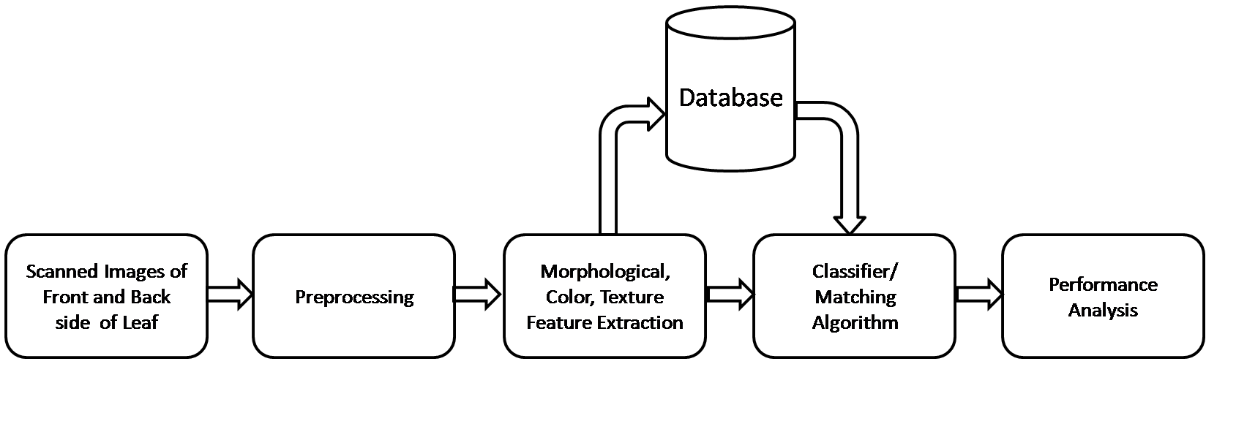
Existing System[1]
Fig.2 Block Diagram of Existing System[1]

Slide 21
Algorithm
Steps:
firstly, scanned front and back side of leaf images.
Then, apply method gray scalling and resize the images in pre processing block.
Then, Apply Morphological Operation , geometric features, feature extraction methods.
Apply Classification Method for classified the image and compare with training Phase
Finally, identify the plant leaf.
Stop.

Slide 22
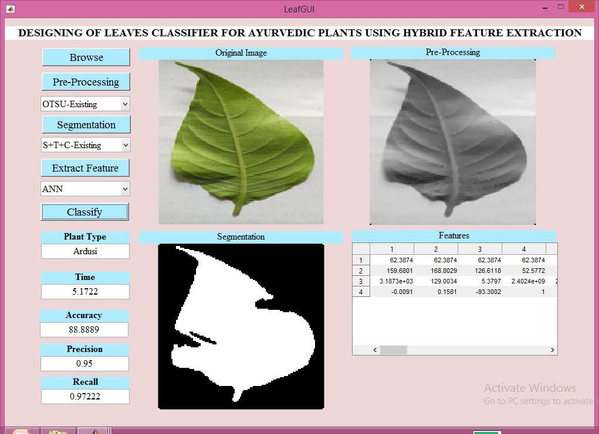
Implementation Result: Existing System
Fig. 3 OTSU’S Leaf Segmentation with ANN Classifier

Slide 23
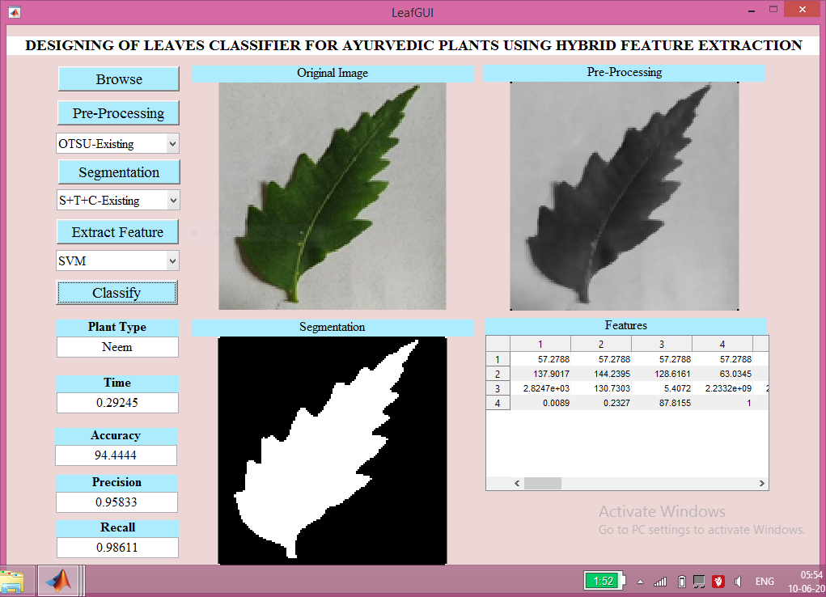
Implementation Result: Existing System
fig.4 OTSU’S Leaf Segmentation with SVM Classifier

Slide 24
Existing Vs Proposed
Parameters | Existing[1] | Proposed
Pre-Processing | - Gray Scalling, Resize | - Gray Scalling, Resize
Segmentation | morphological operation OTSU’S Thresholding | Canny Edge Detection Contourlet Transform
Feature | - Color(HSV mean & std.) Texture (contrast, correlation, Zernike movement) -Geometry feature (diameter, solidity, eccentricity, extent, aspect ratio, compactness) | Shape (Area, Perimeter, Major and Minor Axis,Centroide) Color (HSV mean & std.) Texture(GLCM) Vein
Classifier | - ANN | - SVM,ANN,RF
Table 4: Existing Vs Proposed

Slide 25
PROPOSED SYSTEM

Slide 26
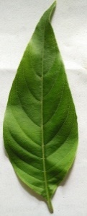
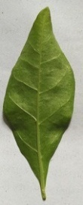
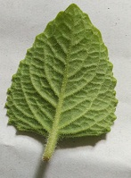
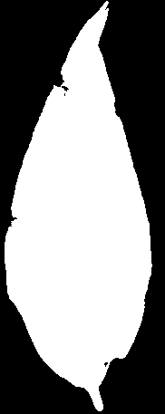

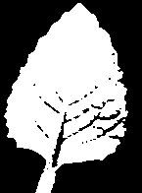
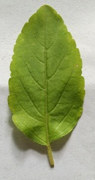

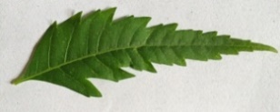
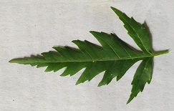


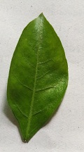

Proposed System Block Diagram
Pre-Processing
Shape, Color, Vein, Texture Features Extraction
ANN,
SVM,
RF
Classifier
Plant Leaf Samples
Segmentation
Pre-Processing
Shape, Color, Vein, Texture Features Extraction
Identify Plant Leaf
Test Image
Segmentation
Fig 5. Block diagram of proposed system

Slide 27
Training Phase
Testing Phase
Plant Leaf Samples Collection
Input Test Image
Image Acquisition
Image Preprocessing
Image Pre-processing
Segmentation
Segmentation
Feature Extraction
Feature Extraction
Feature Fusion
Feature Fusion
Matching or Predict
Plant Feature Database
Classification
Group Predict
Plant Identification
Fig.6 training phase and testing phase of system

Slide 28
Algorithm of Proposed System
Steps:
Prepare Training Dataset
Collect Plant Leaf Samples.
Acquisition of plant leaf images
Apply Preprocessing on each plan leaf image includes Gray conversion, median filtering and then binarization and segmentation.
Extract Features of plant leaf such as shape, color, vein, texture etc.
Fuse the features based on combination.
Prepare features vector.
Read the testing plant leaf image
Apply Preprocessing on test image including same steps in step 1-c
Extract Features specified in Step 1-d and Fuse them based on combination.
Train the training dataset and predicate testing image by using SVM Classifier.
Finally, identify the plan leaf.
Stop.

Slide 29
Dataset
The Dataset of leaves image is downloaded from ImageCLEF 2013. In Proposed System 16 Species with 191 leaf images are Used for Training.
Sr. No. | Plant Species | No. of image
1 | Annick | 45
2 | Ardusi | 6
3 | Banana | 6
4 | Bay Laurel | 6
5 | Buttonbush | 6
6 | Fresa | 25
7 | Heena | 6
8 | Maidenhair | 6
Sr. No. | Plant Species | No. of image
9 | Maple leaf | 6
10 | Mint | 6
11 | Neem | 6
12 | Pipal | 5
13 | Rabano | 25
14 | Tomato | 25
15 | Trillium | 6
16 | Tulsi | 6
Table 5: Leaf Dataset

Slide 30
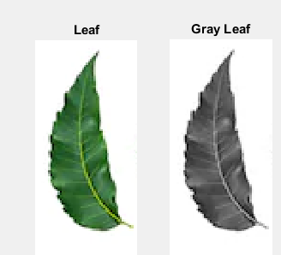
Pre-Processing Method: Gray Scalling and Resizing
A grayscale image is one in which the value of each pixel is a single sample representing only an amount of light. that is, it carries only intensity information.
Images of this sort, also known as black-and-white or gray monochrome, are composed exclusively of shades of gray. The contrast ranges from black at the weakest intensity to white at the strongest.
Fig.7 Original leaf and gray leaf

Slide 31
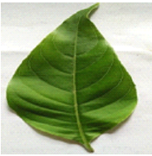
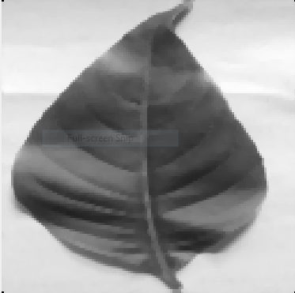
Pre-Processing Method: Gray Scalling and Resizing
187 X 460
Original Image
128 X 128
Resizing Image
Gray-Scalling
&
Filtering
Fig.8 Pre-processing Method

Slide 32
Segmentation Method: Contourlet Transform
The Contourlet transform uses a double filter bank structure to get the smooth contours of images.
In this double filter bank,
Laplacian pyramid (LP)
directional filter bank (DFB)

Slide 33
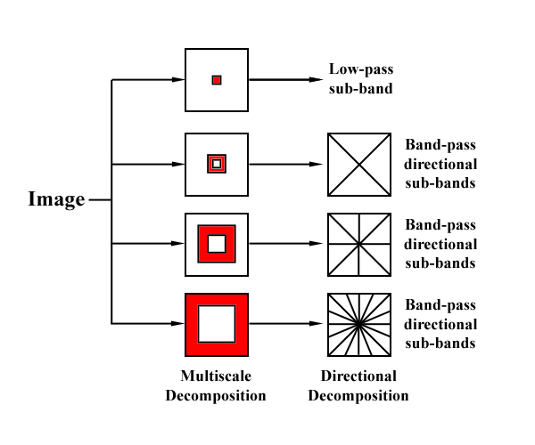
Segmentation Method: Contourlet Transform
Nonsubsampled Contourlet Transform(NSCT):
The Nonsubsampled Contourlet transform (NSCT) was developed mainly because it is shift invariant.
To retain the directional and multiscale properties of the transform, the Laplacian Pyramid was replaced with a Nonsubsampled pyramid structure to retain the multiscale property, and a Nonsubsampled directional filter bank for directionality.
The first major notable difference is that up sampling and down sampling are removed from both processes.
Fig.9 NSCT Block Diagram

Slide 34
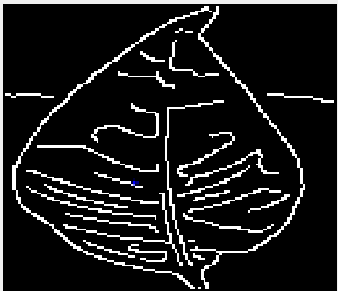
Segmentation Method: Canny Edge Detection
The Canny edge detector is an edge detection operator that uses a multi-stage algorithm to detect a wide range of edges in images.
Canny edge detection is a technique to extract useful structural information from different vision objects and dramatically reduce the amount of data to be processed.
(a)
(b)
Fig.10(a) Original Image and
(b) Canny Edge detector image

Slide 35
Feature Extraction Method
Shape Features:
Features
Description
Area | The Area Specifies the actual number of pixels in the region.
Minor axis length & Major axis Length | That specifies the length (in pixels) of the major axis and minor axis of the ellipse that has the same normalized second central moments as the region.
Perimeter | That specifies the distance between each adjoining pair of pixels around the boundary of the region.
Perimeter Ratio | P/L+W
Centroid | Calculate Centroid for connected components in the image.
Table 6: Shape Features

Slide 36
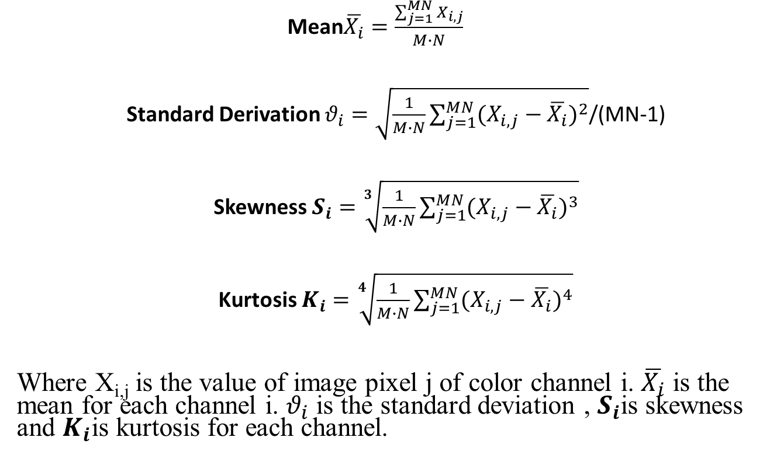
Color features:

Slide 37
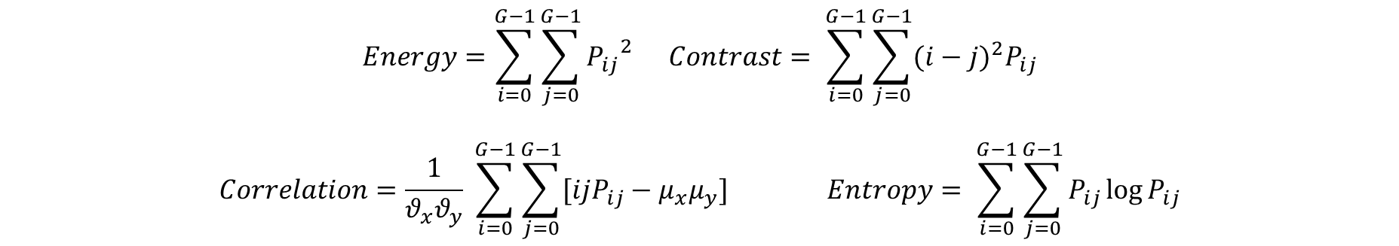
Texture Feature: GLCM
Texture Features:
GLCM(Grey-level co-occurrence matrix) directional analysis
Energy: To measure the orderliness how regularly and orderly pixels are in window.
Contrast: The difference in color and light between parts of an image.
Correlation: A correlation is a single number that describes the degree of relationship between two Pixel.
Entropy: The amount of information which must be coded for by a compression algorithm.
$$Energy=\sum_{i=0}^{G−1}{\sum_{j=0}^{G−1}{{P_{ij}}^{2}}} Contrast= \sum_{i=0}^{G−1}{\sum_{j=0}^{G−1}{{(i−j)}^{2}P_{ij}}}$$
$$Correlation=\frac{1}{θ_{x}θ_{y}} \sum_{i=0}^{G−1}{\sum_{j=0}^{G−1}{[ijP_{ij}−μ_{x}μ_{y}]}} Entropy= \sum_{i=0}^{G−1}{\sum_{j=0}^{G−1}{P_{ij}\log{P_{ij}}}}$$

Slide 38
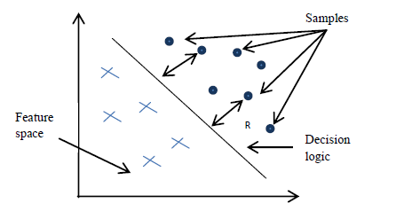
Classifier: SVM(Support Vector Machine)
SVM is a supervised learning models with associated learning algorithm that analyze data used for classification and regression analysis.
Support vector machine is a discriminative classifier formally defined by separating hyper plane. The decision function is fully specified by a subset of training samples of the support vectors.
Fig.11 SVM(Support Vector Machine)

Slide 39
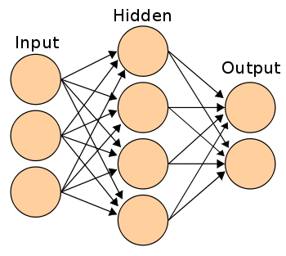
Classifier: ANN (Artificial Neural Network)
An artificial neural network is a network of simple elements called artificial neurons, which receive input, change their internal state (activation) according to that input, and produce output depending on the input and activation.
Fig.12 ANN (Artificial Neural Network)

Slide 40
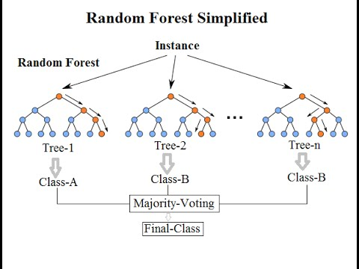
Classifier: RF(Random Forest)
Random forest (RF) is one of the most widely used and powerful machine learning techniques which has shown higher accuracy rate among recent machine learning algorithms.
It is suitable for training large set of data with a guarantee of estimating the most appropriate features required for classification.
RF is a collection of tree-structured classifiers where each tree depends on the values of random vector sampled independently and the distribution of all trees in the forest.
Fig.13 RF (Random Forest)

Slide 41
Implementation
&
Result

Slide 42
Requirement and Specification
Software Requirement
Operating System: Microsoft Windows 8 or high
System Type : 64 bit
Tools
MATLAB R 2016a

Slide 43
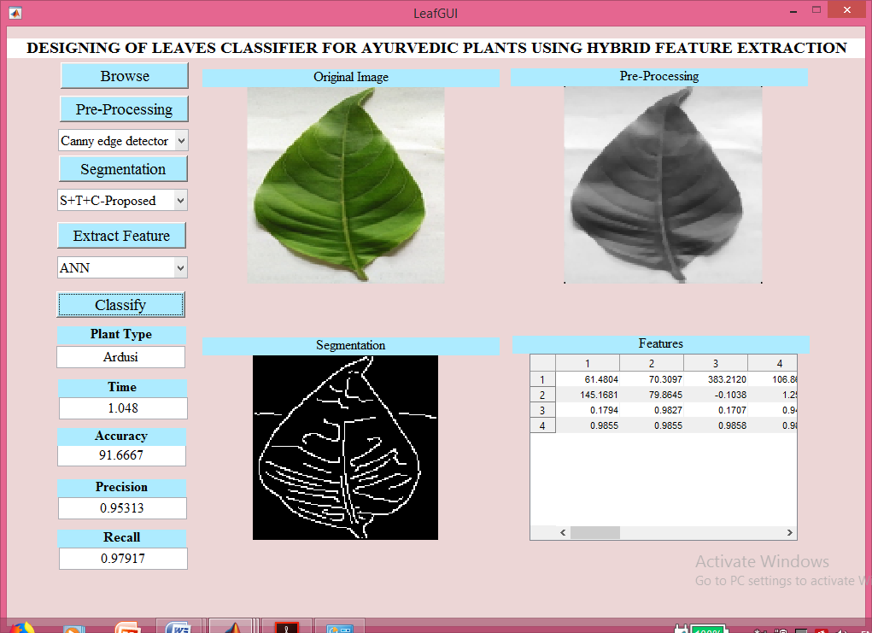
Implementation Result : GUI Design
fig.14 Canny edge detection with ANN Classifier

Slide 44
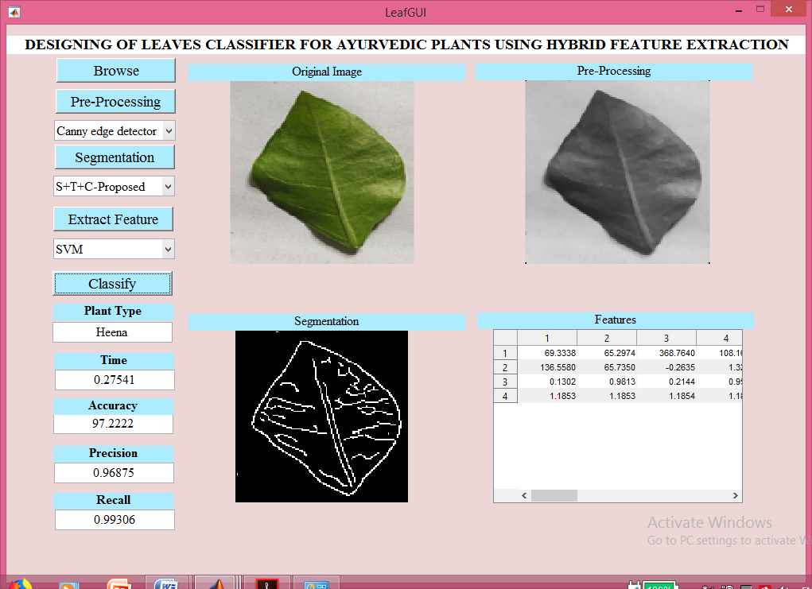
Implementation Result: GUI Design
fig.15 Canny edge detection with SVM Classifier

Slide 45
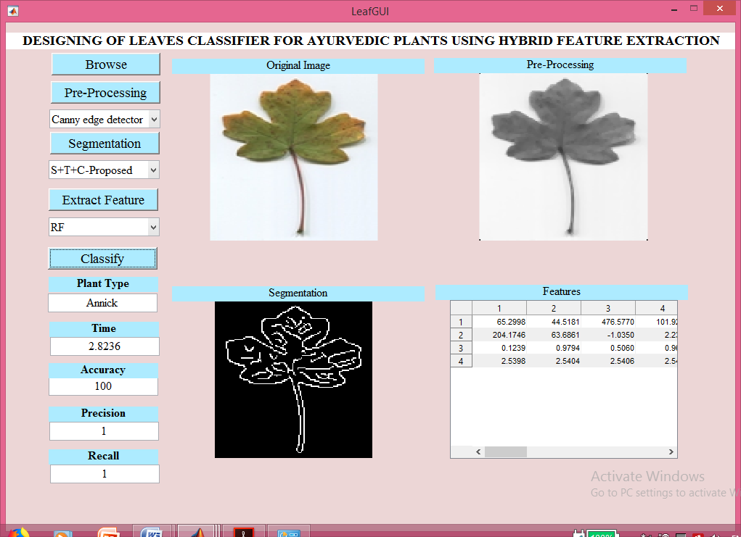
Implementation Result: GUI Design
fig.16 Canny edge detection with RF Classifier

Slide 46
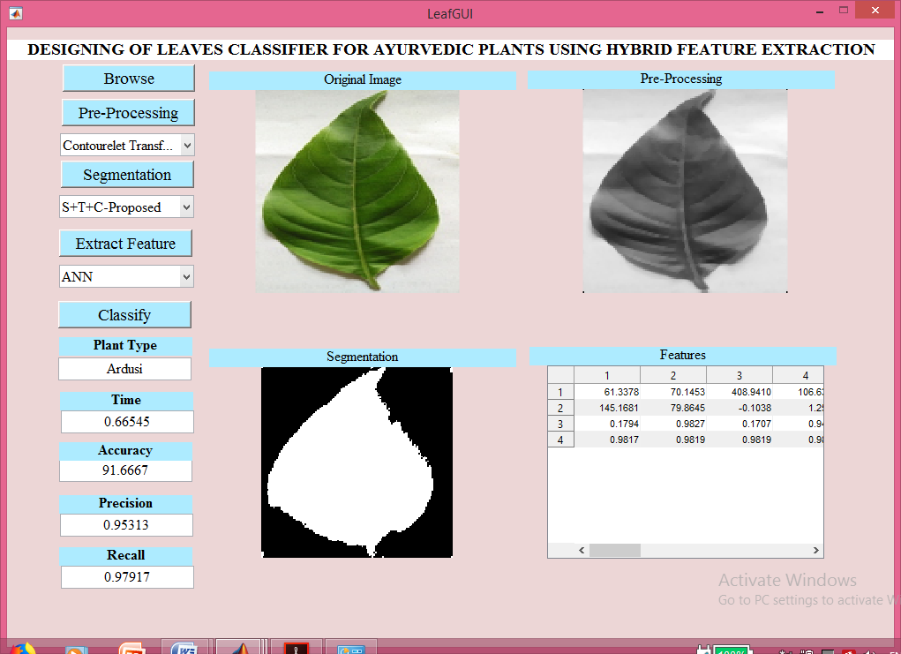
Implementation Result: GUI Design
fig.17 Nonsubsampled Contourlet Transform with ANN Classifier

Slide 47
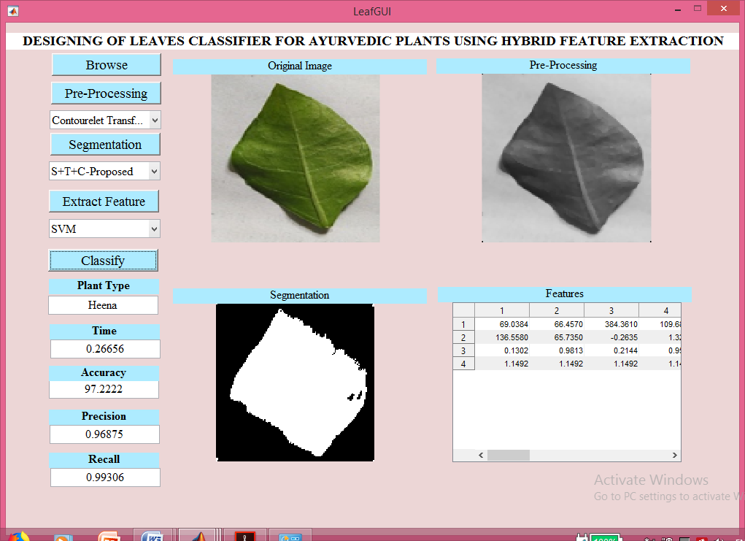
Implementation Result: GUI Design
fig.18 Nonsubsampled Contourlet Transform with SVM Classifier

Slide 48
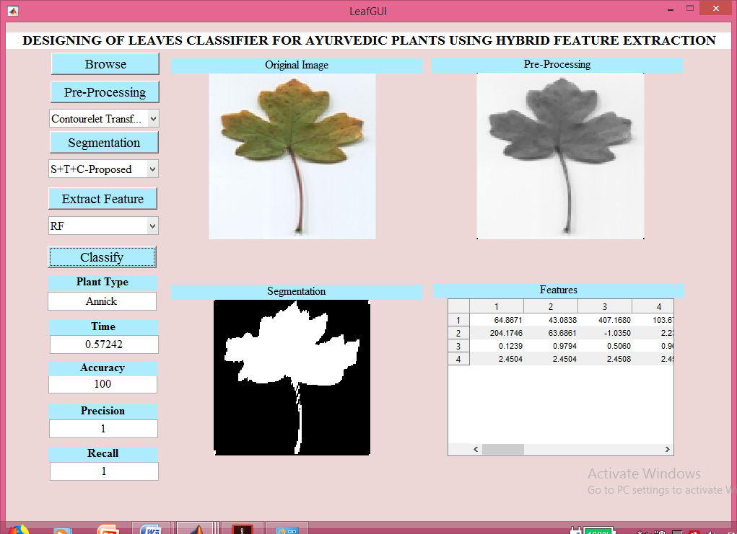
Implementation Result: GUI Design
fig.19 Nonsubsampled Contourlet Transform with RF Classifier

Slide 49
PARAMETERS

Slide 50
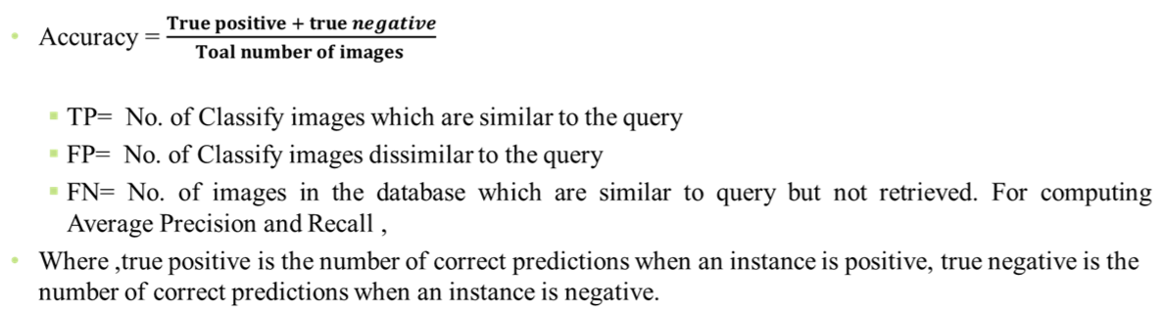


Classification Measurement

Slide 51
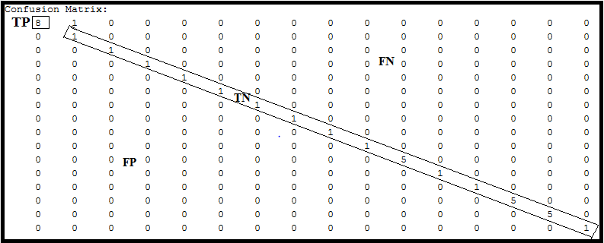
Mathematically Calculation:
For SVM Classifier:
Accuracy = TP + TN/ TP + TN + FP + FN
= 8 + 27/ 8 + 27 + 0 + 1 = 35/36 = 97.222%

Slide 52
Comparison of Performance Analysis Of System
Segmentation Techniques | Classifier | Accuracy | Precision | Recall | Time(sec.)
Canny edge detector | ANN | 91.6667 | 0.95313 | 0.97917 | 1.048
 | SVM | 97.2222 | 0.96875 | 0.99306 | 0.27541
 | RF | 99.9999 | 1 | 1 | 2.8236
Contourlet Transform | ANN | 91.6667 | 0.95313 | 0.97917 | 0.66545
 | SVM | 97.2222 | 0.96875 | 0.99306 | 0.57242
 | RF | 99.9999 | 1 | 1 | 0.26656
Table 7: Performance analysis of system with different segmentation technique and different classifier

Slide 53
Graphically Representation of System Analysis
Processing Time
Fig. 20 Graphical Representation Of Analysis

Slide 54
APPLICATION

Slide 55
Application
Agriculture Industry
Biomedical Department
Ayurveda Department
Forensic Department
Forest

Slide 56
CONCLUSION

Slide 57
Here we conclude that for the segmentation the Contourlet transform as a robust method for both accuracy as well as processing time and also canny edge detector give accurate result, but the processing time is more than NSCT (Nonsubsampled Contourlet transform). By canny edge detector, there were extract vein of the leaves for accurate result. In proposed system, there were RF classifiers given 99.9999% accuracy. So, the RF is more accurate than other classifier for the proposed system and gives the accurate result for leaf identification.

Slide 58
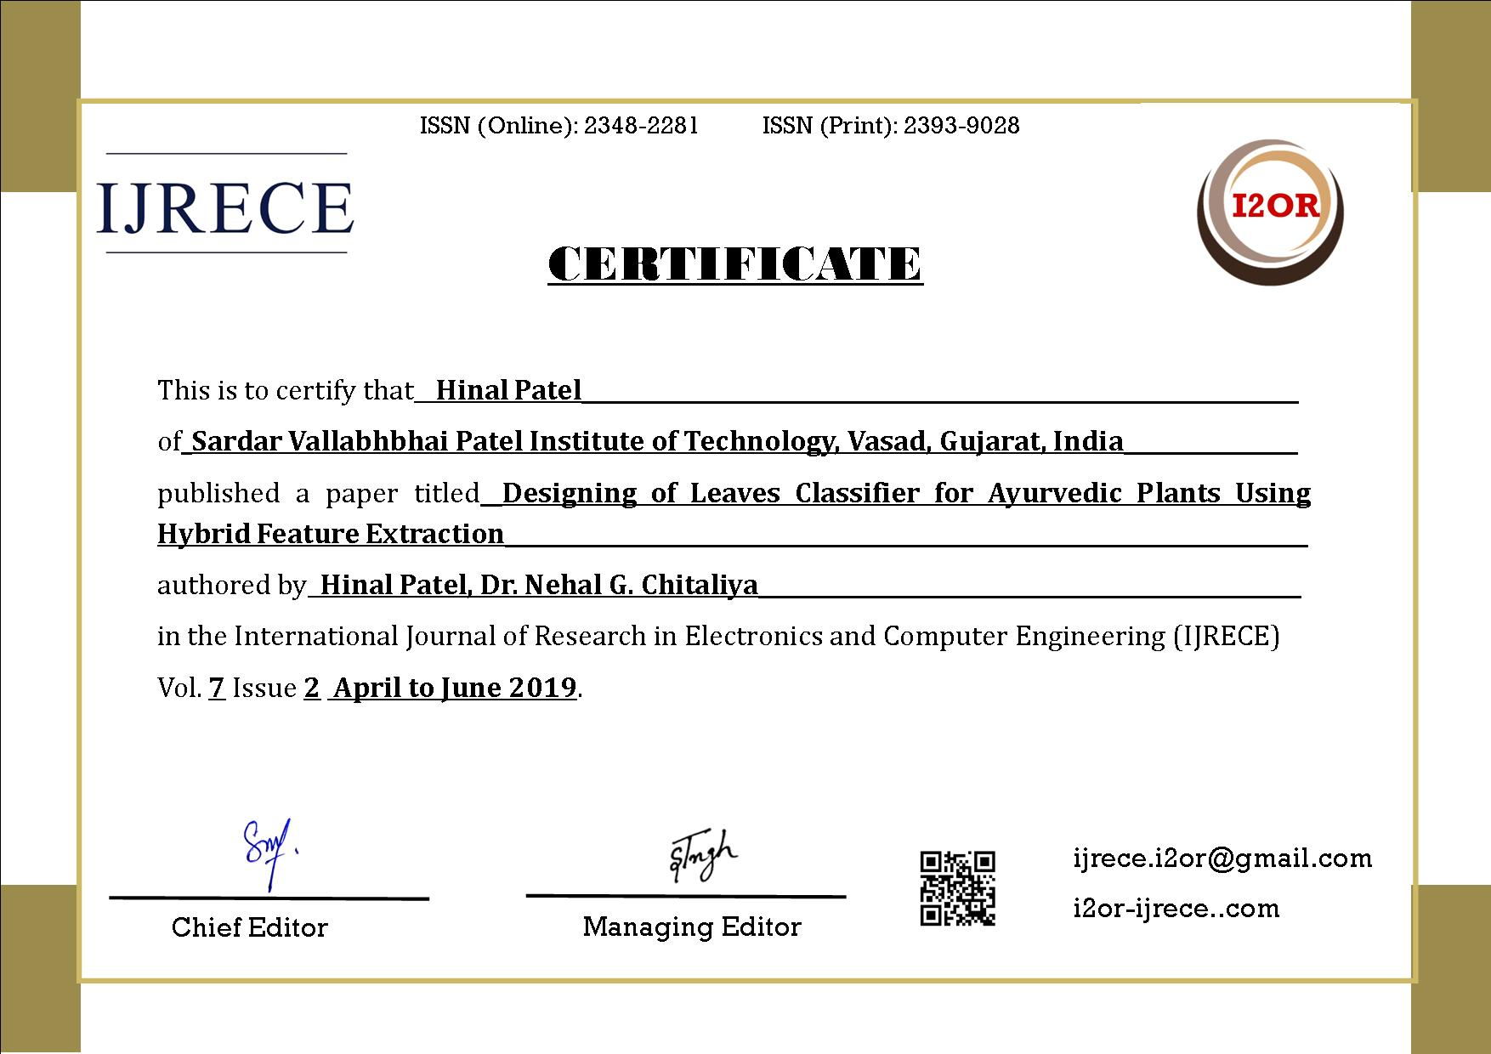
PAPER PUBLICATION
Following Research Paper is published in UGC Approved Journal:
An article “Designing of leaves Classifier for ayurvedic plants using Hybrid Feature Extraction” has been published for publication by the International Journal of Research in Electronics and Computer Engineering (IJRECE), Print ISSN: 2393-9028, Online ISSN: 2348-2281 VOL. 7, ISSUE 2, APRIL - JUNE 2019. The Certificate of research paper is below:

Slide 59
REFERENCES

Slide 60
References
[1] Adil Salman, Ashish Semwal & Upendra Bhatt, “Leaf Classification and Identification using Canny Edge Detector and SVM Classifier”, International Conference on Inventive Systems and Control(ICISC-2017)
[2] Pankaj K & Dr. Thippeswamy G, “Survey on Leaf Recognization and Classification”, International Conference on Innovative Mechanisms for Industry Applications(ICIMIA 2017)
[3] Arturo Oncevay-Marcos, Ronald Juarez-Chambi, Sofia Khlebnikov-Nunezand & Cesar Beltran-Castanon, “Leaf-Based Plant Identification Through Morphological Characterization in Digital Images”, Springer International Publishing Switzerland 2015,G. Azzopardi and N. Petkov (Eds.): CAIP 2015, Part II, LNCS 9257, pp. 326–335, 2015,DOI: 10.1007/978-3-319-23117-4 28
[4] Michael Rzanny, Marco Seeland, Jana Wäldchen & Patrick Mäder, “Acquiring and pre-processing leaf images for automated plant identification: understanding the trade-off between effort and information gain”, Rzanny et al. Plant Methods (2017) 13:97,DOI 10.1186/s13007-017-0245-8
[5] D Venkataraman & Mangayarkarasi N, “Support Vector Machine Based Classification of Medicinal Plants Using Leaf Features”, 2017 International Conference on Advances in Computing, Communications and Informatics (ICACCI)

Slide 61
References(cont...)
[6] Adil Salman, Ashish Semwal & Upendra Bhatt, “Leaf Classification and Identification using Canny Edge Detector and SVM Classifier”, International Conference on Inventive Systems and Control(ICISC-2017)
[7] Pankaj K & Dr. Thippeswamy G, “Survey on Leaf Recognization and Classification”, International Conference on Innovative Mechanisms for Industry Applications(ICIMIA 2017)
[8] Arturo Oncevay-Marcos, Ronald Juarez-Chambi, Sofia Khlebnikov-Nunezand & Cesar Beltran-Castanon, “Leaf-Based Plant Identification Through Morphological Characterization in Digital Images”, Springer International Publishing Switzerland 2015,G. Azzopardi and N. Petkov (Eds.): CAIP 2015, Part II, LNCS 9257, pp. 326–335, 2015,DOI: 10.1007/978-3-319-23117-4 28
[9] Michael Rzanny, Marco Seeland, Jana Wäldchen & Patrick Mäder, “Acquiring and pre-processing leaf images for automated plant identification: understanding the trade-off between effort and information gain”, Rzanny et al. Plant Methods (2017) 13:97,DOI 10.1186/s13007-017-0245-8
[10] D Venkataraman & Mangayarkarasi N, “Support Vector Machine Based Classification of Medicinal Plants Using Leaf Features”, 2017 International Conference on Advances in Computing, Communications and Informatics (ICACCI)

Slide 62
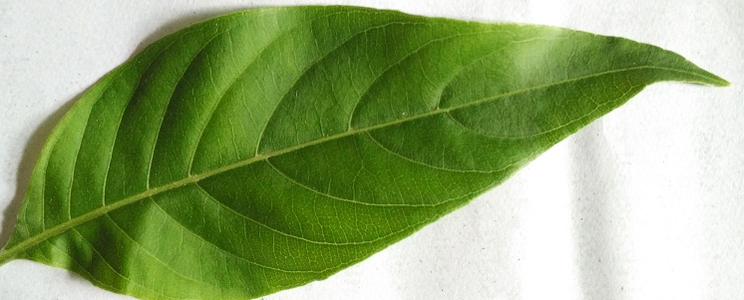
..Thank You..

