Slide 1
DataZen Website(Front page)
By Hinal Pujara

Slide 2

Navbar
Working buttons
DataZen logo – Redirects you to Home page if you are on some other page.
Home – Again Redirects you to Home page if you are on some other page.
About – Takes you to About us info.
Contact us – Takes you to Contact us info.
Register – Takes you to registration

Slide 3

Welcome Part
Working button – Start Learning(It takes you to the Get Started Part)
Opacity of the frame given 0.7 so that background image/gif is visible

Slide 4

About us

Slide 5
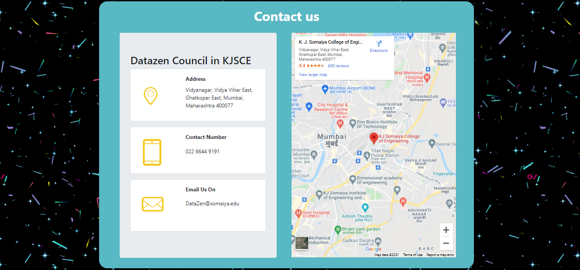
Contact us

Slide 6
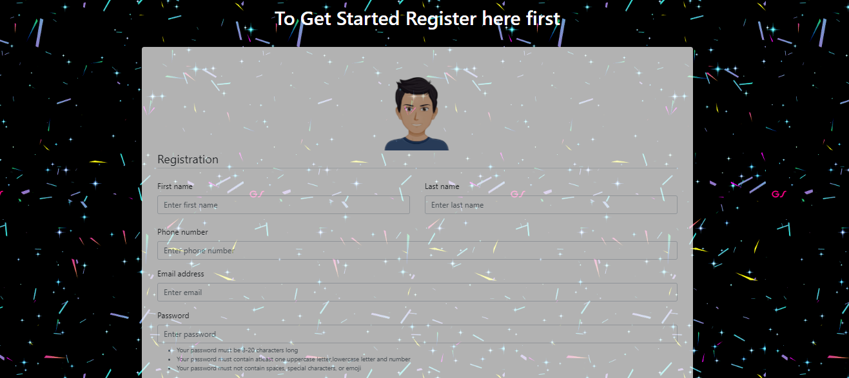
Register

Slide 7

Register continue
Registration form
Password Validation
Opacity again 0.7

Slide 8
Footer

