Slide 1


Donor Prediction Model
Nour AZAR
Sofie GHYSELS
Hina HUSSAIN

Slide 2
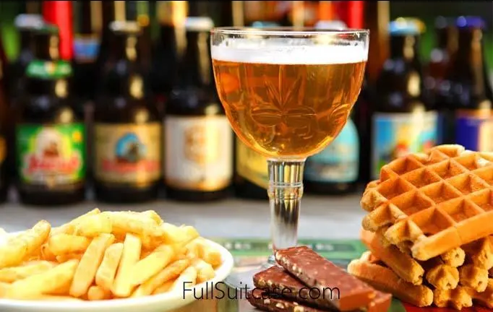
Setting the scene
240 euros per year
54% → philanthropy is a moral duty
Popular good causes: health, nature & local
1/10 → will → 330 million €

Slide 3
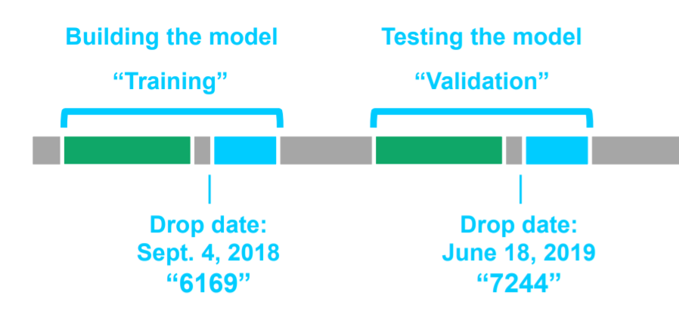
Project definition
Target | What do we want to predict? Donors who donated more than 30 euros
Population | Who do we want to make the predictions for? People who donated for DSC campaigns
Timeline | What is the timeframe of the predictions?
Plan usage | How will business use the predictions? Contact optimal number of donors that will donate > 30 euros

Slide 4
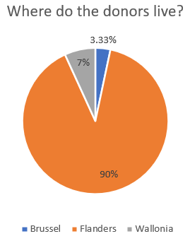
Exploratory data analysis
Total number of donors = 44657
Youngest donor: 23 years old
Oldest donor: 102 years old
Average age: 52 years old
Language spoken:
90% Dutch / 10% French

Slide 5
Feature engineering
Recency
Active period
Freq donated > 30
Donations in campaign only
Age groups
Donations of last year
Frequency last year
Donations last 3 years
Frequency last 3 years
Latest date of donations
First date of donations
Maximum dontated
Minimum donated
Average donated
Number of donations
Total donated
Donations last 5 years
Frequency last 5 years
Dummies for existing categorical variables

Slide 6
Feature selection
Algorithm used → Pearson method
prov_Hainut
prov_Walloon Brabant
prov_Antwerp
prov_Brussels
prov_East Flanders
prov_Limburg
prov_Flemish Brabant
prov_Luxembourg
prov_Liege
prov_Namur
prov_West Flanders
Female Male age lang_FR lang_NL sum recency active_period freq_donated>30 donation_last3years donation_last5years

Slide 7
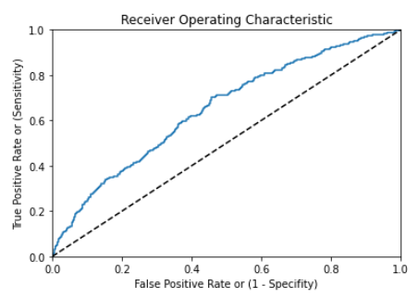

Models
Logistic regression
Random Forest
Boosted Tree

Slide 8
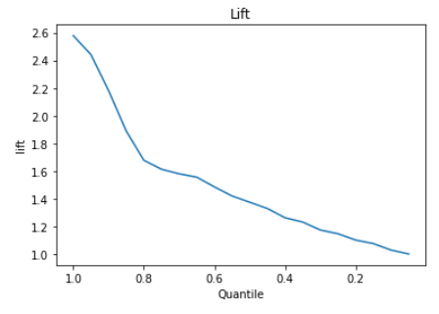
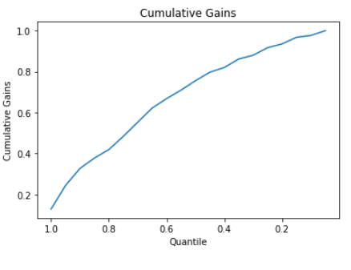
Selected model : logistic regression

Slide 9
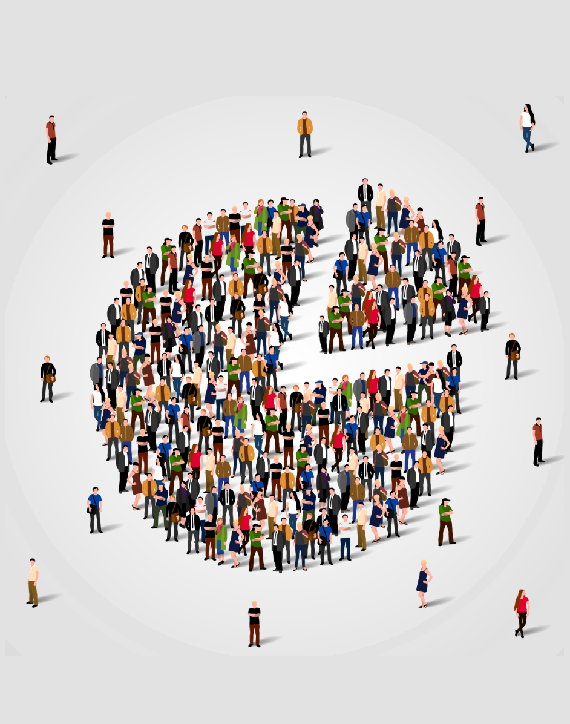

Gains of our model
Gain over random selection
=
3236,60 euros
Contact 40% of the population

Slide 10
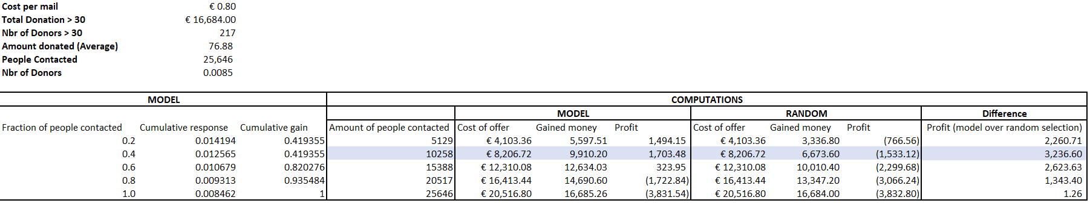
Gains of our model

Slide 11
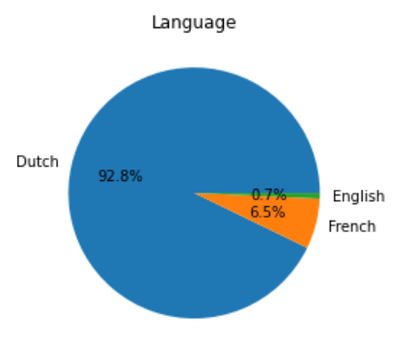
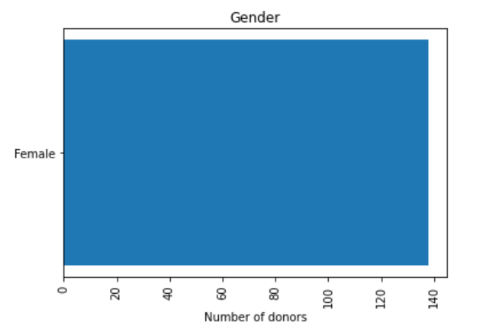
People who are more likely to donate

Slide 12
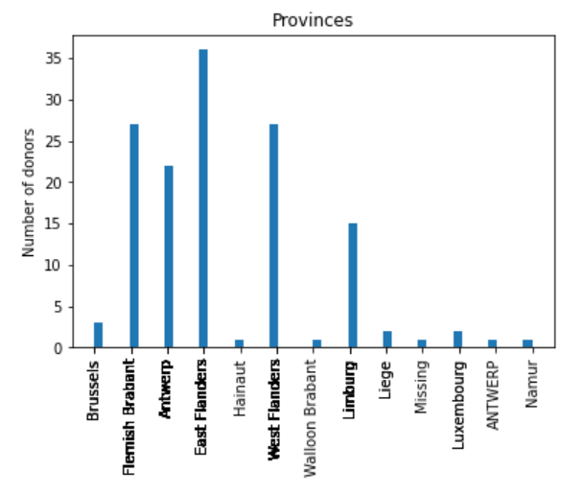
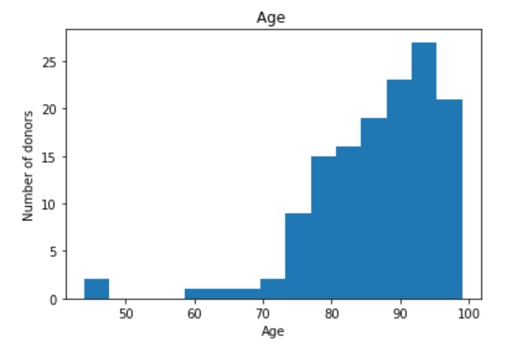
People who are more likely to donate

Slide 13
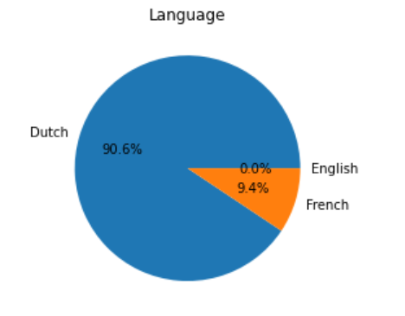
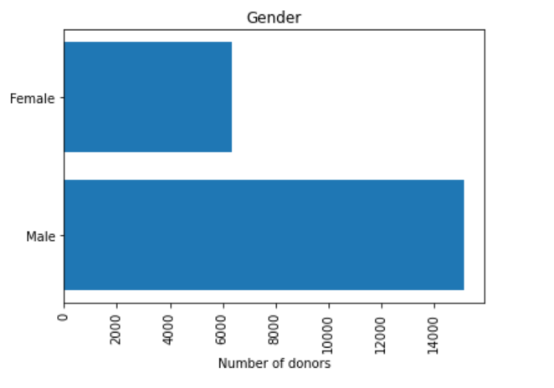
People who are less likely to donate

Slide 14
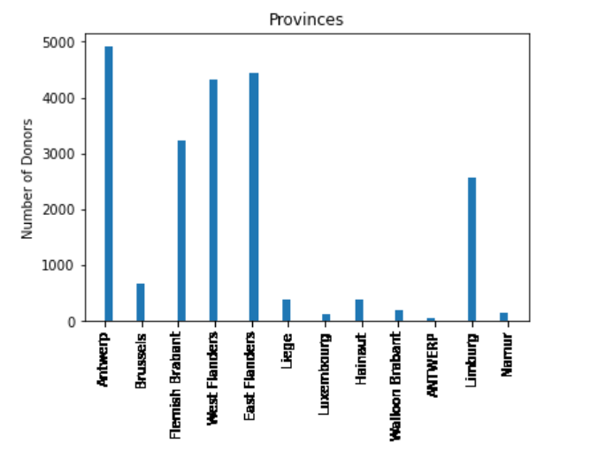
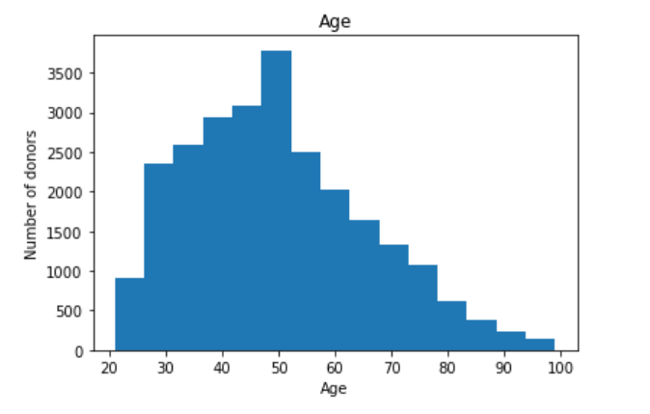
People who are less likely to donate

Slide 15

Suggestions to become more data-driven
Salary level
Profession
Education level
Preferred causes (nature, human rights etc.)
Preferred mode of communication

Slide 16


Slide 17
Sources
ANONYMOUS, ‘Python: Convert timedelta to int in a dataframe’, internet, Stackoverflow, s.a., (https://stackoverflow.com/questions/25646200/python-convert-timedelta-to-int-in-a-dataframe).
ANONYMOUS, ‘Remove multiple items from a Python list in just one statement’, internet, Stackoverflow, s.a., (https://stackoverflow.com/questions/36268749/remove-multiple-items-from-a-python-list-in-just-one-statement).
ANONYMOUS, ‘Age from birthdate in python’, internet, Stackoverflow, s.a., (https://stackoverflow.com/questions/2217488/age-from-birthdate-in-python).
BHANDARI, A., ‘AUC-ROC Curve in Machine Learning Clearly Explained’, internet, Analytics Vidhya, 2020-06-16, (https://www.analyticsvidhya.com/blog/2020/06/auc-roc-curve-machine-learning/).
JANSSENS, N. (2021). Descriptive & Predictive Analytics. [Course]. Lille: IESEG Management School. MSc in Big Data Analytics.
RACQUET, E., ‘Belg steeds vrijgeviger voor goede doelen’, internet, De Tijd, 2017-05-25, (https://www.tijd.be/netto/budget/belg-steeds-vrijgeviger-voor-goede-doelen/9886629.html).
ROMMERS, W., ‘Vlaming doneert gemiddeld 240 euro per jaar: aan deze goede doelen geeft u het meest én het minst’, internet, Het Nieuwsblad, 2019-12-21, (https://www.nieuwsblad.be/cnt/dmf20191220_04776933#:~:text=Een%20Vlaming%20geeft%20jaarlijks%20zo,Ontwikkelingssamenwerking%20ontvangt%20de%20minste%20steun.%E2%80%9D).

