Slide 1

Wrist Watch
A Comprehensive E-commerce Platform for watches

Slide 2
Group Members
CLASS : MCA 2-B
SUBJECT : FINAL PROJECT
COLLAGE : MARWADI UNIVERSITY.
DATE : 20-03-2025.
THOBHANI HINA (92400584099).
AJANI ANJALI (92400584100).
PAMBHAR PRIYANSHI (92400584101).

Slide 3
Introduction
An Online Watch Shop is a website where people can look at and buy watches from their home. This shop makes it easier and more convenient for customers to find and buy the watches they like without going to a store.

Slide 4
Features of Store
easy shopping for all types
Help store owners manage their products
Secure payment and order tracking

Slide 5
Why an Online Watch Shop?
Shop anytime, anywhere – no need to visit a store.
Explore a wide range of watch styles and brands..
Great prices with special deals and discounts.
24/7 access – browse and buy whenever you want.

Slide 6
Watch Categories
Men
Women
Kids

Slide 7
Tools & Technologies
Frontend: HTML5, CSS3, JavaScript , Python
Backend: SQLite

Slide 8
Modules Overview
Admin Panel:
Easily manage watch listings, track orders, and handle customers
Customer Interface:
Browse watches, place orders, and check order status anytime
Database:
All watch details, orders, and customer info stored safely

Slide 9
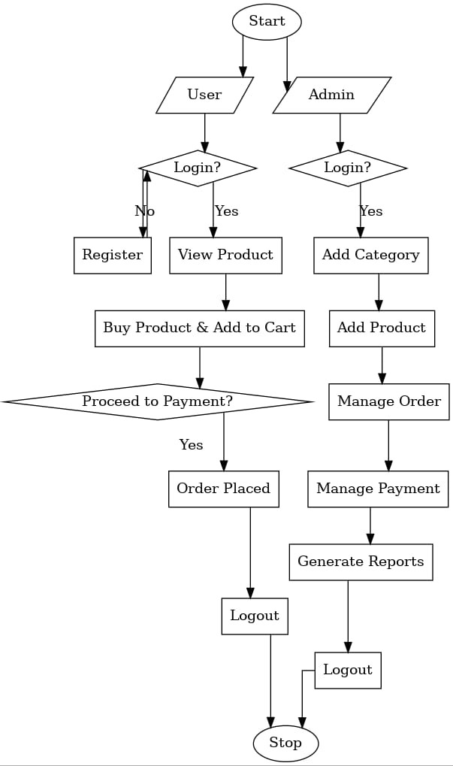
Flow chart

Slide 10
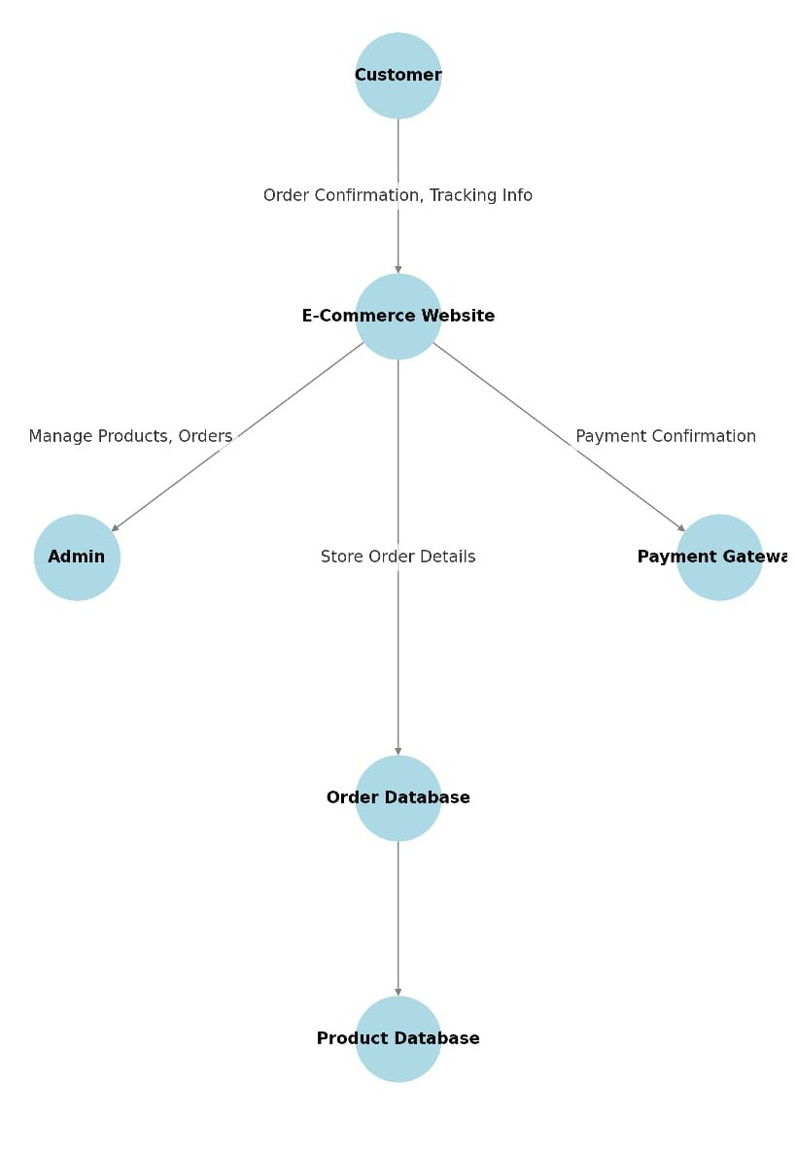
Data Flow

Slide 11
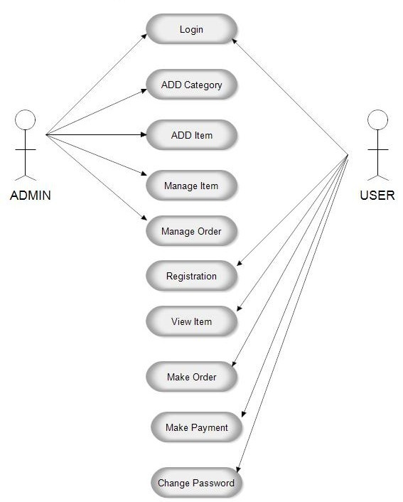
Use Case

Slide 12
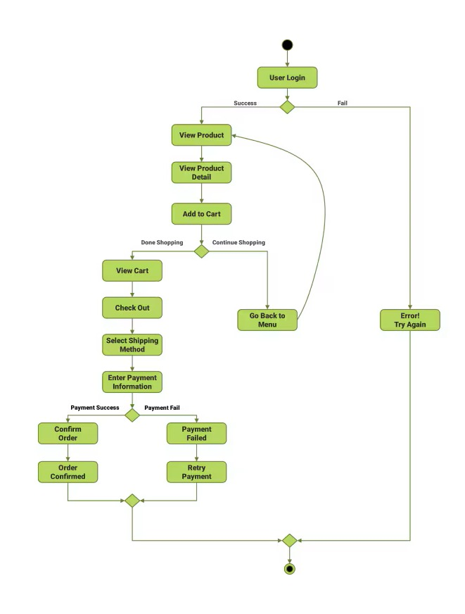
Activity Diagram

Slide 13
Order Flow & Distribution
The system stores information in the following tables:
Users Table:
Stores customer login and profile details
Orders Table:
Stores watch purchase details and order status
customer Table:
Stores customer contact and shipping information

Slide 14
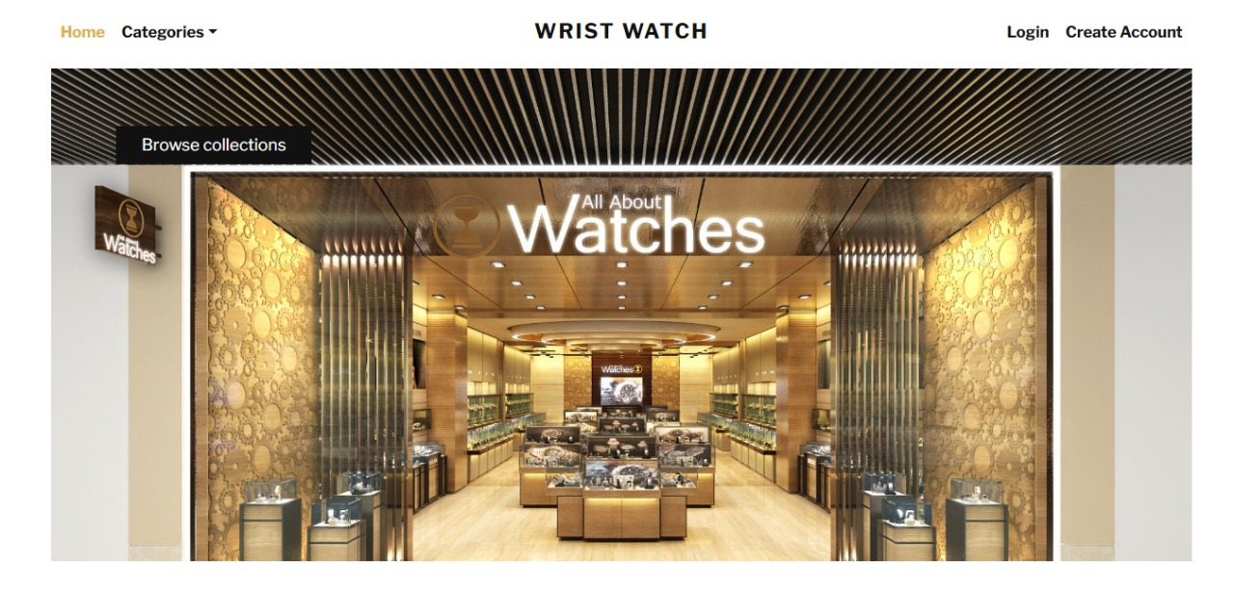
user panel

Slide 15
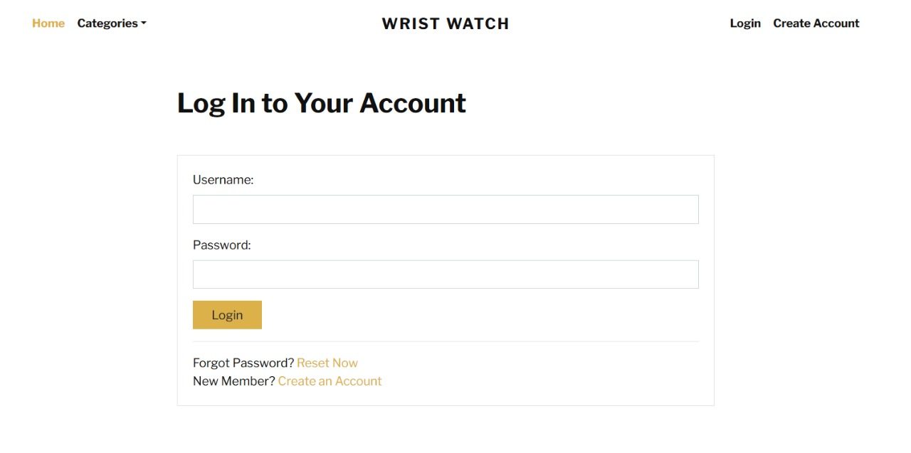
Login Form

Slide 16
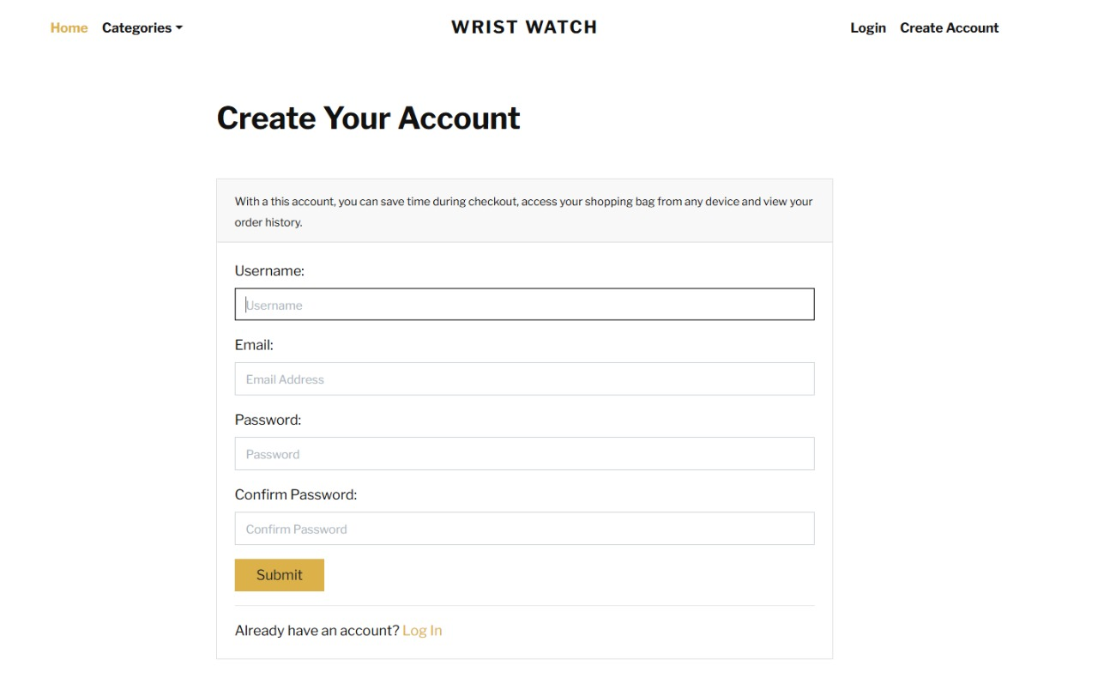
Register Form

Slide 17
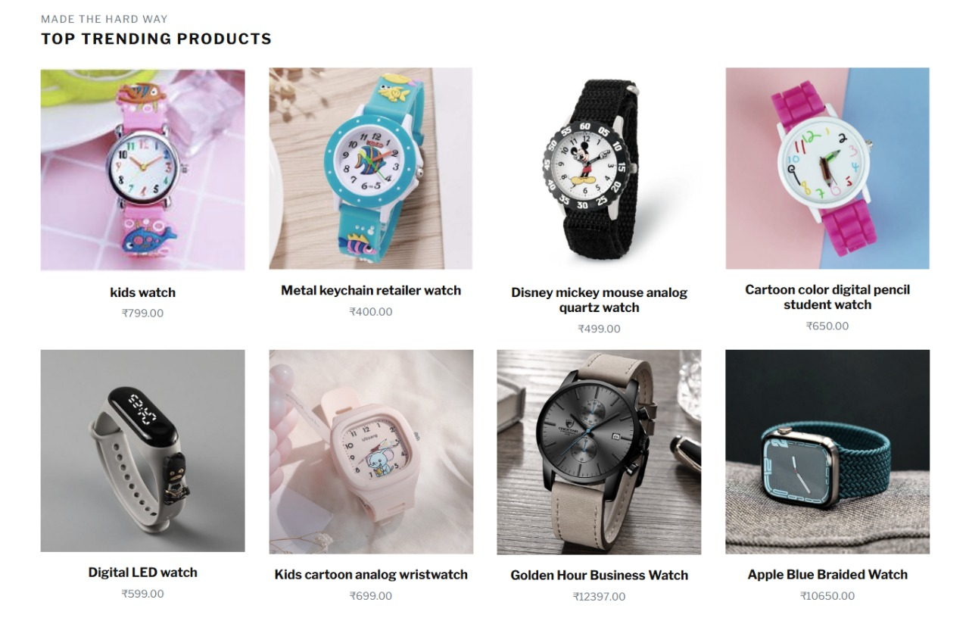
Products

Slide 18
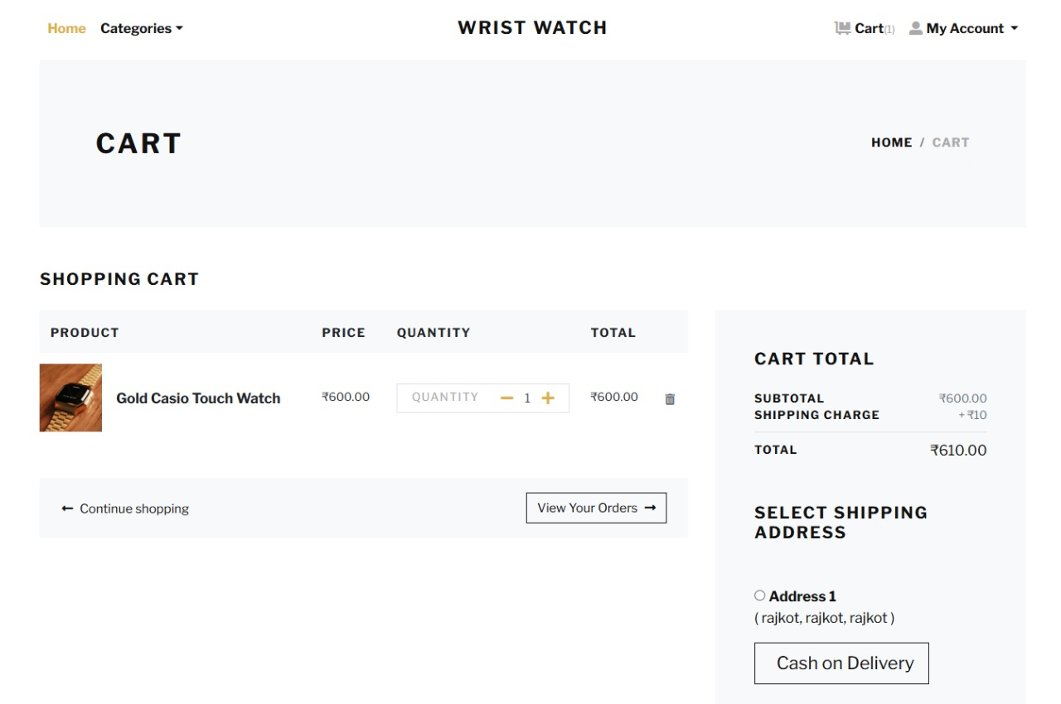
Add To Cart

Slide 19
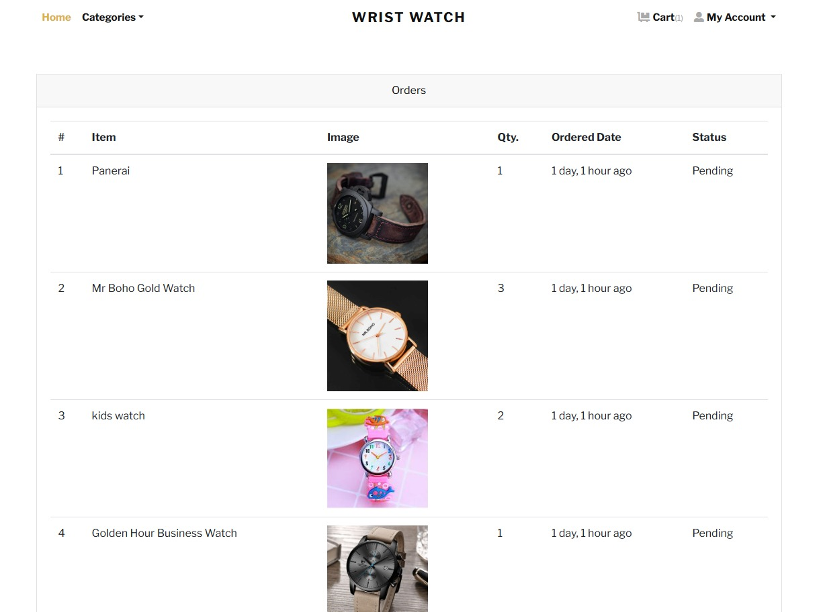
Customer Order

Slide 20
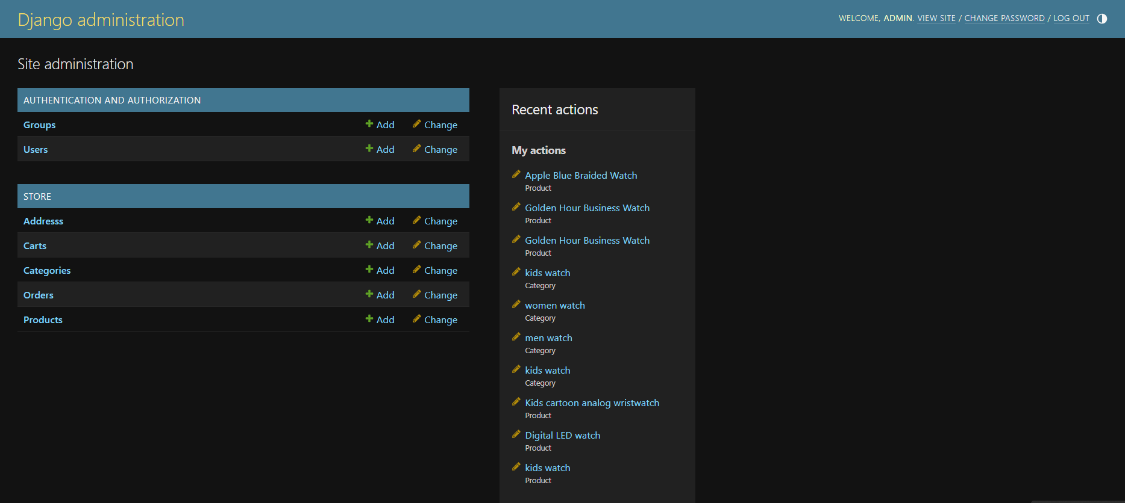
Admin Dashboard:

Slide 21
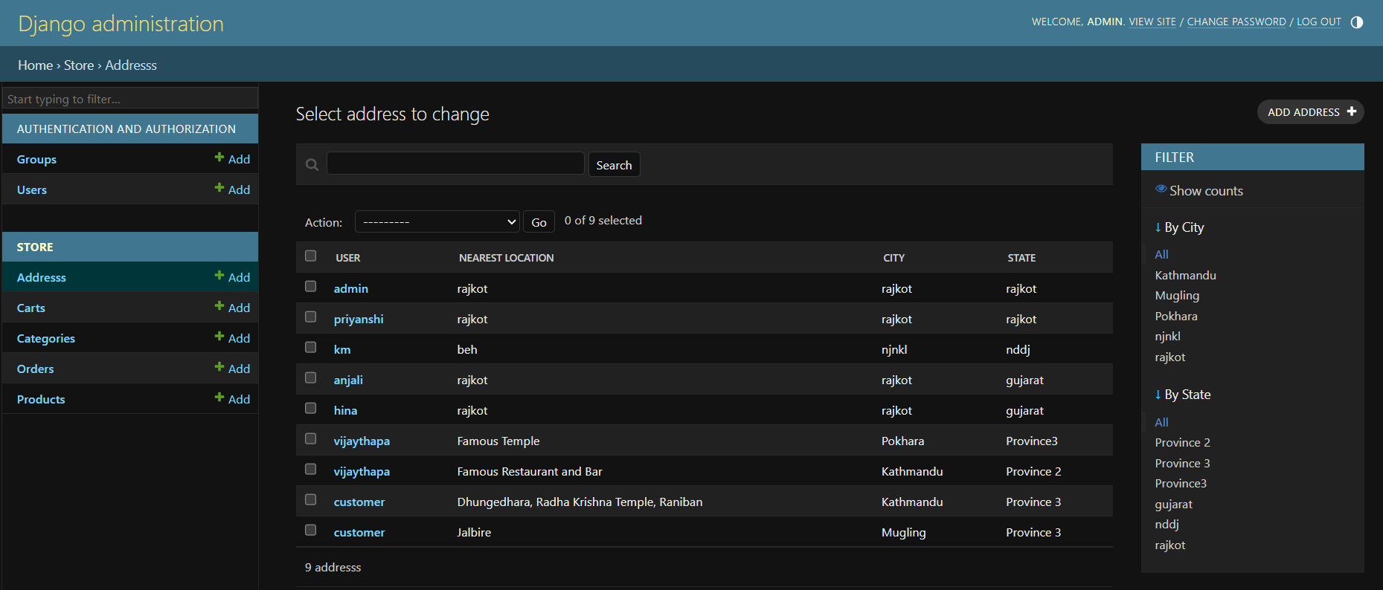
User’s Address:

Slide 22
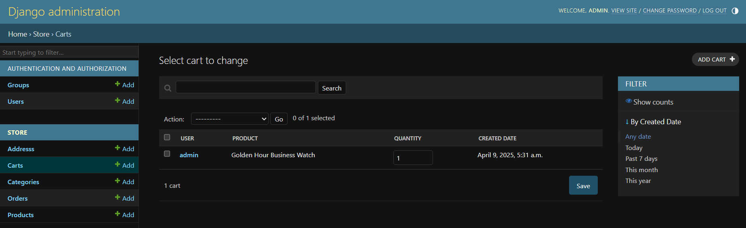
Cart:

Slide 23
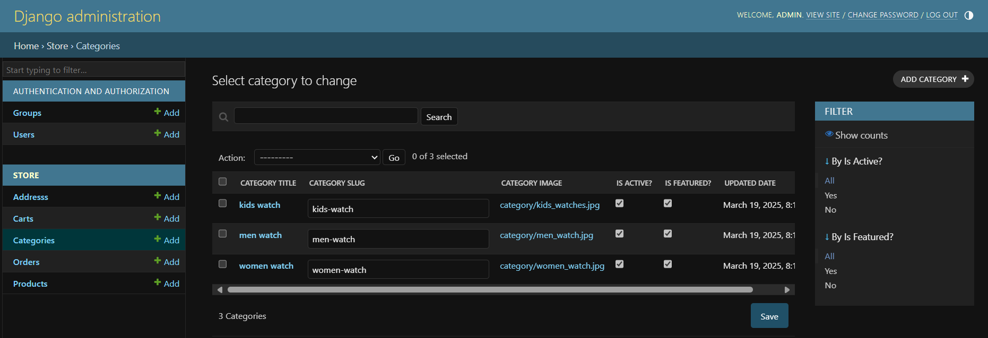
Categories:

Slide 24
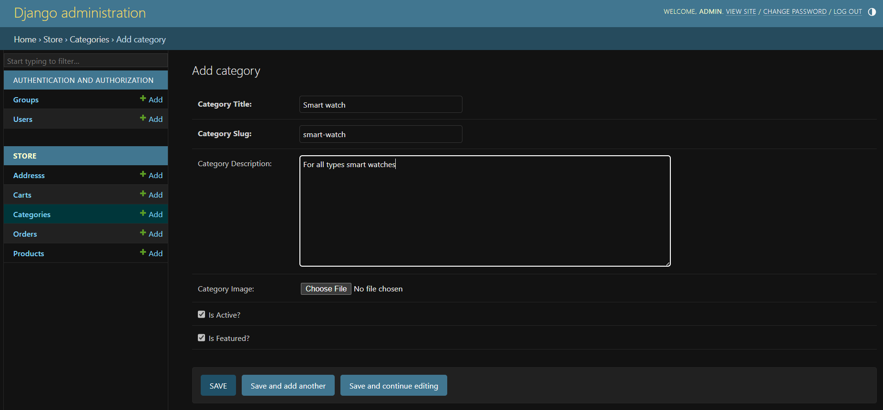
Add Categories:

Slide 25
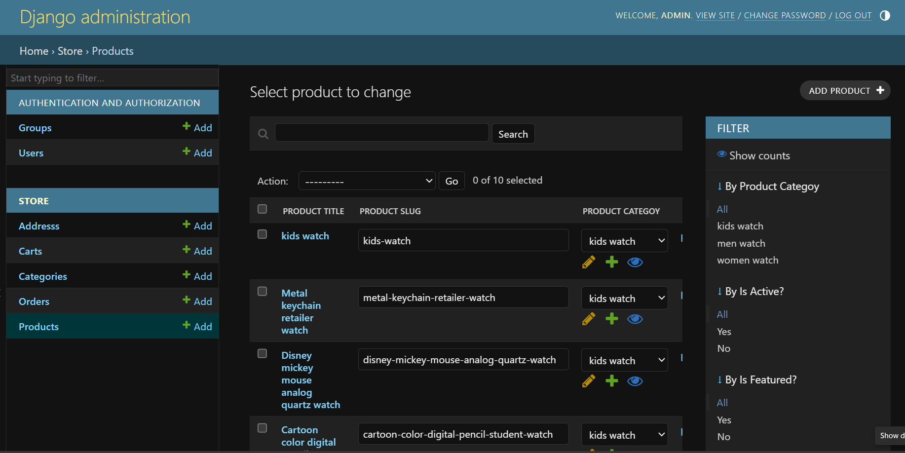
All Added Products:

Slide 26
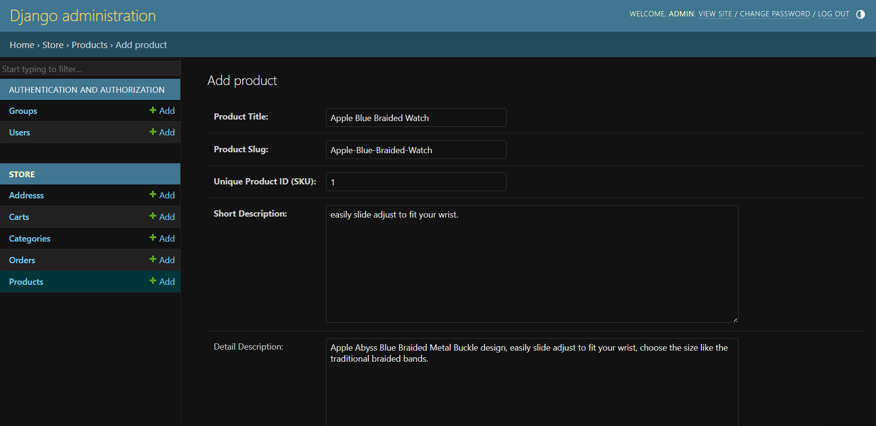
Add New Products:

Slide 27
Benefits of Shopping for Watches Online
Access to hundreds of styles, brands, and price ranges in one place.
Find exclusive online deals, discounts, and competitive pricing..
Read real buyer feedback to help choose the perfect watch.
Get your watch delivered safely and securely to your doorstep.
Shop anytime, no store hours or crowds to worry about.

Slide 28
Why Buy Watches Online?
Hassle-free return policies in case it’s not the right fit
Personalized suggestions based on your style and preferences.
Stay updated with the newest releases and styles.

Slide 29
Conclusion
The system makes shopping and management easy
Future upgrades:
Wishlist/Favorites
Price Drop Alert
Gift Cards/Voucher
Multiple Payment Option

Slide 30
THANK YOU.

