Slide 1
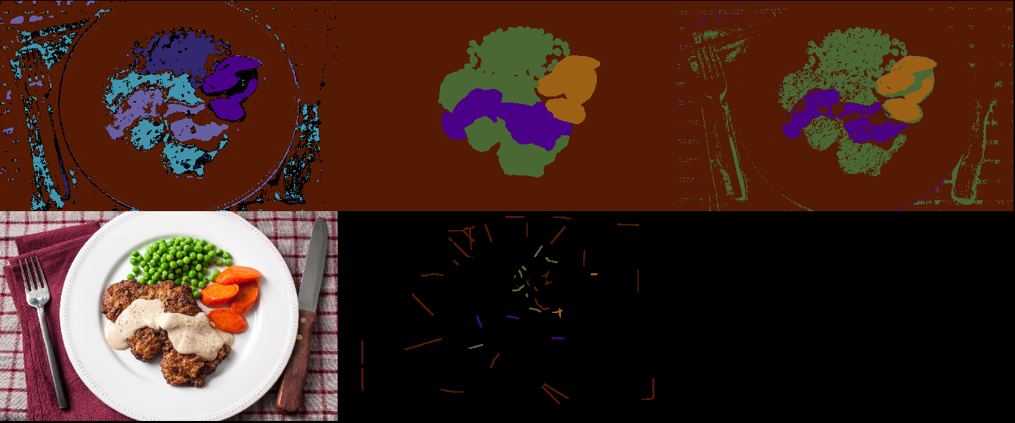
Ilastik Ground Truth Convpaint
Annotated: 1.86%
Accuracy Convpaint: 89.87%
Accuracy Ilastik: 67.34%

Slide 2
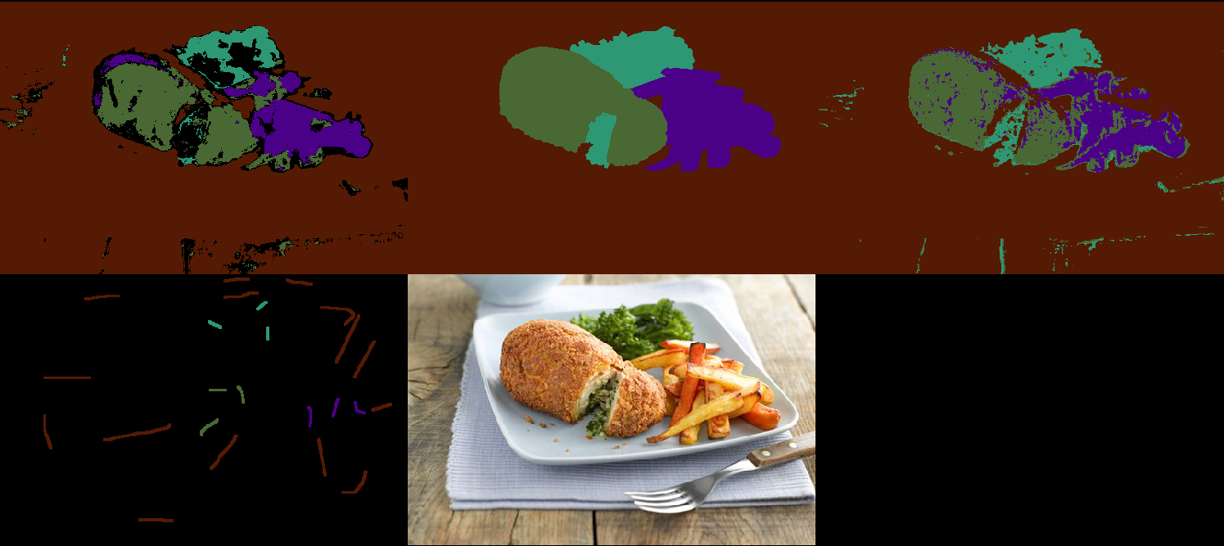
Img 1429
Ilastik Ground Truth Convpaint
Annotated: 2.38%
Accuracy Convpaint: 91.97%
Accuracy Ilastik: 86.28%

