Slide 1

EcoMatch
A better way
to trade what
already exists.
Circular material exchange
01
Notes:
25 sec. Namaste, hum EcoMatch bana rahe hain. Businesses ke paas jo usable stock aur equipment idle hai, use kisi aur ki supply banane mein help karte hain. Our focus is discovery, assessment and a documented exchange.
Sources: EcoMatch product positioning. Cover: original conceptual artwork created for this deck, not actual inventory.

Slide 2
Reuse needs a more dependable exchange
3×
THE LOCAL PROBLEM
Sellers need a next owner.
Buyers need a reliable lot.
Global resource extraction
in the past five decades
Unclear condition, uncertain value
and a difficult handover can keep
reusable stock from moving.
Resource statistic: UNEP, Global Resources Outlook 2024. Local problem framing is a product hypothesis.
02
Notes:
40 sec. UNEP ke 2024 report ke mutabik global resource extraction five decades mein three times hui. Yeh EcoMatch ka market-size number nahi hai. Local opportunity: existing assets ko assess aur exchange karna easier banana.
Sources: https://www.unep.org/resources/Global-Resource-Outlook-2024; product hypothesis based on EcoMatch workflows.

Slide 3
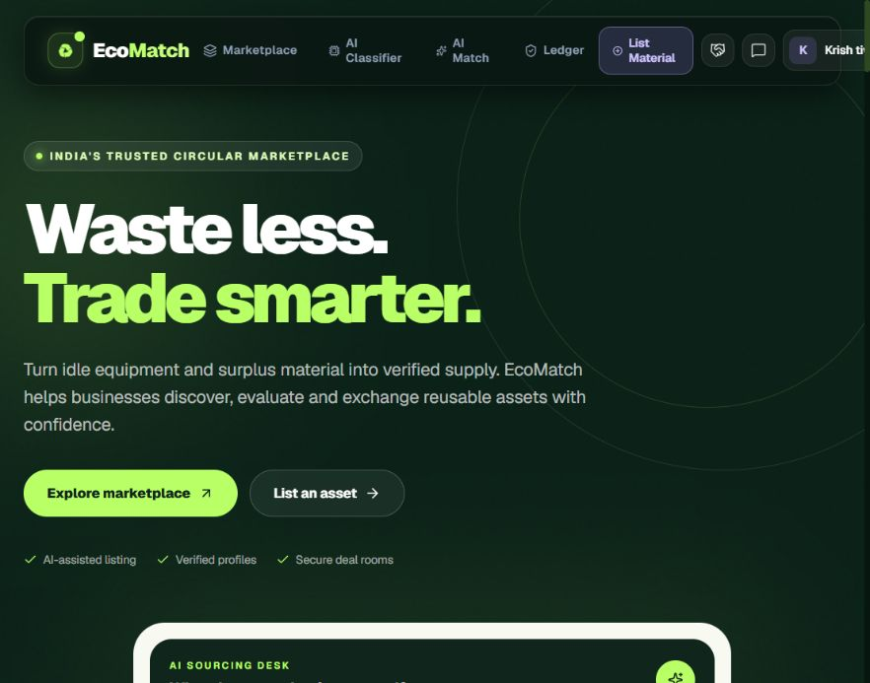
EcoMatch connects discovery with exchange
Usable stock.
A relevant buyer.
A clear next step.
A marketplace for surplus materials and reusable equipment, with AI assistance and a shared deal flow.
Deployed web prototype: eco-match-sepia.vercel.app
03
Notes:
35 sec. EcoMatch ko ek sentence mein explain karein: reusable assets ke liye marketplace jahan listing se handover tak information saath rehti hai. Homepage sourcing panel contains illustrative UI values; these are not traction metrics.
Source: EcoMatch repository and deployed website, inspected 22–23 September 2026. https://eco-match-sepia.vercel.app/

Slide 4
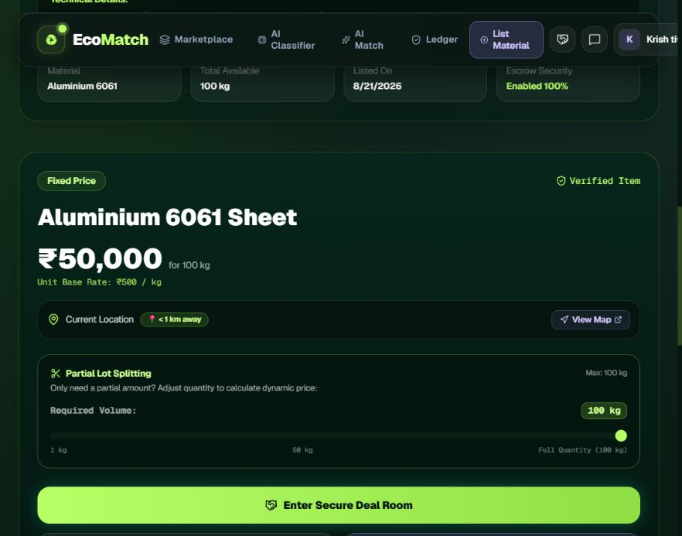
Material details before the first conversation
Assess the lot
before the deal
Review photos and specifications. Check available quantity. See the asking price. Then contact the seller.
Actual product interface. Listing information still needs physical inspection.
04
Notes:
40 sec. Ek real product listing dikhayein. Material, condition, quantity aur price ek jagah milte hain. Seller data aur photo inspection ko independent product testing ke barabar present na karein.
Sources: https://eco-match-sepia.vercel.app/marketplace; src/app/product/[id]/page.tsx.

Slide 5
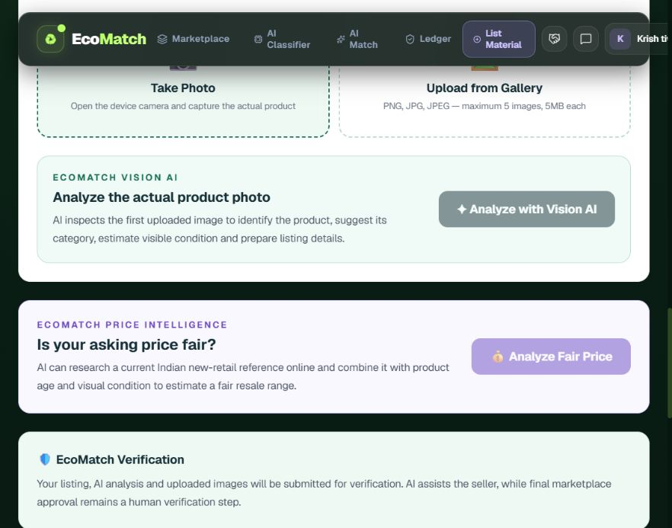
AI assistance makes listing easier
Less effort
to describe
an asset
Photo analysis suggests product details and condition cues. The seller reviews the listing and sets the asking price.
AI suggestions support the seller. They do not certify hidden condition or performance.
05
Notes:
40 sec. Seller ko har detail scratch se type nahi karni padti. Vision route category, description aur visible condition suggest karta hai. Seller confirmation important hai. Price guidance is an estimate and may use a fallback.
Sources: src/app/seller/add-product/page.tsx; src/app/api/ai/analyze-product/route.ts; src/app/api/ai/price-intelligence/route.ts.

Slide 6
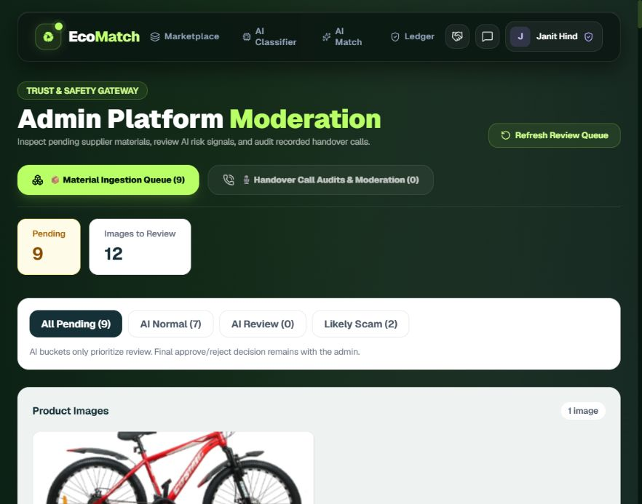
Human review before marketplace approval
A review step
before publication
Admins inspect the product photos and submitted details. Risk signals help prioritize review. A person approves or rejects.
Actual moderation interface. Automated risk scores help prioritize review.
06
Notes:
30 sec. Listing marketplace mein aane se pehle admin product details aur images review karta hai. AI risk buckets review priority ke liye hain. Final approval human decision hai.
Sources: https://eco-match-sepia.vercel.app/admin; src/app/admin/page.tsx.

Slide 7
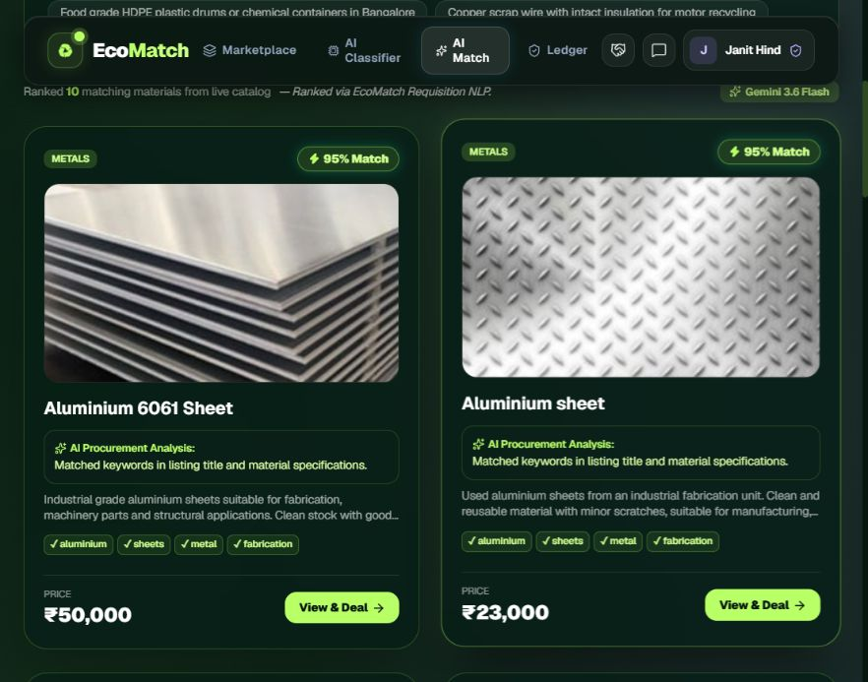
Buyers can search in their own words
Describe
what you need
Enter the material or use case in English or Hinglish. Review suggested lots and check the fit.
Matching suggestions are advisory. Buyers verify quantity, budget and suitability.
07
Notes:
40 sec. Buyer apni requirement natural language mein likhta hai. Relevant lots with match explanations appear. Match score is not a measured accuracy rate. The implementation has an AI path and a keyword fallback.
Sources: https://eco-match-sepia.vercel.app/ai-match; src/app/api/ai/match/route.ts.

Slide 8
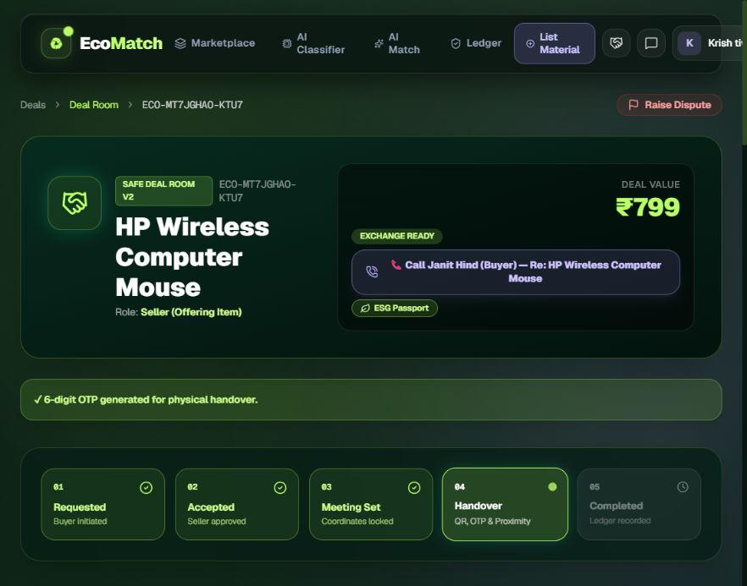
A shared path to physical handover
Agreement
before pickup
A deal records both participants. Meeting details guide the exchange. QR / OTP checks support handover. Both sides confirm completion.
Prototype handover workflow. Payment-provider escrow is a separate production requirement.
08
Notes:
50 sec. Deal room trust ka practical part hai. Request, acceptance, meeting, handover verification aur completion ka sequence explain karein. Do not claim payment-provider escrow without integration evidence.
Sources: src/app/deals/[id]/page.tsx; supabase/phase16_safe_deal_and_calling_system.sql.

Slide 9
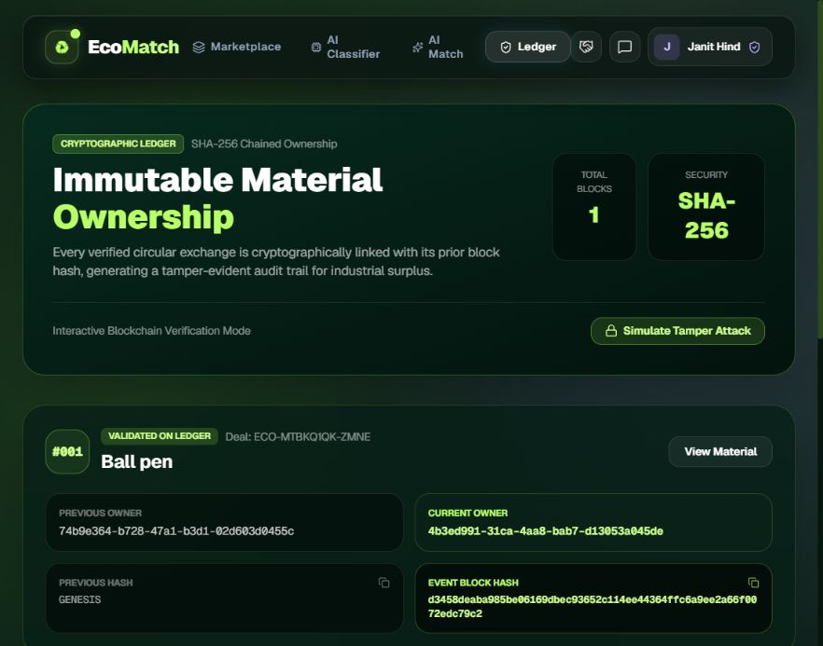
A record beyond the conversation
Traceable
ownership
events
The ledger displays ownership events and linked hashes. It gives the exchange a record that can be referenced later.
SHA-256 linked-record prototype. A decentralized blockchain is a future option.
09
Notes:
35 sec. Ownership-event trail ko explain karein. Hash linking is present in the design, but this is not a deployed decentralized network. Do not describe UI tamper simulation as an independent security audit.
Sources: README.md; src/app/ledger/page.tsx; Supabase ownership_events schema.

Slide 10
Why users would choose EcoMatch
FOR SELLERS
FOR BUYERS
Make surplus
easier to sell
Make reuse
easier to assess
Turn photos into clearer listings.
Reach buyers with a matching need.
Coordinate the exchange in one place.
Search by intended use.
Check lot details before contact.
Keep a shared handover record.
Value propositions to validate in the first pilot.
10
Notes:
35 sec. Seller aur buyer ke liye practical value alag explain karein. We have built these workflows, and the pilot will test whether they reduce effort and uncertainty. Avoid claiming measured savings until observed.
Source: EcoMatch repository and deployed website, inspected 22–23 September 2026. https://eco-match-sepia.vercel.app/

Slide 11
Local density before geographic expansion
ONE LOCAL NETWORK
Workshops, small businesses
and institutional surplus owners
01
02
03
Seed useful supply
Recruit matching demand
Learn from each exchange
Onboard relevant lots with clear
photos and specifications.
Reach nearby buyers through
local business networks.
Watch where assessment or
handover still breaks down.
11
Notes:
40 sec. Proposed launch: ek compact local network mein relevant supply aur demand build karein. Broad categories product mein available hain, but pilot ko limited geography aur use cases par focus rakhenge. This is a proposed go-to-market plan, not current partnerships.
Source: EcoMatch repository and deployed website, inspected 22–23 September 2026. https://eco-match-sepia.vercel.app/

Slide 12
A business model for repeat trade
PROPOSED REVENUE STREAMS
Transaction fee
Business tools
Charge when the platform delivers
a completed exchange with useful
coordination and records.
Offer paid tools for repeat sellers:
bulk inventory, team workflows
and reporting.
Pricing and willingness to pay require pilot validation. Validate willingness to pay before setting fees.
12
Notes:
35 sec. Do proposed revenue options hain. Transaction fee tab viable hai jab completed exchange mein clear value ho. Pro tools repeat sellers ke liye. We have not assumed a fee percentage, current revenue or a forecast.
Source: EcoMatch repository and deployed website, inspected 22–23 September 2026. https://eco-match-sepia.vercel.app/

Slide 13
The next milestone is a focused pilot
90 days
Validate real exchange behaviour
Time to a suitable match
Completed handovers
Repeat buyers and sellers
Disputes and abandonment
Proposed pilot horizon
ASK
Pilot partners and
product feedback
Pilot plan: validate the workflow first, then set commercial targets from observed results.
13
Notes:
40 sec. Next ask is access to a local pilot network, early users and feedback. Proposed 90-day timeline: user observation and onboarding, live supported trials, then iteration. Targets should come from baseline data, not invented traction.
Source: EcoMatch repository and deployed website, inspected 22–23 September 2026. https://eco-match-sepia.vercel.app/

Slide 14
Team EcoMatch
Janit Kumar Hind
Team leader
Krish Tiwari
Jeetu Yadav
Khushboo Sharma
Khushi Kumari
hindjanit8@gmail.com 7982615157
14
Notes:
15 sec. Team members introduce karein. Specific roles only mention karein if agreed within the team.
Sources: Team name, member names and contact details provided by Janit Kumar Hind in this conversation.

Slide 15
EcoMatch
Let’s put
useful assets
back to work.
Seeking pilot partners
and product feedback
eco-match-sepia.vercel.app
15
Notes:
20 sec. Close: EcoMatch is ready for a focused pilot. Invite the audience to open the live prototype and help validate the exchange journey.
Sources: https://eco-match-sepia.vercel.app/; conceptual cover artwork.

Slide 16
Technical foundation and next validation
BUILT IN THE PROTOTYPE
NEXT VALIDATION
Next.js + React
Supabase Auth, database and storage
AI routes with fallback behaviour
Deal and ownership-event workflows
Complete exchange testing
AI output quality and disclosure
Production identity and payment flow
Documented impact methodology
Q&A backup. AI confidence scores and environmental estimates are not independent certifications.
16
Notes:
Backup slide, outside the main pitch. The public classifier is rules-based. Photo analysis and matching use external model routes with deterministic fallbacks. Pricing may use heuristics. Ledger records are hash-linked, not a decentralized blockchain. Certificates do not establish third-party regulatory certification.
Sources: package.json; README.md; src/lib/wasteClassifier.ts; src/app/api/ai/*; src/app/api/deals/epr-certificate/route.ts; src/app/ledger/page.tsx.

