Slide 1
ECOMATCH
A circular marketplace
for cleaner, more
resourceful cities
11
Sustainable Cities
and Communities
Giving usable materials, equipment and industrial surplus a trusted second life.
Segue 3.0 Finale | Team EcoMatch
Janit Kumar Hind · Krish Tiwari · Jeetu Yadav · Khushboo Sharma · Khushi Kumari
Live product
eco-match-sepia.vercel.app
Notes:
Opening: EcoMatch helps cities recover value before usable material becomes waste. Show the live product after the pitch.

Slide 2
02
EcoMatch | Segue 3.0
The urban surplus problem
Usable assets are difficult to discover, verify and move before they become waste.
A city already has the material it needs.
It is simply locked inside offices, warehouses and institutions.
What happens today
1
A seller has usable surplus but no trusted buyer
2
A buyer cannot assess condition, location or fair value
3
Transport and handover feel risky, so reuse stalls
Result: material loses value, disposal pressure grows and cities miss a local reuse opportunity.
Notes:
Problem framing. No local waste statistic is claimed without a source.

Slide 3
03
EcoMatch | Segue 3.0
Reuse before disposal
EcoMatch creates a local path for usable assets before they enter the waste stream.
“Reduce the adverse per capita environmental impact of cities … paying special attention to air quality and municipal and other waste management.”
11.6
Waste management
& city impact
EcoMatch acts upstream: it makes reuse a practical option before a usable item reaches the waste stream.
Source: United Nations Sustainable Development Goal 11, Target 11.6
Notes:
Source: https://sdgs.un.org/goals/goal11. Target 11.6 wording. EcoMatch contribution is an intended pathway, not a measured claim.

Slide 4
04
EcoMatch | Segue 3.0
Three users, one broken exchange
Each stakeholder sees the same surplus through a different risk.
Material owner
Buyer / recycler
City ecosystem
“I want to recover value, but I need a serious buyer and safe pickup.”
“I need condition, price and location clarity before committing.”
“More assets should circulate locally before they become disposal work.”
01
02
03
EcoMatch gives each side the information and protocol needed to progress to a safe exchange.
Notes:
User problem model based on product design observation. No customer validation count is claimed.

Slide 5
05
EcoMatch | Segue 3.0
EcoMatch turns scattered surplus into a trusted exchange
LIST → MATCH → VERIFY → DEAL → MOVE → HANDOVER → OWNERSHIP RECORD
01
List
Photos and product details become a structured listing
02
Evaluate
AI assistance, condition notes and fair-price context
03
Deal
Private negotiation with verified identity signals
04
Move
Seller pickup and buyer destination create a route estimate
05
Complete
Evidence, QR/OTP handover and ledger record
One platform for discovery, confidence and accountable handover.
Notes:
Core EcoMatch workflow. Demo it live after slide 8.

Slide 6
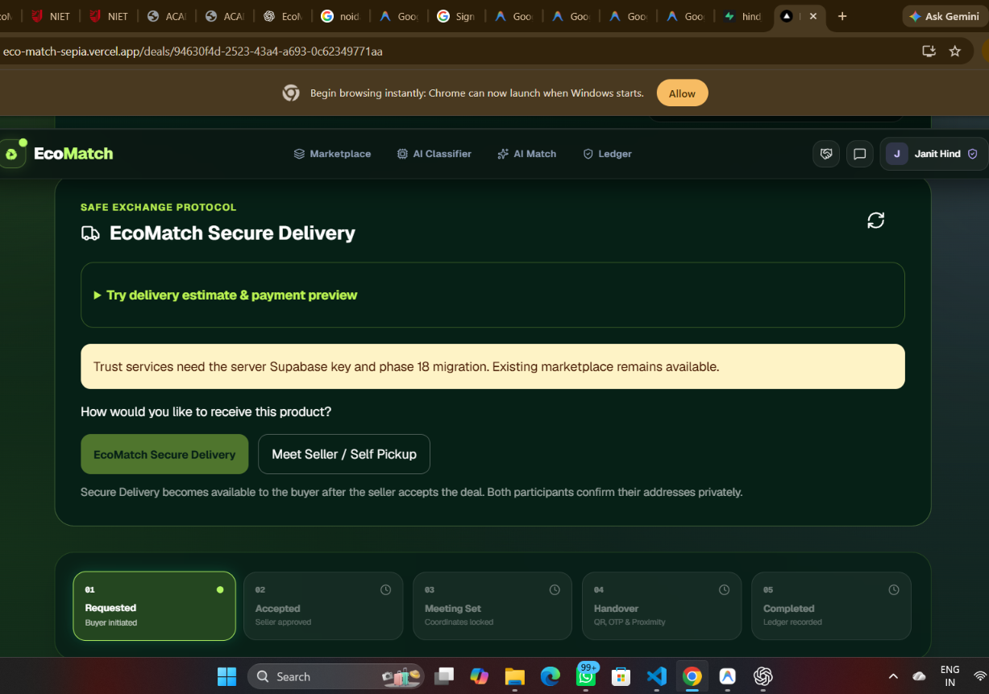
06
EcoMatch | Segue 3.0
This is not a concept. EcoMatch is live.
A deployed product connects discovery to a secure deal room.
01
02
03
Marketplace
AI tools
Deal room
Search reusable materials, filter by location and view seller signals
Classify materials and support clearer product information
Agree terms, chat privately and choose fulfilment
04
05
06
Secure delivery
Ledger
Trust Center
Route-based estimate, payment simulation, QR/OTP handover
Record completion and ownership transfer
Admin review for listings, delivery cases and disputes
Live demo: eco-match-sepia.vercel.app
Notes:
Product proof based on deployed EcoMatch application. Live URL: https://eco-match-sepia.vercel.app/

Slide 7
07
EcoMatch | Segue 3.0
A marketplace is easy to build. Trust is harder.
VERIFY THE PERSON → VERIFY THE PRODUCT → SECURE THE MEETING → VERIFY THE EXCHANGE → TRACE THE OWNERSHIP
Seller
EcoMatch
Buyer
Saved pickup location
Product price from deal
Road distance
Weight & vehicle logic
Current location or
searched destination
Estimated total = product price + delivery estimate + 10% delivery service fee
Carrier booking and payment stay labelled as simulation until partner and gateway credentials are connected.
Notes:
Integrity controls: browser does not choose pickup, product price or distance. Real carrier booking and payment are not claimed.

Slide 8
08
EcoMatch | Segue 3.0
Trust moves the exchange forward
EcoMatch separates the signals a buyer needs before agreeing to a handover.
01
02
03
04
Identity
Listing
Transaction
Handover
KYC status makes the counterparty visible
Images, condition and admin review support listing quality
Private deal terms and payment state create a shared record
Evidence plus a time-bound QR/OTP completes the physical exchange
The aim: make the transaction inspectable, accountable and easier to complete.
Notes:
Do not call every user verified. The platform displays distinct identity, listing and handover signals.

Slide 9
09
EcoMatch | Segue 3.0
Impact measurement begins with every completed exchange
We will report what moves through EcoMatch rather than make unverified impact claims.
Assets reused
Material diverted
Count of completed item or material exchanges
Seller-entered, verified weight category or confirmed weight
Local circulation
Trust quality
Route distance and buyer/seller locality
Verified listings, completed handovers and dispute resolution time
Pilot goal: establish a credible baseline before publishing environmental savings.
Notes:
All impact measures are proposed product metrics. No environmental savings figures are claimed until measurement methodology and pilot data are available.

Slide 10
010
EcoMatch | Segue 3.0
A practical path to city-scale reuse
Start with dense supply, learn from exchanges, then connect institutions and logistics.
PHASE 1
PHASE 2
PHASE 3
Pilot
Network
Institutional
Work with campuses, offices and local recyclers. Validate listing quality and successful handovers.
Build repeat buyer-seller communities around material streams and local areas.
Offer reporting, controlled workflows and reuse insights to organizations and city partners.
Revenue can come from transaction services and institutional workflow tools after the pilot proves exchange quality.
Notes:
Roadmap is a plan, not a forecast. Avoid revenue claims until pilot metrics and pricing validation are available.

Slide 11
THE ASK
Help us make reuse
visible, trusted and
worth choosing.
LIVE
DEMO
EcoMatch\nGiving usable resources a trusted second life.
eco-match-sepia.vercel.app
EcoMatch | Segue 3.0 Finale
Notes:
Closing ask: invite judges to open the deployed app. End, then switch to the live product walkthrough.

