Slide 1




VCube Software Solutions
Dictionary Object

Slide 2
Features of Dictionary
Dictionary is an unordered set of key and value pair
Mutable i.e., value can be updated.
Key must be unique and immutable, such as numbers, strings
Values of a dictionary may be any data type
key and value is known as item
Container that contains data, enclosed within curly braces.

Slide 3
Creating Dictionary
Dictionary enclosed within curly braces.
The key and the value is separated by a colon (:), pair is known as item
Items are separated from each other by a comma (,)
Different items are enclosed within a curly brace and this forms Dictionary

Slide 4
Creating dictionaries example
dict1 = {'Name': 'Ajay', 'Age':30, 'Profession’ : 'Programmer'}
print(dict1)
dict2 = {}
print(type(dict2))

Slide 5
Accessing dictionary Items
Dictionaries value can be accessed by their keys
dict1 = {'ID': '100', 'Name': 'Shashank ', 'Age':30, 'Profession’: 'Programmer'}
print(dict1)
no = dict1['ID']
print(no)
Note: if the key is not available returns Error
age = dict1['Age']
print(age)
#des = dict1.['Description']
#print(des)
name = dict1['Name']
print(name)

Slide 6
Accessing values using get()
Dictionary elements also be accessed with get()
syn: get(“key”)
dict1 = {'ID': '100', 'Name': 'Shashank ', 'Age':30, 'Profession’: 'Programmer'}
print(dict1)
job2 = dict1.get('Profession')
print(job2)
des = dict1.get('Description')
print(des)
# Key

Slide 7
Dictionary Mutability Updating dictionary values
Dictionary is mutable
- new items added or existing items can be changed
- If the key is already present, value gets updated, else {key: value} pair is added to the dictionary
dict1 = {'ID': '100', 'Name': 'Shashank ', 'Age':30, 'Profession’: 'Programmer'}
# update value
dict1['Name'] = "Aditya"
dict1
# add item
dict1[‘Description'] = "Python Programming"
dict1

Slide 8
Updating dictionary values using update()
update() : updates the dictionary with the elements from another dictionary object
or
from an iterable of key/value pairs.
dict1 = {'ID': '100', 'Name': 'Shashank ', 'Age':30, 'Profession':'Programmer'}
dict2 ={"Area":"Machine Learning"}
dict1.update(dict2)
print (dict1)

Slide 9
Deleting values from dictionaries using del
del statement is used for performing deletion operation
- Item can be deleted from a dictionary using the key
Syntax: del [key]
- Whole dictionary can be deleted using the del statement
Note: For deleting all items of dictionary
Note: For deleting specific item using Key
del dict1
dict1 = {'ID': '100', 'Name': 'Shashank ', 'Age':30, 'Profession’: 'Programmer'}
del dict1['ID']
dict1

Slide 10
Deleting values from dictionaries using pop
pop: removes as item with the provided key and returns the value
- remove an item in a dictionary
dict1 = {'ID': '100', 'Name': 'Shashank ', 'Age':30, 'Profession’: 'Programmer'}
dict1.pop ('ID')
dict1

Slide 11
Deleting values from dictionaries using clear
clear(): Remove all items form the dictionary.
dict1 = {'ID': '100', 'Name': 'Shashank ', 'Age':30, 'Profession':'Programmer'}
dict1.clear()

Slide 12
Dictionary Iteration
keys() : displays a list of all the keys in the dictionary
values() : Return dictionary's values
Items(): Return (key, value) in tuple pairs
dict1 = {'ID': '100', 'Name': 'Shashank ', 'Age':30, 'Profession’: 'Programmer’}
print (dict1.keys())
print (dict1.values())
print (dict1.items())

Slide 13
Iterating dictionary elements using keys()
dict1 = {'ID': '100', 'Name': 'Shashank ', 'Age':30, 'Profession':'Programmer'}
for k in dict1.keys():
print (k, dict1[k])

Slide 14
Iterating dictionary elements using items()
dict1 = {'ID': '100', 'Name': 'Shashank ', 'Age':30, 'Profession':'Programmer'}
for k,v in dict1.items():
print (k, v)

Slide 15
Iterating dictionary elements using values()
dict1 = {'ID': '100', 'Name': 'Shashank ', 'Age':30, 'Profession':'Programmer'}
values = dict1.values()
values
for value in dict1.values():
print(value)

Slide 16
Dictionary len(), copy()
len() : Return number of items in the dictionary
copy() : Return a copy of the dictionary.
dict1 = {'ID': '100', 'Name': 'Shashank ', 'Age':30, 'Profession':'Programmer'}
print (len(dict1))
dict1 = {'ID': '100', 'Name': 'Shashank ', 'Age':30, 'Profession':'Programmer'}
dict2 = dict1.copy()
print(dict2)

Slide 17
fromkeys()
fromkeys() : creates a new dictionary from the given sequence of elements
dict.fromkeys(keys, value)

Slide 18
Dictionary all(), any()
all(): returns True if all keys of the dictionary are true
- or if the dictionary is empty
any () return True if any key of the dictionary is true.
- If the dictionary is empty, returns “False”.

Slide 19
PYTHON PROGRAMMING
Dictionary Comprehensions
Dictionary comprehension is an elegant and concise way to create dictionaries.
Dr Venkat Raju

Slide 20
Dictionary Comprehension
Dictionary comprehensions are used when the input is in the form of a dictionary
or a Key : Value pair
      dict_variable = { key: value for var in iterables}
is a powerful concept and can be used to substitute for loops and lambda functions.

Slide 21
Dictionary Comprehension
dict1 = {'a': 1, 'b': 2, 'c': 3, 'd': 4, 'e': 5}
double_dict1 = {k:v*2 for (k,v) in dict1.items()}
print(double_dict1)

Slide 22
Dict Vs List
Imagine that you are organizing a data science conference. You are making a list of attendees. Later you want to look up a name in this attendee list. How much time does it take to find a name if you store the data as a list, and as a dictionary?
If 100 people are attending your conference, you don’t have to think about lookup speed. You can keep your data in lists or dictionaries. You can even build an Excel table and use INDEX and MATCH keys to find the names you want.
What if you are storing billions of names? Do you think it is a good idea to store too many elements in a list? Can dictionaries do a better job in finding a certain item in a collection of too many elements?

Slide 23
Dict Vs List
In general, accessing an element in a dictionary is faster than accessing an element in a list in Python, especially when the collection size is large.
The reason for this is that dictionaries use a hash table to store their data, which allows for constant-time access to elements. When a value is looked up in a dictionary by its key, Python computes a hash value for the key and uses it to find the corresponding value in the hash table quickly. On the other hand, in a list, Python must traverse the list sequentially to find the desired element, which takes time proportional to the size of the list.

Slide 24
Dict Vs List
Notice how dictionaries are significantly faster, and how search runtime increases as input increases on our lists.
This is because dictionaries in Python are implemented as hash tables, something we listed as a critical difference between these two data types in our previous section.
In a nutshell, hash tables are made up of hash functions, which map data of any length to a fixed-length value (hashes).
It doesn’t matter what your input is (10, 1000, or 10000); the result will always be a predetermined, fixed-length hash.
Since the same string will always produce an exact hash, they’re incredibly fast to compute, especially compared to lists

Slide 25
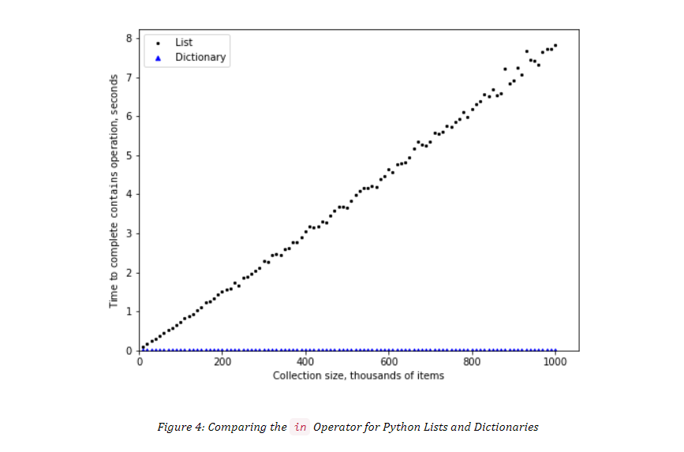
Dict Vs List
https://runestone.academy/ns/books/published/pythonds3/AlgorithmAnalysis/Dictionaries.html

