Slide 1
Automotive Services

Slide 2
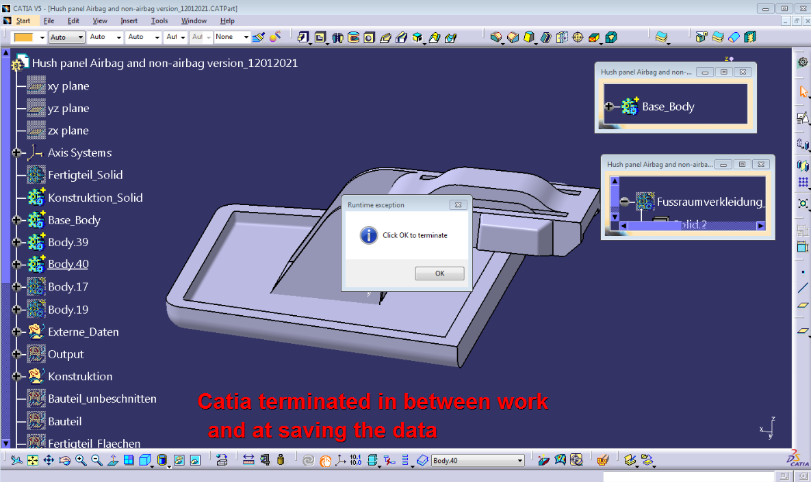

Slide 3
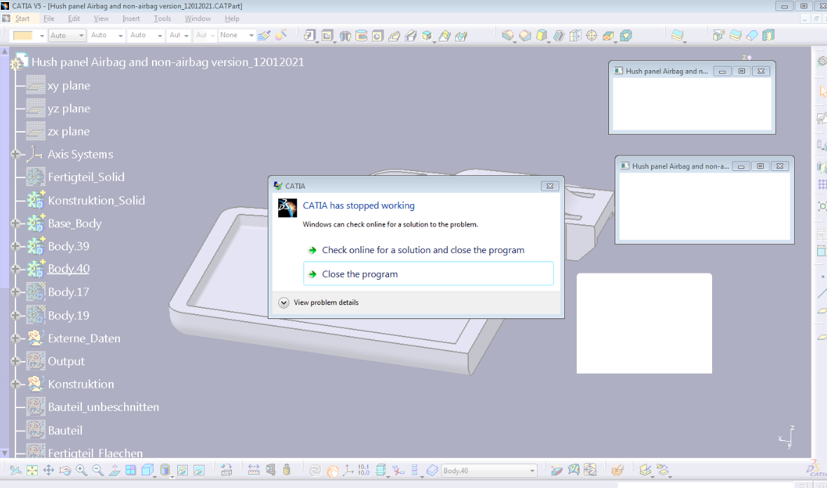

Slide 4
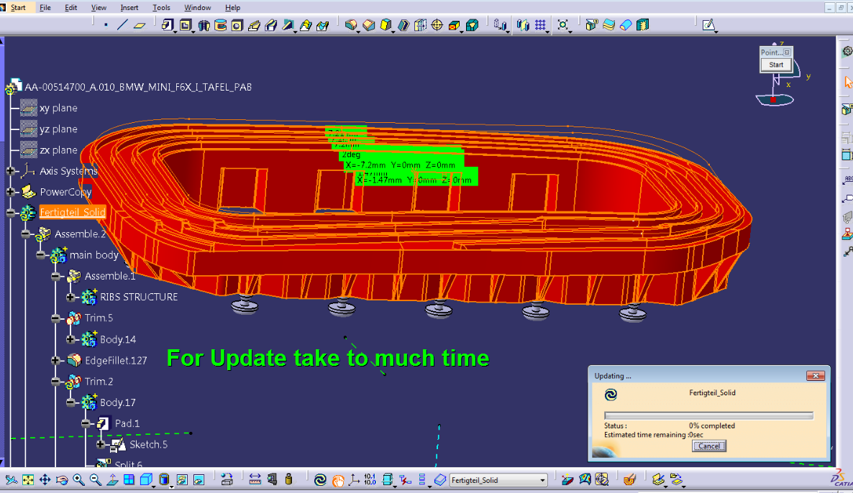

Slide 5
THANK YOU…

