Slide 1
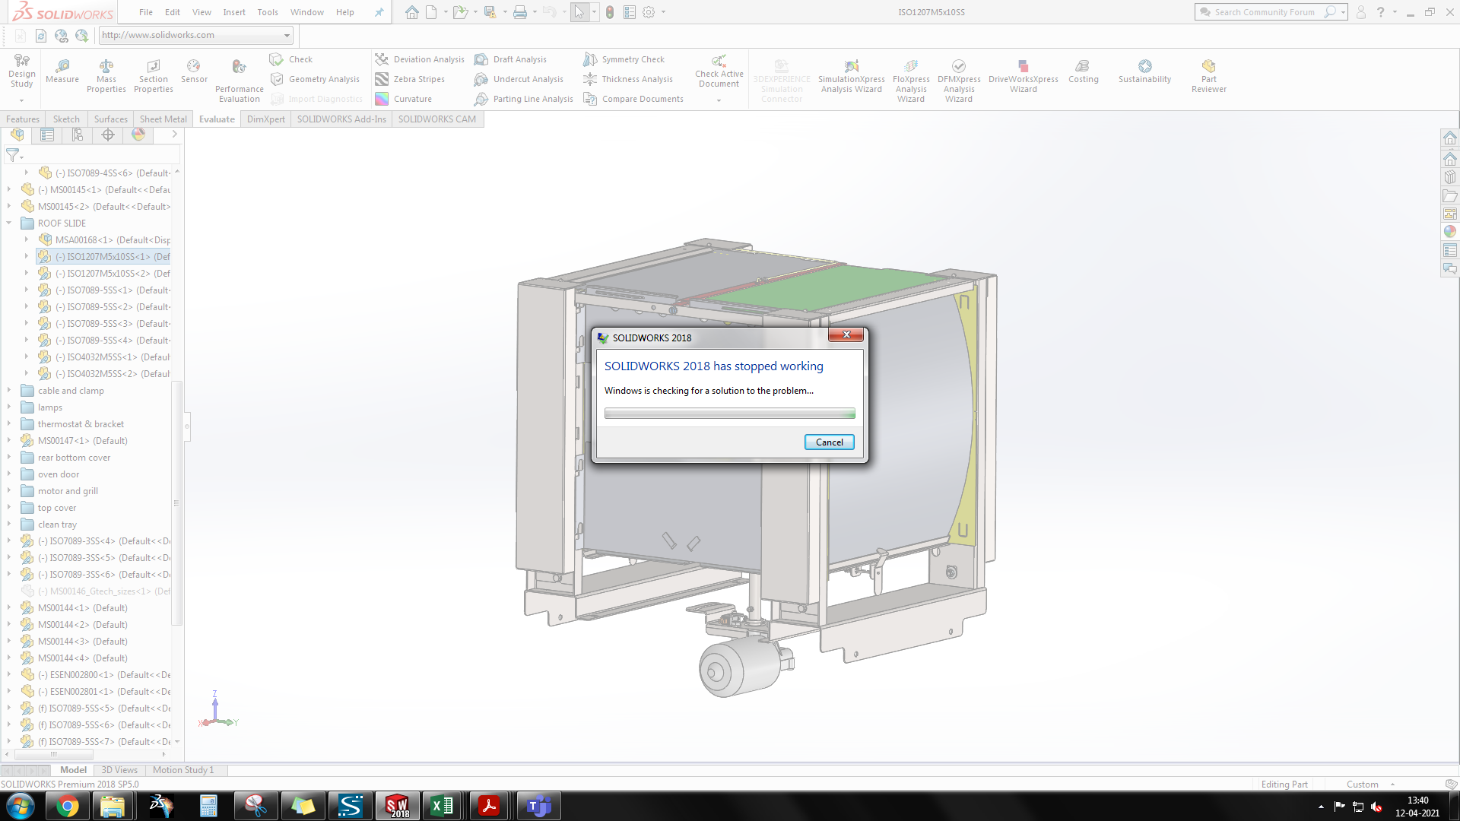
Solid Works Crash

Slide 2
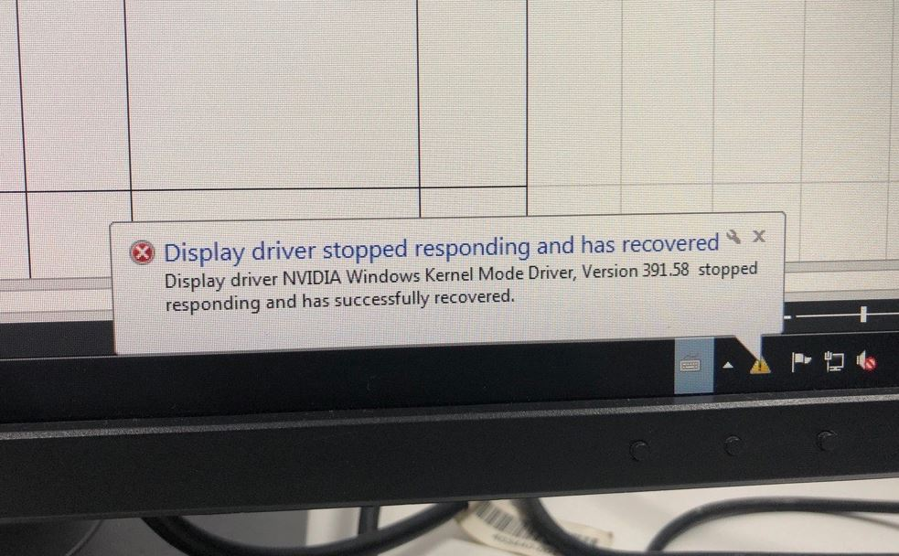
System display goes off frequently

Slide 3
