Slide 1
Pulse Secure VPN Installation and use - partners

Slide 2
Pulse Secure installation
Windows 7 and 10:
Download installation package from ftp://ftp.cygate.fi/outgoing/Pulse_secure-win.zip
Uncompress the files, contains 32 –bit ja 64 –bit installation packages
Install proper package by doubleclicking it’s name
Continue to configuration of the client when installation is done
Optional download site below (x64: 64 –bit, x86: 32 –bit):
Windows
https://ssl.metsagroup.com/dana-na/jam/getComponent.cgi?command=get;component=PulseSecure;platform=x64
https://ssl.metsagroup.com/dana-na/jam/getComponent.cgi?command=get;component=PulseSecure;platform=x86

Slide 3
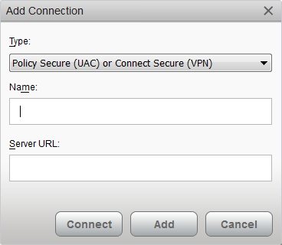
Pulse Secure settings
Start Pulse Secure (from Windows Start menu) ja and add new connection by clicking ’+’
Name the connection e.g. ’Metsa Group Partner’
Set server URL to ’https://ssl.metsagroup.com/partners’
Click Add and settings are done

Slide 4
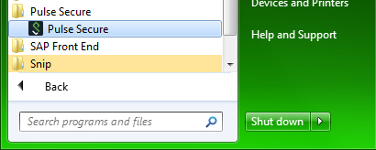
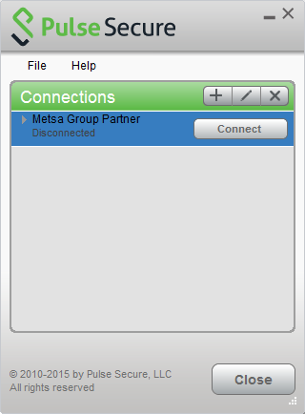

Pulse Secure use 1/4
Pulse Secure is found from Start Menu.
Client started.
Client icon is as below. (Icon can be hidden and can be seen by clicking the arrow. Can be dragged to task bar to see it all the time.)

Slide 5
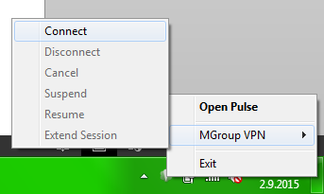
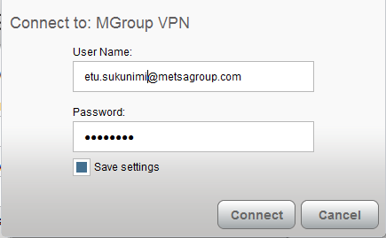
Pulse Secure use 2/4
Open connection by clicking ’Connect’.
Type your userid (your own email address, do not use ext -userid) and leave ’Password’ empty. Then check Save settings and click Connect.

Slide 6
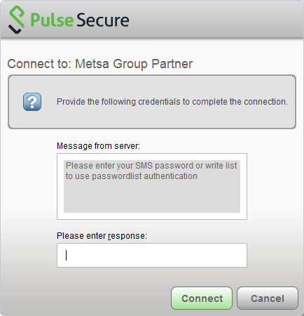
Pulse Secure use 3/4
Pulse Secure requires passcode which is sent with SMS to you mobile phone
Type passcode to ’Please enter response’ click Connect and connection is ready
A new passcode is sent for every new session

Slide 7

Pulse Secure use 4/4
Now VPN connection can be established and disconnected from the Pulse Secure icon

Slide 8
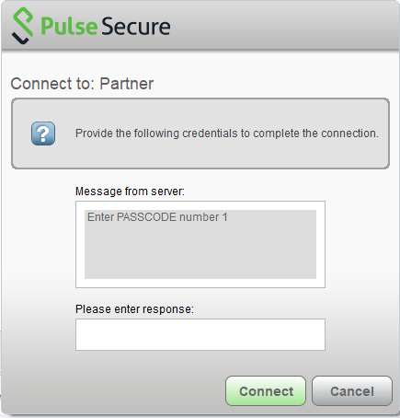
Pulse Secure password list
After you have successfully logged in with SMS passcode you will also receive a list of one-time-passwords. This is for cases you are not able to receive SMS message for the VPN service (e.g. roaming contracts missing for some mobile operators).
Logging in: Type ‘list’ to the Challenge/Response field above. You will be get to screen below:
Type in the passcode corresponding to list item, click Sign In and you are connected

Slide 9
Support
Pls, contact Metsä Group Service Desk in case you need support through your Metsä Group contact person

