Slide 1

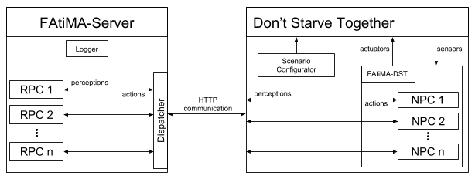
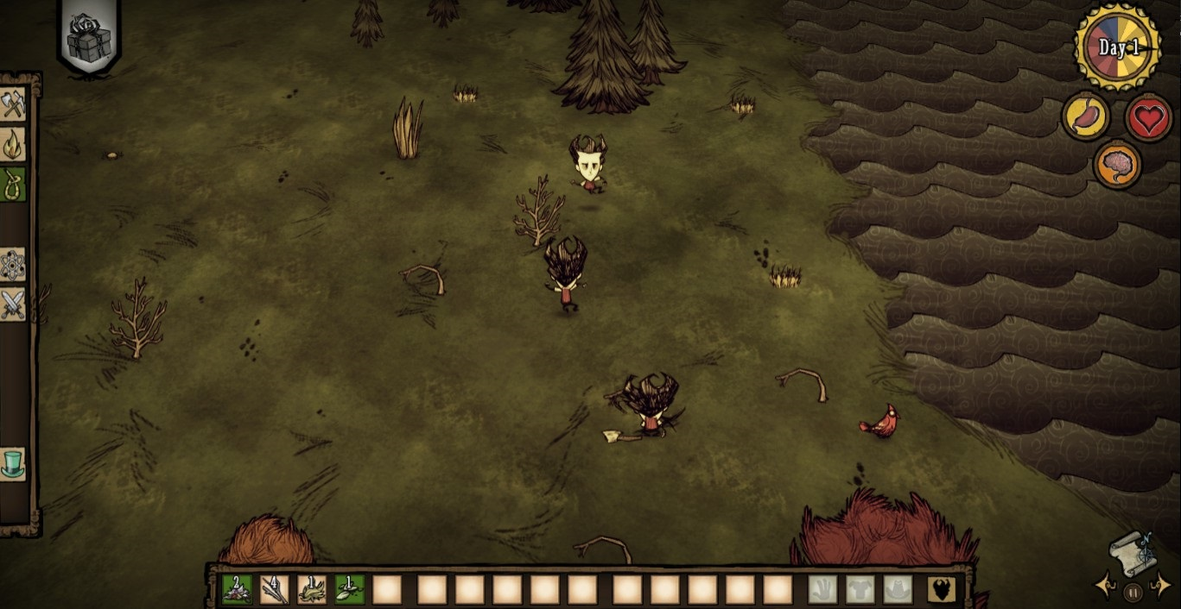
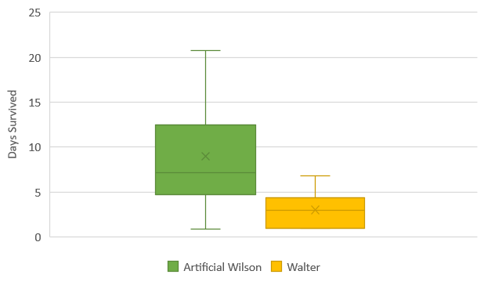
Creating an Agent-Based Framework for Don’t Starve Together
Master in Information Systems and Computer Engineering
Fábio Almeida
Instituto Superior Técnico
Objectives
We propose the development of a platform that will enable the creation of NPCs controlled by agency based models for survival games. By making use of FAtiMA, an agency based model, and Don’t Starve Together (DST), a survival game, we will create a framework where agents can be created with FAtiMA and played in (DST).
Motivation
In recent years, the continuous improvement and development in computer graphics has pushed video games to new levels of graphical fidelity. Graphical representations of virtual worlds have become increasingly more realistic, allowing players to experience new levels of immersion. Additionally, with the recent boom in virtual reality systems, players have never been so physically immersed in a game’s virtual world.
The increases on fidelity and lifelikeness of the virtual world cause players to create expectations on the interactions they can have on the world. This expectation applies not only to interactions with the virtual world itself, but is also extended to the interactions with the characters that compose the world, typically called Non Playable Characters (NPCs).
Many modern day video games are dependent on player to NPC interaction, and while some degree of independent decision making is implemented through the use of AI techniques, it’s mostly based on combat and has no social concern whatsoever. This lack of social ability in NPC can badly impact their believability and in turn affect the player’s gaming experience. While some work has been done to tackle the problem of believability in NPC, survival games however, have not been subject of this effort.
FAtiMA
Fearnot AffecTIve Mind Architecture (FAtiMA) is an agent architecture with planning capabilities designed to use emotions and personality to influence the agent’s behaviour.
FAtiMA has a modular architecture where functionalities and processes are divided into modular independent assets. This enables developers to use a lighter and simpler version of FAtiMA by adding the required assets, according to their necessities.
Don’t Starve Together
Don’t Starve Together is a multiplayer wilderness survival game developed by Klei Entertainment, where the players must survive as long as they can. The game presents mechanics for hunger, health, temperature, wetness, day and night cycles, seasons, and sanity.
Putting it Together
The solution consists in two modules: FAtiMA-DST, a DST mod; and FAtiMA-Server, a C# console application. Both these modules have been made publicly available on the Github repository https://github.com/hineios/FAtiMA-DST.
In the repository there is also a guide to help anyone develop an NPC for Don’t Starve Together. As shown in Figure 1, the communication between the two modules is made using HTTP, which transfers JSON objects back and forth.
Figure 1 - A graphical representation of the solution.
Figure 2 - A player (center) playing with two Walters (top and bottom).
Evaluation and Conclusion
As an example and proof of concept, we’ve also created Walter, see Figure 2, a model based NPC that was published in the Steam Workshop.
Additionally, the platform has been successfully used to implement a planning agent using the MCTS algorithm. By creating a new Dynamic Property, the developers were able to create an agent using FAtiMA and run it in DST.
In order to evaluate our work, we’ve compared our example agent, Walter, with Artificial Wilson, an agent created using the in-game’s behaviour trees by an anonymous modder, Figure 3. Although Walter’s performance is poor when compared to Artificial Wilson, the discrepancy can be justified due to the difference in the size of both implementations. While Walter counts with nineteen rules of decision, Artificial Wilson counts over seventy nodes in its behaviour tree.
This dissertation provides the ground work for future developments in the creation of NPCs for survival games.
Figure 3 – Days survived comparison.

