Slide 1
Cooperative AI for Don’t Starve Together
Fábio Almeida
Professor Rui Prada
Samuel Mascarenhas

Slide 2
Outline
Motivation
Problem
Don’t Starve Together
Social Agents
PsychSim
CiF
FAtiMA
Versu
An Architecture for Believable Socially Aware Agents
Solution
Planning

Slide 3
Motivation
Notes:
A way to enter new realities
Belonging to the world
Companies struggle to deliver more and more realistic worlds

Slide 4
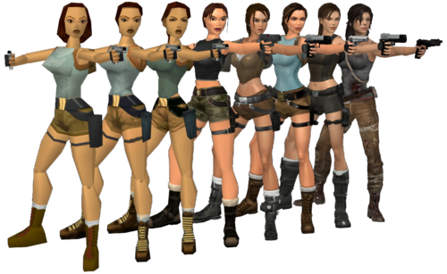
Motivation
Notes:
More realistic and life-like games.
Technological advances in computer graphics

Slide 5
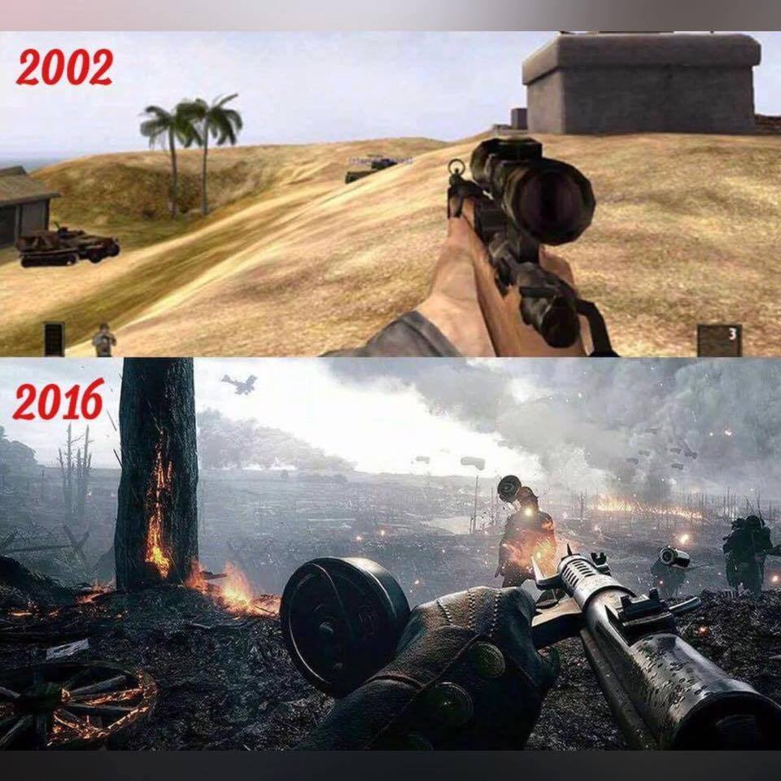
Motivation
Notes:
reality created by exquisite graphics and physics is not broken

Slide 6
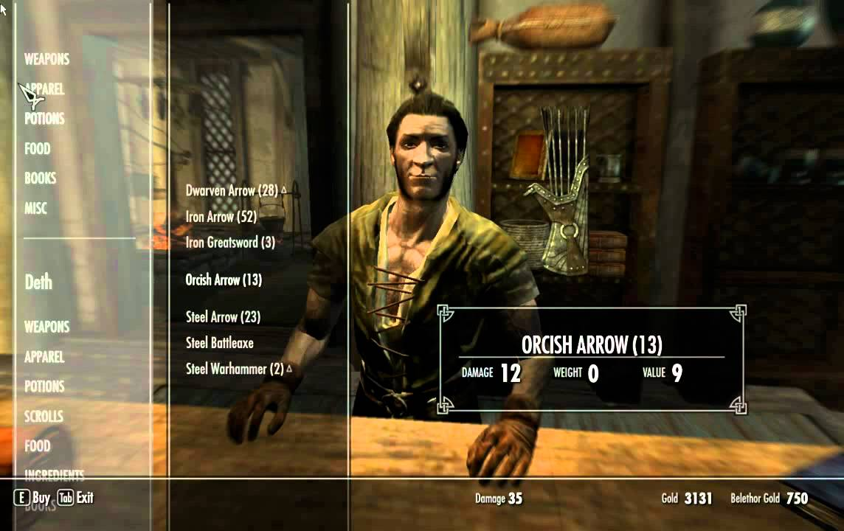
When the immersion breaks
Notes:
But, most of the times, the immersion breaks when players are confronted with NPCs
Repetitive dialogue

Slide 7
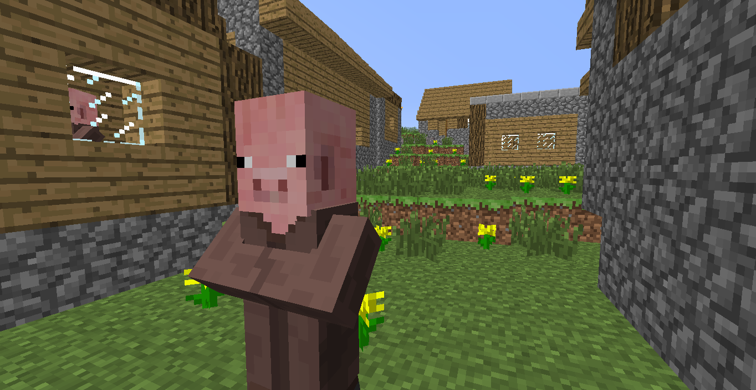
When the immersion breaks
Notes:
Not under the same circunstances

Slide 8
Problem
Can we improve a player’s game play experience in Don’t Starve Together using social agents?

Slide 9
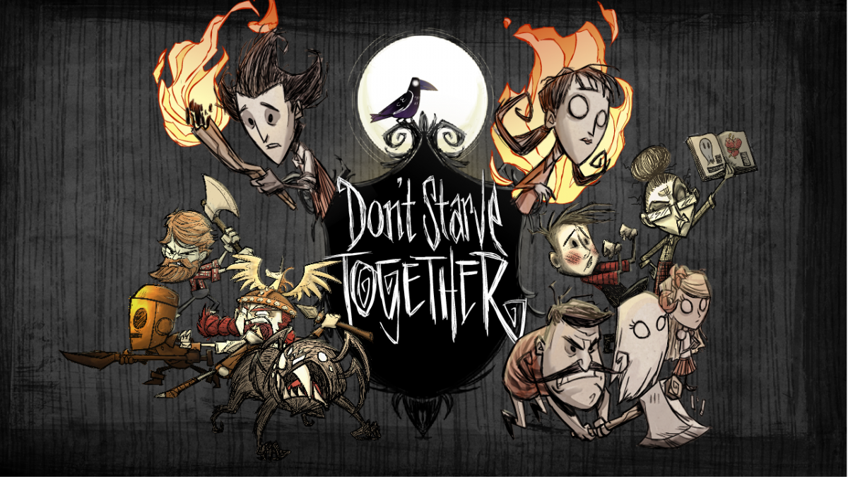
Don’t Starve Together
Notes:
Introduction to DST
Launched April 21st 2016
CCU: 5000-9000
Talk about forum

Slide 10
The World
Partially Observable
Multiagent
Stochastic
Episodic
Dynamic
Continuous
Known
S. Russell and P. Norvig
Artificial Intelligence: A Modern Approach, 3rd
Notes:
Stochastic - spontaneous rains can occur, meteors can fall from the skies, and even lightning strikes can set the players crops ablaze.
Dynamic - during the deliberation process of the agent, the environment around him can change without direct interference from it.
Continuous - time passes continuously without interruptions and actions take time to achieve.

Slide 11

Player’s Characteristics
Hunger
Health
Sanity
Notes:
Hunger Health and Sanity Explain them

Slide 12
General Gameplay
Collecting
Exploring
Prototyping
Crafting
Building
Fighting
Settling
Socializing
Notes:
Finish up by summing up the general actions

Slide 13
Agents
“anything that can be viewed as perceiving its environment through sensors and acting upon that environment through actuators”
S. Russell and P. Norvig
Artificial Intelligence: A Modern Approach, 3rd

Slide 14
Intelligent Agents
Reactivity
Proactiveness
Social Ability
Michael Wooldridge
Introduction to Multiagent Systems
Notes:
Make a remark on communication =/= social ability

Slide 15
Social Agents
Social agents need not only have goals and intentions of their own, but must also be able to understand and model goals and intentions of other agents.
Cristiano Castelfranchi
Modelling social action for AI agents
Notes:
What makes them social?
Getting out of the way example

Slide 16
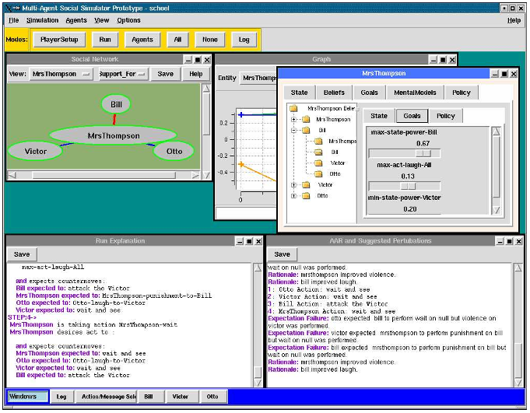
PsychSim

Slide 17
PsychSim
Social simulation tool
Users author and explore social scenarios
Used to explore how individuals and groups react to situations
Based on ToM models
Notes:
Good tool to simulate behaviours
Each agent as a total representation of another agent
These representations are prefabricated
Lacks planning
Not really suited for real time simulation

Slide 18
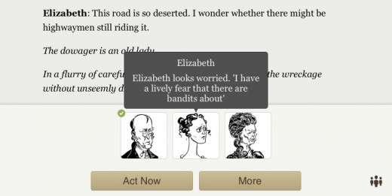
Versu

Slide 19
Versu
Game available for the iPad on the AppStore
Main focus is storytelling
High replayability as players can choose to play as different characters
Relies on Praxis, an high-level DSL based on exclusion logic
Notes:
Use social practices
Several may exist at the same time
They dictate how an agent should behave
Exclusion logic represents a limitation (beliefs about other’s beliefs)

Slide 20
Comme il Faut
Main goal is storytelling
Based on Social Exchanges
High-level social rules
Notes:
Social Exchanges represent knowledge of the world
Lower the burden of authoring, but still….
Prom Week
49 hundred unique influence rules, 60 social exchanges and forty thousand predicates.

Slide 21
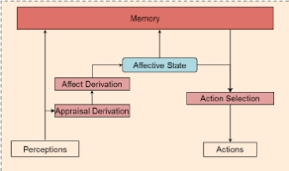
FAtiMA

Slide 22
FAtiMA
Based on appraisal theory
Uses a modular approach
Notes:
Framework

Slide 23
An Architecture for Believable Socially Aware Agents
Makes use of Roles
ToM model
Appraisal Theory
Planning

Slide 24
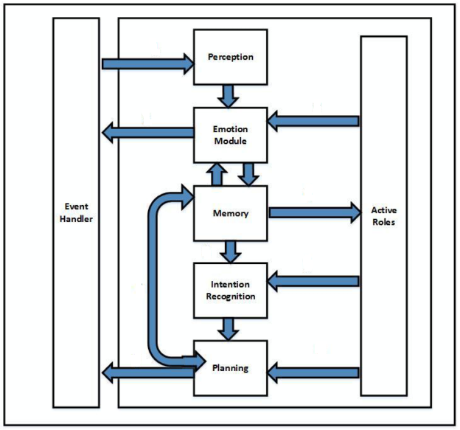

Slide 25
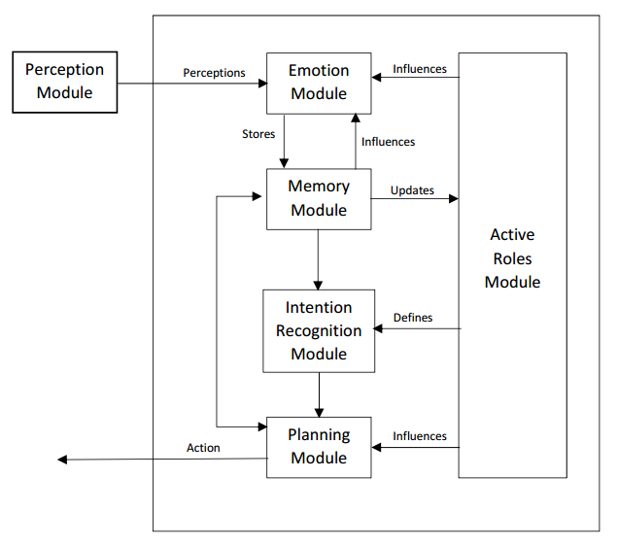
Solution

Slide 26
Evaluation
Player’s gameplay experience
Agent’s ability to survive

Slide 27
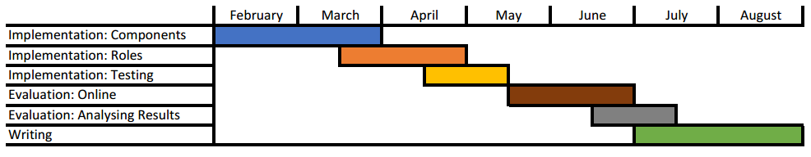
Planning

Slide 28
Questions?

